Slide 1
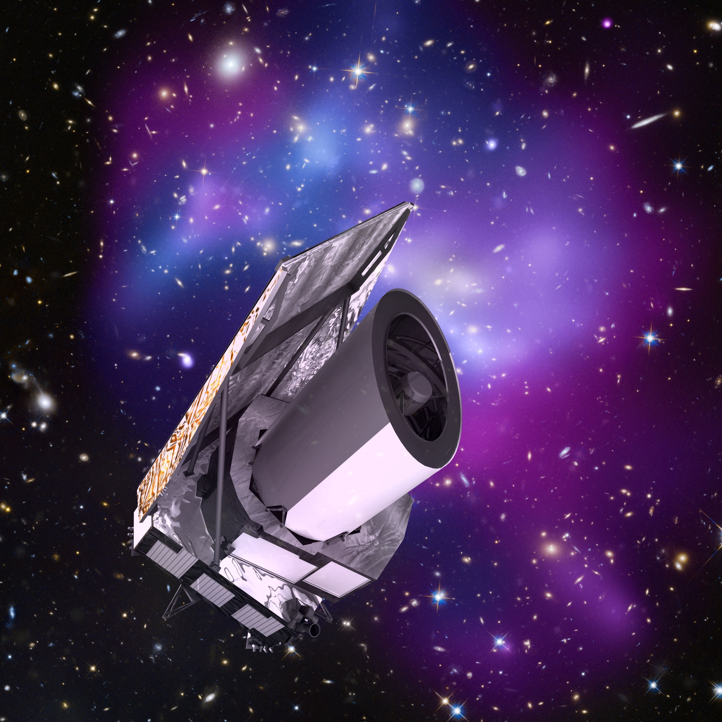




The ESA Euclid
space mission
Martin Kunz
University of Geneva
& AIMS South Africa
On behalf of the Euclid Consortium
Euclid Rencontres de Vietnam, 2015

Slide 2
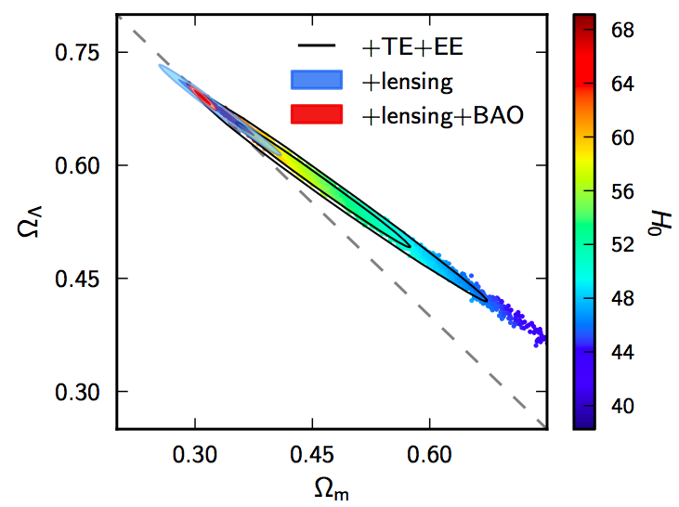

why probe the dark universe?
GR:
evolution of Universe
contents of Universe
↔
relative dark energy
density today
Planck 2015
what makes up 95% of the Universe?!
relative dark matter
density today
[Ω_{b}=4.92±0.13%]

Slide 3

1. Euclid Scientific Mission
2. Euclid Implementation
3. Euclid Performance

Slide 4
Euclid Primary Objectives:
the Dark Universe
Understand the origin of the Universe’s accelerating expansion
Probe the properties and nature of Dark Energy and Gravity,
Probe the effects of Dark Energy, Dark Matter and Gravity by:
  Using at least 2 independent but complementary probes (5 probes)
  Tracking their observational signatures on the
    Geometry of the universe: Weak Lensing (WL), Galaxy Clustering (GC)
    Cosmic history of structure formation: WL, Redshift-Space Distortion (RSD), Clusters of Galaxies (CL)
  Controlling systematic residuals to an unprecedented level of accuracy.

Slide 5
Distinguishing decisively
Assuming:
  DE equation of state: P/ρ = w , and w(a) = w_{p} + w_{a}(a_{p}-a)
  Growth rate of structure formation: f ~ Ω ^{γ} ;
Nature of dark energy
  Distinguish effects of Λ and dynamical DE: Measure w(a) → slices in redshift
  From Euclid data alone, get FoM=1/(Δw_{a} x Δw_{p}) > 400→ ~1% precision on w’s.
  → if data consistent with Λ, and FoM > 400 : Λ favoured with odds of more than 100:1 = a “decisive” statistical evidence.
Nature of gravity on cosmological scales
  Probe growth of structure → slices in redshift ,
  Separately constrain the metrics potentials (Ψ,Φ) as function of scale and time
  Distinguish effects of GR from MG models with very high confidence level:
  → absolute 1-σ of 0.02 on the growth index, γ , from Euclid data alone.
→ WL and RSD are differently sensitive to Ψ, Φ: Ψ +Φ Φ
(WL) ; (GC, RSD)

Slide 6
simplified observations
Curvature from radial & transverse BAO
w(z) from SN-Ia, BAO directly (and contained in most other probes)
In addition 5 quantities, e.g. φ, ψ, bias, δ_{m}, V_{m}
Need 3 probes (since 2 cons eq for DM)
e.g. 3 power spectra: lensing, galaxy, velocity
Lensing probes φ + ψ
Velocity probes ψ (z-space distortions?)
And galaxy P(k) then gives bias
(-> Euclid ☺ )

Slide 7
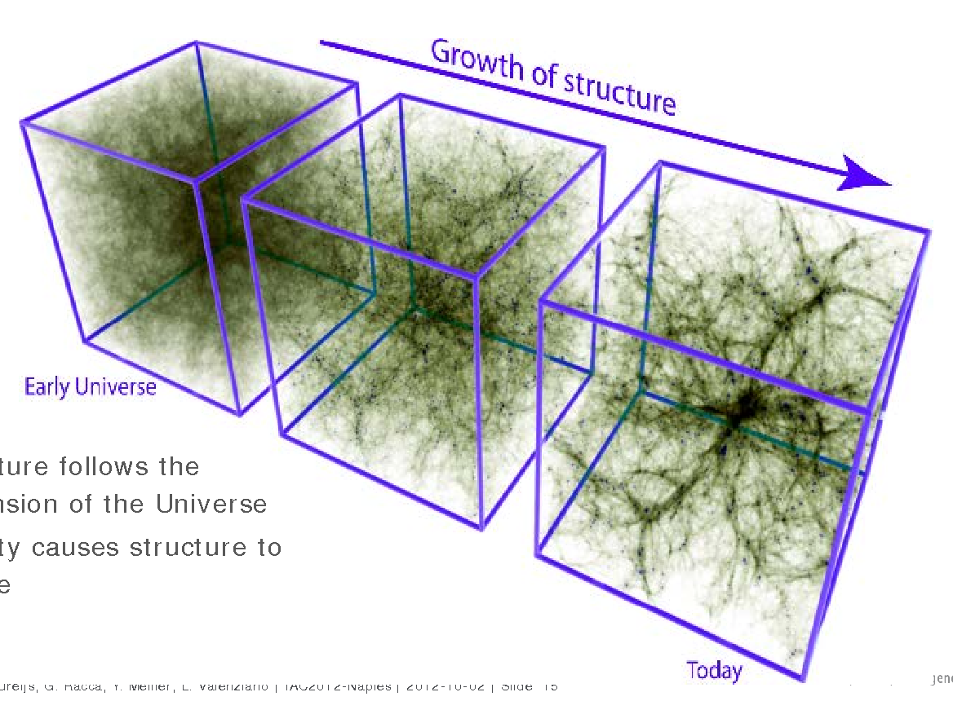
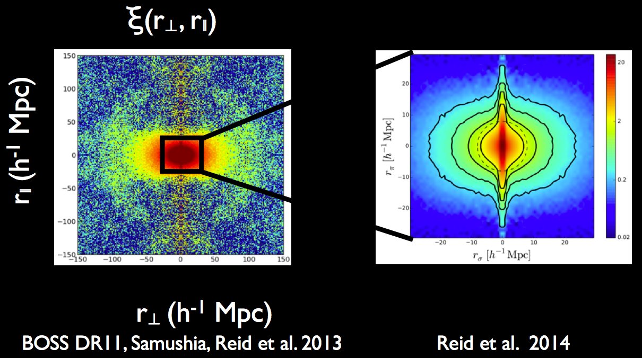
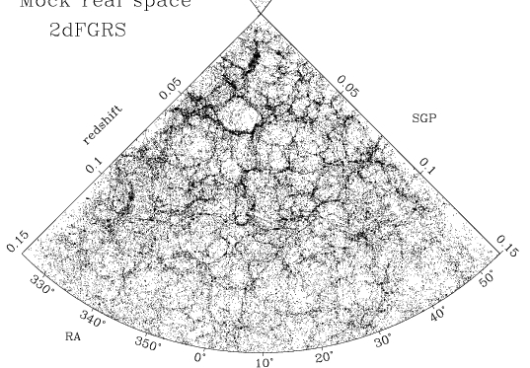
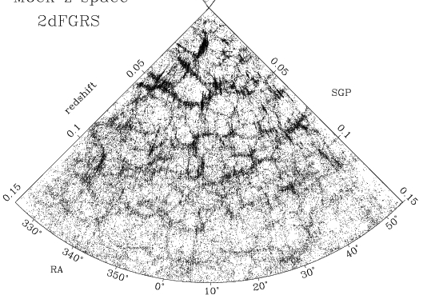
Galaxy Clustering: BAO + RSD
3-D position measurements o of galaxies over 0.7<z<1.8
  Probes expansion rate of the Universe (BAO) and clustering history of galaxies induced by gravity (RSD); ψ, H(z).
  Need high precision 3-D distribution of galaxies with spectroscopic redshifts.
  Euclid:
  30 million spectroscopic redshifts with 0.001 (1+z) accuracy over 15,000 deg²
BAO
RSD

Slide 8
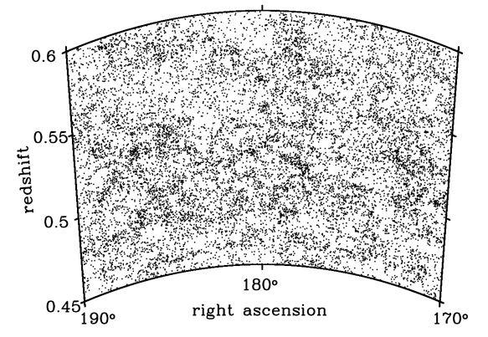
Primary probe 1: Euclid Redshift Survey
What is the expansion rate of the Universe?
Understanding
Dark Energy
Baryon Acoustic Oscillations
What is the expansion rate of the Universe?
Alcock-Paczynski effect
How does structure form within this background?
Understanding
energy-density, gravity
Galaxy Survey
Redshift-Space Distortions
Comoving clustering
What are the neutrino
masses, matter density?
Understanding
energy-density
Large-scale shape
ISW effect
What is f_{nl}, which quantifies non-Gaussianity?
GR-horizon effects
Understanding
Inflation, GR
Does the potential change along line-of-sight to CMB
Understanding
DE, GR

Slide 9
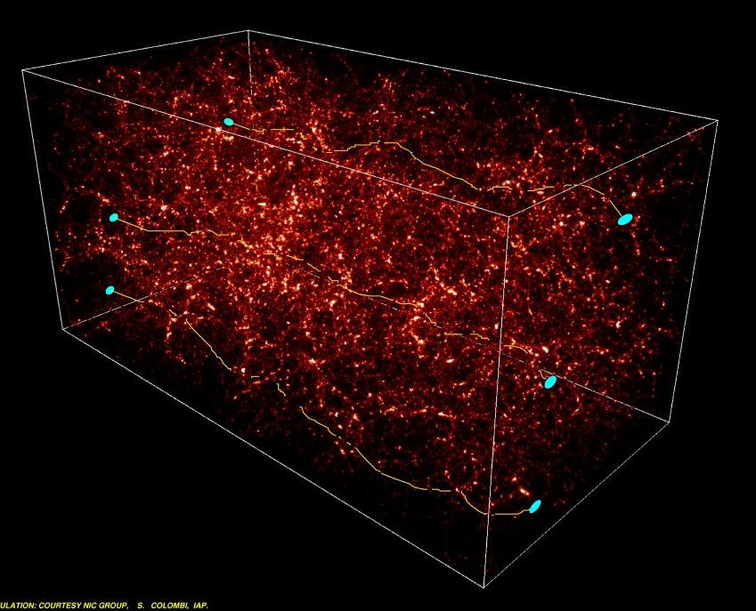
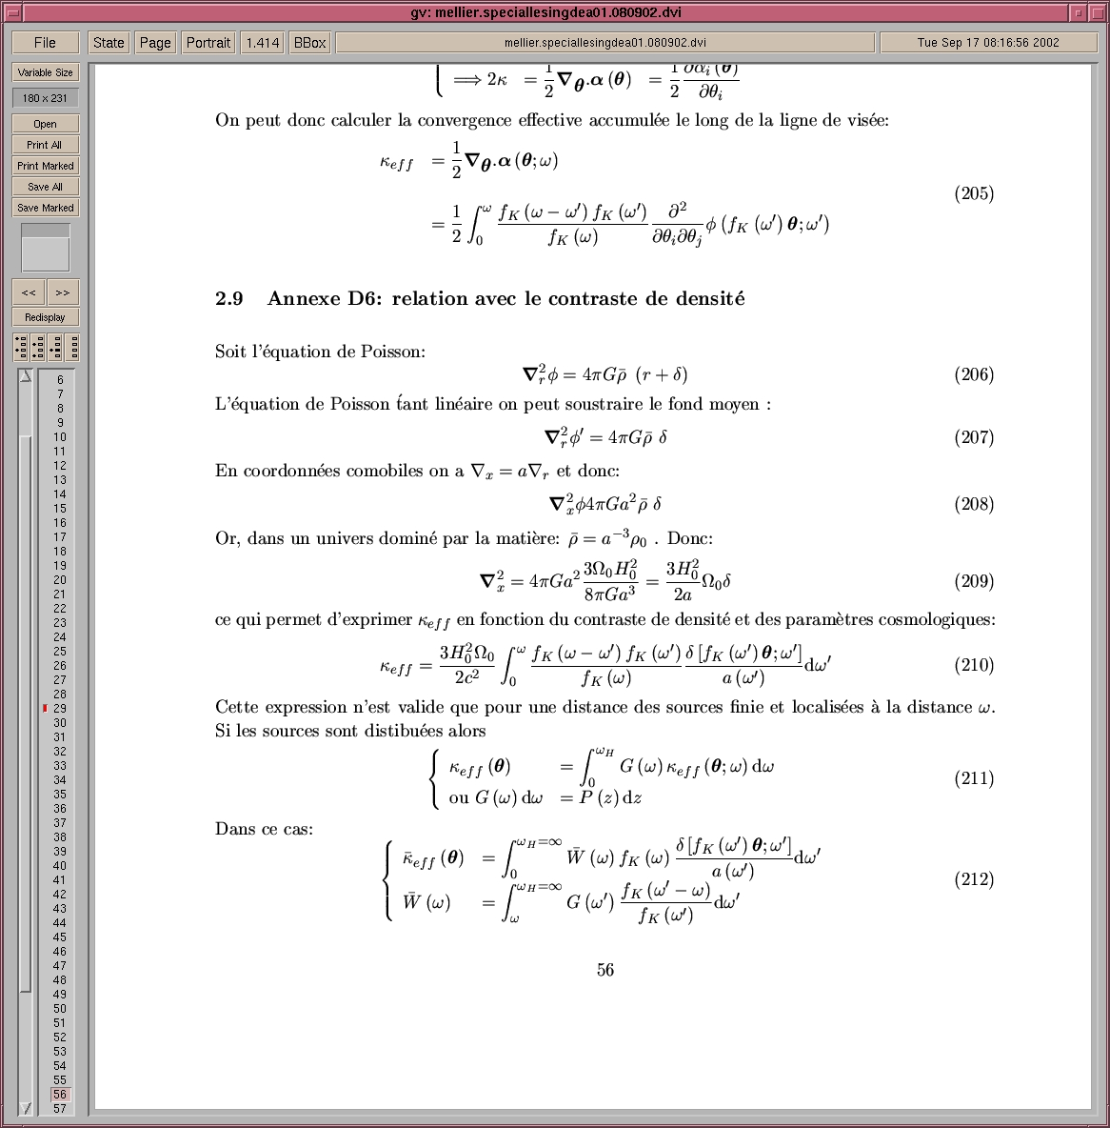
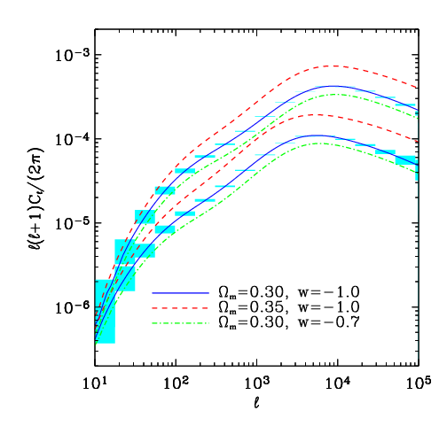
primary probe 2: Euclid Weak Lensing Survey
Cosmic shear over 0<z<2
Probes distribution of matter (Dark +Luminous): expansion history, lensing potential φ+ψ.
Shapes+distance of galaxies: shear amplitude, and bin the Universe into slices.
“Photometric redshifts” sufficient for distances: optical+NIR data.
Euclid:
  WL with 1.5 billion galaxies
  over 15,000 deg²
Colombi, Mellier 2001
Source plane z₂
Source plane z₁

Slide 10
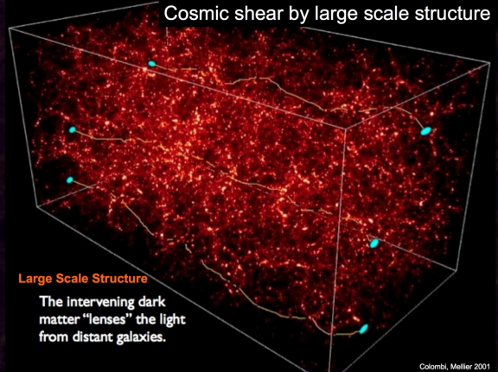
Cosmology with the Euclid Weak Lensing survey
Colombi, Mellier 2001
What is the expansion rate of the Universe?
Understanding
Dark Energy
DM power spectrum, tomography
What is the expansion rate of the Universe?
Peak stat, Clusters Mass Func
How does structure form within this background?
Understanding
energy-density, gravity
WL Survey
DM power spectrum, tomogr
DM power spectrum
What are the neutrino
masses, matter density?
Understanding
energy-density
3-pt statistics , Halos
ISW effect
What is f_{nl}, which quantifies non-Gaussianity?
GR-horizon effects
Understanding
Inflation, GR
Does the potential change along line-of-sight to CMB
Understanding
DE, GR

Slide 11
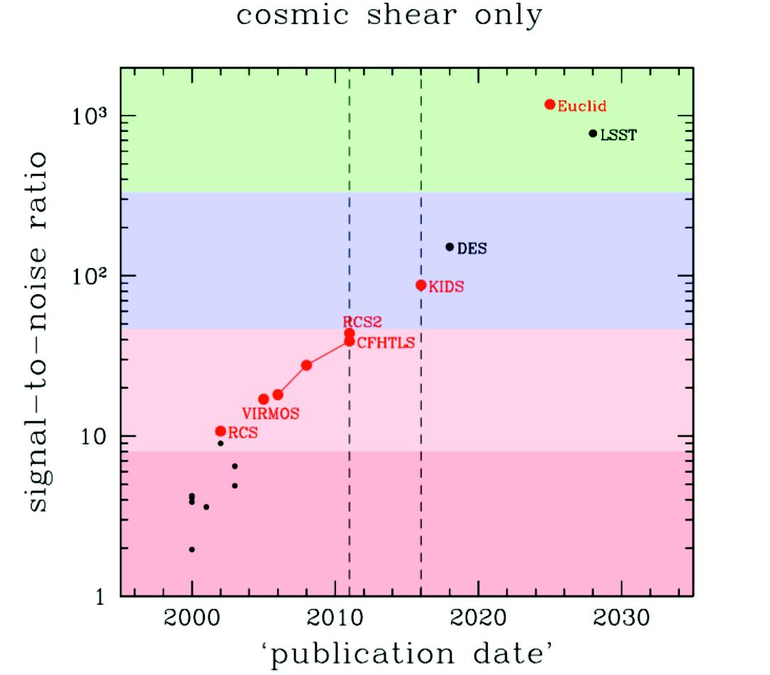
Measuring shear in next generation wide field cosmic shear surveys

Slide 12
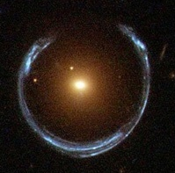
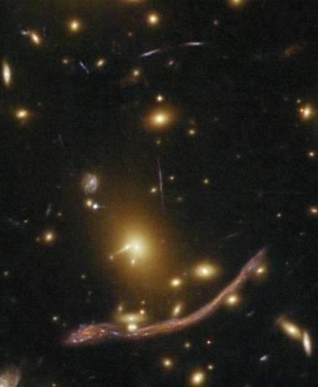

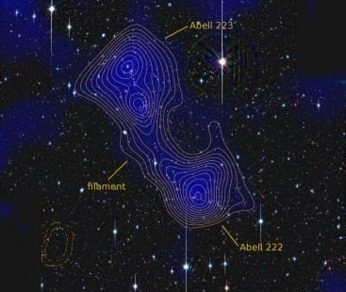
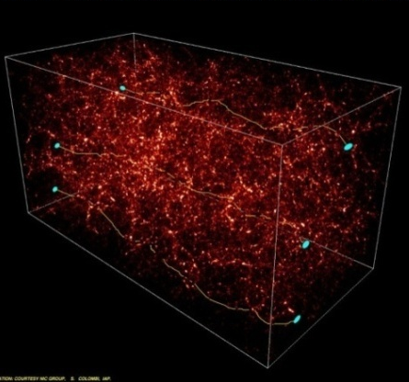
Photometric redshifts needed for Euclid
Weak Lensing : redshifts of 1.5 x10⁹ sources to
  Slice the universe
  Control contamination by intrinsic alignments of galaxies
Redshifts of Euclid clusters: (60,000 clusters, 5,000 giant arcs) → synergy with Planck and eROSITA
Redshifts of sources and lenses: needed at least in the range 0.2<z<2
→ Photo-z needed with VIS+NIR data
HST/ACS credit NASA/ESA
HST/ACS; credit NASA/ESA
Galaxy halos Clusters of galaxies
Dietrich et al 2012
Colombi/Mellier
Filaments between clusters Cosmic shear

Slide 13
little theory side-trip
Amendola, MK, Motta, Saltas, Sawicki 2013
transverse & radial P(k)
weak lensing
Σ = Y(2+η) = Q(2+η)/(1+η)
We can observe these quantities, but we want b, f and Σ …
We need to build combinations that do not contain δ_{t,0}!
usually called β, but we don’t know b
introduced as E_{G} in Zhang et al 2007
“growth” observable
That’s all – other combinations can be expressed in terms of P₁ – P₃
and their derivatives.

Slide 14
testing Horndeski
In the quasistic regime, the Horndeski model makes a very specifc prediction for the scale dependence of the anistropic stress:
h₂, h₄ and h₅ are only functions of time, i.e. constants at a given redshift. Measurements on (at least) 4 scales could therefore test the relation and support or rule out all Horndeski-type models.
Horndeski is not too big to fail!
Amendola, MK, Motta, Saltas, Sawicki 2013
(and η is a ‘direct’ observable, which leads us to …)

Slide 15
the importance of η / π
(MK, Sapone 2007; Amendola, MK, Sapone 2008; Saltas & MK 2011)
non-minimal coupling f(φ)R in action :
-> unique link π <-> MG
quintessence, K-essence, etc: π = 0
DGP, S/T, f(R), f(G), etc: π ≠ 0
(except in GR limit)
-> extra scalar d.o.f. very directly linked to π
→ η or π can rule out whole classes of models!
actually it is a diagnostic for ‘modifications of GR’!

Slide 16




aniso stress & grav. waves
gravitational waves are the dynamical d.o.f. of GR
modification of their propagation is really ‘modified gravity’
Horndeski, bimetric massive gravity and other theories show a direct link between anisotropic stress and gravitational wave propagation, e.g. in Horndeski:
Saltas, Sawicki, Amendola, MK 2014
→ η is a key observable for us

Slide 17
1. Euclid Scientific Mission
2. Euclid Implementation
3. Euclid Performance

Slide 18
Euclid Survey Machine: 15,000 deg² + 40 deg² deep
Space Euclid VIS and NIR observer of stars and galaxies
12 10⁹ sources, 1.5 10⁹ WL galaxies, 3.10⁷spectra Wide
External Photometry
and
External Spectroscopy
VIS Imaging
I_{AB}=24.5 ; 10σ
I_{AB}=26.5 ; 10σ
NIR Photometry
Y,J,H=24.0 ; 5σ
Y,J,H=26.0 ; 5σ
NIR Spectroscopy
2 10⁻¹⁶ erg.cm⁻².s⁻¹ ; 3.5σ
5 10⁻¹⁷ erg.cm⁻².s⁻¹ ; 3.5σ
Other Euclid probes
Cosmic Shear survey
Galaxy Redshift survey
Dark Matter and Galaxy
Power Spectra with look back time
Planck, eROSITA, …
Cosmological explorer of
gravity, dark matter, dark energy and inflation
Legacy
Science
Cosmo. Simul.

Slide 19

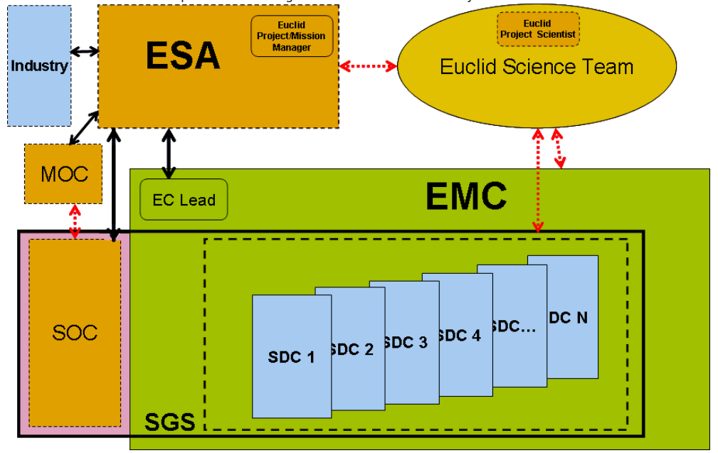


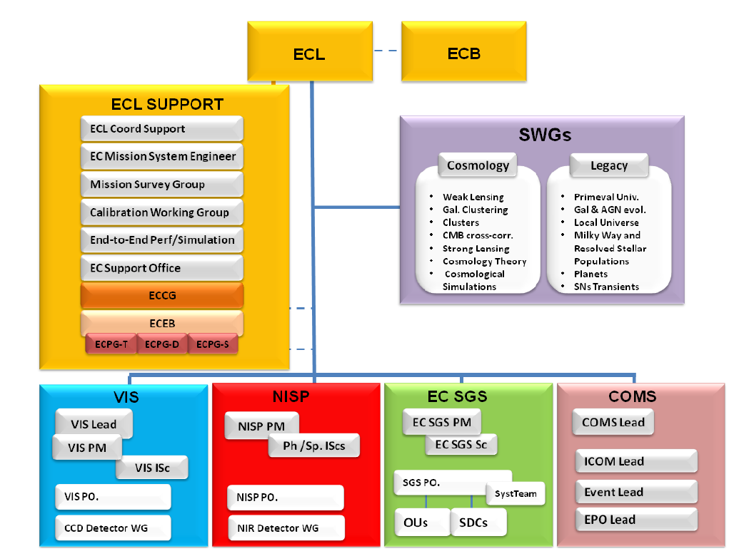
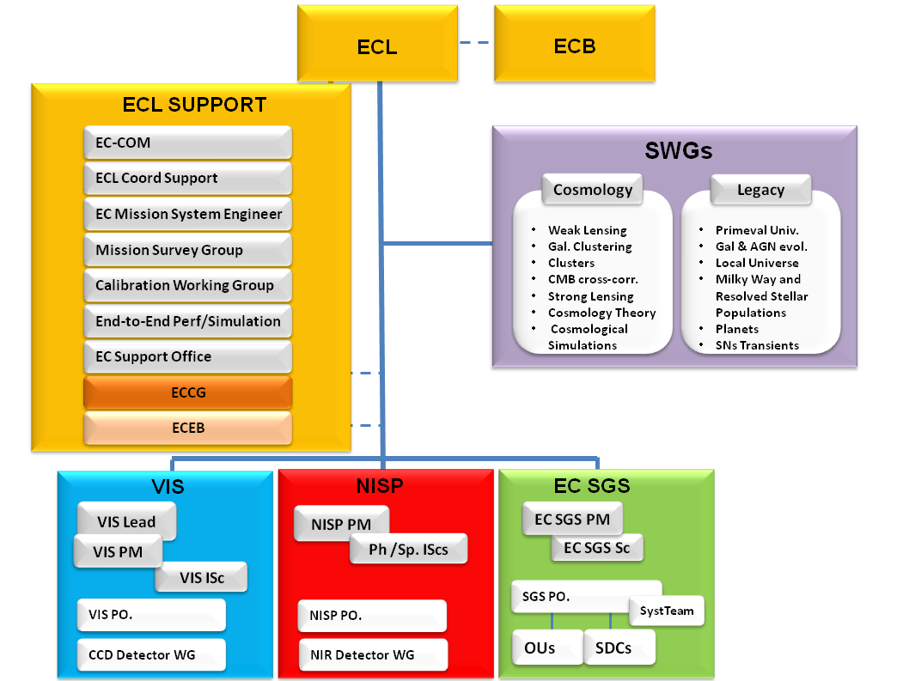
Euclid Collaboration/Consortium
Euclid Consortium
- 1250 members,
- 125 Labs
- 15 countries:
Austria, Belgium, Denmark,
France, Finland,, Germany, Italy,
The Netherlands, Norway,
Portugal, Romania,
Spain, Switzerland, UK
US/NASA and
Berkeley labs.
SGS-SDC

Slide 20
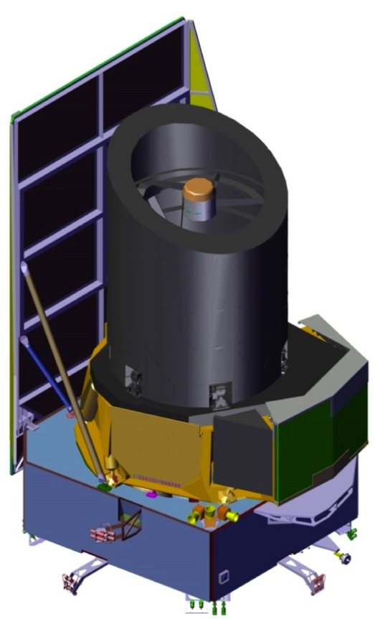
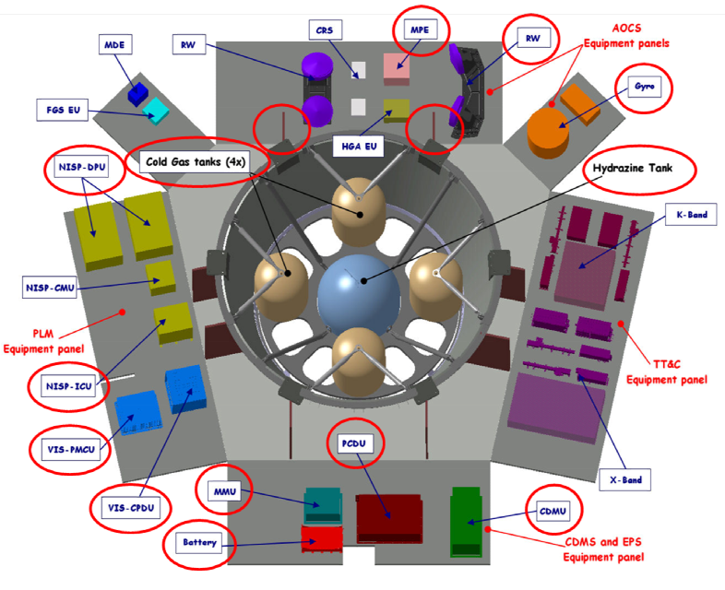
Courtesy TAS-I / ESA
Euclid satellite: Thales Alenia Space
Pointing error along the x,y axes= 25mas over a period 700 s.
Total Mass of the satellite : 2 200 kg
Dimensions:
4,5 m x 3 m
Notes:
size / mass similar to planck

Slide 21
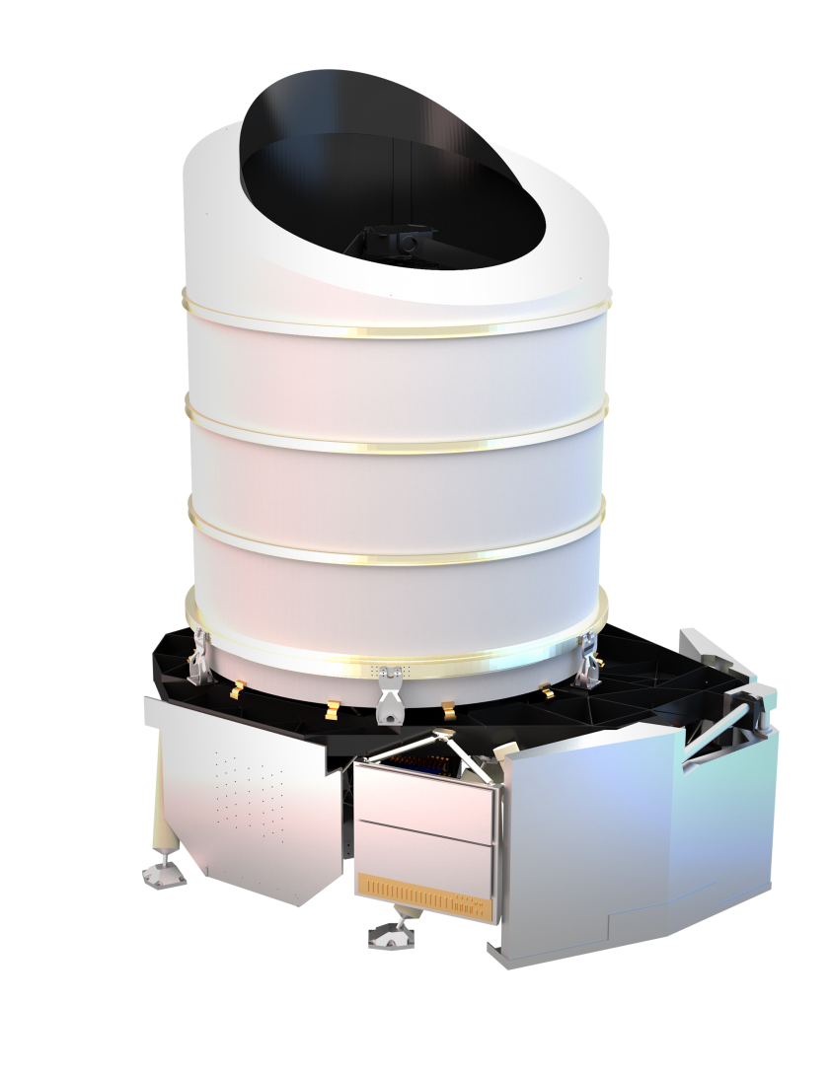
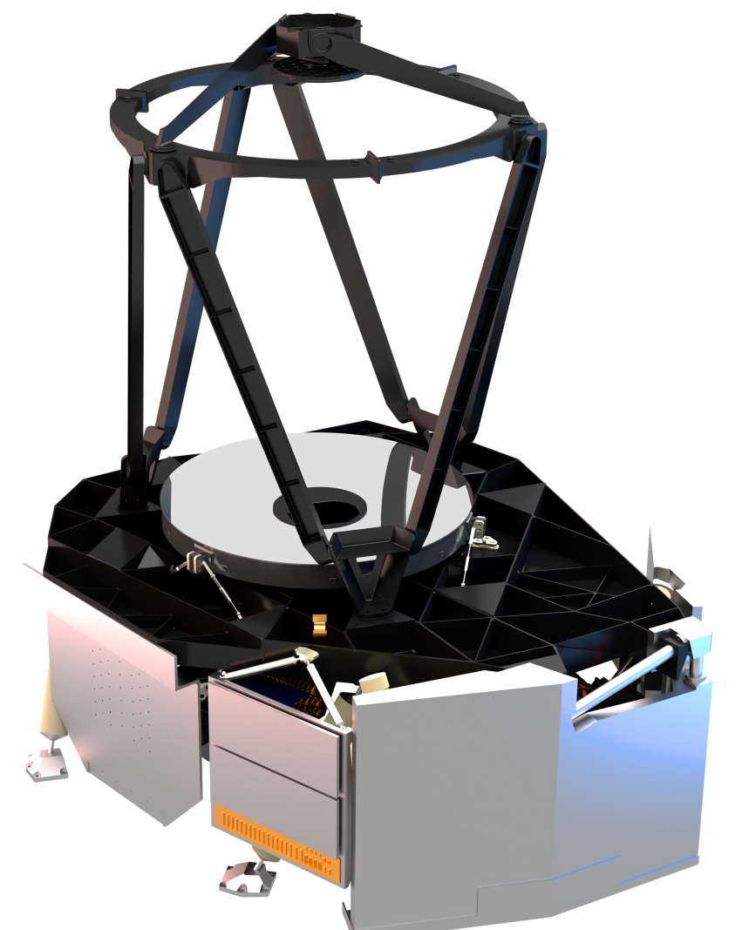
Euclid telescope: Airbus DS
Télescope 1,2 m: FoV: 0.54 deg²
Miror in Silicon Carbide= ultra-stable:
Temp.: -150 deg. Stability +:- 0.05 deg.
M2 mirror
Telescope
baseplate
M1
mirror
External
baffle
NISP
radiator
VIS
radiator
Courtesy Airbus DS / ESA

Slide 22
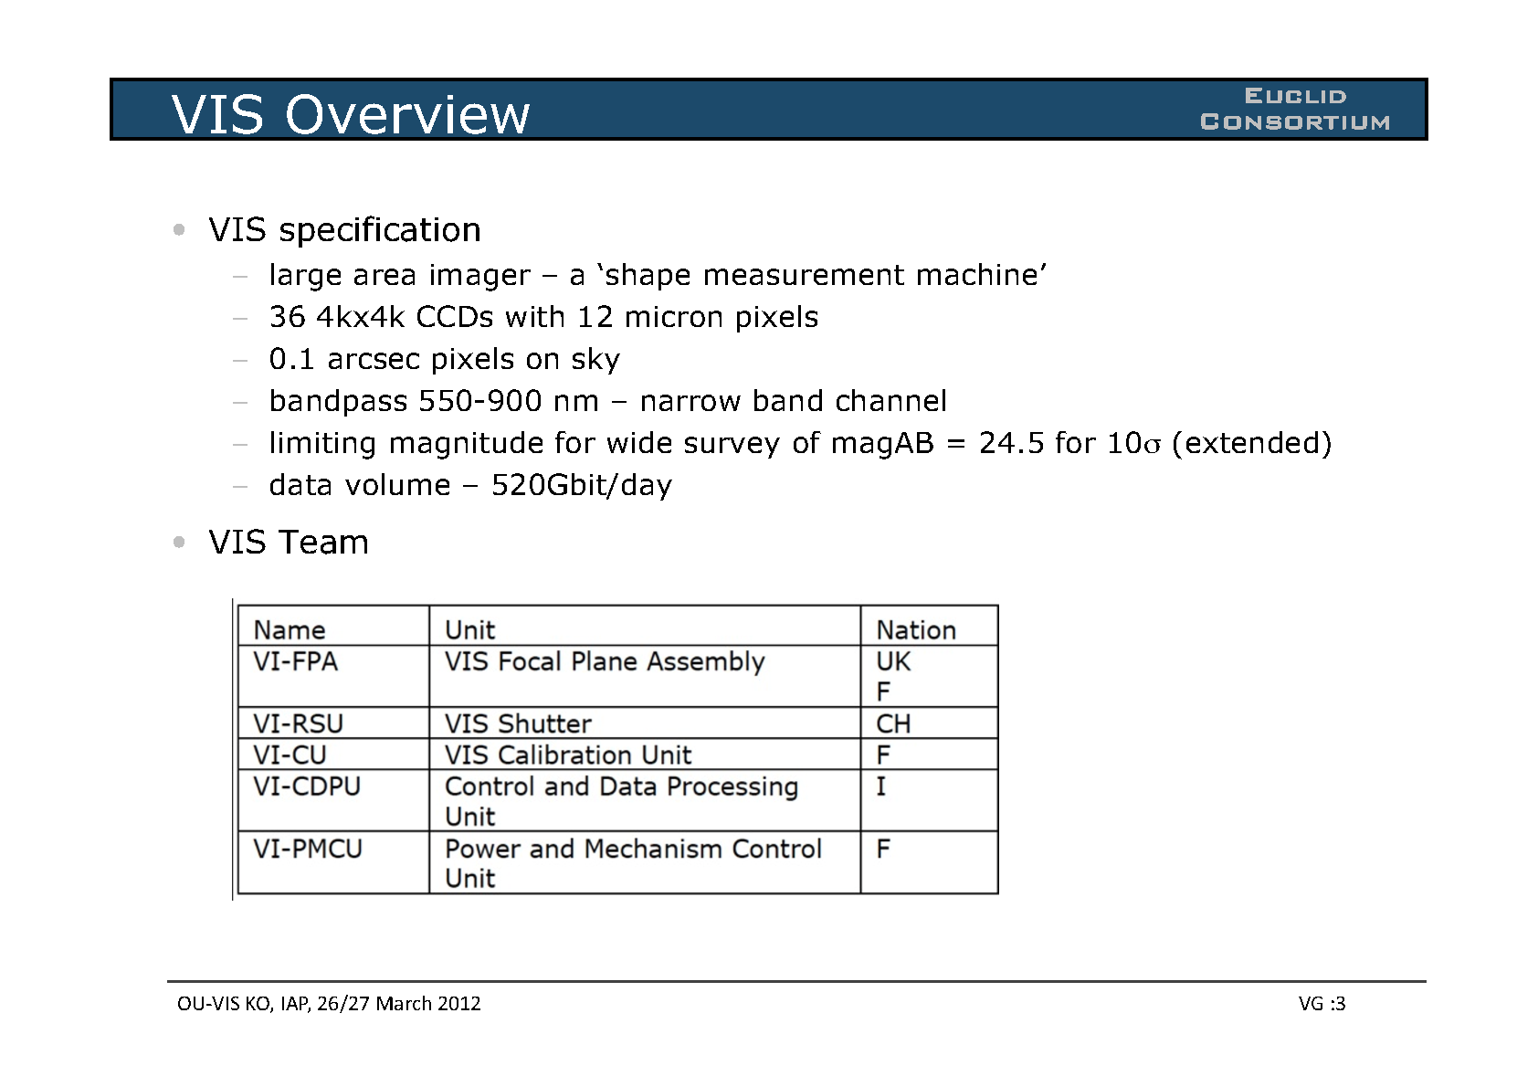
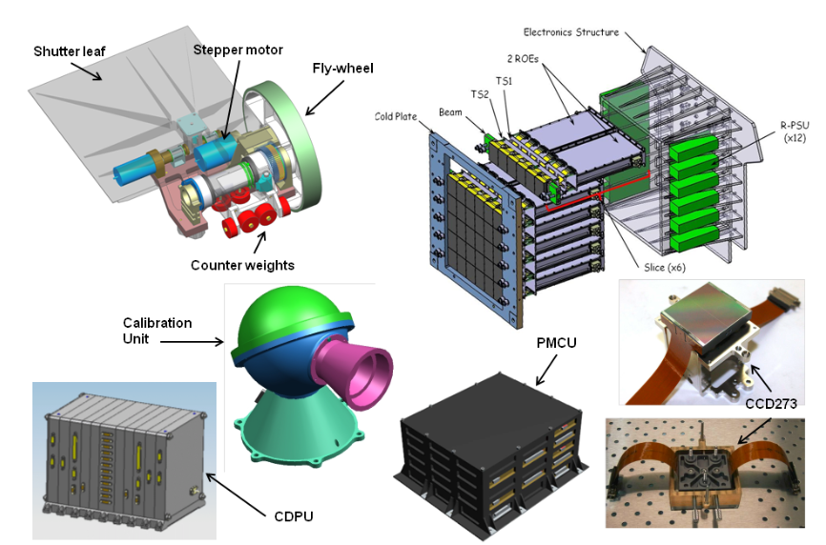
VIS
FoV = 0.54 deg²
Courtesy: S. Pottinger, M. Cropper and the VIS team
(wide band channel)
- Total mass: 135 kg
Euclid Conf&Location Date, 2015

Slide 23
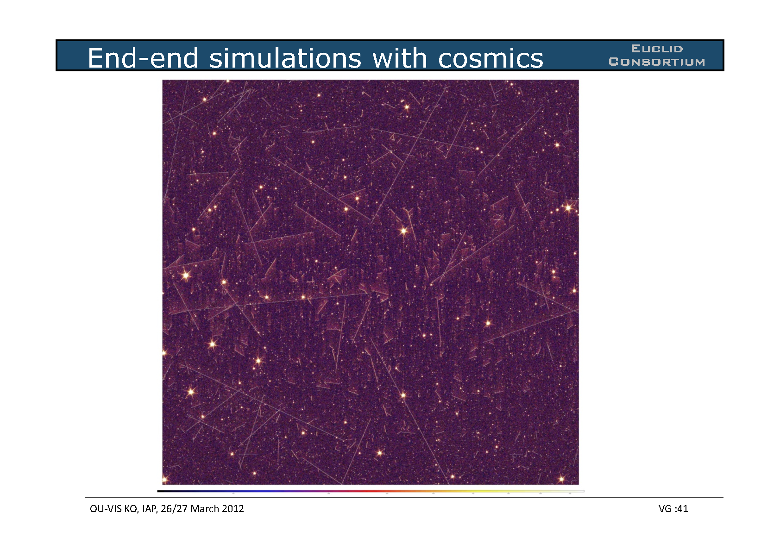
VIS performance:imaging
A 4kx4k view of the Euclid sky
VIS image: cuts made to highlight artefacts
Courtesy Mark Cropper,
Sami M. Niemi

Slide 24
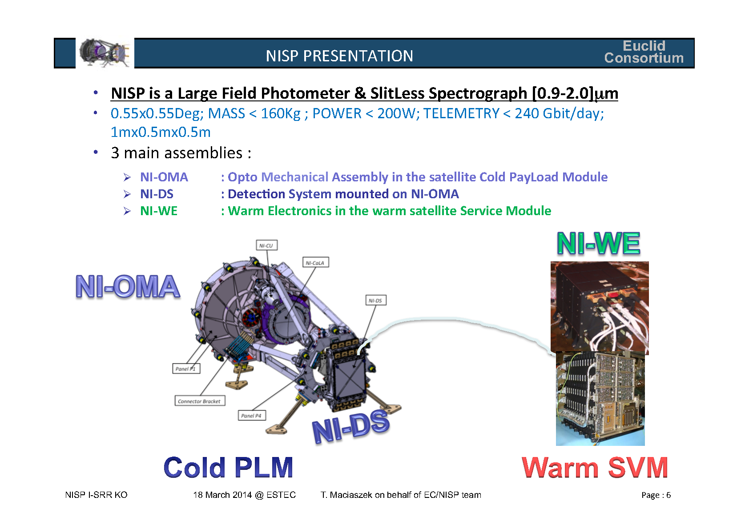
NISP instrument
Courtesy: T. Maciaszek and the NISP team
3 main assemblies:
  NI-IOMA: Opto Mechanical Assembly in the satellite Payload Module
  NI-DS : Detection System mounted in NI-OMA
  NI-WE: Warm Electronics in the warm satellite Service Module
Fov: 0.55x0.55 deg2
Mass : 160 kg
Power < 200 W
Telemetry: 240 Gbt/day
Size: 1m x 0.5 m x 0.5 m
16 2kx2K H2GR detectors
0.3 arcsec pixel on sky
(Wide survey only with R-grism)
Limiting mag AB: 24 (5 σ )
3 Filters: Y (920-1146nm), J (1146 – 1372nm), H (1372 – 2000nm)
4 grisms: 1B (920 – 1250nm) , 3R (1250 – 1850nm)
Cold PLM Warm SVM

Slide 25
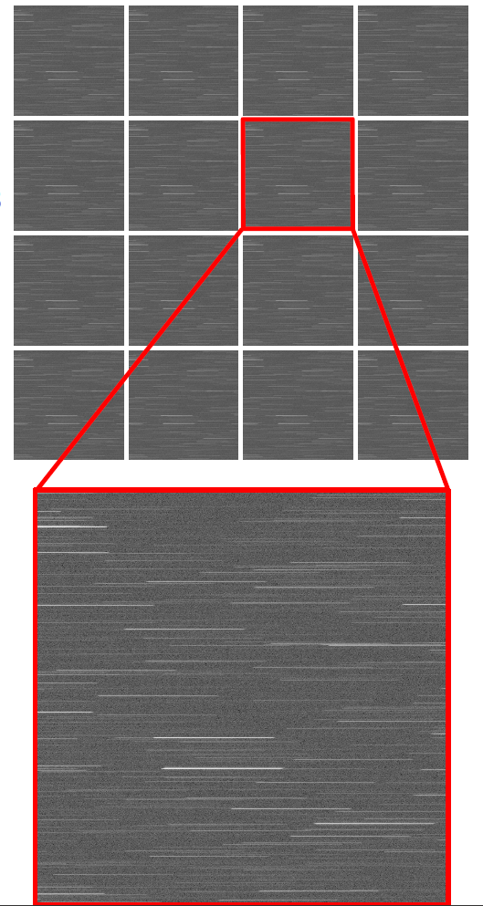
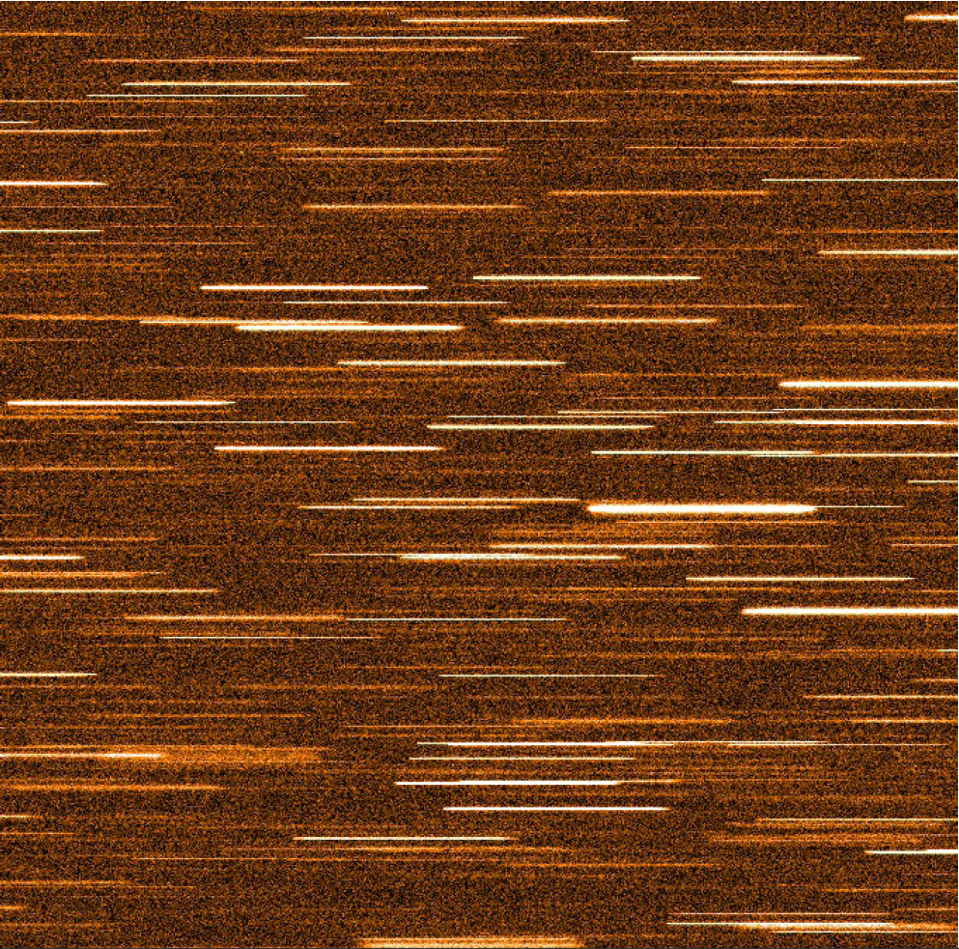
NISP-spectroscopy (2015 simulations)
From P. Franzetti, B. Garilli, A. Ealet, N. Fourmanoit & J. zoubian

Slide 26
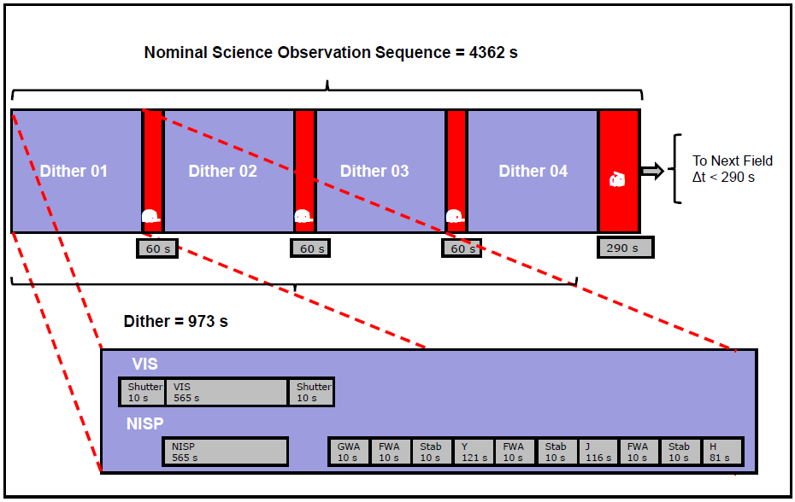
Obs. sequence: 4 (VIS+NISP) frames/pointing
For the wide: one pass only
95% (90%) pixels covered at least 3 times with VIS (NISP)
VIS and NISP observe in parallel
4x[(VIS+Grims)+(J,Y,H) then Grism change+dither]
4 different grism exposures
VIS
Data transfer to Earth: 4 hours/day
From J. Amiaux and the ESSWG

Slide 27
1. Euclid Scientific Mission
2. Euclid Implementation
3. Euclid Performance

Slide 28
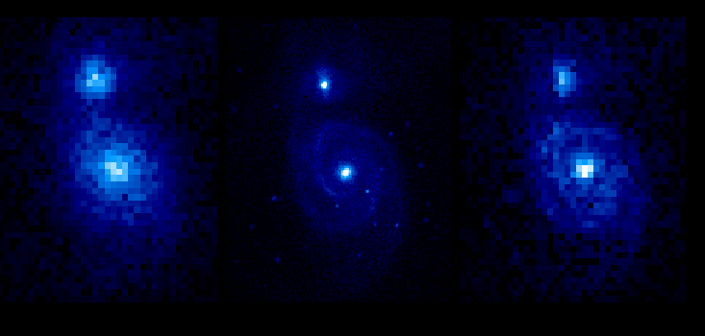
Simulation of M51 with VIS
(Courtesy J. Brinchmann and S. Warren )
SDSS @ z=0.1
Euclid @ z=0.1
Euclid @ z=0.7
Messier 51 galaxy at z~0.1 and 0.7:
Euclid will get the resolution of Sloan Digital Sky Survey but at z=1 instead of z=0.05.
Euclid will be 3 magnitudes deeper → Euclid Legacy = Super-Sloan Survey

Slide 29
BAO : SDSS vs Euclid
Distance-redshift
relation moves P(k)
SDSS today
EUCLID expected
0.15<z<0.5
0.7<z<2.0

Slide 30
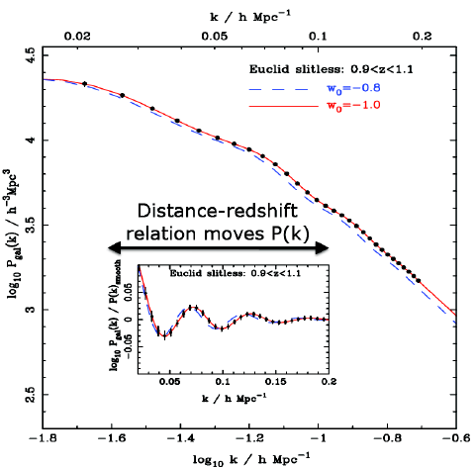
Euclid: Combining WL and GC data
Dark matter Galaxies
Input P(k)
B-modes
Tomographic WL shear cross-power spectrum for 0.5 < z < 1.0 and 1.0 < z < 1.5 bins.
Percentage difference [expected – measured] power spectrum: recovered to 1% .
V_{eff} ≈ 19 h⁻³ Gpc³ ≈ 75x larger than SDSS
Redshifts 0.7<z<1.85
Percentage difference [expected – measured] power spectrum: recovered to 1% .

Slide 31
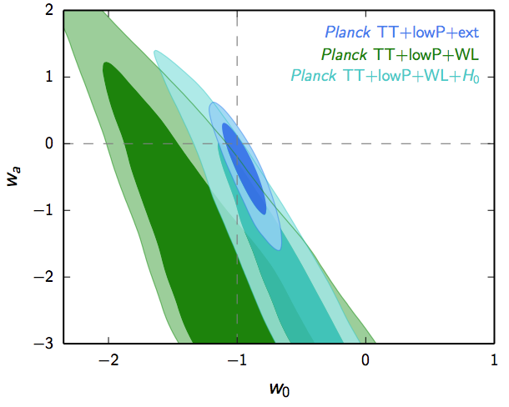
Euclid Post-Planck Forecast for the Primary Program
Assume systematic errors are under control
 | Modified Gravity | Dark Matter | Initial Conditions | Dark Energy
Parameter | γ | m _{ν} /eV | f_{NL} | w_{p} | w_{a} | FoM
Euclid primary (WL+GC) | 0.010 | 0.027 | 5.5 | 0.015 | 0.150 | 430
EuclidAll (clusters,ISW) | 0.009 | 0.020 | 2.0 | 0.013 | 0.048 | 1540
Euclid+Planck | 0.007 | 0.019 | 2.0 | 0.007 | 0.035 | 6000
Current (2009) | 0.200 | 0.580 | 100 | 0.100 | 1.500 | ~10
Improvement Factor | 30 | 30 | 50 | >10 | >40 | >400
Ref: Euclid RB arXiv:1110.3193
= 1/(Δw₀×Δw_{a})
current
constraints
(Planck++)
  DE equation of state: P/ρ = w , and w(a) = w_{p} + w_{a}(a_{p}-a)
  Growth rate of structure formation: f ~ Ω ^{γ} ;
  From Euclid data alone, get FoM=1/(Δw_{a} x Δw_{p}) > 400→ ~1% precision on w’s.
  Notice neutrino constraints -> minimal mass possible ~ 0.05 eV!

Slide 32
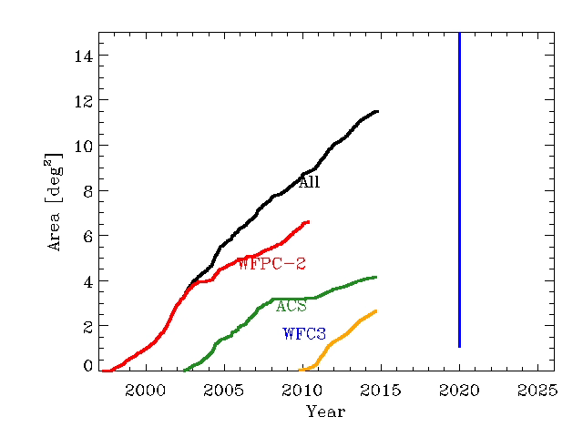
Euclid VIS+NISP Legacy
12 billion sources, 3-σ
30-50 million redshifts;
A mine of images and spectra for the community for several decades;
A reservoir of targets for JWST, GAIA, E-ELT, TMT, ALMA, Subaru, VLT, etc…
Synergy with LSST, e-ROSITA, SKA
Objects | Euclid | Before Euclid
Galaxies at 1<z<3 with precise mass measurement | ~2x10⁸ | ~5x10⁶
Massive galaxies (1<z<3)) | Few hundreds | Few tenss
Hα Emitters with metal abundance measurements at z~2-3 | ~4x10⁷/10⁴ | ~10⁴/~10² ?
Galaxies in clusters of galaxies at z>1 | ~2x10⁴ | ~10³ ?
Active Galactic Nuclei galaxies (0.7<z<2) | ~10⁴ | <10³
Dwarf galaxies | ~10⁵
Teff ~400K Y dwarfs | ~few 10² | <10
Lensing galaxies with arc and rings | ~300,000 | ~10-100
Quasars at z > 8 | ~30 | None
sky area of HST quality imaging
(Jarle Brinchmann)

Slide 33
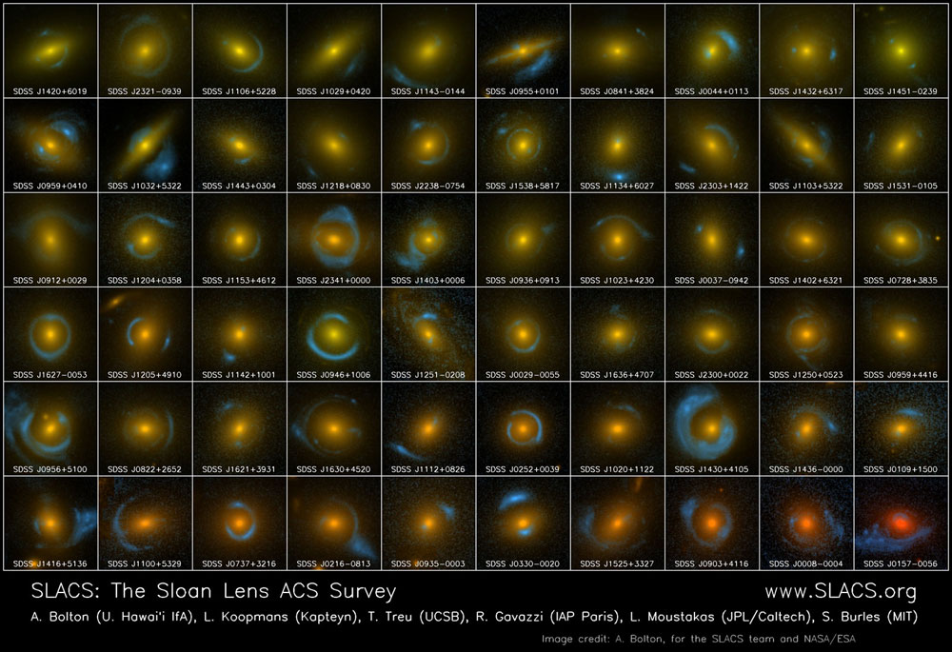
SLACS (~2010 - HST)
Galaxy-scale strong lensing with Euclid

Slide 34
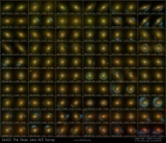
SLACS
Euclid VIS Legacy : after 2 months
(66 months planned)

Slide 35

Euclid Rencontres de Vietnam 2015

Slide 36
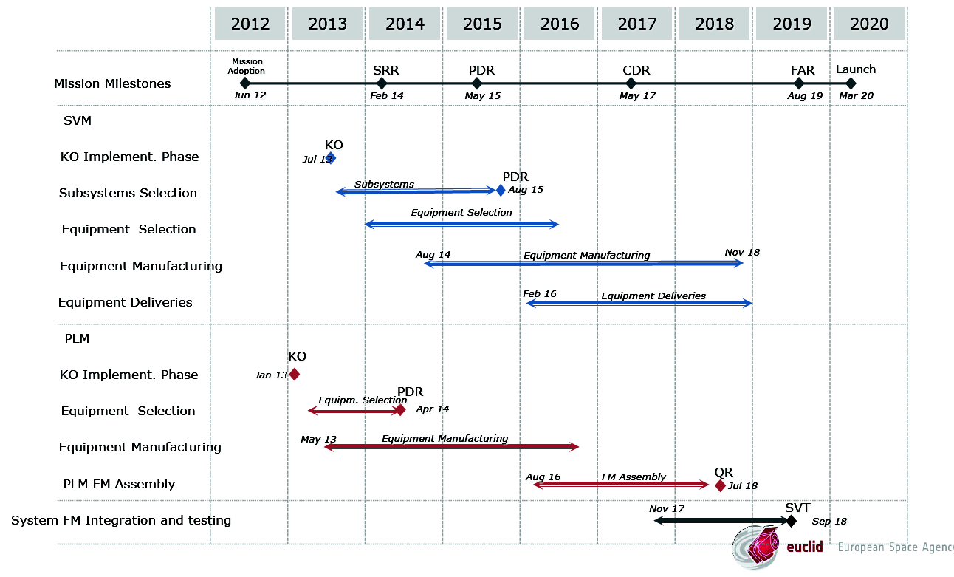
Euclid Schedule (Oct 2014)
Courtesy. G. Racca/ESA

Slide 37
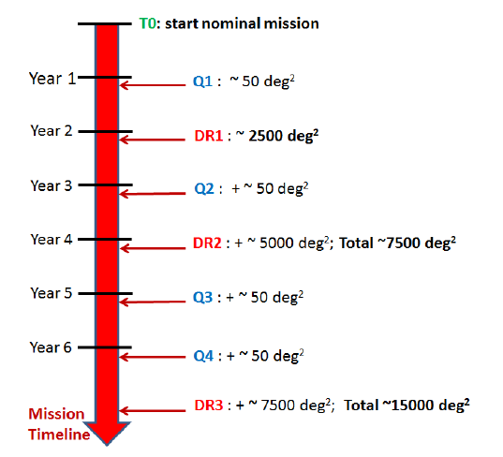
Euclid data release
Year -3
T-3 start ground based observations (<2017)
All Euclid pointings set
Yr -1 Ground DR1
ready (2500 deg²⁾
T-0 start Euclid nominal mission (2020)
Yr+1 Ground DR2
ready (7500 deg²)
Yr +3 Ground DR3
ready (15000 deg²)
LSST north data? Public in 2024?

Slide 38
Challenges of Euclid
EC Management: 1250 persons, 120 labs, 14 countries:
Data management and processing: huge volume, multi-wavelength data, ground + space, NIR+VIS, 10 SDCs , archive → data, algorithm and hardware challenges
Shape measurements/systematics
  Control multiplicative and additive biases, shape measurement algorithms
Photometric redshifts:
  Ground based photometry in 4 bands : 15,000 deg² (i.e. north and south)
Numerical simulations with power spectrum to a 1% accuracy :
  Underlying physics: e.g. numerical simulations with baryons
  Numerical simulations of a large number of DE, GR models
  10³ to 10⁵ simulations to estimate covariance matrices
End-to-End performances
Spectroscopic surveys to:
  Calibrate deep photo-z and understand BAO and RSD samples
Notes:
~100 Pbytes
1+ million images
> 10¹⁰ sources (>3-sigmas)

Slide 39
Summary: the post-Planck cosmology mission
Euclid will
  Explore the dark universe as a whole: DE, MG, DM (in particular neutrinos), inflation
  Use 5 cosmological probes, with at least 2 independent
  Get percent precision on w and gravitational potentials
  Prepare a revolution for wide field VIS and NIR surveys
  Prepare the next generation wide field panchromatic all sky surveys: GAIA, LSST, WFIRST, e-ROSITA, SKA
Euclid Legacy = 12 billion sources, >30 million redshifts;
  A mine of images and spectra for the community for years;
  A reservoir of targets for JWST, E-ELT, TMT, ALMA, VLT
  A set of astronomical catalogues useful until 2040+
  A fantastic project for next generation of scientists

Slide 40
Thank you
Euclid Rencontres de Vietnam 2015

