Slide 1
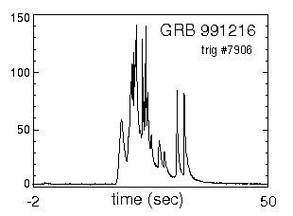
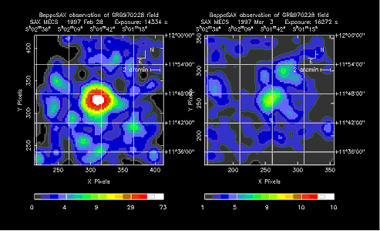
Gamma-Ray Burst models
Theory of prompt and afterglow emission
Robert Mochkovitch (Institut d’Astrophysique de Paris)

Slide 2
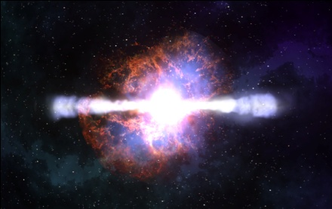
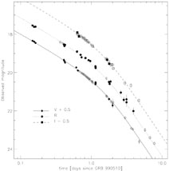
What we know for (almost) sure….
relativistic jet
internal dissipation: prompt emission
central engine
photosphere
RS FS
afterglow emission
jet break

Slide 3
What we know for (almost) sure….
relativistic jet
internal dissipation: prompt emission
central engine
photosphere
RS FS
afterglow emission
jet break
Unsettled issues:
• acceleration/energy content of the jet: thermal/magnetic?
• dissipation mechanism at work?
• respective contributions of the forward and reverse shocks to the afterglow
• surprises in the early afterglow

Slide 4
Models
• Basic requirements
z → D_{L} + observed flux → E_{γ,iso} = 10⁵¹ – 10⁵⁴ erg
short time scale variability → compact source
Relativistic outflow to avoid opacity problem: γγ → e⁺e⁻
Γ_{min} ~ 100 – 1000
• Acceleration of the flow
Thermal :
r₀ ∼ 10 – 100 km
m : entrained mass
“baryonic pollution”
η = 400
(fireball model)
.
r_{acc} ~η r₀
T₀ ~ a few MeV
.

Slide 5
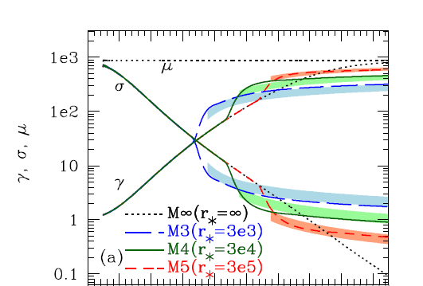
• Acceleration of the flow
Magnetic :
slower acceleration:
initially
.
r^{1/3}
.
(Tchekhovskoy et al, 2010)
→ Acceleration may not be completed at the photosphere
→ Thermal emission can be much reduced if
→ Remaining magnetization at infinity ?

Slide 6
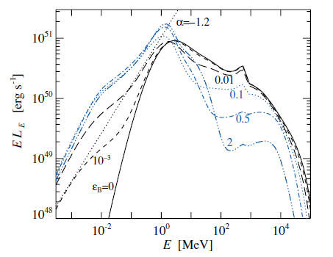
• Dissipation processes
below the photosphere: “photospheric models”
np collisions
shocks → energetic electrons (and positrons)
reconnection IC on thermal photons at a few optical depths below the photosphere
+ synchrotron contribution/geometrical effect at low energy
E²N(E)
IC
syn
Planck → broken PL
E
(Vurm et al, 2011)

Slide 7
• Dissipation processes
above the photosphere: internal shocks
variable Lorentz factor in the outflow
Γ
Γ
Γ₁>Γ₂
Γ_{r}
γ
dissipate 10 – 20 % of the flow KE
r
r
50 – 300 keV
Redistribution of the dissipated energy :
ε_{e} x E_{diss} : into a non thermal (power law)
distribution of electrons
ε_{B} x E_{diss} : in magnetic energy
→ synchrotron emission
(Daigne & Mochkovitch, 1998)

Slide 8
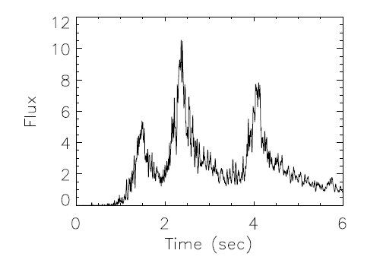
Above the photosphere: reconnection
σ∞ > 1
difficult and uncertain physics
→ few predictions except ICMART (Internal-Collision-induced MAgnetic Reconnection and Turbulence)
(Zhang & Zhang, 2014)
Potentially large efficiency : 30 – 50 % ?

Slide 9
• Evaluating the models
Internal shocks: many predictions in good agreement
with observations : hardness – duration, W(E), Lags, HIC
Potential problems
• efficiency requires cooling electrons in “fast cooling regime”
→ low energy slope α = -1.5 while <α>_{obs} ∼ -1
• acceleration of electrons: much energy into a small (1%) fraction of the electrons
• magnetic acceleration required to avoid bright photospheric emission
but then what about σ∞ and the existence/efficiency of shocks ?
8-260 keV
260 keV - 5 MeV
Photon flux
Photon flux
GBM LAT
>100 MeV
>1 GeV
Time [s]
(Bosnjak & Daigne, 2014)
Reconnection: natural model if magnetic acceleration with large σ∞ ?
• uncertainties with the spectrum: general shape, low energy spectral slope α
Photospheric models: less uncertain input physics
• requires an “adaptable dissipative process”
should work for a full range of L, E_{p} (whole burst evolution)
→ Looking for tests of the various models…

Slide 10
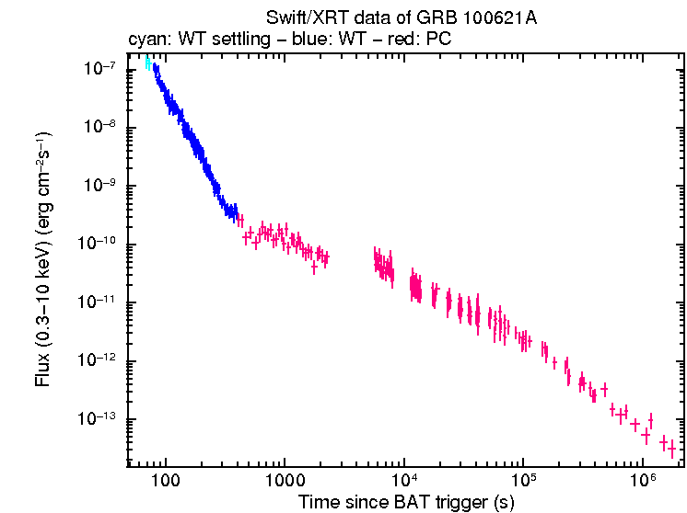
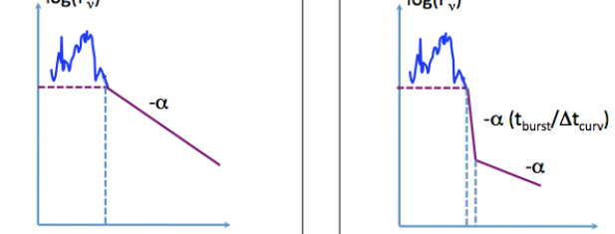
• Temporal tests
steep decay at the end of the prompt phase
α ∼ -3
t_{b}
ΔR
“high latitude emission”
IS, ICMART : Δt_{geo} ~ t_{b} → α ~ -3
Photospheric models : Δt_{geo} << t_{b}
In photopheric models the initial decay must correspond
to an effective behavior of the central engine
t_{b}
(Hascoët et al, 2012)

Slide 11
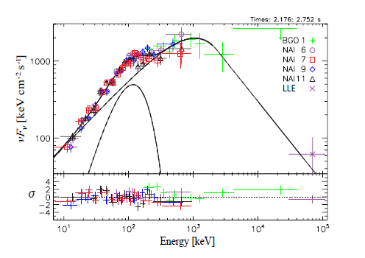
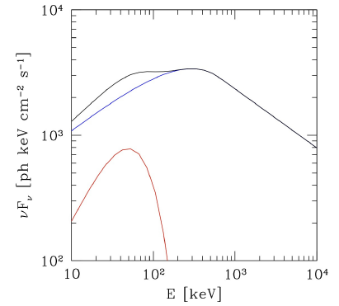
• Spectral tests
additional thermal (photospheric) component in the spectra ?
expected in internal shock, reconnection models…
…but a priori not in photospheric models where the spectrum is the (modified)
photospheric emission
(Guiriec et al, 2013)

Slide 12
The afterglow
… results from the deceleration of the flow by the external medium (uniform or stellar wind)
• The pre-Swift era: afterglows looked pretty simple !
Forward shock dynamics described by the Blandford-McKee solution
(at deceleration radius, swept up mass: )
 | uniform medium | stellar wind
λ_{R} | -3/2 | -1/2
λ_{t} | -3/8 | -1/4
Shock dissipated energy injected into a non-thermal distribution of electrons: ε_{e} , p , ζ
and amplifies the magnetic field: ε_{B}
Injection Lorentz factor of the electrons: ν_{m} ∼ Bγ_{m}² Γ
Post-shock magnetic field: → (t_{syn} ~ t_{dyn}) ν_{c} ∼ Bγ_{c}² Γ

Slide 13
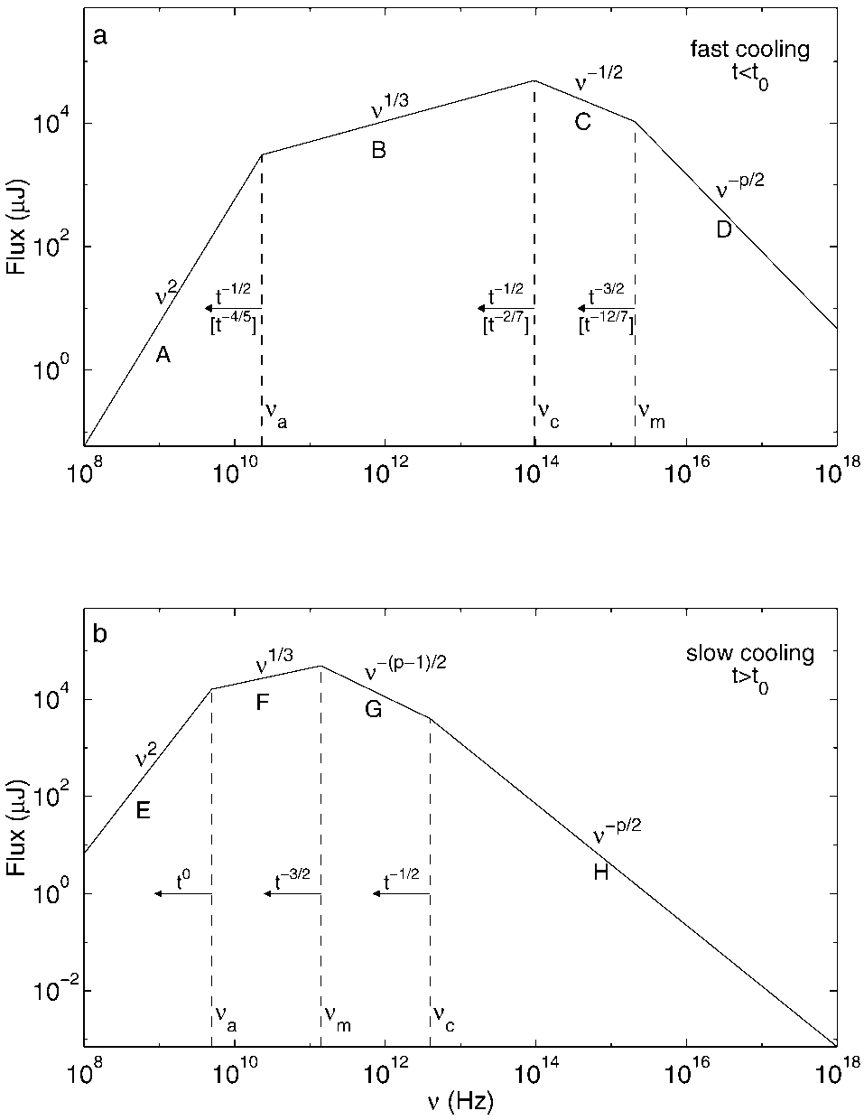
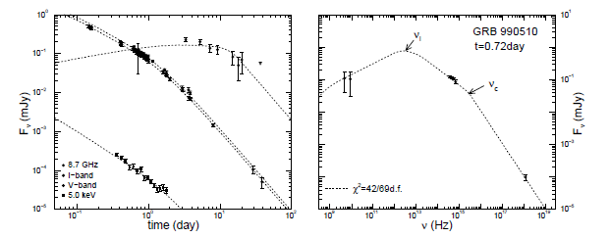
Afterglow spectra and light curves are modelled by consecutive power-law segments
spectra
ν_{c} < ν_{m} ν_{m} < ν_{c}
(Sari, Piran, Narayan, 1998)
Hz Hz
light curves
X V
(Panaitescu & Kumar, 2000)
day day
multi-wavelength fit of the afterglow → E_{K} , ε_{e} , ε_{B} , p , n/A*
E_{K} = 2.6 10⁵³ erg ; n = 0.14 cm⁻³
ε_{e} = 0.046 ; ε_{B} = 8.6 10⁻⁴ ; p = 2
(Panaitescu & Kumar, 2002)

Slide 14
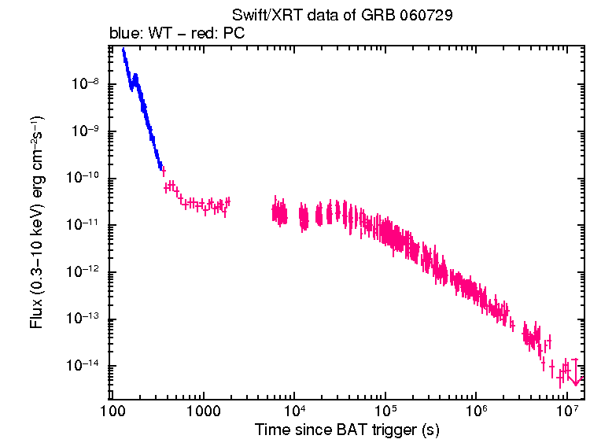
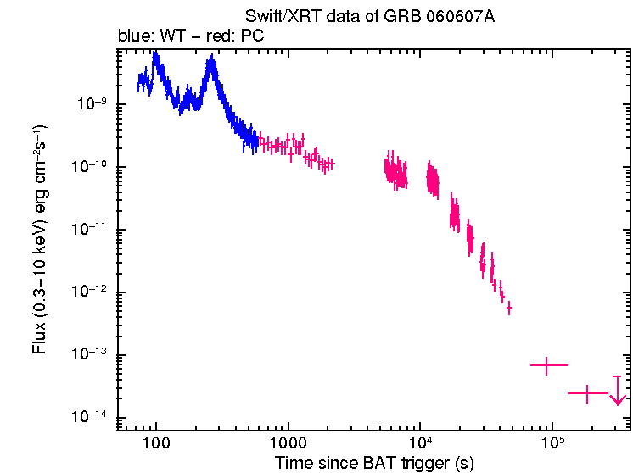
Concerns: robustness of the results
→ constant microphysics parameters ?
→ uniform external medium often found; at odds with expectation for a WR progenitor
• The Swift era: surprises in the early afterglow
plateau phase, flares, steep slopes,…
t ^{-3.2}
New ingredients/paradigm needed !

Slide 15
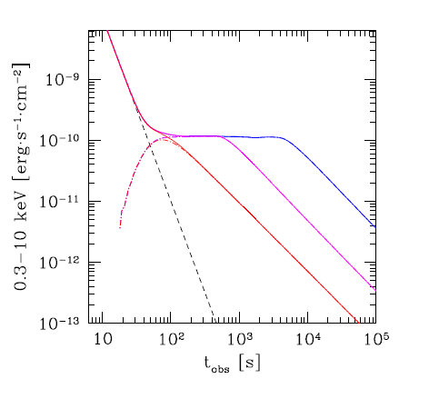
New ingredients
A late activity of the central engine ?
Extended plateaus require large amounts of energy to be injected into the forward shock
E₀ = 10⁵² erg
E_{inj} = k × E₀ with k = 2 , 10 , 100
E_{fs} = E₀ + E_{inj}
→ efficiency crisis for the prompt phase
but
Ex: f_{mes} = 0.1 ; k = 10 , 100 → f_{true} = 0.53 , 0.92 !
An initially inefficient afterglow ?
Let us assume:
• a wind external medium
• ε_{e} ∝ n^{-ν} (n > n_{crit}) and constant for n < n_{crit}
→ flat plateau for ν ~ 1
“missing energy”

Slide 16
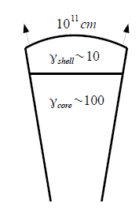
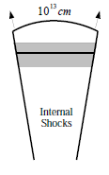
Early deceleration by material surrounding the star
γ ~ 30
coasting phase
deceleration
Duffell & Mac Fadyen, 2014

Slide 17
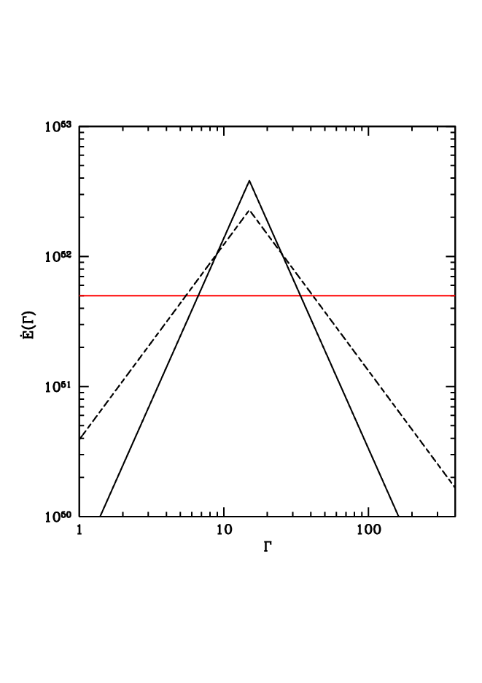
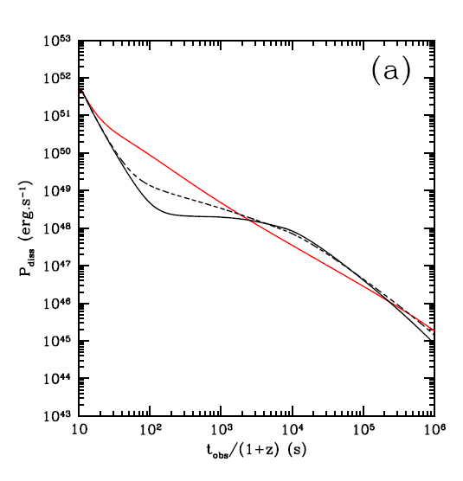
New paradigm
Making the early afterglow with a long-lived reverse shock
Standard picture: the reverse shock is short-lived; it rapidly crosses the high Γ ejecta, heats the electrons
→ slow cooling electrons radiate in optical/IR: early optical flash (GRB 990123; Sari & Piran, 1999)
Alternative proposal: ejecta has a low Γ tail → the reverse shock is long-lived
(Genet et al, 2007; Uhm & Beloborodov, 2007)
Emission from the reverse shock sensitive to the distribution of energy in the ejecta
→ great flexibility in light curve shapes (Uhm et al, 2012)
Plateaus
injected power in the tail

Slide 18
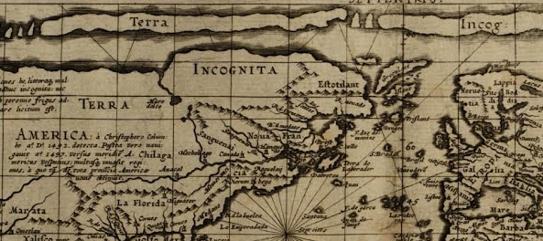
Conclusions
Prompt emission
“Model geopolitics”
territories: | friendly | hostile | Terra incognita
internal shocks | large | quite large | small
photospheric | medium | medium | medium
Reconnection | small | small | large
Afterglow
Life was easy in the pre-Swift era…
XRT findings: Plateau, flares, steep slopes were not expected in the standard model
Several interpretations, none fully convincing
How to make new progress?
• Expect a Rosetta stone burst: GRB 130427A ?
• A new dedicated mission: SVOM (2020)
• The multi-messenger era
neutrinos, cosmic rays, gravitational waves…
→ new clues on GRB physics ? (shock waves, magnetization)

