Slide 1
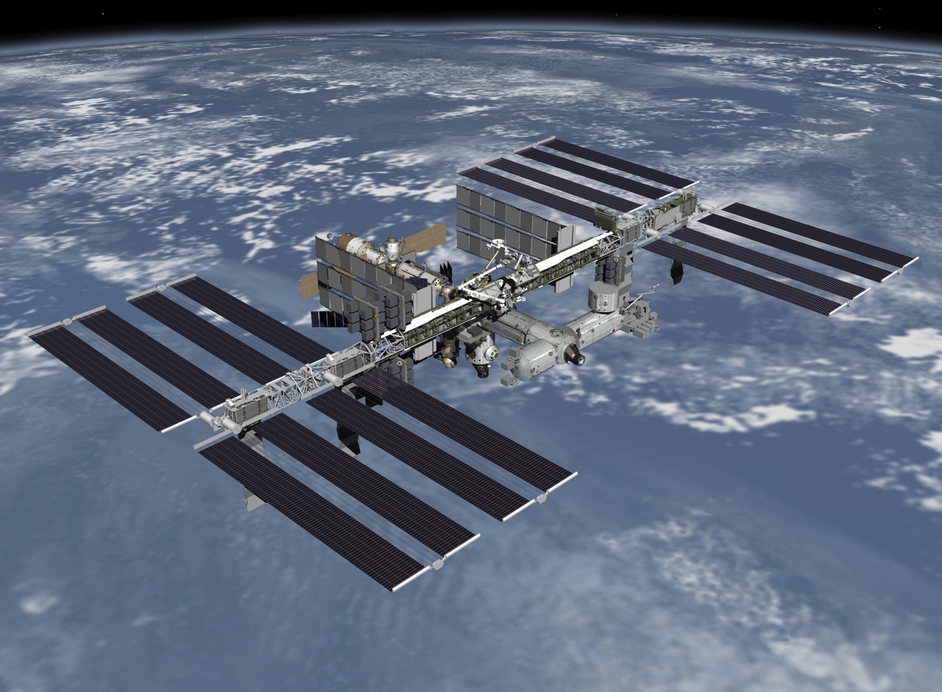




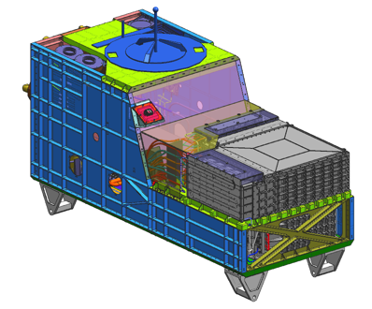
The CALorimetric Electron Telescope (CALET):
A High Energy Cosmic-ray Observatory
on the International Space Station
Shoji Torii
for the CALET Collaboration
Waseda University &
Japan Aerospace Exploration Agency (JAXA)
CALET
Very High Energy Universe in the Universe
Quy Nhon, Vietnam August 4-9, 2014

Slide 2

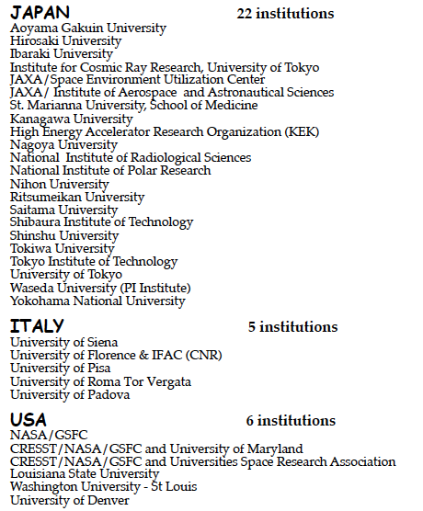





CALET International Collaboration
Waseda University
CALET is a
Recognized
Experiment
ASI
NASA

Slide 3

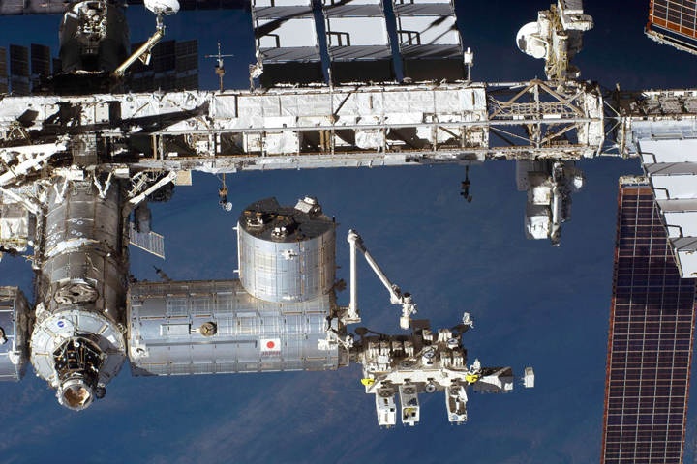
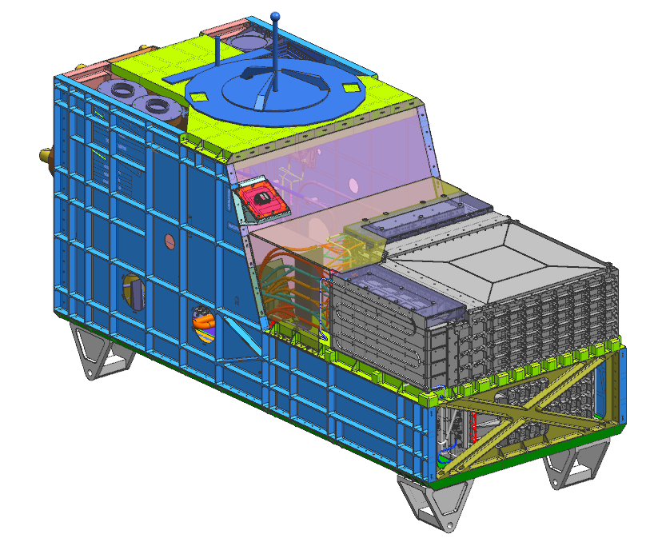
CALorimetric Electron Telescope overview
The CALorimetric Electron Telescope, CALET, project is a Japan-led international mission for the International Space Station, ISS,
in collaboration with Italy and the United States.
Weight: 650 kg
Mission Life: 5 years
Launch Target: by March, 2015
(Fiscal Year 2014)
Gamma - Ray Burst Monitor
JEM-EF Port #9
Calorimeter
The CALET payload will be launched by the Japanese carrier, H-II Transfer Vehicle 5 (HTV5) and robotically attached to the port #9 of the Japanese Experiment Module – Exposed Facility (JEM-EF) on the International Space Station.

Slide 4
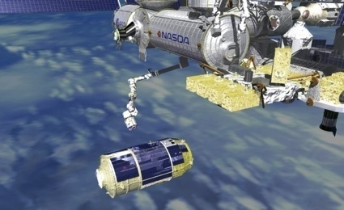
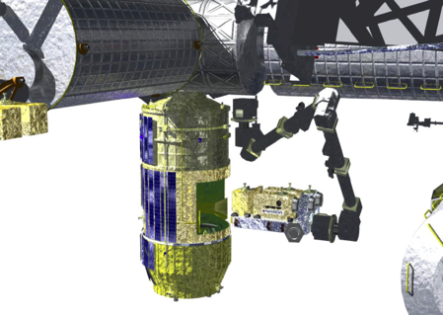
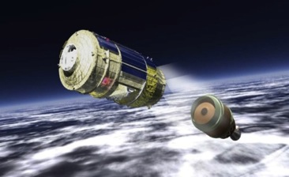
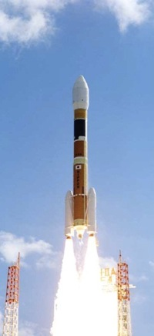
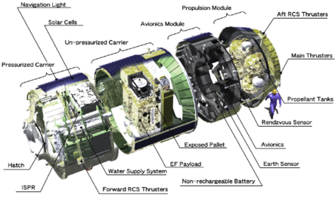
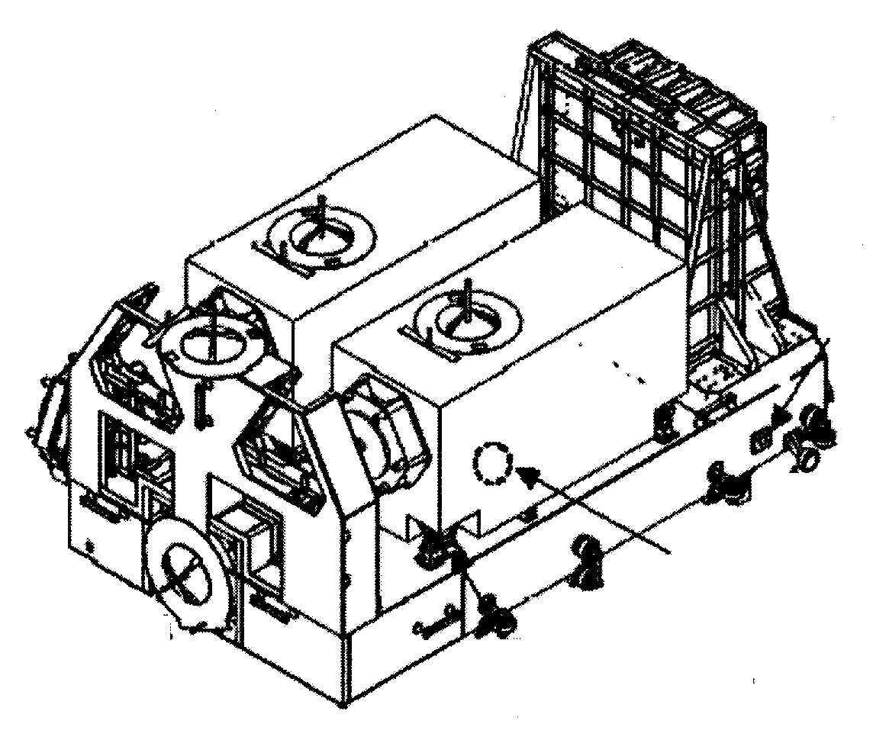
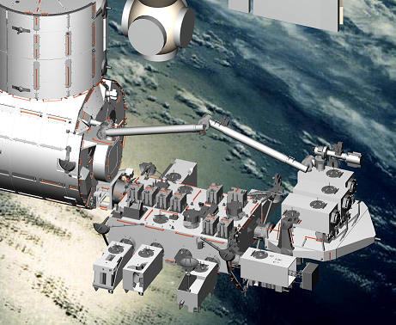
Launching Procedure of CALET
Separation from H2B
ISS
HTV
HTV
Approach to ISS
Pickup of CALET
CALET
Attach to JEM-EF
H2 Transfer Vehicle（HTV)
Launching by
H2B Rocket
CALET
HTV Exposed Palette

Slide 5
CALET Science Goals
The CALET mission will address many of the outstanding questions of
High Energy Astrophysics, such as the origin of cosmic rays,
the mechanism of CR acceleration and galactic propagation,
the existence of dark matter and nearby CR sources.
Science Objectives | Observation Targets
Nearby Cosmic-ray Sources | Electron spectrum into trans-TeV region
Dark Matter | Signatures in electron/gamma energy spectra in the several GeV – 10 TeV range
Cosmic-ray Origin and Acceleration | p-Fe energy spectra up to 10¹⁵ eV and trans-iron elements (Z=26-40) at a few GeV
Cosmic–ray Propagation in the Galaxy | B/C ratio above TeV /nucleon
Solar Physics | Electron flux below 10 GeV
Gamma-ray Transients | Gamma-rays and X-rays in the 7 keV - 20 MeV range

Slide 6

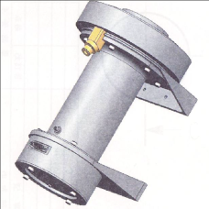
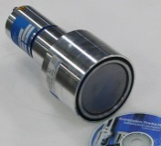
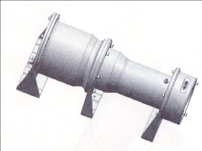
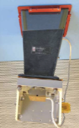
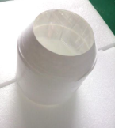

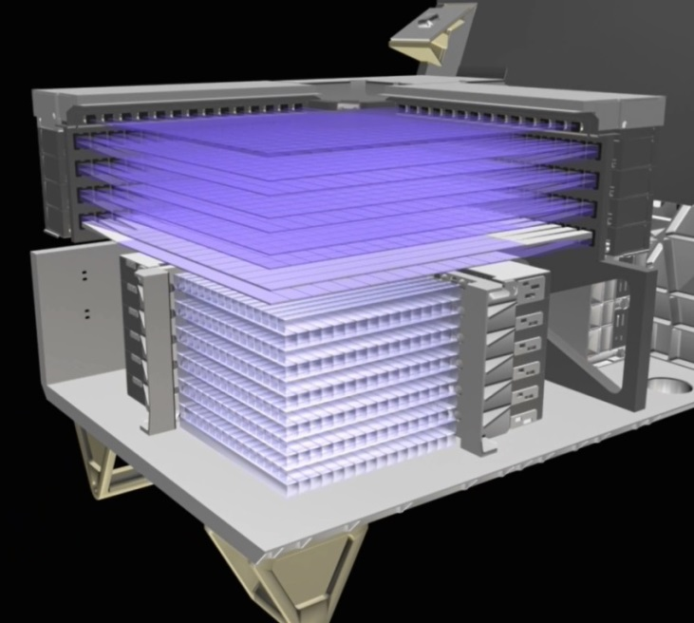
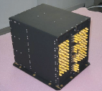
CALET Payload Overview
・ Mass: 650 kg
・ Size (JEM-EF Standard Payload) : L1850 × W800× H1000 mm
・ Power: 650 W（nominal）
・ Data rate： medium 600 kbps, low 35 kbps
HXM x2
7keV-1MeV
CGBM
LaBr₃(Ce)
CGBM/SGM
FRGF (Flight Releasable Grapple Fixture)
SGM x1
0.1-20MeV
CGBM/HXM
ASC (Advanced Stellar Compass)
GPSR
(GPS Receiver)
BGO
CHD-FEC
CHD-FEC
CAL/CHD
CHD
HV Box
(by ASI)
IMC-FEC
IMC-FEC
IMC
CAL/IMC
MDC (Mission Data Controller)
CAL/TASC
TASC-FEC
TASC-FEC
TASC
CAL (CHD/IMC/TASC)

Slide 7
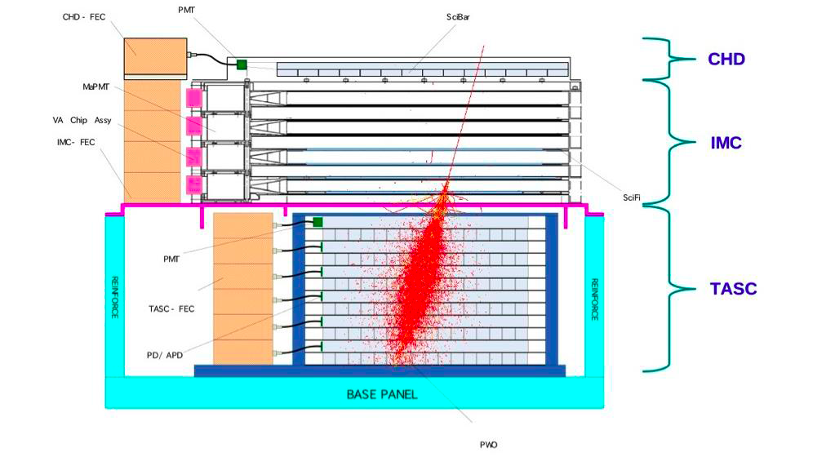
CALET instrument characteristics
Field of view: ~ 45 degrees (from the zenith)
Geometrical Factor: 0.12 m²sr (for electrons)
Unique features of CALET
Thick, fully active calorimeter:
Allows measurements well into
the TeV energy region with
excellent energy resolution
Fine imaging upper calorimeter:
Accurately identify the starting
point of electromagnetic showers.
Detailed shower characterization:
Lateral and longitudinal
development of showers enables
electrons and abundant protons
to be powerfully separated.
45 cm
1 TeV electron shower
 | CHD (Charge Detector) | IMC (Imaging Calorimeter) | TASC (Total Absorption Calorimeter)
Function | Charge Measurement (Z=1-40) | Arrival Direction, Particle ID | Energy Measurement, Particle ID
Sensor (+ Absorber) | Plastic Scintillator : 14 × 1 layer (x,y) Unit Size: 32mm x 10mm x 450mm | SciFi : 448 x 8 layers (x,y) = 7168 Unit size: 1mm² x 448 mm Total thickness of Tungsten: 3 X₀ | PWO log: 16 x 6 layers (x,y)= 192 Unit size: 19mm x 20mm x 326mm Total Thickness of PWO: 27 X₀
Readout | PMT+CSA | 64 -anode PMT(HPK) + ASIC | APD/PD+CSA PMT+CSA ( for Trigger)@top layer

Slide 8
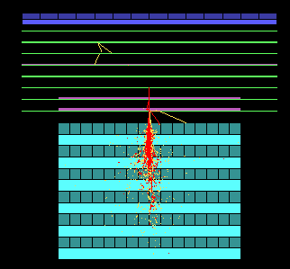
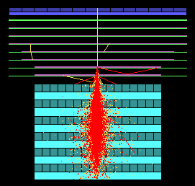
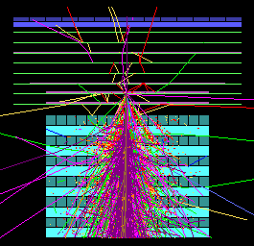

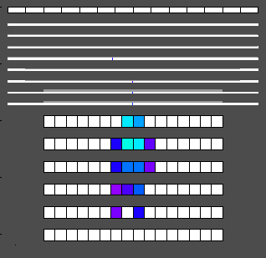
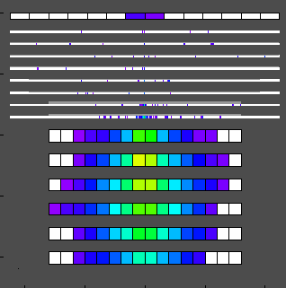
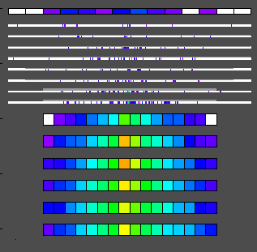
CALET/CAL Shower Imaging Capability (Simulation)
Gamma-ray 10 GeV
Electron 1 TeV
Proton 10 TeV
In Detector Space
Proton rejection power of 10⁵ can be achieved with IMC and TASC
shower imaging capability.
Charge of incident particle is determined to σ_{Z}=0.15-0.3 with the CHD.

Slide 9

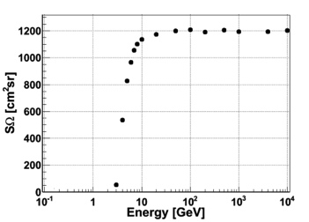
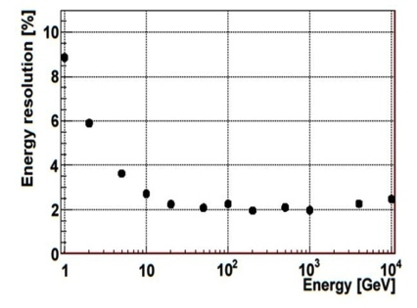
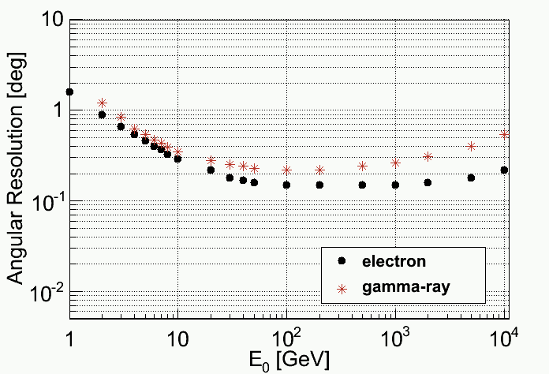
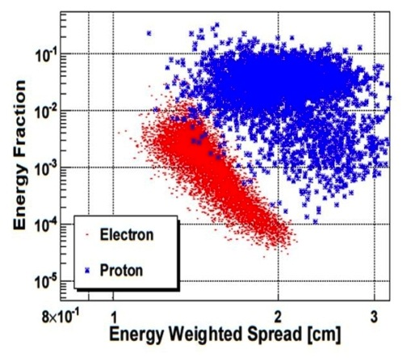
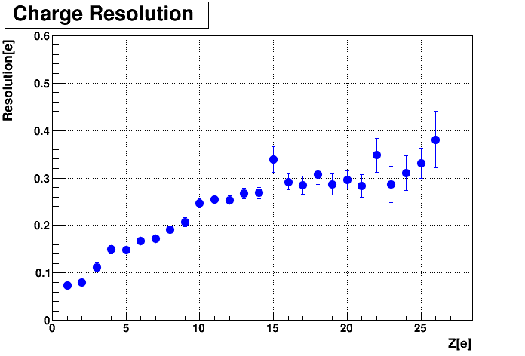
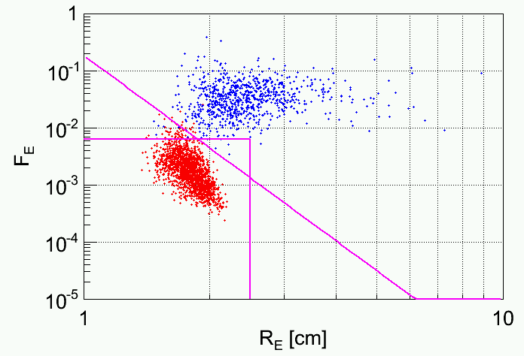
CALET Expected Performance by Simulations
Energy resolution for electrons (>10GeV) :
σ/m = ~2%
Angular resolution for gamma ray (10GeV-1TeV):
σ = 0.2-0.3 deg
Geometrical factor for electrons:
~1200 cm²sr
CHD
Experiment
@CERN-SPS
Proton rejection power at 1TeV ≈10⁵ with 95% efficiency for electrons
Charge resolution:
σ_{Z} = 0.15e(@B) – 0.30e(@Fe)
electrons
protons
electrons
protons
Preliminary
Preliminary

Slide 10
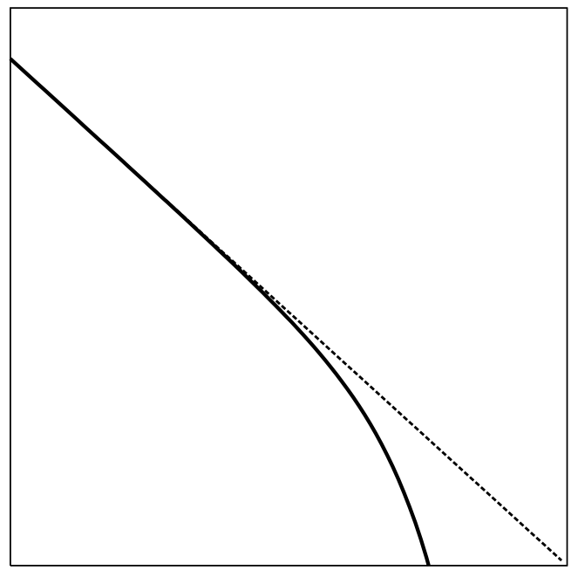
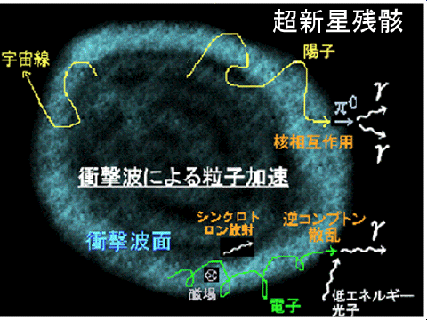
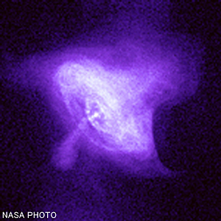
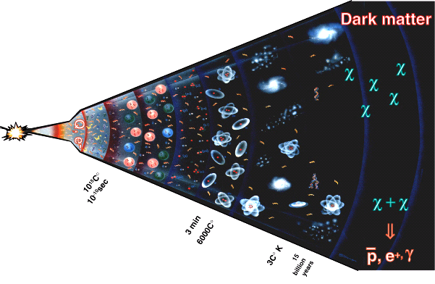
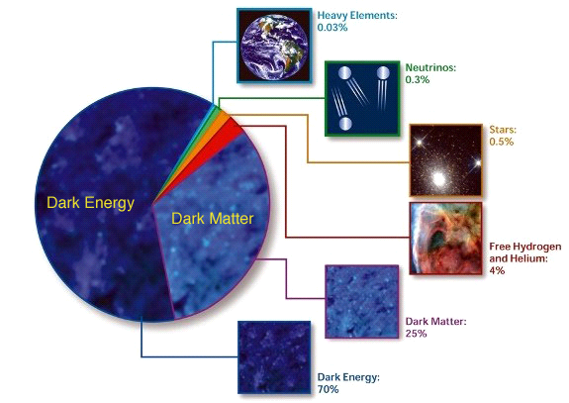
Electron & Positron Origins and Production Spectrum
Astrophysical Origin
Power Law Distribution
with a Cutoff
Shock Wave Acceleration in SNR
Acceleration in PWN
dN/dE ∝ E⁻²exp(-E/E_{c})
Log(dN/dE)
↑
Ec
e⁺+e⁻
etc.
Log(E)
Dark Matter Origin
Evolution of the Universe
Typical Distribution Depending
on the Mass and Type of DM
Constitutes of
the Universe
重元素
宇宙の質量構成比
Heavy Element
宇宙の質量構成比
重元素
重元素
0.03%
0.03%
0.03%
0.03%
ニュートリノ
Neutrino
0.3%
0.3%
ニュートリノ
ニュートリノ
0.3%
0.3%
星
Star
0.
0.
%
５
%
星
５
星
0.
0.
%
５
%
５
暗黒エネルギー
暗黒エネルギー
暗黒エネルギー
暗黒エネルギー
水素、
暗黒エネルギー
Hydrogen、
暗黒エネルギー
暗黒エネルギー
暗黒エネルギー
暗黒物質
暗黒物質
暗黒物質
暗黒物質
ヘリウム
水素、
Helium
暗黒物質
水素、
暗黒物質
暗黒物質
暗黒物質
%
Annihilation of Dark Matter（WIMP)
４
%
４
ヘリウム
ヘリウム
%
４
%
４
χχ→e⁺,e⁻
M_{χ}
暗黒物質
Dark Matter
暗黒物質
暗黒物質
25%
25%
2３%
25%
(ⅰ) Monoenergetic: Direct Production of e+e- pair
（ⅱ）Uniform：Production via Intermediate Particles
（ⅲ）Double Peak： Production by Dipole Distribution
via Intermediate Particles
暗黒エネルギー
Dark Energy
70%
7３%

Slide 11
e± Propagation in the Galaxy

Slide 12

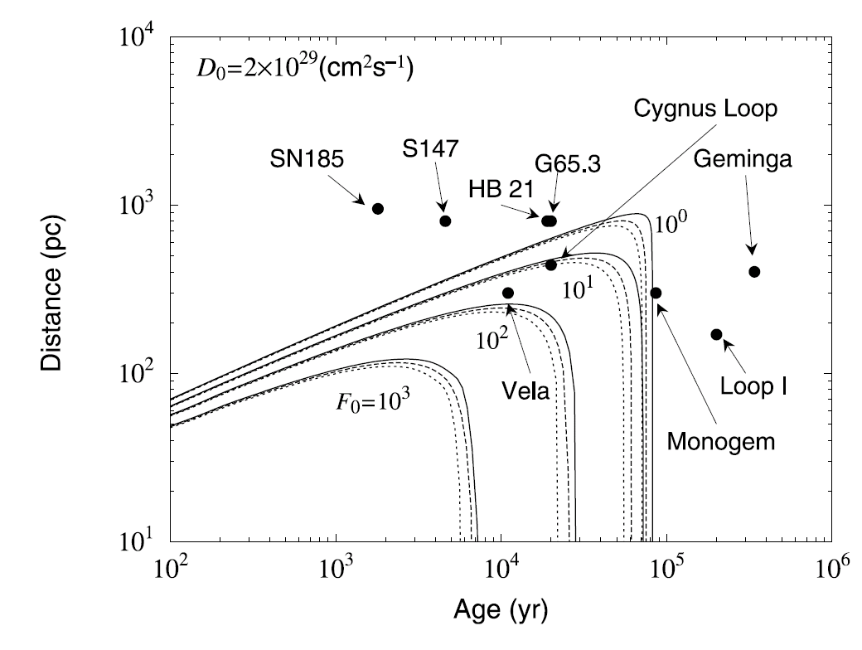
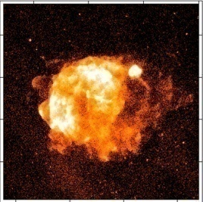
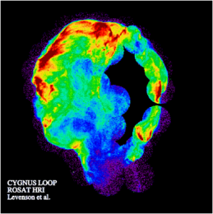
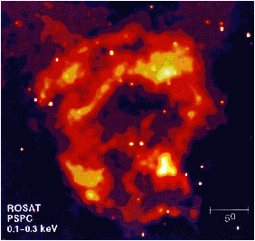
Nearby Sources of Electrons in TeV region
    T (age) = 2.5 ×10⁵ × (1 TeV/E) yr
    R (distance) = 600 × (1 TeV/E)^{1/2} pc
> 1 TeV Electron Source:
Age < a few10⁵ years
very young comparing
to ~10⁷ year at low energies
Distance < 1 kpc
nearby source
Source (SNR) Candidates :
Vela Cygnus Loop Monogem
Unobserved Sources?
Contribution to 3 TeV Electrons
from Nearby Source Candidates
(F₀: E³ x Flux at 3TeV)

Slide 13

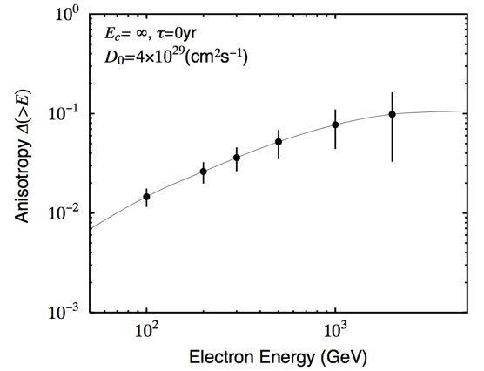
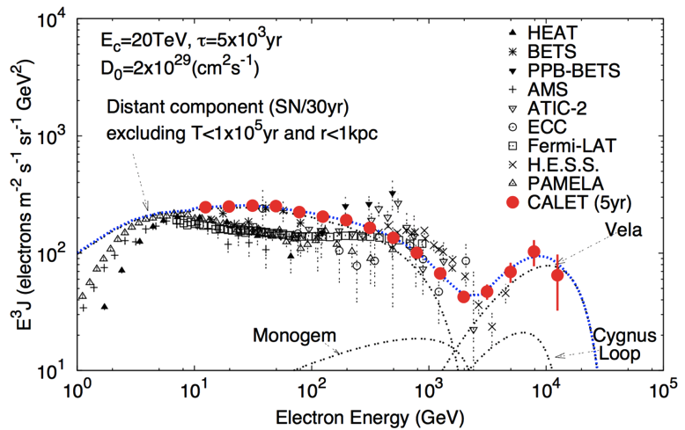
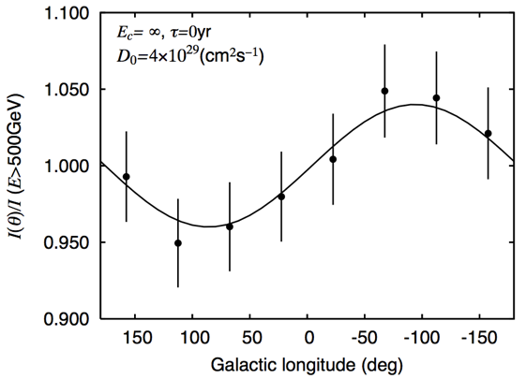
CALET Main Target: Identification of Electron Sources
Some nearby sources, e.g. Vela SNR, might have unique signatures
in the electron energy spectrum in the TeV region (Kobayashi et al. ApJ 2004)
> 10 GeV | ~ 2.7 x 10⁷
>100 GeV | ~ 2.0 x 10⁵
>1000 GeV | ~ 1.0 x 10³
Expected Anisotropy
from Vela SNR
Expected flux
for 5 year mission
~10% @1TeV
Identification of the unique signature from nearby SRNs,
such as Vela in the electron spectrum by CALET

Slide 14
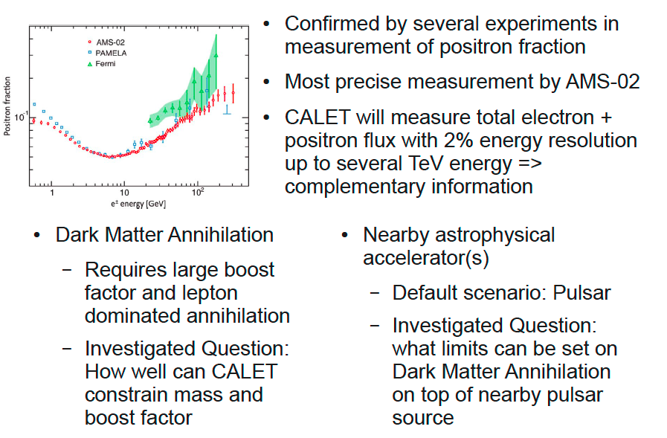
Cosmic Ray Positron Excess

Slide 15

Dark Matter Search by e⁺+e⁻ Observation – LSP decay-
Expected e⁺+e⁻ spectrum by Lightest Super Symmetry Particle (LSP)
after 5-year CALET measurement, which is consistent with present data of positron excess and e⁺+e⁻ spectrum

Slide 16
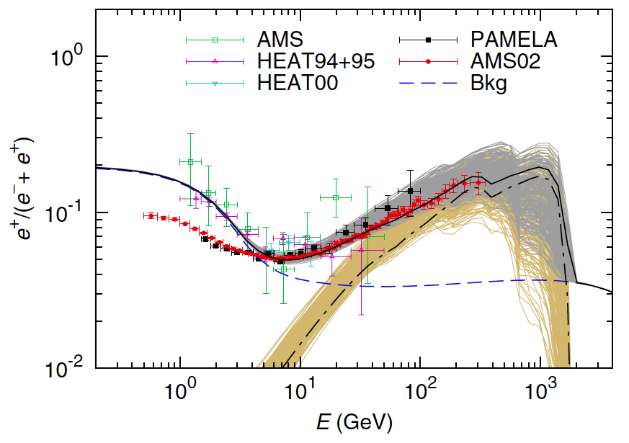
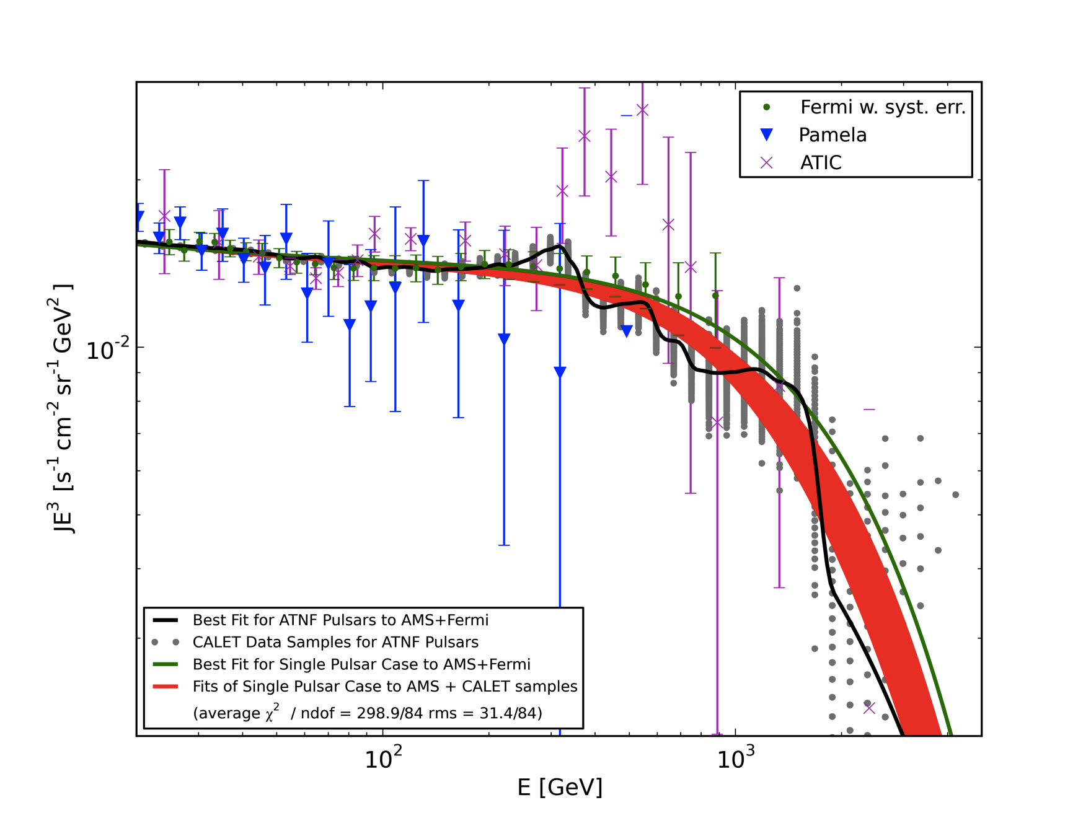
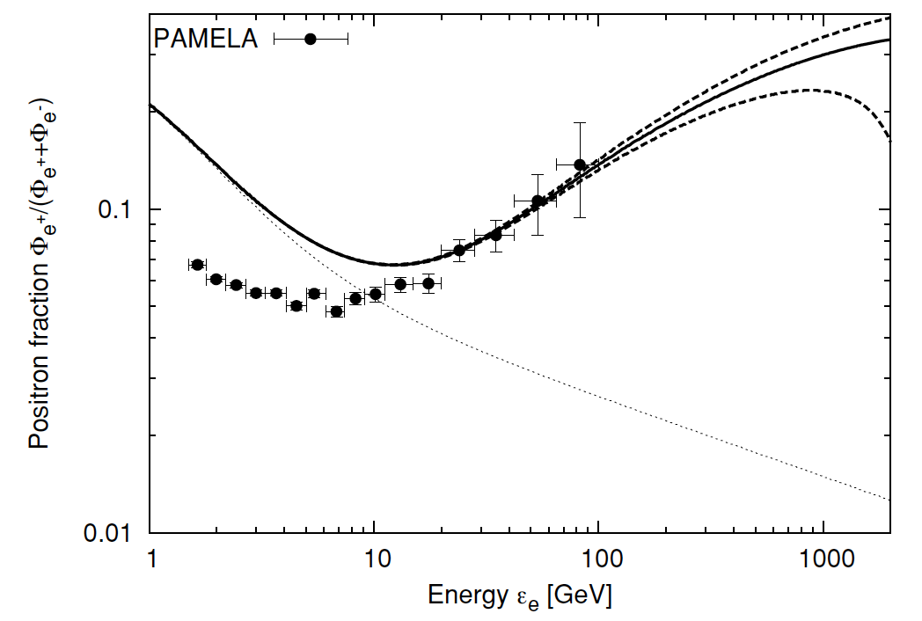
Pulsar Energy Spectrum: Fine Structure
Multiple pulsars make fine structure
Best Fit of e⁺+e⁻ -energy spectrum for ATNF pulsars
from [Malyshev et al. PRD 2009 ] to AMS02+Fermi/LAT
(black line) and of a Single Pulsar spectrum (green line) .
By using 1000 CALET 5-yr samples (grey dots):
− The fine structure (black line) is observable by
CALET thanks to the high energy resolution
− With more than 5σ if the Single Pulsar case is
assumed (red lines).
Yin+ 13
Poisson
dispersion
Kawanaka, KI & Nojiri 10
Large sample(cosmic) variance
at high energy

Slide 17
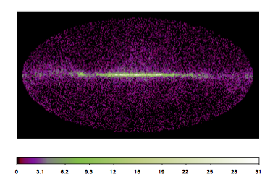
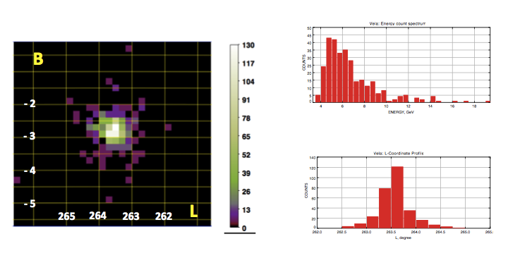

Detection of High Energy Gamma-rays
Performance for Gamma-ray Detection
Simulation of Galactic Diffuse Radiation
Energy Range | 4 GeV-10 TeV
Effective Area | 600 cm² (10GeV)
Field-of-View | 2 sr
Geometrical Factor | 1100 cm²sr
Energy Resolution | 3% (10 GeV)
Angular Resolution | 0.35 ° （10GeV)
Pointing Accuracy | 6′
Point Source Sensitivity | 8 x 10⁻⁹ cm⁻²s⁻¹
Observation Period (planned) | 2014-2019 (5 years)
~25,000 photons are expected per one year
*) ~7,000 photons from extragalactic
γ-background (EGB) each year
Simulation of point source observations in one year
Energy Spectrum
Position
Position
Vela: ~ 300 photons above 5 GeV
Geminga: ~150 photons above 5 GeV
Crab: ~ 100 photons above 5 GeV

Slide 18



Detection Capability of Gamma-ray Lines from Dark Matter
Monochromatic gamma-ray signals from WIMP dark matter annihilation would provide a distinctive signature of dark matter, if detected. Since gamma-ray line signatures are expected in the sub-TeV to TeV region, due to annihilation or decay of dark matter particles, CALET, with an excellent energy resolution of 2- 3 % above 100 GeV, is a suitable instrument to detect these signatures .
Gamma-ray excess in
the Galactic Center?
A 130 GeV line?
Simulated gamma-ray line spectrum for 2yr from neutralino annihilation toward the Galactic center
with m=820GeV, a Moore halo profile, and BF=5

Slide 19

P and He Observation
p and He spectra at TeV are harder than the low-energy spectra and have different slopes in the multi TeV region (CREAM)
Hardening in the p and He at 200 GV observed by PAMELA
➔Hint of concavity due to CR interactions with the shock?
➔Cutoff in the p spectrum (proton knee) ?
➔Different types of sources or acceleration mechanisms?
However AMS-02 did not observe any break or spectral features
CALET expected in 5 y (red points)
Energy reach in 5 years:
Proton spectrum to ≈ 900 TeV
He spectrum to ≈ 400 TeV/n

Slide 20
Intermediate Nuclei to Fe Observation
All primary heavy nuclei spectra well fitted to single power-laws with similar spectral index (CREAM, TRACER)
However hint of a hardening from a combined fit to all nuclei spectra (CREAM)
➔ Possible features (concave spectrum) or spectral breaks?
CALET energy resolution for nuclei 20÷30% independent on energy
CALET expected in 5 y (red points)
CALET energy reach in 5 yr
~20 TeV/n : C, O, Ne, Mg, Si
~10 TeV/n : Fe

Slide 21

B/C ratio measurements by CALET
At high energy (> 10 GeV/n) the B/C ratio measures the energy dependence of the
escape path-length，~E^{-δ}， of CRs from the Galaxy
Data below 100 GeV/n indicate δ~0.6. At high energy the ratio is expected to flatten out (otherwise CR anisotropy should be larger than that observed)
Balloon experiments CREAM and TRACER measured the B/C ratio up to ~1 TeV/n
But: - large statistical error (limited exposure)
- large systematic errors due to corrections for B produced by interaction of
of heavier nuclei with atmosphere
E ^{–δ}
CALET can measure in 5 years the B/C ratio up to 5-6 TeV/n.
CALET measurements in orbit
free from atmospheric production of boron
CALET can also measure the sub-Fe over Fe abundance ratio.
δ＝0.3
δ=0.6

Slide 22


Ultra Heavy Nuclei
Geomagnetic Latitude
CALET (expected) vs. TIGER data
Ultra heavy nuclei abundances provide information on CR site and acceleration mechanism
CHD resolution is ~constant above 600 MeV/n ➔Charge ID from saturated dE/dx
No need to measure energy ➔ No passage through TASC ➔ Large acceptance ~0.4 m²sr
The energy threshold cut is based on the vertical cutoff rigidities seen in orbit
CALET should collect in 5 years 2-4 times the statistics of TIGER, w/o corrections for residual atmosphere overburden

Slide 23








Hardware Development: Structure and Thermal Model (STM)
CHD
IMC
TASC
SciFi Layer
PWO + APD/PD
Plastic Scintillator
+ Light Guide
Structure of IMC
Structure of TASC
Plastic Scintillator Layer
Random Vibration Test
Random Vibration Test
©JAXA

Slide 24









CERN Beam Test using the STM
Beam Test Results
Charge Detector: CHD
Schematic Side View of the Beam Test Model
ΔE-E_{beam}
Imaging Calorimeter: IMC
Electron shower
transition curve
in TASC
The Beam Test Model at CERN SPS H8 Beam Line
Total Absorption Calorimeter: TASC
Angular resolution
for electrons

Slide 25



General Alerts of Transients
LIGO-Virgo MOU
CALET on ISS
TDRSS
DRTS
Counterpart search
Further follow up observations in longer EM wavebands
CGBM data
・TH: Timing Histogram
・PH: Pulse height Histogram
・GRB triggered data
MSFC/NASA
JAXA
Tsukuba SC
CALET Ground System in UOA
Data Processing
in
Waseda CALET Operations Center (WCOC)
GCN, ATel,
Web
Alerts
・GCN:
Gamma-ray Coordinates Network
・ATel:
Astronomer’s Telegram

Slide 26

Conclusions
CALET is a space-based calorimeter designed to perform cosmic ray measurement with high energy resolution, mainly aimed at the electron component
Its main instrument is a deep (27 X₀), homogeneous, segmented PWO calorimeter, which provides both an excellent energy resolution and a high e/p rejection power
CALET will investigate the spectrum of many cosmic ray species in a broad energy range, providing valuable information for indirect DM search, and study acceleration and propagation mechanisms
Development of the CALET flight hardware is now well underway
The CALET project has been approved for flight by HTV-5 to the Japanese Experiment Module (Kibo) , to be launched by March 2015
The expected mission is 5 years
-> electron exposure = 220 m² sr days

Slide 27
Comparison of Space Experiment Performance for e⁺+e⁻
Payload (Launching Date) | Energy Region (GeV) | Energy Resolution | e/p separation | Instruments* | Exposure in 5 years** （m^{２} sr day) | Total Weight (kg)
PAMELA (2006) | 1-700 | 5 % @200 GeV | 10⁵ | Magnet Spectrometer (0.43T) + Sampling Calorimeter (Si＋W: 16 X₀) +TOF+ Neutron Detector | ~ 4 | 470
FERMI/LAT (2008) | 20-1,000 | 5-20 % (20-1000 GeV) | 10³-10⁴ (20-1000GeV) Increase with Energy | ACD Detector +Tracking Calorimeter (Si＋W: 1.5X₀) +CsI Cal. (8.6X₀) | 1500@TeV | 7.000
AMS-02 (2011) | 1-2,000 (~800) | ～10 ％ ＠100 GeV | 10⁴ -10⁵ | Magnet Spectrometer (0.15T) + Sampling Calorimeter (SciFi + Pb: 17X_{o}) +TOF+TRD+RICH | 55@2TeV (170@800GeV) | 7,000
CALET (2014) | 1-20,000 | ~2 % (>10 GeV) | ~10⁵ Mostly Energy Independent | Imaging Calorimeter (W+SciFi: 3 X_{o}) + Total Absorption Cal. (PWO : 27 X_{o}) ＋Charge Detector (SCN) | 220 | 650
DAMPE* (China：2015?) | 5-10,000 | ~1.5 % | ~10⁵ | Silicon Tracker +Total Absorption Cal. (BGO: ~31 X₀) +ACD Detector +Neutron Detector | 900 | 1,500
GAMMA-400* (Russia：2017?) | 1-sevral 10,000 | ~1 % (>100GeV) | ~4x10⁵ | Imaging Calorimeter (2X₀) + Main Calorimeter- calocube (25 X₀) | 730(vertical) x10 (all) | 1,700
*) Estimated from Presentations

Slide 28


Slide 29





Model Dependence of Energy Spectrum and Nearby Source Effect
Ec: Cutoff Energy ΔT: Acceleration Period D: Diffusion Constant at 1 TeV (∝E^{0.6})
Ec=∞、 ΔT=0 yr, Do=2x10²⁹ cm²/s
Do=5 x 10²⁹ cm²/s
uniform source distribution
Ec= 20 TeV
Ec=20 TeV、 ΔT=10⁴ yr
Kobayashi et al. ApJ (2004)

Slide 30
Gamma Line: Differences to HESS
● Very stringent limit but localized search.
● Max. 1.58 deg distance from GC only
● Limit depends on halo profile, used Einasto profile with general factor for
subhalo distribution
● Could have missed nearby subhalos
(extragalactic search also because data from point source observation)
● Wide (2 sr) field of view
● Search in outer regions of galactic halo
– less dependent on halo profile, extragalactic background only
● Certain to see nearby subhalos providing large boost factor
● Up to larger energy than Fermi-LAT

Slide 31

Energetics
U(proton)
~1eV/cm³
← Supernova
remnants
U(electron)
~10⁻²eV/cm³
U(positron)
~10⁻³eV/cm³
~ 0.1% of p
Even less @TeV
ε^{-2.7}
0903.1987

Slide 32


Slide 33


Slide 34

Expected Allowed Region for LKP
Tested several Dark Matter candidate particles scanning the mass from
200 GeV to 4 TeV for ability to explain positron excess only by emission
from annihilation – given a sufficiently high boost factor
If fit without pulsar term to AMS-02 and Fermi/LAT data gives χ2 <95%CL: allowed model => LKP allowed for mass > 500 GeV => Range of boost factor with χ2 <95% CL: allowed region (blue region)
Assuming m(LKP)=1000 GeV the allowed region can be significantly reduced by including CALET data (red region)
Assuming the Pulsar Case, a much smaller contribution from Dark Matter would already be excluded (red line)

Slide 35





Characteristics of HXM and SGM in CGBM
HXM
SGM
LaBr₃
BGO

Slide 36

CALET GRB performance
Broad energy range (from few keV X-rays to GeV-TeV gamma-rays):
long-duration GRBs, short-duration GRBs, X-ray flashes and GeV GRBs.
Sensitivity of CGBM: ~10⁻⁸ ergs cm⁻² s⁻¹ (1-1000 keV) for 50 s long bursts.
Parameters | CAL | CGBM
Energy range | 1 GeV - 10 TeV (GRB trigger) | HXM: 7 keV - 1 MeV (goal 3 keV - 3 MeV) SGM: 100 keV - 20 MeV (goal 30 keV - 30 MeV)
Energy resolution | 3% (10 GeV) | HXM: ~3% (662 keV) SGM: ~15% (662 keV)
Effective area | ~600 cm² (10 GeV) | 68 cm² (2 HXMs), 82 cm² (SGM)
Angular resolution | 2.5° (1 GeV) 0.35° (10 GeV) | -
Field of view | ~45° (~2 sr) | ~3 sr (HXM), ~4π sr (SGM)
Dead time | 2 ms | 40 µs
Time resolution | 62.5 µs | GRB trigger: 62.5 µs (event-by-event data) Normal mode: 125 ms with 8 ch, 4 s with 512 ch (histogram data)
Notes:
N: (Yamaoka) The deadtime for the CAL is now 5.8 ms, not 2 ms. Finally it will be > 2 ms, still to confirmed.

Slide 37

CALET Science Data Flow
Collaboration with
LIGO/Virgo

