Slide 1


Recent results
of the KLOE-2 Experiment
Paweł Moskal
Jagiellonian University, Cracow, Poland
On behalf and for the KLOE and KLOE-2 Collaborations
-Xth Rencontres du Vietnam,
Flavour Physics Conference
Quy Nhon, July 27th – August 2nd, 2014
Notes:
1
1
One of the main purpose of KLOE are studies of the CPT symmetrie using quantum entangled kaons….
Interferometry of entangled pairs (long lived) provides unique opportunities.
Today I will talk about hadron physics studies at KLOE and…

Slide 2
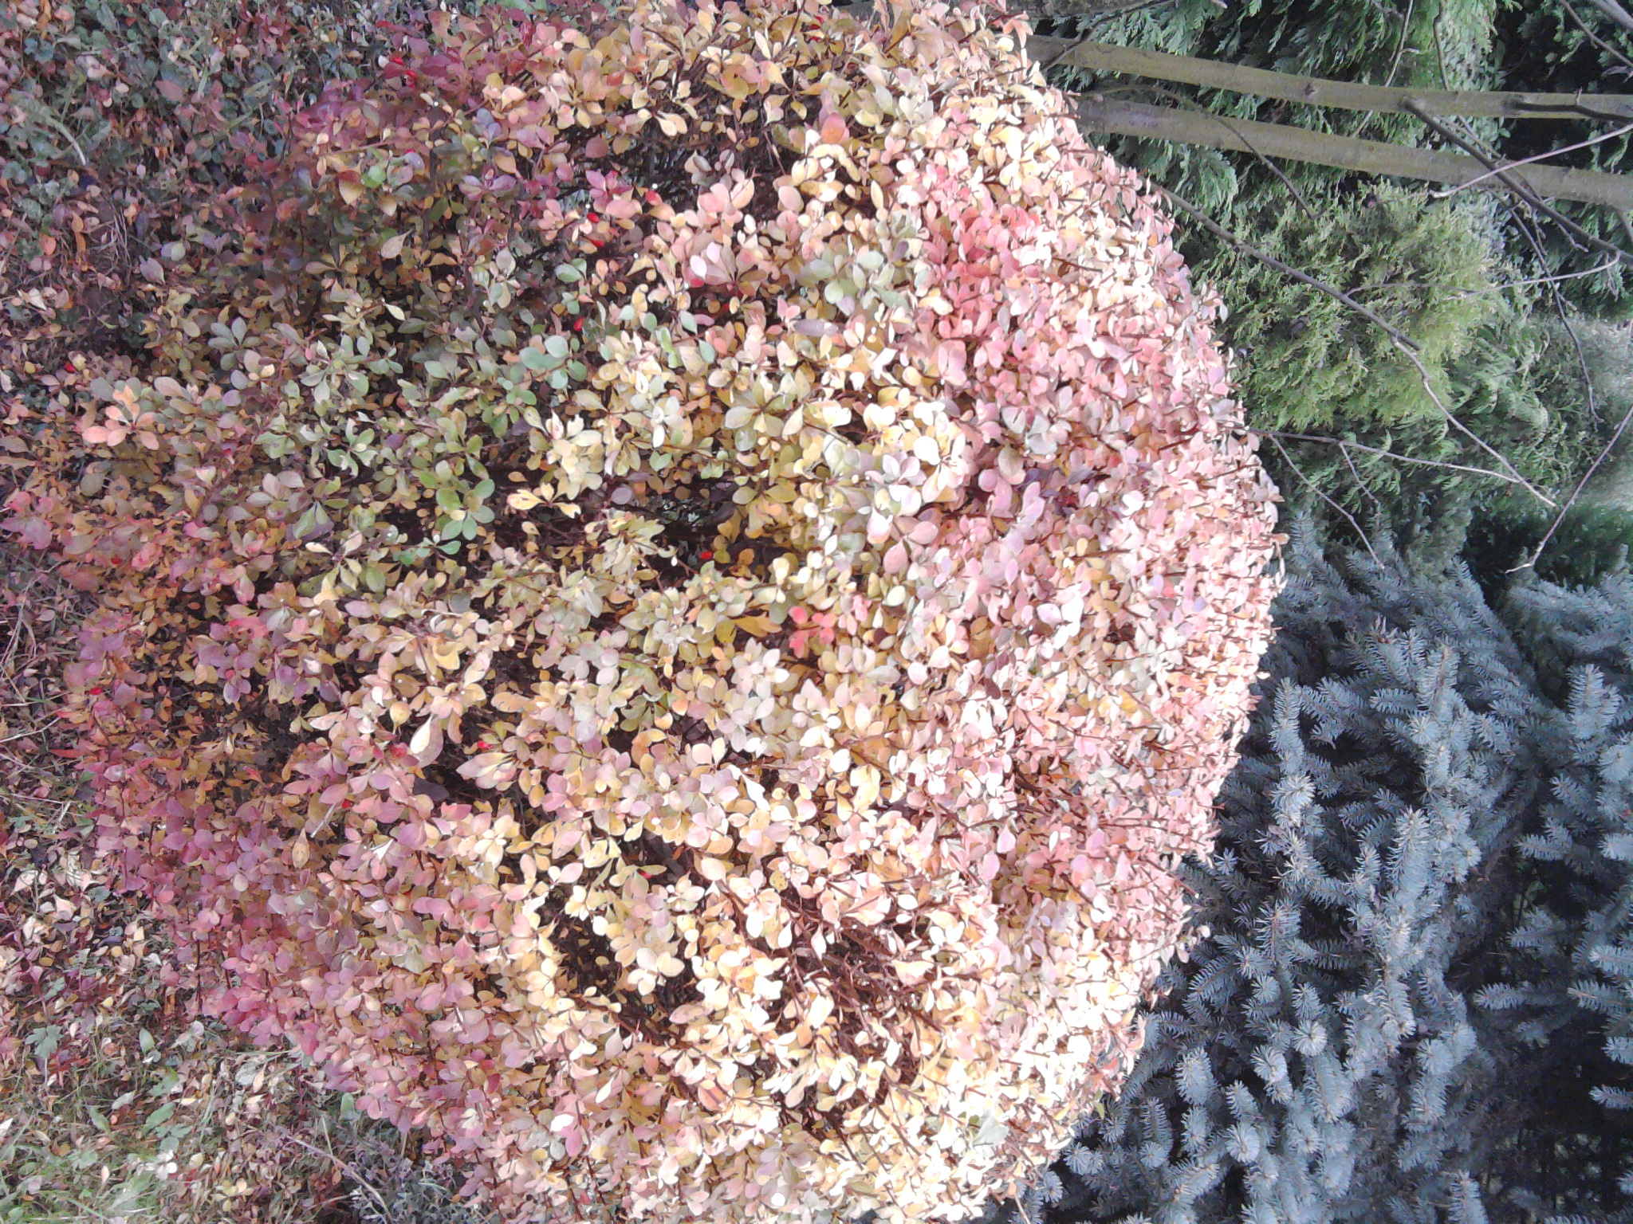
Indeed recent results of KLOE/KLOE-2:
A new limit on the CP violating decay K_{S}→3π⁰
Phys. Lett. B 723 (2013) 54
Test of CPT and Lorentz symmetry
Phys. Lett. B 730 (2014) 89
The absolute branching ratio of the K⁺→ π⁺π⁻π⁺(γ)
arXive: 1407.2028
Production:
test of charge symmetry
search for the eta-mesic nuclei
studies of ABC effect – new resonance?
hadronic interactions …
Notes:
contributing to the study of the muon
anomalous magnetic moment
Jakos to poskladac do kupy … dlaczego eta SM etc…
Polaczyc z nastepna strona i nawiazac podobnie as two years ago I will repeat since …than to Falsify the theory !!!
With Wasa at COSY we study both production and decays of the eta-meson but Today I will concentrate
of decays which is also a primordial aim of the experiment
In general we search for the phenomena which cannot be describe by the Standard Model…

Slide 3
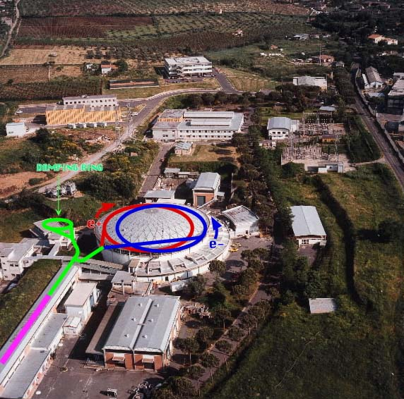

DAΦNE e⁺e⁻ collider Frascati (Rome)‏
BR’s for selected φ decays
KLOE Detector
K⁺K⁻
49.1%
e⁺
K_{S}K_{L}
34.1%
e⁻
ρπ +π⁺π⁻π⁰
15.5%
η γ
1.3 %
η’ γ
0.006%
e⁺e⁻ → φ √s ~ m_{φ} = 1019.4 MeV
KLOE completed data taking in 2005 with 2.5 fb⁻¹
corresponding to ~ 8 ∙ 10⁹ φ , ~ 10⁸ η and ~ 5 ∙ 10⁵ η’
Notes:
3

Slide 4
KLOE
completed data taking with 2.5 fb⁻¹
~ 8 ∙ 10⁹ φ
~ 2.5 10⁹ K⁰K⁰ entangled pairs
~ 3.6 10⁹ K⁺K⁻ pairs
this presentation is based on
~ 3 · 10⁷
Notes:
So how many eta meson we have?
What is the level we can reach ?
And THIS IS THE NUMBER I WOULD LIKE YOU TO REMEMBER !!!
10^9 but Today, The analysis just started or is in progress, Today I will report results from the eralier experimental compaigns wih the
3^10^7 eta meson reconstructed…

Slide 5
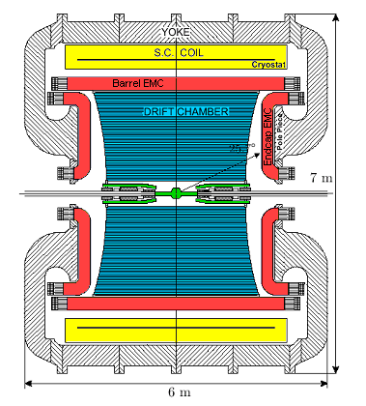
KLOE
K LOng Experiment
Drift chamber
Gas: 90% He + 10% C₄H₁₀
δp_{t} / p_{t} < 0.4% (θ>45°)
σ_{xy} ≈ 150 μm ; σ_{z} ≈ 2 mm
EM calorimeter
lead/scintillating fibers
98% solid angle coverage
σΕ / E = 5.7% / √(E(GeV))
σt = 55 ps / √(E(GeV))⊕100 ps
PID capabilities
Magnetic field 0.52 Tesla
Notes:
Collision of e+ and e- is inside the detector… pi produced almost at rest with a small transversal momentum of fewXXX MeV

Slide 6
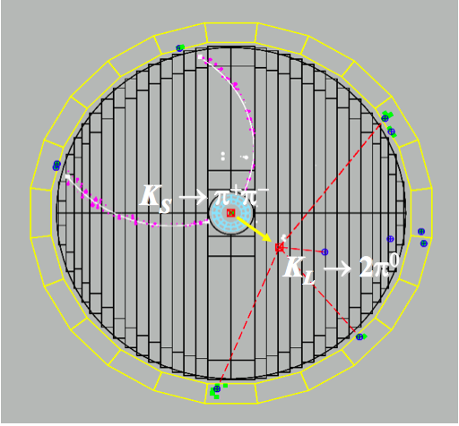
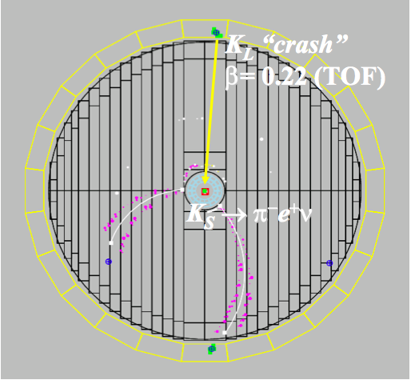
Ks tagging a unique feature at KLOE
e⁺e⁻ → φ → K_{S}K_{L} (K⁺ K⁻)
φ: J^{CP} = 1⁻⁻ K_{S}K_{L} are quantum entangled
e⁺e⁻ → φ →|K_{S,}p>|K_{L,}-p> -|K_{S,}-p>|K_{L,}p>
KLOE: τ_{S} = 89.56 ± 0.03 ± 0.07 ps ( ~0.1%)
SETP0 KLOE-2 5 fb⁻¹ ( ~0.03 %)

Slide 7
Indeed recent results of KLOE/KLOE-2:
A new limit on the CP violating decay K_{S}→3π⁰
Phys. Lett. B 723 (2013) 54
Test of CPT and Lorentz symmetry
Phys. Lett. B 730 (2014) 89
The absolute branching ratio of the K⁺→ π⁺π⁻π⁺(γ)
arXive: 1407.2028
Production:
test of charge symmetry
search for the eta-mesic nuclei
studies of ABC effect – new resonance?
hadronic interactions …
Notes:
contributing to the study of the muon
anomalous magnetic moment
Jakos to poskladac do kupy … dlaczego eta SM etc…
Polaczyc z nastepna strona i nawiazac podobnie as two years ago I will repeat since …than to Falsify the theory !!!
With Wasa at COSY we study both production and decays of the eta-meson but Today I will concentrate
of decays which is also a primordial aim of the experiment
In general we search for the phenomena which cannot be describe by the Standard Model…

Slide 8
50th anniversary of the discovery of CP violation
J. H. Christenson, J. W. Cronin, V. L. Fitch, R. Turlay
"Evidence for the 2π Decay of the K⁰₂ Meson System".
Physical Review Letters 13 (1964) 138
CP allowed: K_{L}→πππ CP violating: K_{L} → ππ
CP allowed: K_{S} →ππ CP violating: K_{S} →π⁰π⁰π⁰
CP violating: K_{S} → π⁰π⁰π⁰
never observed so far !
SM Γ(K_{S}→3π⁰) = Γ(K_{L}→3π⁰) |η₀₀₀|² ⇒ BR(K_{S}→3π⁰) ~ 2×10⁻⁹

Slide 9
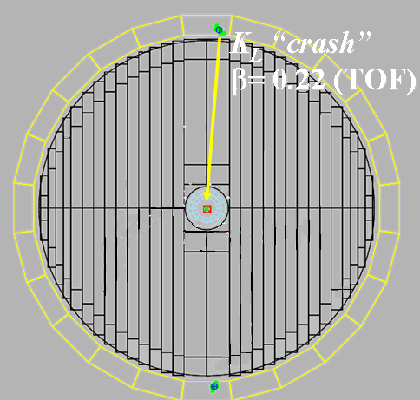
SELECTION OF K_{S} →π⁰π⁰π⁰ events
SIGNAL BACKGROUND
γ
γ
γ
γ
γ
γ
γ
γ
γ
γ
γ
γ
γ
Splitted clusters
K_{S} → 3π⁰ → 6γ K_{S} → 2π⁰ + 2 splitted clasters / accidental
coincidences DAPHNE
K_{L} → 3π, K_{S} → π⁺ π⁻ („fake K_{L} crash”)

Slide 10
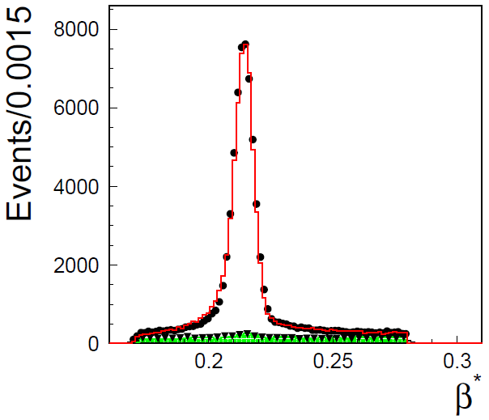
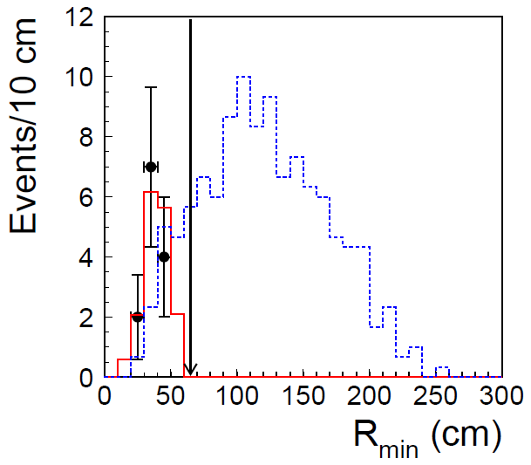
K_{L} selection
Final stage of Ks → 3π⁰ selection
K_{L} velocity in the φ meson center of mass
for events in the six-photon sample.
Black points represent data.
Lines denote results of background simulations.
Green colour indicates events rejected by „track veto”
Black points represents data.
Solid red line: background simulations
Blue dashed line: Ks →3π⁰ simulations

Slide 11



50th anniversary of the discovery of CP violation
J. H. Christenson, J. W. Cronin, V. L. Fitch, R. Turlay
"Evidence for the 2π Decay of the K⁰₂ Meson System".
Physical Review Letters 13 (1964) 138
CP allowed: K_{L}→πππ CP violating: K_{L} → ππ
CP allowed: K_{S} →ππ CP violating: K_{S} →π⁰π⁰π⁰
CP violating: K_{S} →π⁰π⁰π⁰
never observed so far !
SM Γ(K_{S}→3π⁰) = Γ(K_{L}→3π⁰) |η₀₀₀|² ⇒ BR(K_{S}→3π⁰) ~ 2×10⁻⁹
KLOE/KLOE-2: Phys. Lett. B 723 (2013) 54
Factor of five better than previous results
KLOE-2 has a chance to observe K_{S} - -> π⁰π⁰π⁰ decay
for the first time in the near future

Slide 12
Indeed recent results of KLOE/KLOE-2:
A new limit on the CP violating decay K_{S}→3π⁰
Phys. Lett. B 723 (2013) 54
Test of CPT and Lorentz symmetry
Phys. Lett. B 730 (2014) 89
The absolute branching ratio of the K⁺→ π⁺π⁻π⁺(γ)
arXive: 1407.2028
Upper limit improved by a factor of five
Production:
test of charge symmetry
search for the eta-mesic nuclei
studies of ABC effect – new resonance?
hadronic interactions …
Notes:
contributing to the study of the muon
anomalous magnetic moment
Jakos to poskladac do kupy … dlaczego eta SM etc…
Polaczyc z nastepna strona i nawiazac podobnie as two years ago I will repeat since …than to Falsify the theory !!!
With Wasa at COSY we study both production and decays of the eta-meson but Today I will concentrate
of decays which is also a primordial aim of the experiment
In general we search for the phenomena which cannot be describe by the Standard Model…

Slide 13
1964: CP violation discovered K_{L} → ππ
J. H. Christenson et al., Phys. Rev. Lett. 13 (1964) 138
2012: T violation confirmed experimentally for the first time
BABAR: J. P. Lees et al., Phys. Rev. Lett. 109 (2012) 211801
So now is the time for the observation of CPT violation !!
I thought… the scientific theories were not the digest of observation,
but that they were inventions-conjectures boldly put forward for trial
to be eliminated if they clashed with observation …
David Hume
Since nothing is more pleasurable than to falsify the theory !!
Notes:
Phenomena which cannot be explained in the framework of the SM

Slide 14
Tests of CPT symmetry
LORENTZ SYMMETRY,
UNITARITY,
LOCALITY
➔
C P T
G. Lüders, Ann. Phys. 2 (1957) 1.; Ann. Phys. 281 (2000) 1004 „Proof of the TCP theorem”
Nothing would be more pleasurable
than to falsify the theory !!
especially such strong as CPT

Slide 15
Kaon interferometry: φ →K_{S}K_{L}→π⁺π⁻ π⁺π⁻
φ:J^{CP} = 1⁻⁻ e⁺e⁻ → φ →|K_{S,}p>|K_{L,}-p> -|K_{S,}-p>|K_{L,}p>
Δt=t₁-t₂
Δm from here
π
π
φ
I(Δt) (a.u)‏
π
t₁
t₂
π
Perfect vertex resolution
no simultaneous decays
(Δt=0) in the same
final state due to the
destructive
quantum interference
Δt/τ_{S}
Notes:
15

Slide 16
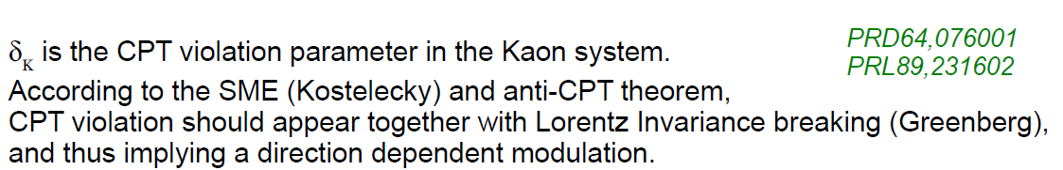
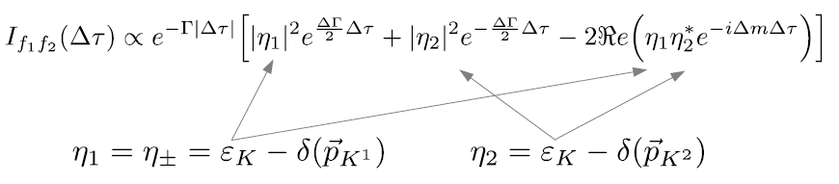
|K_{S}(t)> = e^{-λst}|K_{S}>
|K_{L}(t)> = e^{-λLt}|K_{L}>
|K_{S}> ≈ (1+ε_{s})|K⁰> + (1-ε_{s})|K⁰>
|K_{L}> ≈ (1+ε_{L})|K⁰> - (1-ε_{L})|K⁰>
δ = (ε_{s} – ε_{L} )/2
δ

Slide 17
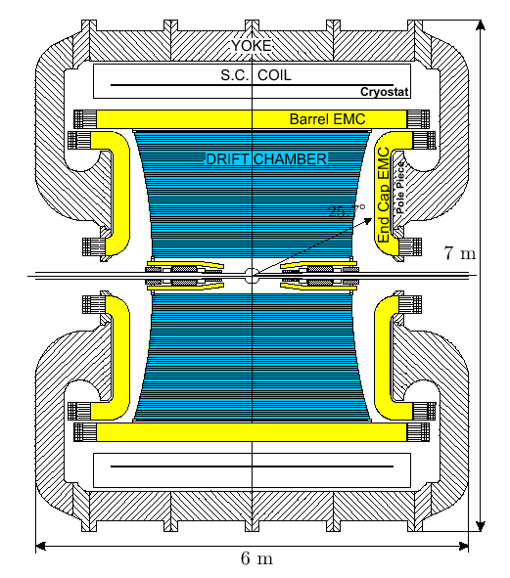
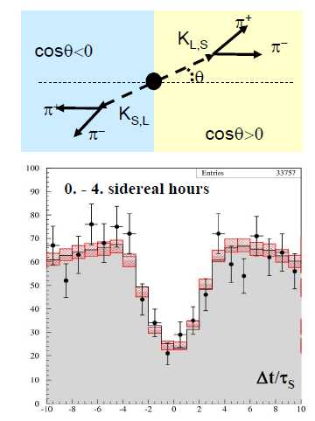
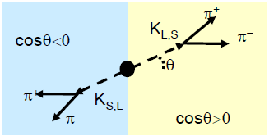
Kaon interferometry and CPT tests
φ
Δt=t₁-t₂
π
π
φ
π
t₁
t₂
π

Slide 18
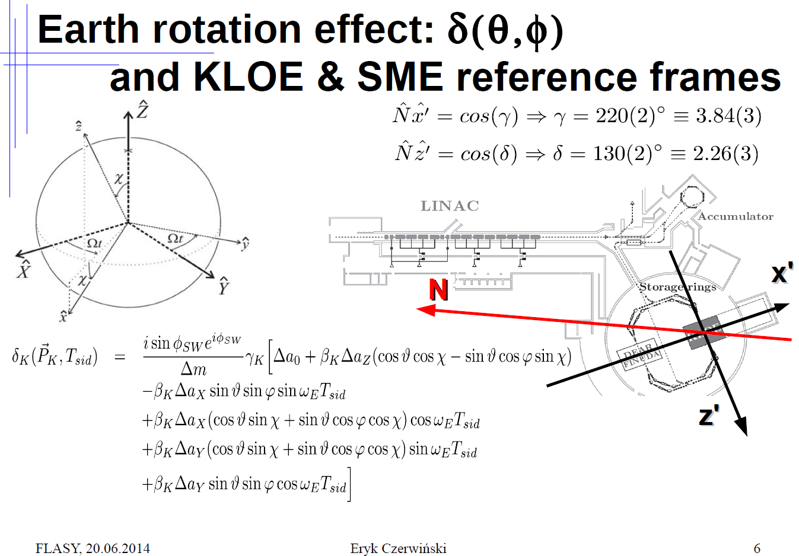

Slide 19
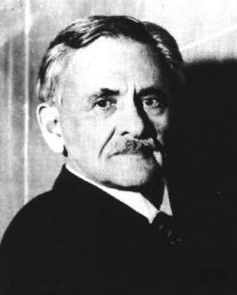
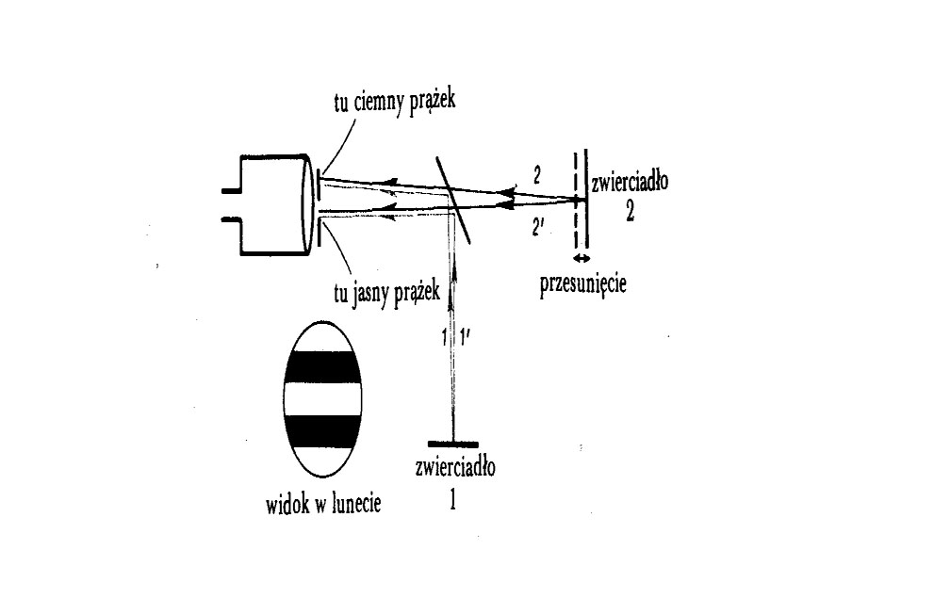
A . A. Michelson, Am. J. Sci. 22 (1881) 120.
interference fringes
Strzelno 1852
10⁻²⁰ ← PRECYZJA → 0.01
V_Ziemi 30 km/s ➔ 0.04 prążka dokładność uzyskana wyniosła 0.01
k = 0 dowodzi, że prędkość światła jest niezależna od kierunku

Slide 20
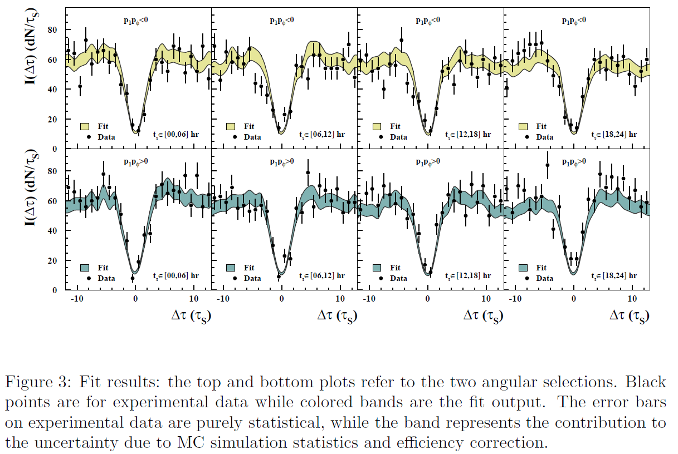
KLOE-2: Phys. Lett. B 730 (2014) 89

Slide 21
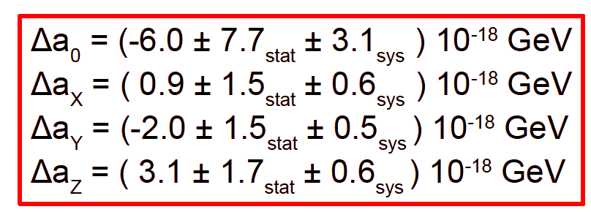
KLOE-2: Phys. Lett. B 730 (2014) 89

Slide 22
KLOE-2: Phys. Lett. B 730 (2014) 89
The best sensitivity ever reached in the quark sector

Slide 23
Indeed recent results of KLOE/KLOE-2:
A new limit on the CP violating decay K_{S}→3π⁰
Phys. Lett. B 723 (2013) 54
Test of CPT and Lorentz symmetry
Phys. Lett. B 730 (2014) 89
The absolute branching ratio of the K⁺→ π⁺π⁻π⁺(γ)
arXive: 1407.2028
Upper limit improved by a factor of five
The best sensitivity ever reached in the quark sector
Production:
test of charge symmetry
search for the eta-mesic nuclei
studies of ABC effect – new resonance?
hadronic interactions …
Notes:
contributing to the study of the muon
anomalous magnetic moment
Jakos to poskladac do kupy … dlaczego eta SM etc…
Polaczyc z nastepna strona i nawiazac podobnie as two years ago I will repeat since …than to Falsify the theory !!!
With Wasa at COSY we study both production and decays of the eta-meson but Today I will concentrate
of decays which is also a primordial aim of the experiment
In general we search for the phenomena which cannot be describe by the Standard Model…

Slide 24
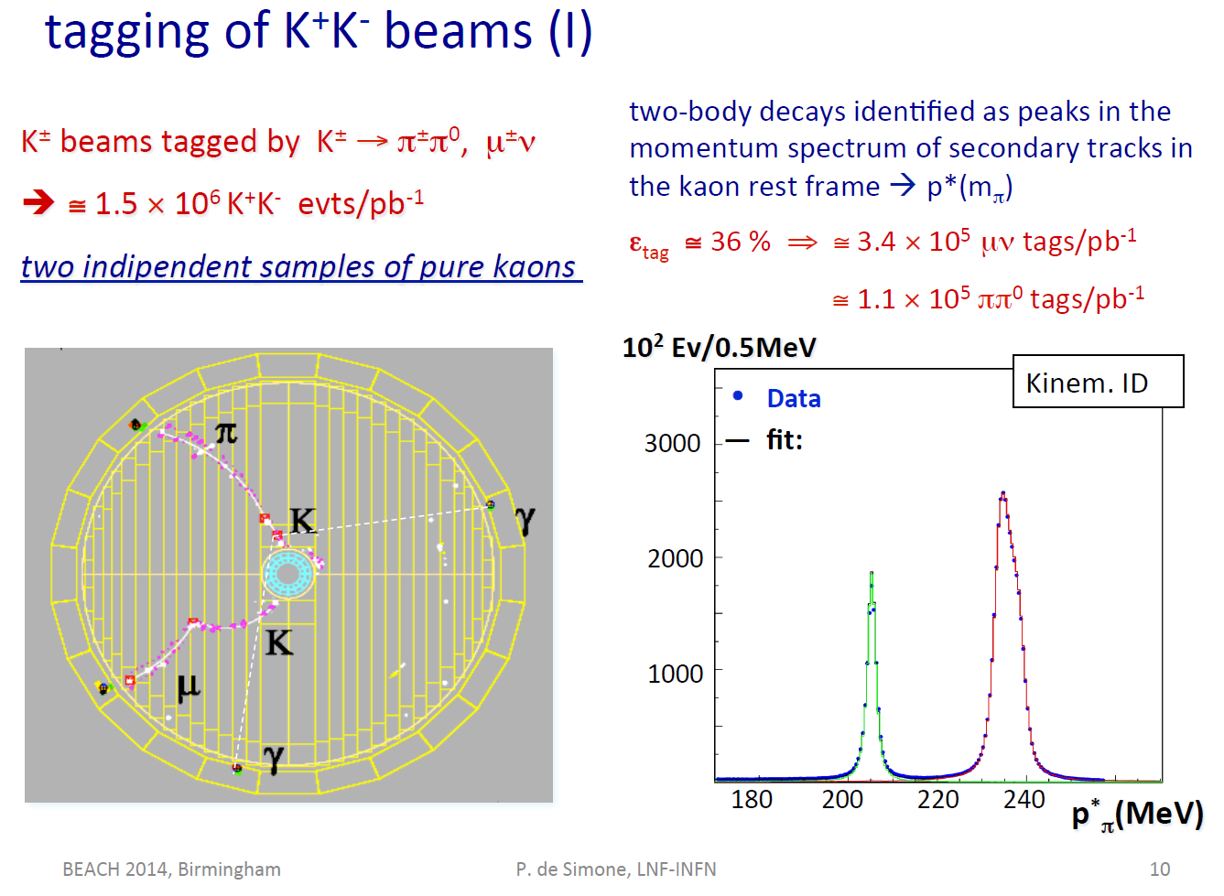
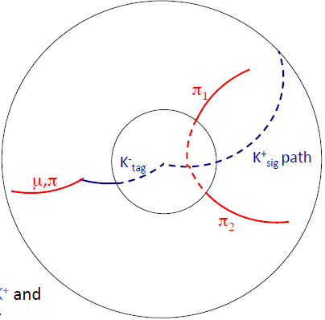
two independent samples of pure kaons

Slide 25
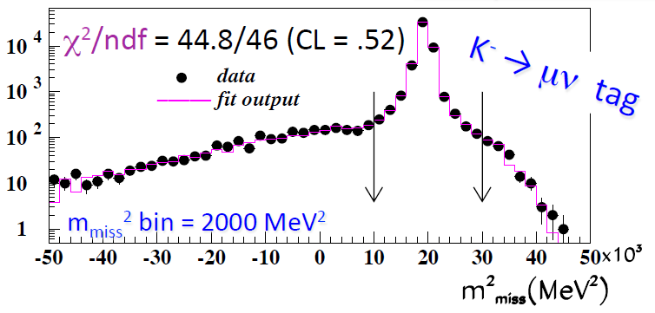
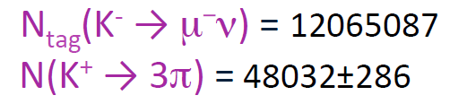
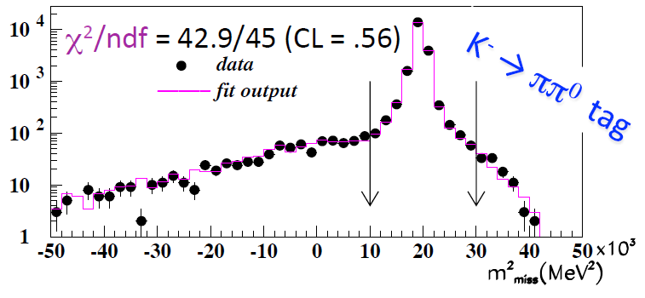
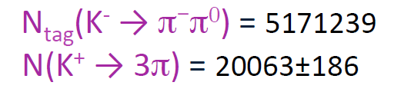
K⁺→ π⁺π⁻π⁺(γ)

Slide 26
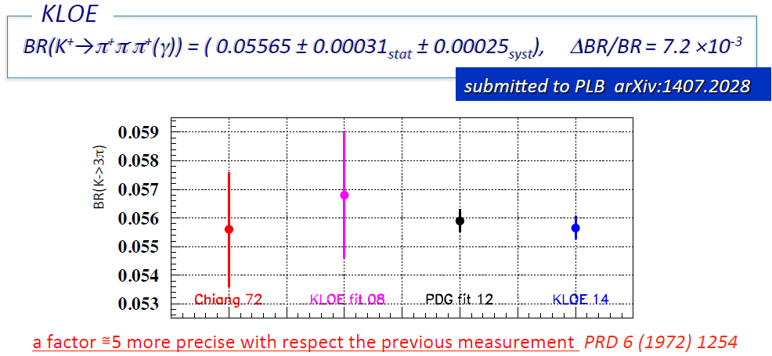

Slide 27
Indeed recent results of KLOE/KLOE-2:
A new limit on the CP violating decay K_{S}→3π⁰
Phys. Lett. B 723 (2013) 54
Test of CPT and Lorentz symmetry
Phys. Lett. B 730 (2014) 89
The absolute branching ratio of the K⁺→ π⁺π⁻π⁺(γ)
arXive: 1407.2028
Upper limit improved by a factor of five
The best sensitivity ever reached in the quark sector
Precision improved by a factor of five
Production:
test of charge symmetry
search for the eta-mesic nuclei
studies of ABC effect – new resonance?
hadronic interactions …
Notes:
contributing to the study of the muon
anomalous magnetic moment
Jakos to poskladac do kupy … dlaczego eta SM etc…
Polaczyc z nastepna strona i nawiazac podobnie as two years ago I will repeat since …than to Falsify the theory !!!
With Wasa at COSY we study both production and decays of the eta-meson but Today I will concentrate
of decays which is also a primordial aim of the experiment
In general we search for the phenomena which cannot be describe by the Standard Model…

Slide 28
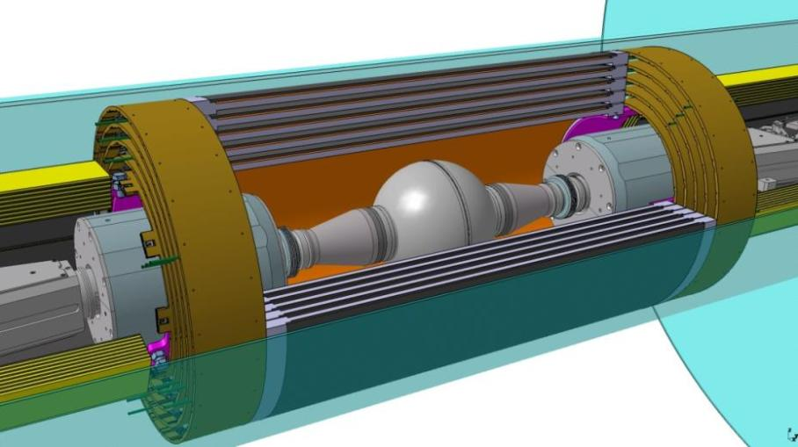
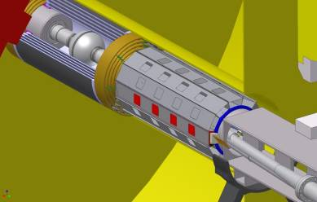
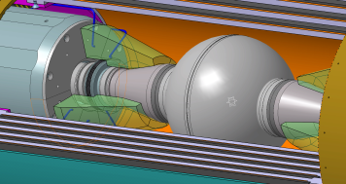
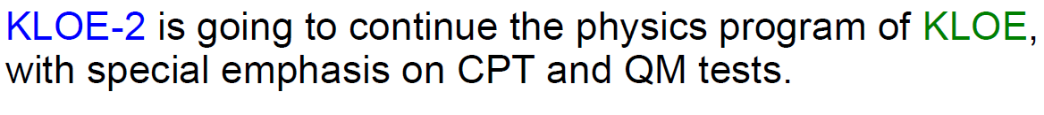
KLOE-2
C-GEM
γγ
New Interaction Region
γγ
QCALT
CCAL
Magnetic field 0.52 Tesla

Slide 29
THANK YOU
FOR YOUR ATTENTION

Slide 30
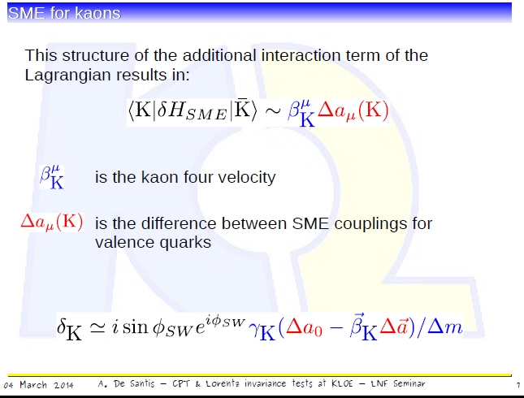

Slide 31
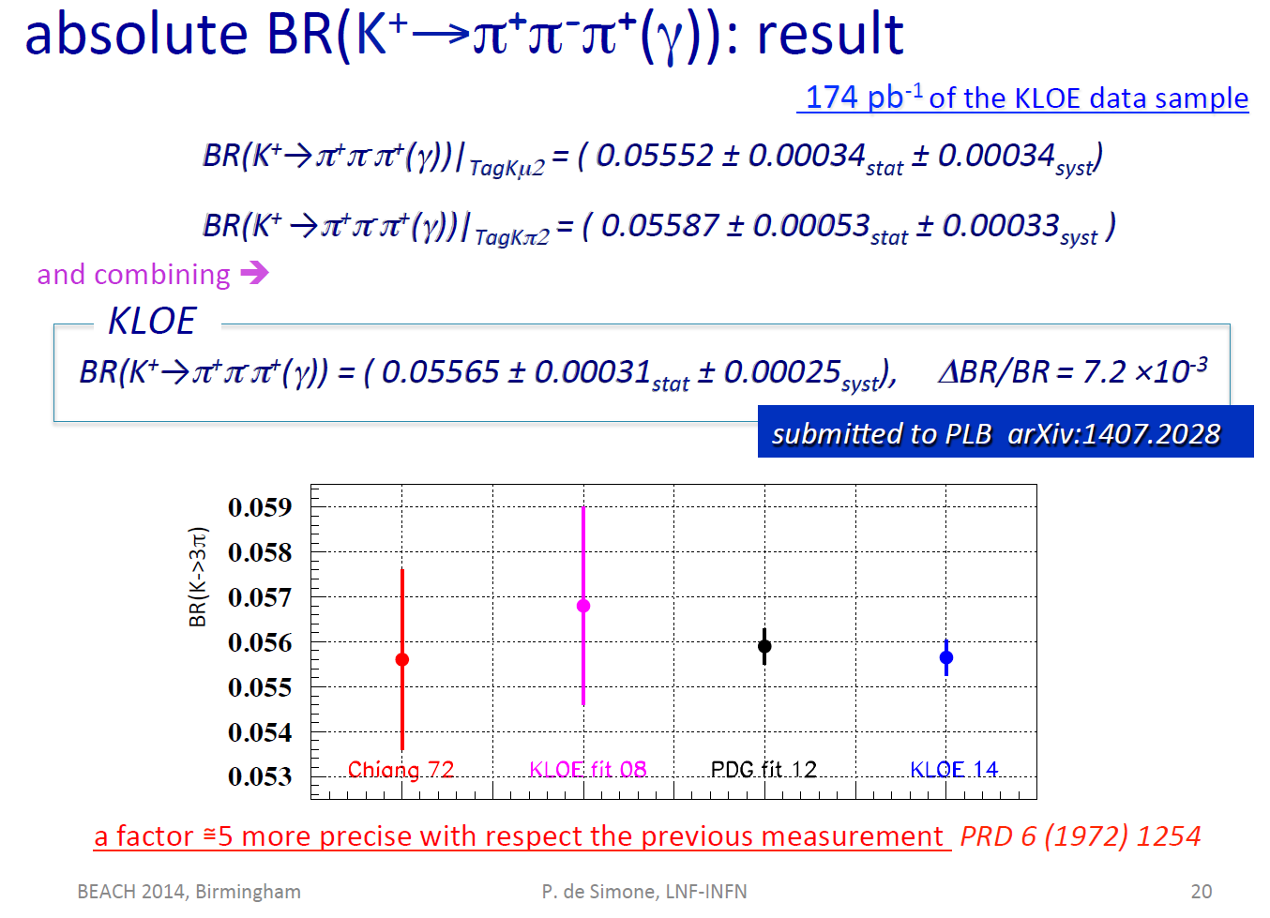

Slide 32
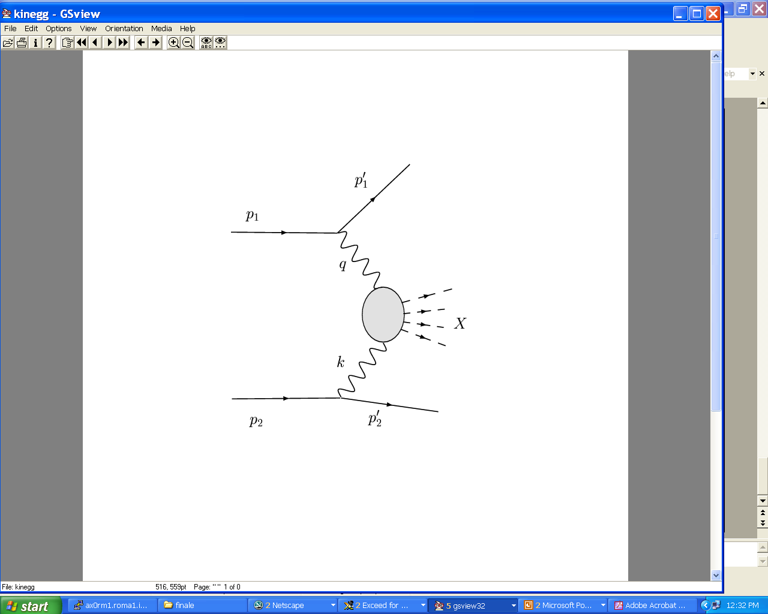
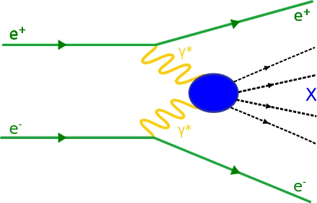
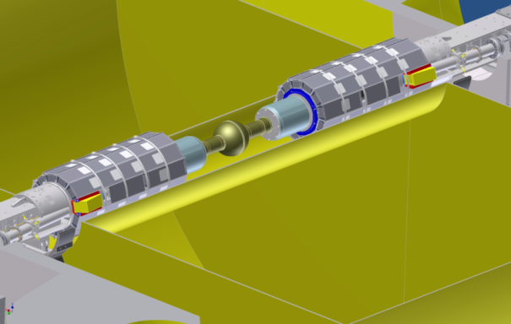
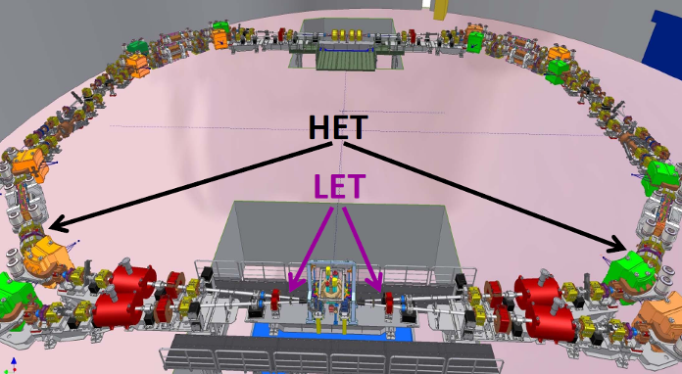
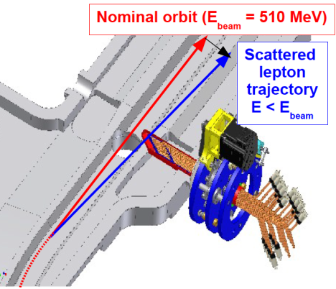
KLOE-2
γγ - interaction:
e⁺e⁻ → e⁺e⁻ γ *γ * → e⁺e⁻ + X
LET: E=160-230 MeV
LYSO+SiPM σ_{E}<10% for E>150 MeV
KLOE-2
HET: E > 400 MeV
11 m from IP
Scintillators
+ PMTs
σ_{Ε} ∼ 2.5 MeV
σ_{T} ~ 200 ps
Notes:
…some numerics in the performance

Slide 33
Pairs of quantum entangled neutral mesons
e⁺e⁻ → φ →|K_{S,}p>|K_{L,}-p> -|K_{S,}-p>|K_{L,}p>
φ: J^{CP} = 1⁻⁻
e⁺e⁻ → Y(4s) →|B⁰,p>|B⁰,-p> - |B⁰, p>|B⁰, -p>
Y(4S): J^{CP} = 1⁻⁻
KLOE: τ_{S} = 89.56 ± 0.03 ± 0.07 ps ( ~0.1%)
SETP0 KLOE-2 5 fb⁻¹ ( ~0.03 %)
Notes:
Novel method based on entanglement
Example of entanglement…

Slide 34
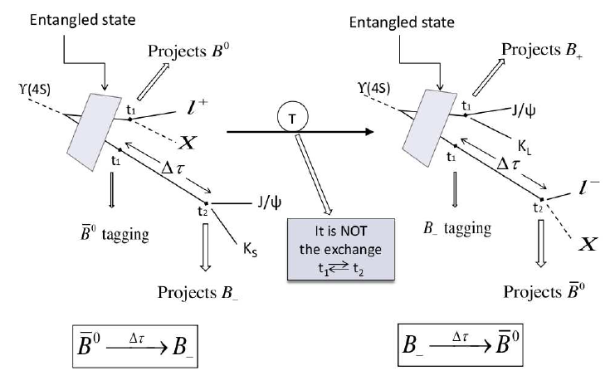
e⁺e⁻ → Y(4s) →|B⁰,p>|B⁰,-p> - |B⁰, p>|B⁰, -p>
B ₋ ≡ B⁰ -- > J/ψ K₊ - -> J/ψ ππ
B ₊ ≡ B⁰ -- > J/ψ K₋ - -> J/ψ π⁰π⁰π⁰
J. Barnabeu et al., JHEP08 (2012) 064
Notes:
For the entanglement it is important that they are ortogonal

Slide 35
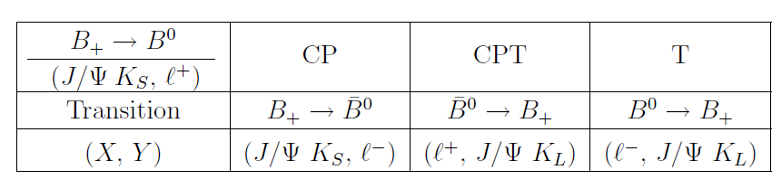
B ₋ ≡ B⁰ -- > J/ψ K₊ - -> J/ψ ππ
B ₊ ≡ B⁰ -- > J/ψ K₋ - -> J/ψ π⁰π⁰π⁰

