Slide 1
Production and Decays of Heavy Flavors at CMS
Sarmad Masood Shaheen
(IHEP,Beijing,China)
On behalf of CMS Collaboration

Slide 2
Next 15 minutes covers..
Overview of CMS Detector
Flavor Physics at CMS
Some recent Results
Υ(1S),Υ(2S) and Υ(3S) cross section Measurements
Summary

Slide 3
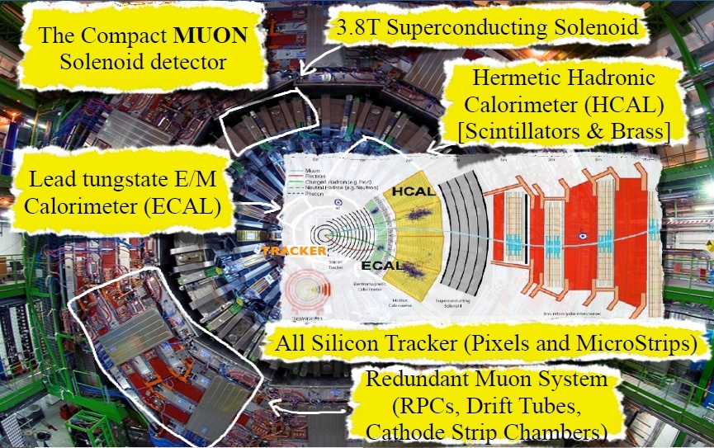
CMS Detector

Slide 4
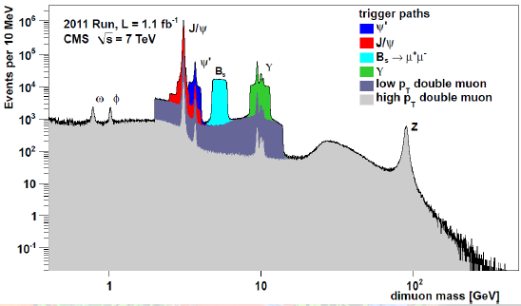
Flavor Physics at CMS
study b hadrons production and properties
cross section, branching ratio, polarization, mass, lifetime, mixing, cp asymmetries, ...
searches and study of new and exotic states
quarkonium-like states X, Y, Z’s; new b baryons
Searches for new Physics
new heavy particles can induce measurable deviations from SM:
b quark production measurements help model backgrounds in searches involving b (H->bb, SUSY )

Slide 5
Υ(1S),Υ(2S) and Υ(3S) cross section Measurements
Pheno 2013
CMS PAS BPH-12-006
Provides an interesting probe of QCD.
Several models predict differential cross section.
NRQCD fit to data, impact the polarization predictions at all p_{T} .
CSM with higher order p_{T} dependent corrections and k_{t} –factorization are consistent with data from LHC.
Previous CMS results for central rapidity. LHCb went more forward for 2<|y |<4.5 where ATLAS published with p_{T} =70 GeV.
Explored higher p_{T} range (100GeV) for measuring the cross section .
Studied µ⁺µ⁻ final state with CMS 2011 data(4.9 fb⁻¹) .
Events selected with dimuon rapidity |y(µµ)|<0.6 covering a
p_{T} (µµ)=10-100GeV ( Mass-resolution is best).

Slide 6
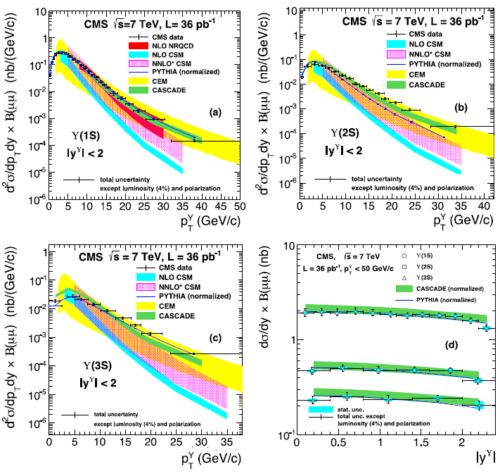
Υ(1S),Υ(2S) and Υ(3S) cross section Measurements
Physics Letters B 727 (2013) 101–125

Slide 7
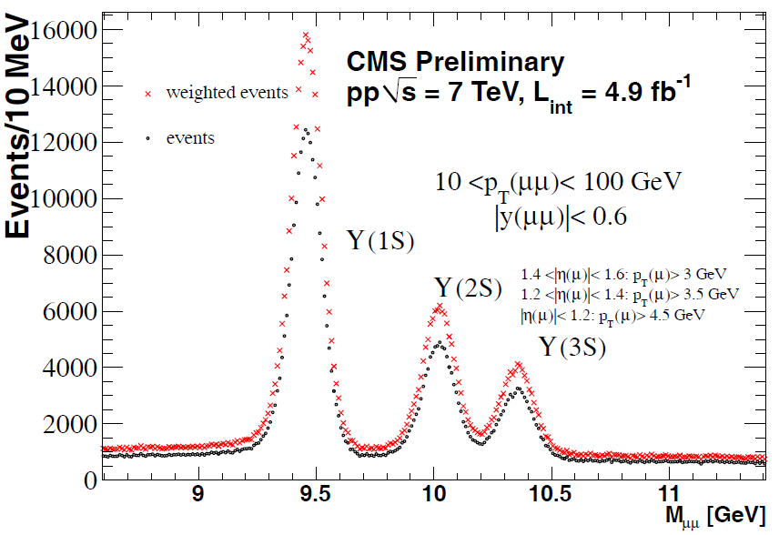
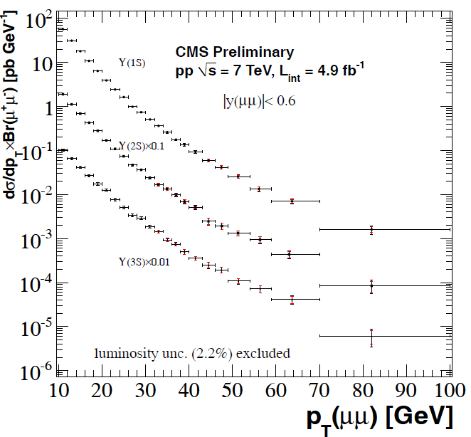
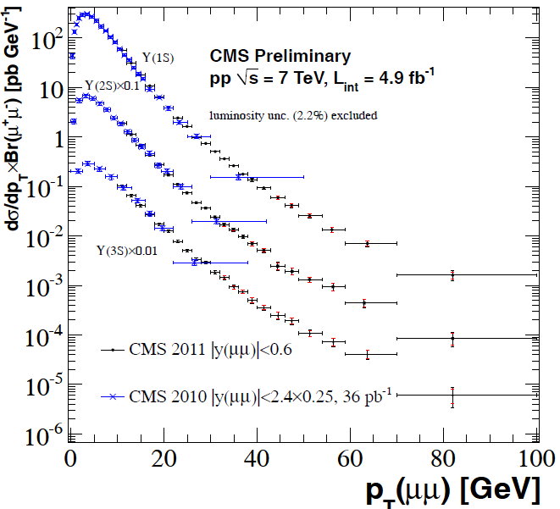
Differential cross-section peak near 4 GeV.
The shape can be expressed by a simple exponential for 10GeV<p_{T}<20 GeV.
Shows transition after p_{T}<20 GeV.
The power law describes well the high p_{T} behavior.

Slide 8
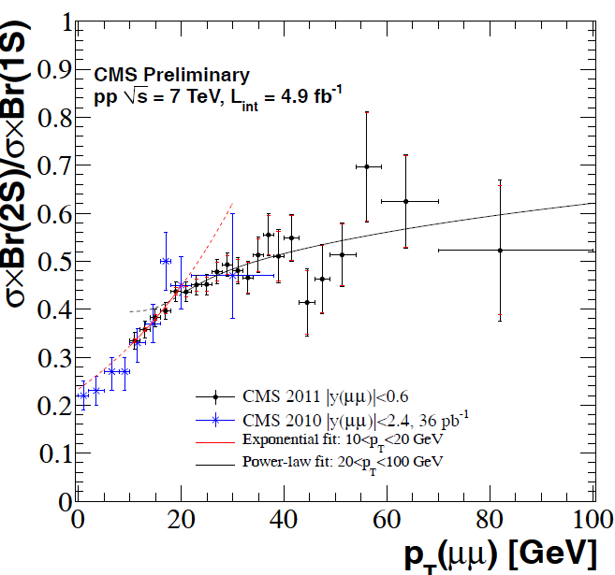
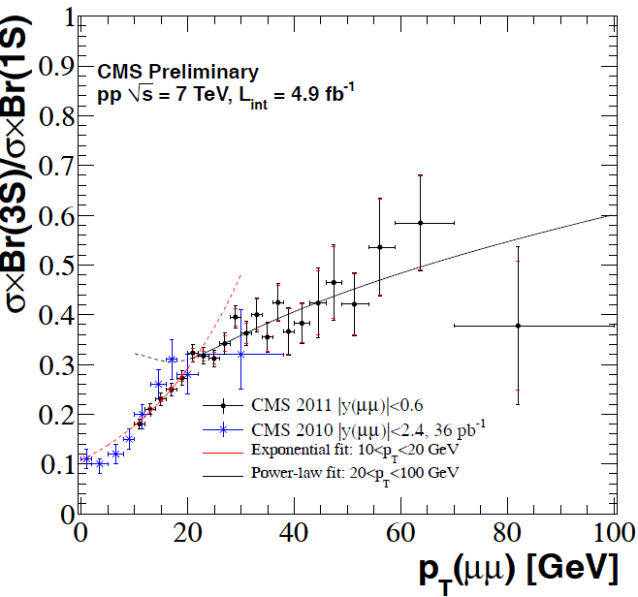
The systematic are estimated from
The background fit method
the efficiency
uncertainties on the polarization
Uncertainty on the luminosity (2.2 % for all p_{T} bins)
Ratio of 2S/1S
Ratio of 3S/1S
The CMS 2010 results are also compared with the 2011 data and is found to be in good agreement.

Slide 9
PASCOS 2013
CMS-PAS-BPH-12-011
Is a ground state of the system
Because of two different flavors, provides a ground to study heavy quark dynamics in different aspects from others.
Both flavors compete in the decay.
PQCD and fragmentation mechanism in main stream for the calculation of the cross section(theoretical).
Gluon- gluon contribution dominates at LHC.
B_{c} with much lower production probability than other quarkoniums.
So far no Cross section measurement.
2011 data sample used with an integrated luminosity 5.1 fb⁻¹
Studied the decay mode in p_{T} >15 GeV and rapidity |y |<1.6.
the analysis proceeds by reconstructing J/Ψ Meson

Slide 10
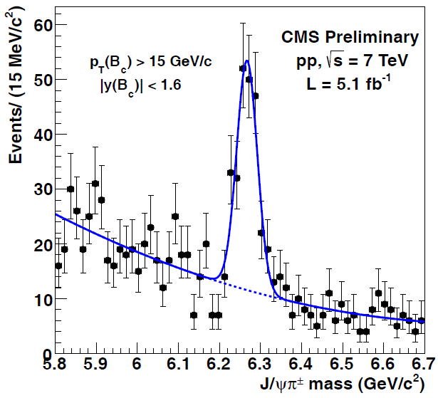
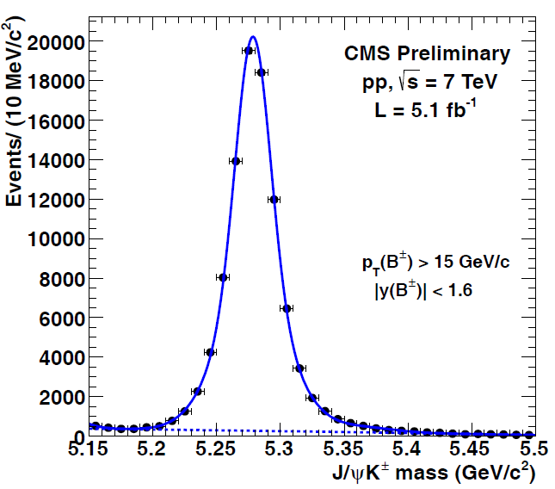

Slide 11
Results of the measurement

Slide 12
Hadron 2013
CMS-PAS-BPH-13-005
NRQCD depends on long distance MEs of color octet.
Υ(1S, 2S, 3S) resonances and transitions among them have been treated well.
Less is known about P –wave state
Quarkonium polarization measurement are limited to S-wave Quarkonia.
Decays from P-wave states non-negligible effects on measurements.
First step being taken by measuring
First Measurement in bottomonium family at Hadron Collider.
Small difference in the masses (19.4 MeV), thus a challenging measurement.

Slide 13
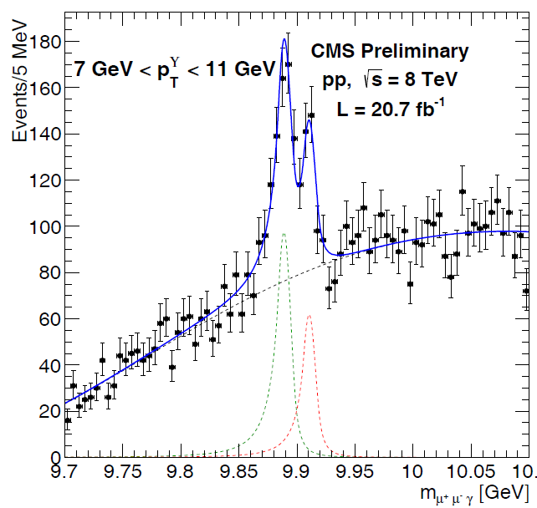
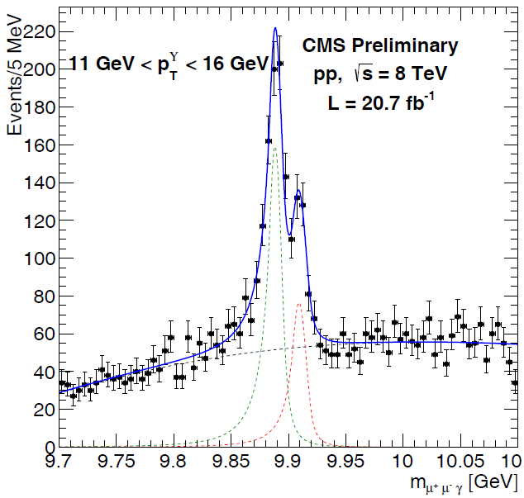
Promptly produced states studied for integrated luminosity 20.7fb⁻¹ at
Detecting through radiative decays
Measured in the phase space
in four Υ(1s) p_{T} bins ranging from 7 to 40 GeV and the ratio is 0.90

Slide 14
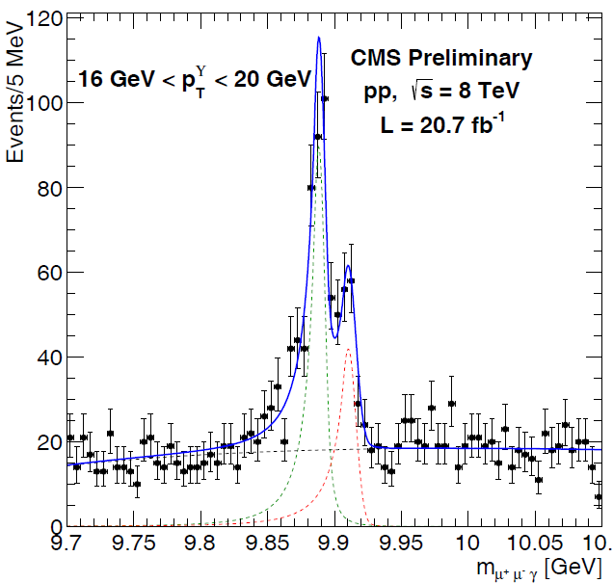
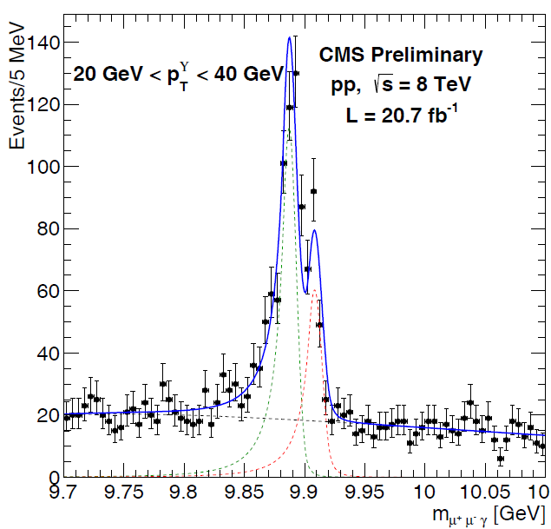

Slide 15
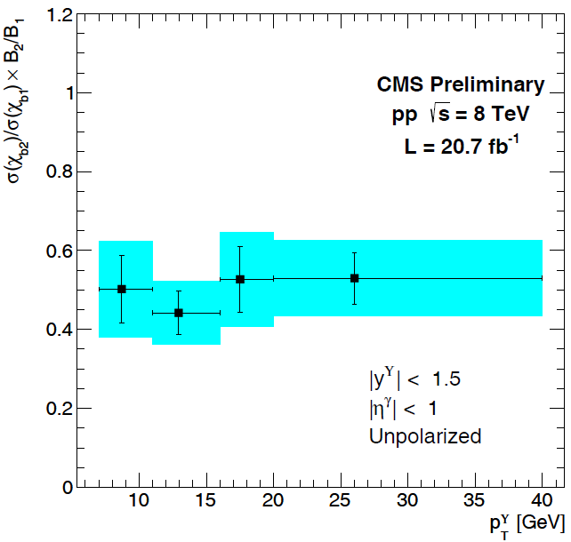
 |  | HX | CS
7 – 11 | 0.50±0.09(stat.)±0.08(syst.) | +0.01 -0.01 | +0.03 -0.02
11 – 16 | 0.44±0.06(stat.)±0.06(syst.) | +0.02 -0.01 | +0.02 -0.02
16 – 20 | 0.53±0.08(stat.)±0.09(syst.) | +0.02 -0.01 | +0.01 -0.02
20 – 40 | 0.53±0.07(stat.)±0.07(syst.) | +0.01 -0.01 | +0.01 -0.01
The measurement assumes unpolarized production of χ_{b} whereas the last 2 columns
Corresponds to the variations because of the Polarization while considering in helicity(HX) and Collins-Soper(CS) frames.

Slide 16
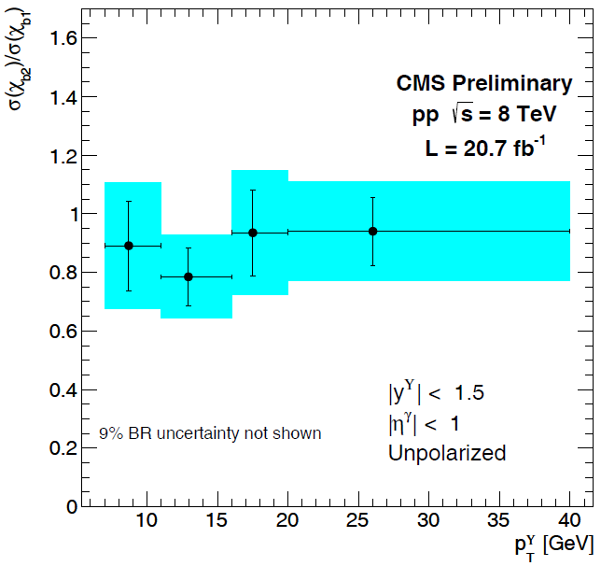
7 – 11 | 0.89±0.15(stat.)±0.12(syst.)±0.08(BR)
11 – 16 | 0.78±0.10(stat.)±0.11(syst.)±0.07(BR)
16 – 20 | 0.94±0.15(stat.)±0.14(syst.)±0.08(BR)
20 – 40 | 0.94±0.12(stat.)±0.12(syst.)±0.08(BR)
Shows the uncertainty because of Branching fractions.
A comparison to theoretical calculations made by correcting the ratios for the branching fractions
Includes systematic and statistical error (no BR)

Slide 17
Summary
rich and competitive heavy flavor program
Results found to be consistent with previous measurements.
Precise Differential cross section measurement of Υ(nS) for the p_{T} range 10-100GeV
The transition from exponential to power law at high pT challenges the theoretical models.
There is no measurement of the cross section of Bc Meson yet and this ratio measurement would be remarkable step to understand the behavior of Bc Meson and further measurements.
The result of the ratio in a good agreement with LHCb (only estimation)
The cross ratio measured for χ_{b2} to χ_{b1} is 0.90 with no significant dependence upon transverse momentum of Υ(1S).
The ratio of σ (χ_{b2} ) and σ (χ_{b1}) is the first measurement and would be helpful as an inputs to constrain studies in future .

Slide 18
Questions and Comments are Welcomed
Thanks for being Patient

Slide 19
Backup

Slide 20
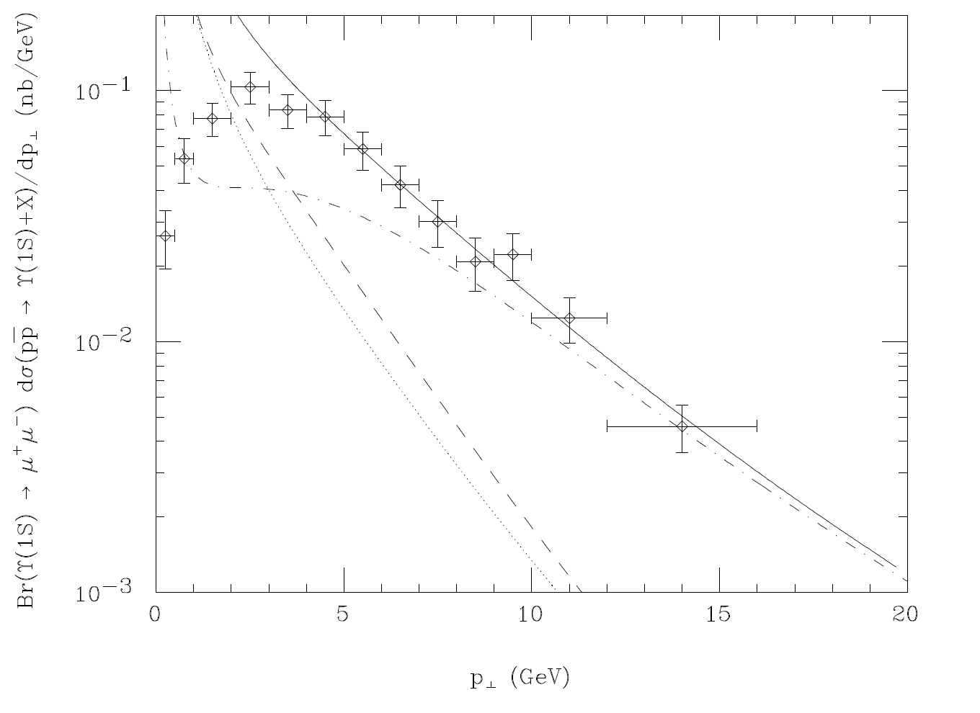
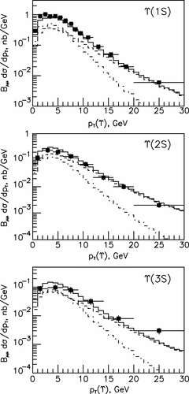
Υ(1S),Υ(2S) and Υ(3S) cross section Measurements

Slide 21
Υ(1S),Υ(2S) and Υ(3S) cross section Measurements
Pheno 2013
CMS PAS BPH-12-006
Event Selections
Dimoun trigger involving tracker and muon systems.
Two muons with |y | <1.25
8.5<M_{µµ} < 11.5 GeV , dimuon vertex with _{χ}² probability > 0.5 %
Muons meeting standard quality requirements.
p_{T} thereshold 5-9 GeV.
Offline selection requires | y |<0.6, dimuon vertex Probabilty > 1 %.
Number of fitted Events in p_{T} bin of width ∆p_{T}
Dimuon Efficiency
Polarization corrected acceptance
ε For seagull selection
Dimuon vertex χ² probabilty requirement of 1%(0.99±0.01))

Slide 22
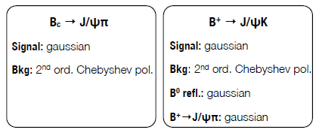
PASCOS 2013
CMS-PAS-BPH-12-011
Event Selection
Dimuon Trigger
tracker hits > 6 and pixel hits > 2
χ²/ndof <3
|η| < 2.4
p_{T} > 0.9 GeV/c
p_{T}(Bc) > 15 GeV
|y(Bc)| < 1.6
cosθ > 0.99
vtx CL > 20%
p_{Tπ} > 2.5, 1.7 or 0.9 GeV
Efficiency for B_{c} reconstruction
The efficiency can be calculated by the expression for i-th bin
Efficiency for B± reconstruction

