Slide 1
CP violation: review and perspectives
Tagir Aushev (ITEP)

Slide 2
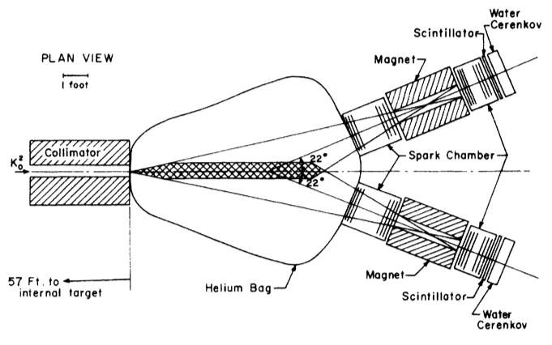
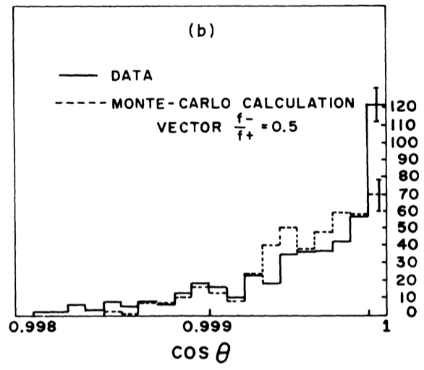
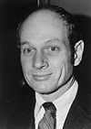
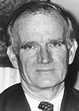
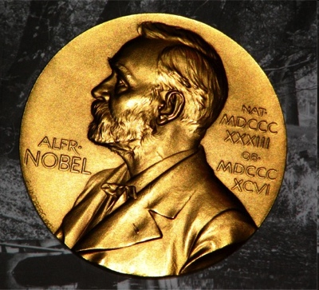
50 years of CP violation
This year, 50th anniversary of CP violation:
In 1964 J. H. Christenson, J. W. Cronin, V. L. Fitch, and R. Turlay discovered CPV in the neutral long-lived kaon system: K_{L}→π⁺π⁻
J. Cronin
V. Fitch
1980

Slide 3
Kobayashi-Maskawa model
In 1973 to explain CPV in kaons M.Kobayashi and T.Maskawa proposed a model with:
existence of the third generation of quarks
remarkable that only u, d & s quarks were known at that time
presence of complex phase in the quarks transitions
Cabibbo matrix was extended to 3x3 CKM matrix:

Slide 4
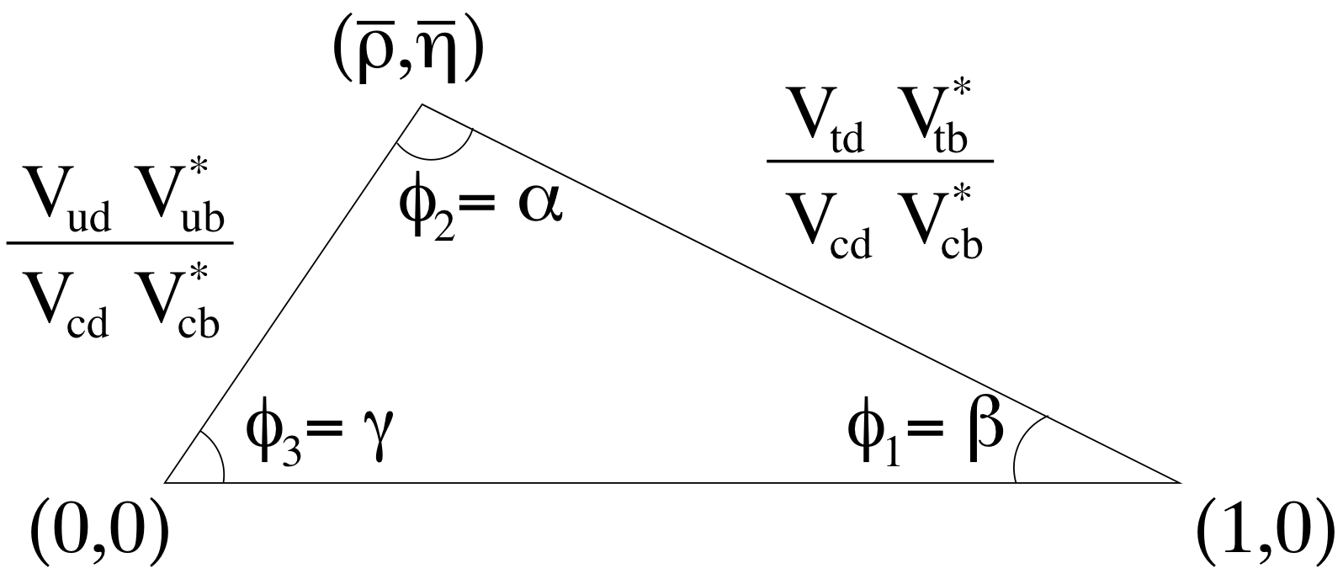
Unitarity triangle
Unitarity of the CKM matrix leads to one of equations:
Involves matrix elements corresponding to B meson decays and mixing
Can be presented on the complex plane as a triangle
Non-zero square of the Unitarity triangle
existence of CP violation

Slide 5
CPV in B⁰ system
For almost 40 years K⁰-K⁰bar system was the only one, where CPV was observed
Observation of large B⁰-B⁰bar mixing by ARGUS was a crucial discovery for further CPV studies:
it led to the proposal of a construction of the asymmetric energy B-factories to study CPV in B decays
CP violating effects in the B sector are O(1) rather than O(10⁻³) as in the kaon system
In 1999 two experiments, BaBar at SLAC, USA and Belle in KEK, Japan, started the data collection

Slide 6
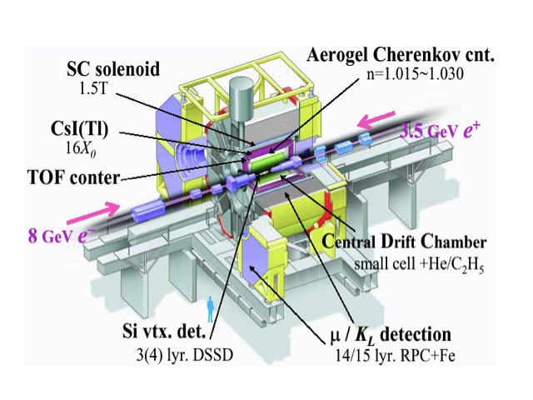
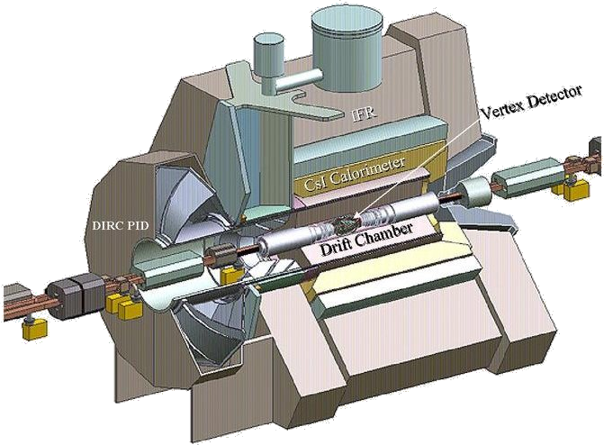
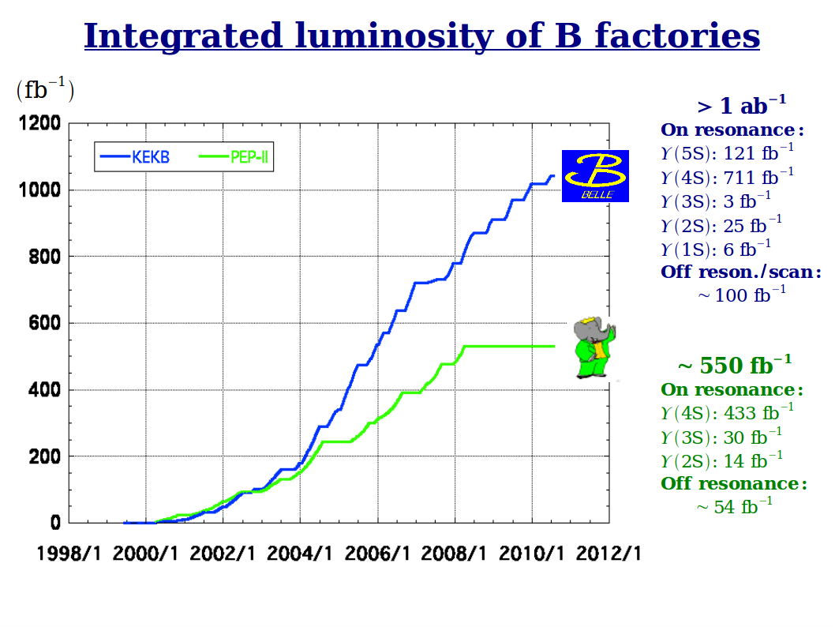
Decade of Belle & BaBar B-factories
Drift Chamber
40-layer, small cell
Silicon Vertex Tracker
5-layer, double-sided strips
1.5 T
Solenoid
Flux Return
RPC and LST instrumented iron
DIRC (PID)
quartz Cherenkov detector
EM Calorimeter
CsI crystals

Slide 7
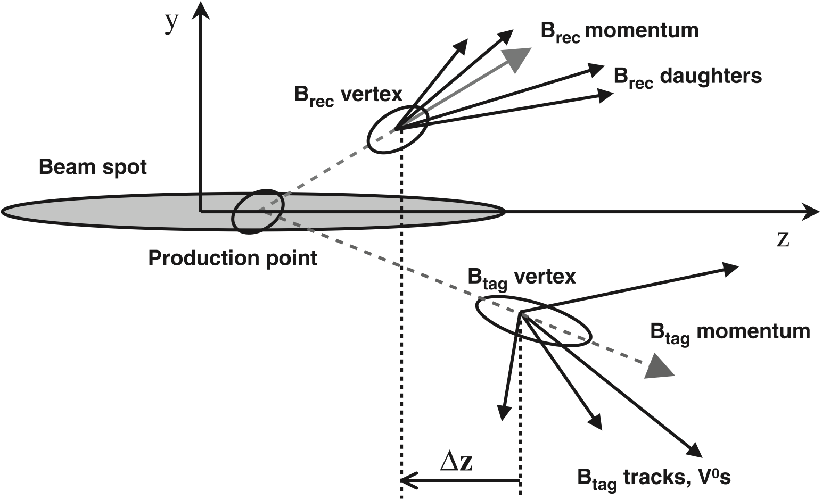
Main principles of CPV measurements
CPV is observed in the interference of direct decay and via mixing:
The “golden mode” is B⁰→J/ψ K⁰
Due to the asymmetric beam energies of B-factories, B mesons fly in the same direction
→ allows to measure Δt
Flavor and decay vertex of another B
are determined by its decay products
e⁻ e⁺
t₂
t₁

Slide 8
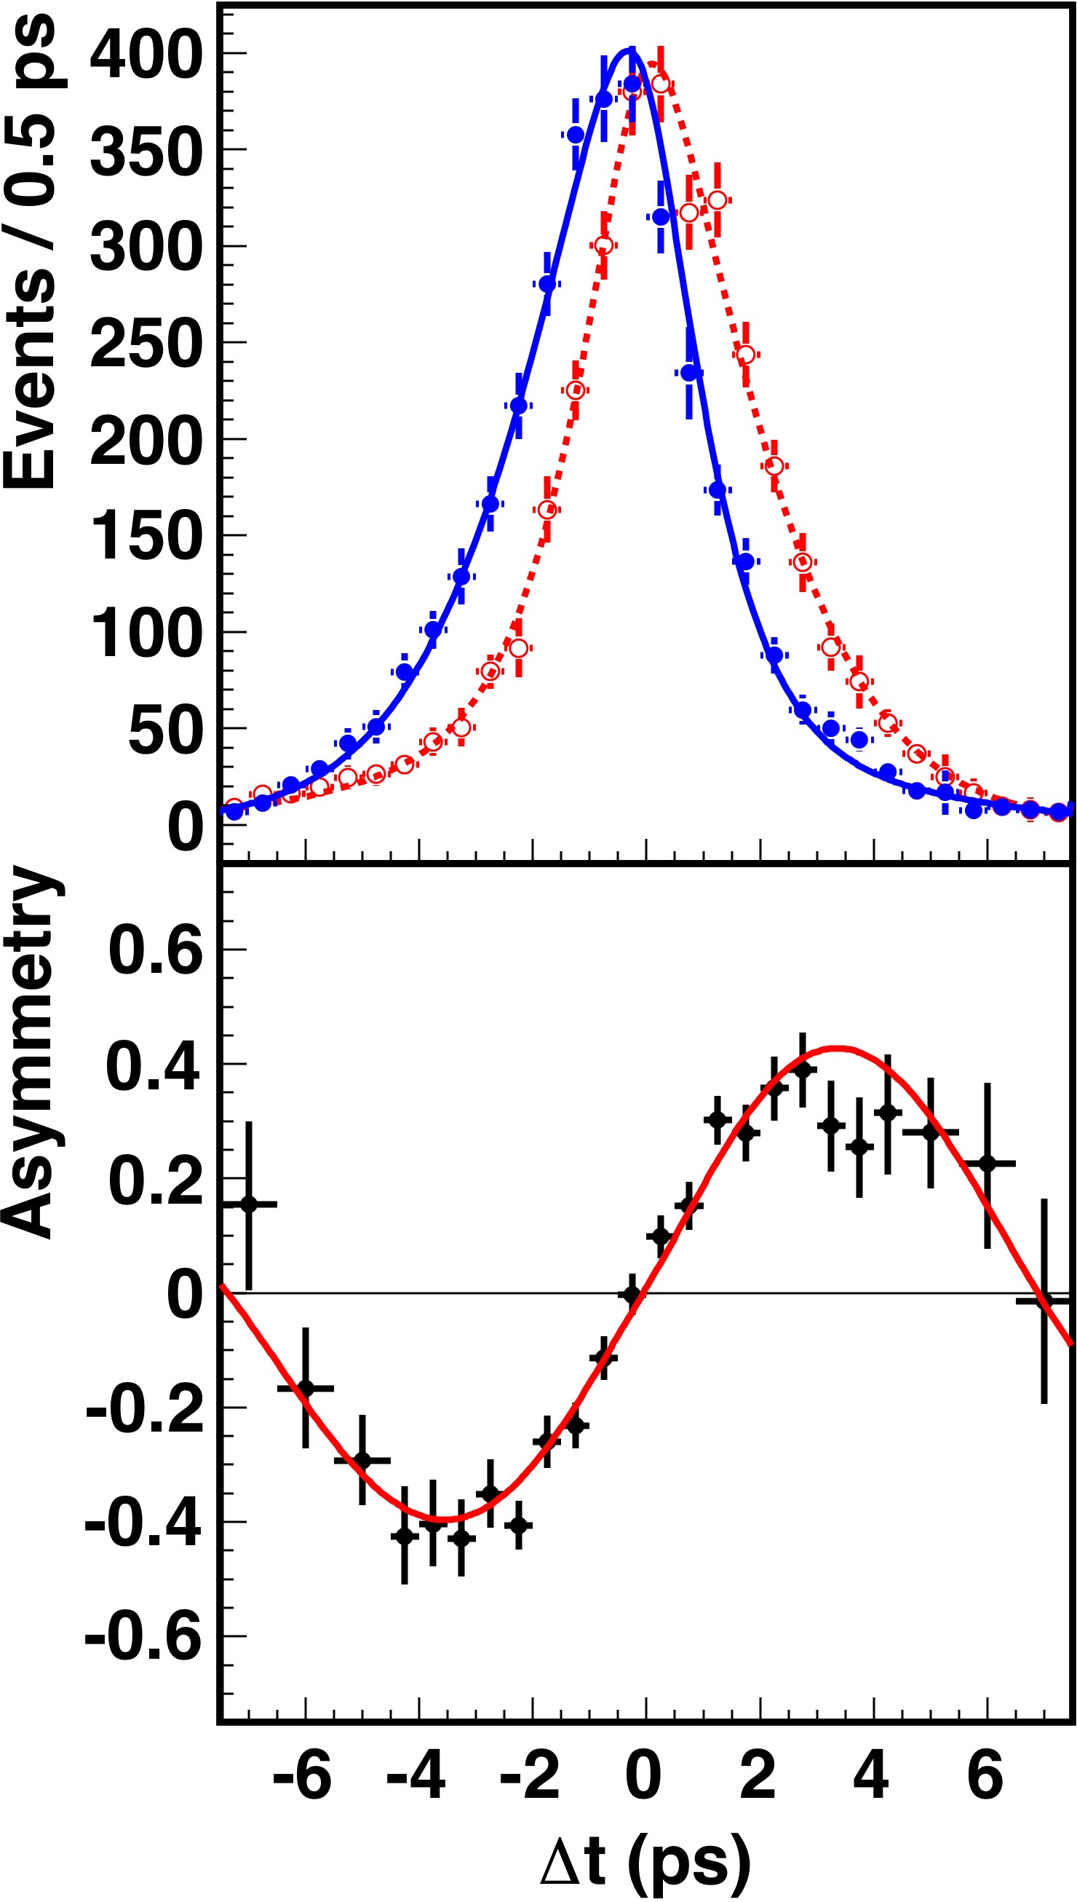
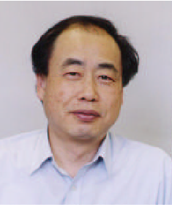
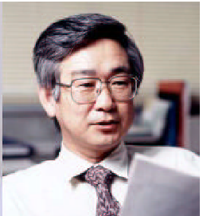
Results for φ₁ = β
B⁰→(cc)K_{S}
sin2ϕ₁ (WA) = 0.682 ± 0.019
2001 first evidence
2002 first observation
2005 precise measurement
2008 Nobel prize
2012 final result
M. Kobayashi
T. Maskawa
2008

Slide 9
Unitarity triangle self-consistence
Build theory
Confirm theory
Disprove theory
SM – done by Kobayashi & Maskawa
Large CPV in B system found by Belle & BaBar
One of the way – check whether all parameters of Unitarity triangle are consistent

Slide 10
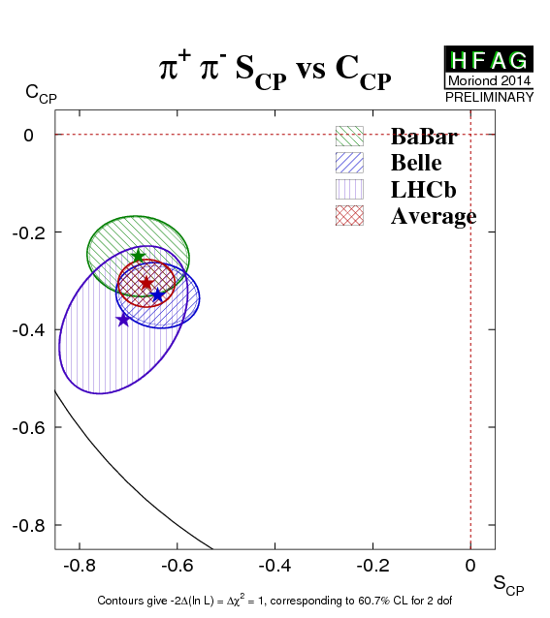
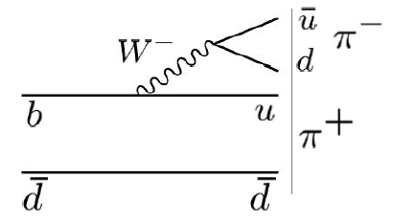
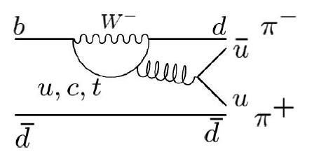
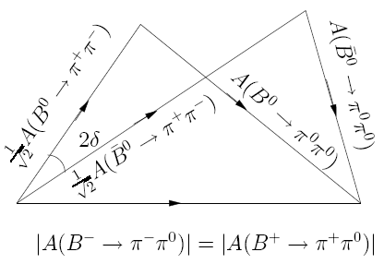
φ₂ = α
Similar to ϕ₁, sin(2ϕ₂) thought to be measured in B⁰→π⁺π⁻ time-dependent analysis
Assumed to be easy to do, but finally it turned to be the most complicated one
First results shown that penguin pollutions, which have different weak phase, are too large
Possible to determine δ using isospin analysis (Gronau & London, PRL 65, 3381, 1990),
but with 8-fold ambiguities because
all BR of B→ππ have the same order
+
S_{ππ} ∝ sin2α_{eff} = sin2(α + δ )

Slide 11
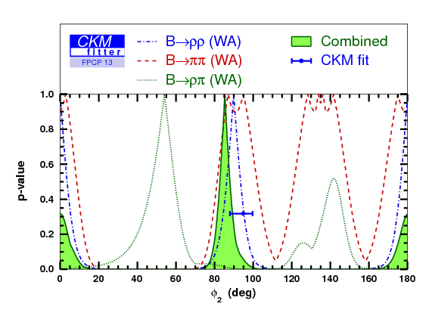
sin(2φ₂) using B → ρρ
Not the case for B→ρρ: Γ_{ρ+ρ-} ~ Γ_{ρ+ρ0} >> Γ_{ρ0ρ0}
only two fold ambiguity
Penguin contribution in B→ρρ is small
Longitudinal polarization is ~100%

Slide 12
Methods of φ₃ = γ measurement
Based on B⁰ decays (measurement of 2φ₁+φ₃)
B⁰→D^{(*)-}π⁺, Dρ
Based on B→D^{(*)}K decay with D⁰-D⁰ interference:
GLW (CP eigenstates: D⁰→ππ, KK, K_{S}φ, K_{S}ω)
Gronau & London, PLB 253, 483 (1991);
Gronau & Wyler, PLB 265, 172 (1991)
ADS (CF and DCS states: D⁰→Kπ, Kππ⁰)
Atwood, Dunietz, & Soni, PRL 78, 3257 (1997),
Atwood, Dunietz, & Soni, PRD 63, 036005 (2001)
Dalitz (multibody states: D⁰→K_{S}ππ, K_{S}KK, πππ⁰)
Giri, Grossman, Soffer, & Zupan, PRD 68, 054018 (2003)
Bondar, PRD 70, 072003 (2004)

Slide 13
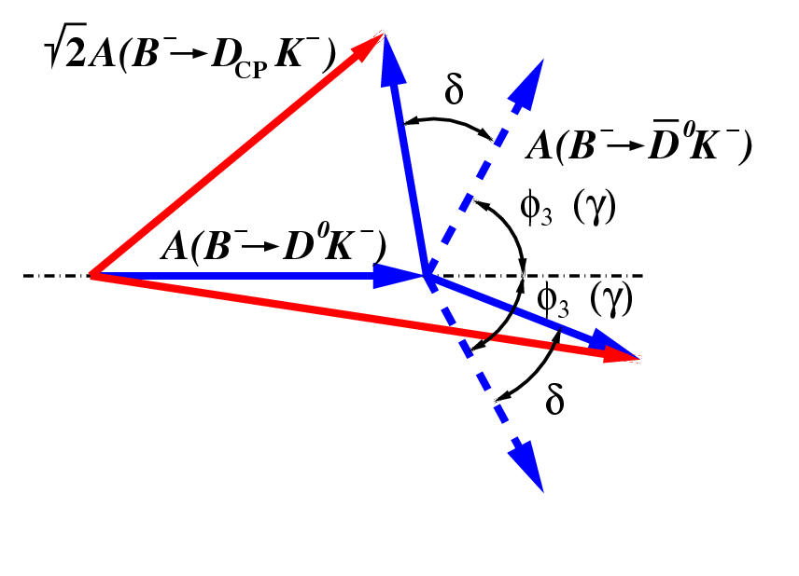
GLW method
M. Gronau, D. London, D. Wyler, PLB 253, 483 (1991); PLB 265, 172 (1991)
CP eigenstate of D-meson is used (D_{CP})
CP-even: D₁→K⁺K⁻, π⁺π⁻, CP-odd: D₂→K_{S}π⁰, K_{S}ω, K_{S}φ, K_{S}η, …
Sensitivity depends on hadronic parameters r_{B} and δ’
Alternative set of variables:
Does not provide direct measurement of φ₃/γ, but helps in combination with other methods
Sensitivity depends on strong phase (δ=0 or 180 give no sensitivity)

Slide 14
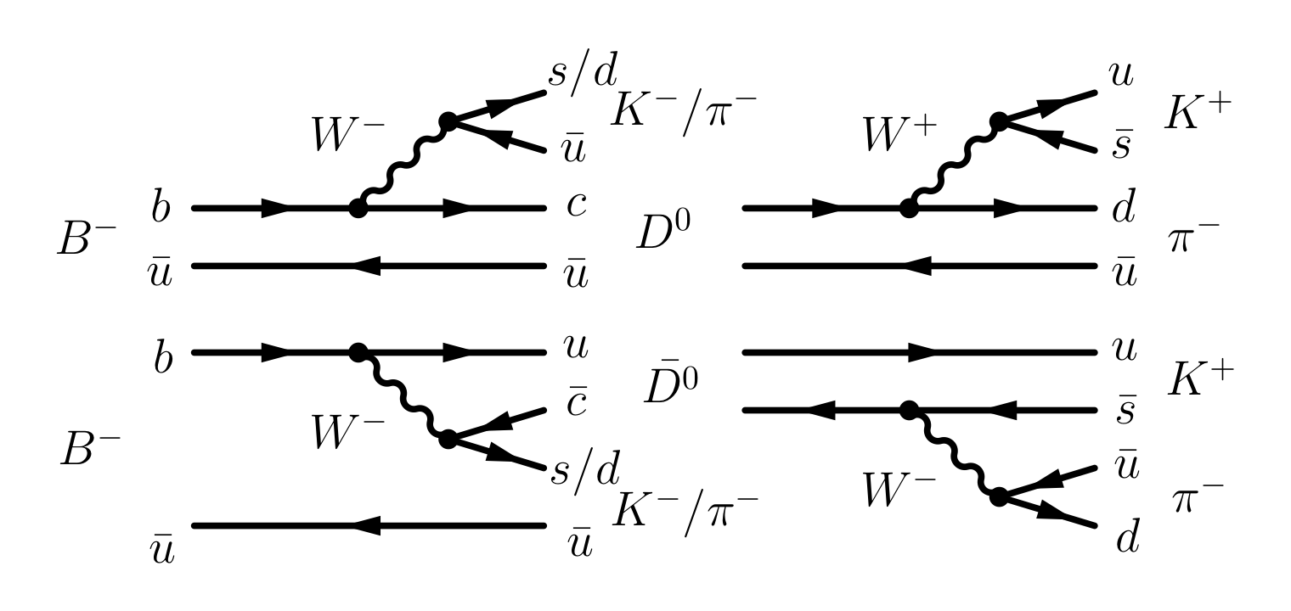
ADS method: B⁻ → DK⁻ with D→K⁺π⁻
D. Atwood, I. Dunietz and A. Soni, PRL 78, 3357 (1997)
Enhance magnitude of CP violation by using Doubly Cabibbo-suppressed D decays

Slide 15
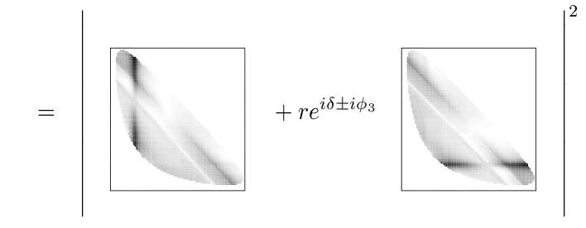
Dalitz analysis: three-body decays
A.Giri, Yu.Grossman, A.Soffer, J.Zupan, PRD 68, 054018 (2003)
A.Bondar, Proc. of Belle Dalitz analisis meeting, 24-26 Sep 2002
Using 3-body final state, identical for D⁰ and anti-D⁰: K_{S}π⁺π⁻
Dalitz distribution density:
(Assuming CP-conservation in D⁰ decays)
If is known, parameters (φ₃/γ,r_{B},δ) are obtained from the fit to Dalitz distributions of D→K_{S}π⁺π⁻ from B±→DK± decays.
Need to know a complex form of the D⁰ decay amplitude, but only |f_{D}|² is obtained from D*→Dπ: Need to use model description, model uncertainty as a result.

Slide 16
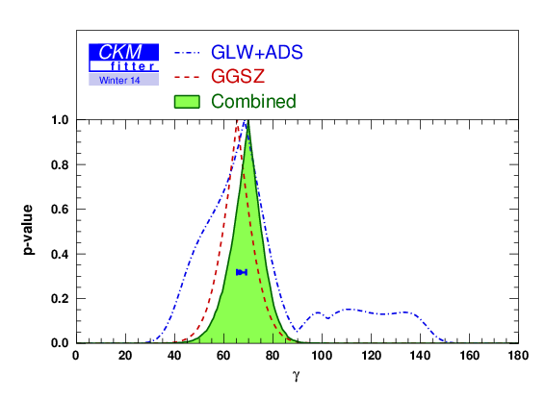
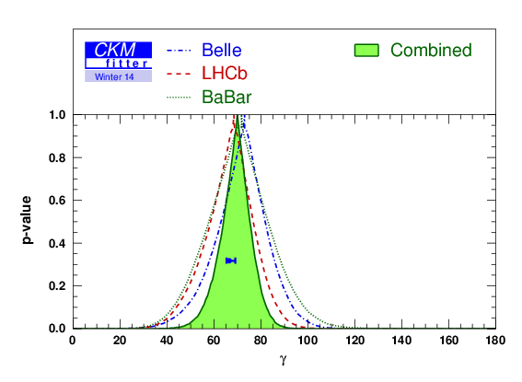
φ₃ = γ results
LHCb entered to the game with the best measurement
BaBar: γ = (69 ⁺¹⁷₋₁₆)°
Belle: φ₃=(68 ⁺¹⁵₋₁₄)°
LHCb: γ = (67 ⁺¹²₋₁₂)°

Slide 17
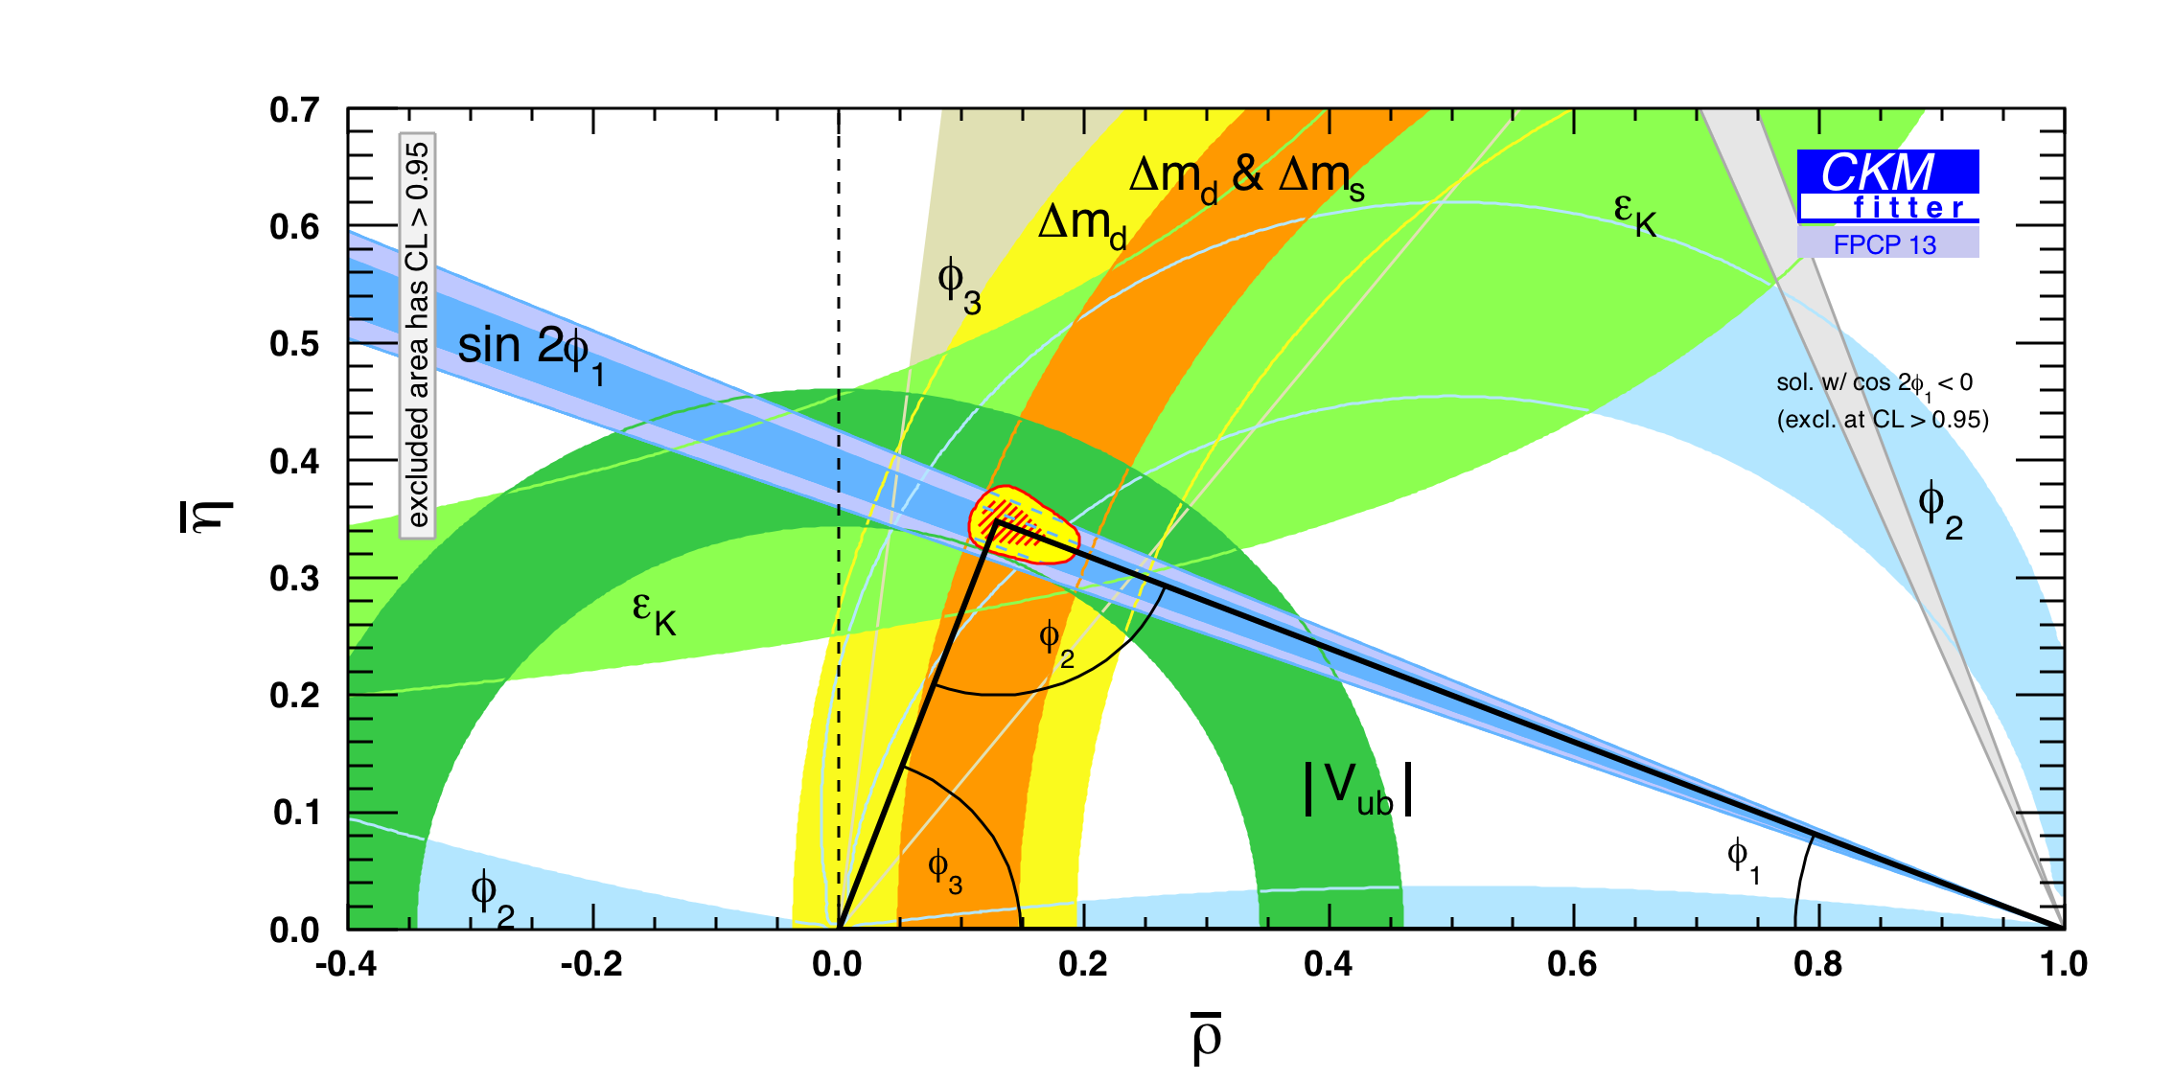
Result of 15 years of Belle, BaBar, LHCb operations
β ≡ φ₁ = (21.5 ^{+0.8}_{−0.7})°
α ≡ φ₂ = (85.4^{+4.0}_{-3.8})°
γ ≡ φ₃ = (68.0^{+8.0}_{-8.5})°
All triangle parameters are well self-consistent ☹
Don’t give up: we still have a chance to see NP in CKM with x50 more data from Belle II and upgraded LHCb

Slide 18
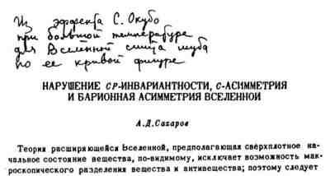
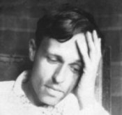
Is it really an end of the story?
In 1967, soon after CPV discovery A.Sakharov shown:
existence of CPV is one of the requirement for the matter-antimatter asymmetry, which we see in the Universe

Slide 19
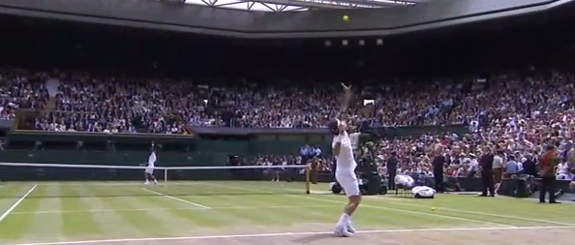
Federer and Nadal are warming up before the game
If Federer serves faster (more often) than Nadal,
sooner or later all balls will be on Nadal’s half
Q: How much faster Federer should serve
to create the existing baryon asymmetry in the Universe?
A: Much faster than the current mechanism of CPV
Notes:
There may be new sources of CPV to discover.

Slide 20
Where is a new source of CPV?
Currently known mechanism of CPV is ~10 orders smaller than necessary to explain a large baryon asymmetry in the Universe
Hardly there is a source of this asymmetry other than CPV
There must be other sources of CPV
Q: Where is it ?!
The answer is unknown, but we can look for/in:
new particles in the penguin loops
direct CPV in B and D decays
leptonic sector
strong interaction

Slide 21
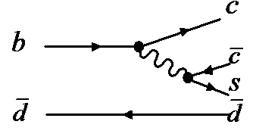
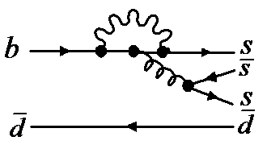
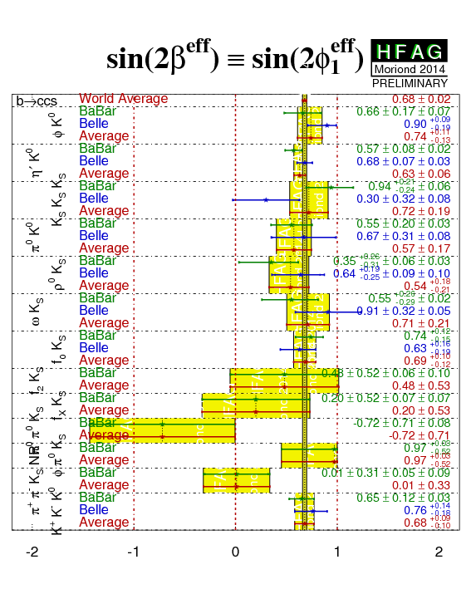
New Physics in the penguin loop
CPV in SM in decays
is proportional to sin(2φ₁), e.g.
– Presence of new particles in the penguin
loops can change CP asym.
– No signs of NP observed yet
– Due to small BR’s of penguin decays,
much larger statistics is necessary
→ looking forward for Belle II
and upgraded LHCb results

Slide 22
CPV in charm
Only two generations are involved
--> CPV is predicted in SM to be small
direct CPV a few 0.1%
indirect CPV in order of 0.01%
any larger evidence of CPV in charm sector indicates NP
D⁰-Mixing is well established, however it is small (<1%)
high statistics is needed to study mixing-induced effects
Current LHCb, BaBar & Belle precisions are at ~0.1% level
no clear evidence for CPV
Future Belle II & LHCb will reach 0.01% level
again, all hopes on that
|q/p|=0.93+0.08-0.09
phi=8.7+9.1-8.8

Slide 23
CP violation in B_{s} system
→ no CPV is expected in SM
Observation of CPV in B_{s} system would be a clear sign of NP
B_{s} mixing is well measured by CDF & LHCb:
Δm_{s} = 17.69 ± 0.08
Main hope for LHCb and ATLAS for the CPV studies in B_{s} decays,
however, it seems, statistics is still not enough to find it:
φ_{s} = (1±6)°
Lets wait for upgraded LHCb

Slide 24
Sources of CP violation
Strong interaction
Quark sector
Lepton sector
Experiments on neutron’s electric dipole moment show no CPV
~10 orders smaller than necessary
Unitary triangle is well self-consistent
Experimental precision is not yet sensitive to CPV
Need to find some new particles (in the loop diagram?)

Slide 25
Conclusion
KM model works good… even too good
Unitarity triangle is well self-consistent
not much space for NP or new source of CP violation
No signs of new particles are found in the penguin loops
SuperB-factories data are necessary
CP violation in D⁰ and B_{s} are not found yet
no NP here as well
SuperB-factories may help
Missing source of the CPV could be found in the leptonic sector
new experiments are needed

Slide 26
CKM change from 1995 to 2014
Thank you!

Slide 27
Backup’s

Slide 28
CPV in neutrinos
Neutrinos have very small masses, but non-zero as postulated in SM → oscillate
Mixing angles diff from quark’s
Can be searched by NOvA, LAGUNA-LBNO, LBNE, Hyper-Kamiokande,…

Slide 29
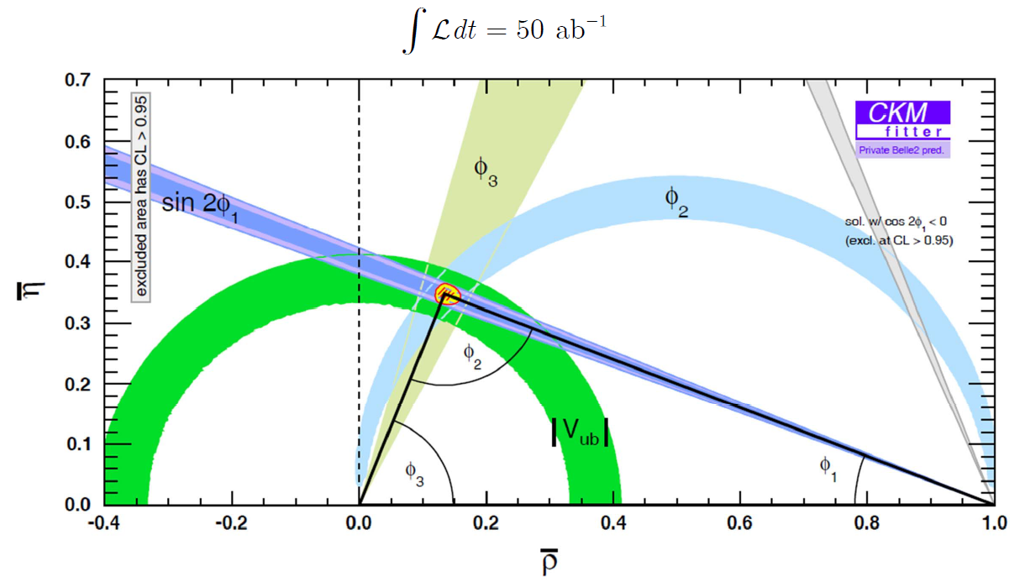

Slide 30
