Slide 1
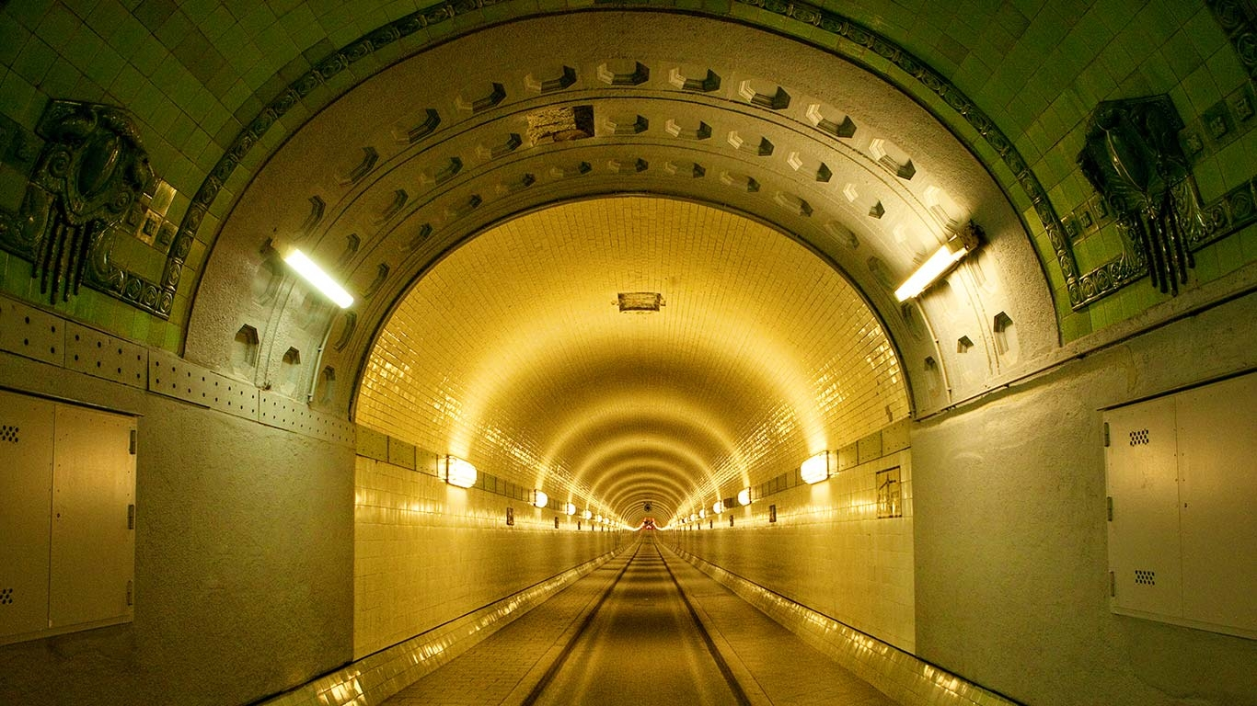


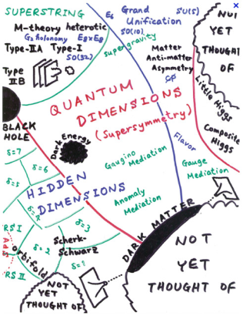
“What is Next in Particle Physics ? - Experimental Perspective”
Maxim Titov (CEA Saclay, France)
Xth Rencontres Du Vietnam “Flavour Physics”
Quy Nhon Vietnam, July 27 – August 3, 2014

Slide 2

It is an honor … and a great responsibility
Outline of the Talk:
Introduction: “Fishing for BSM Physics”
Energy Frontier: Precision Measurements
The Way Forward:
→ Precision Higgs Frontier and BSM Physics
→ Flavor Physics
→ Neutrino Physics
→ Charged Lepton Flavor Violation
Summary and Outlook
Attempt to stay
complementary to
the presentations
at this conference
This is … how do you feel at the
end of the conference (after such a talk)

Slide 3
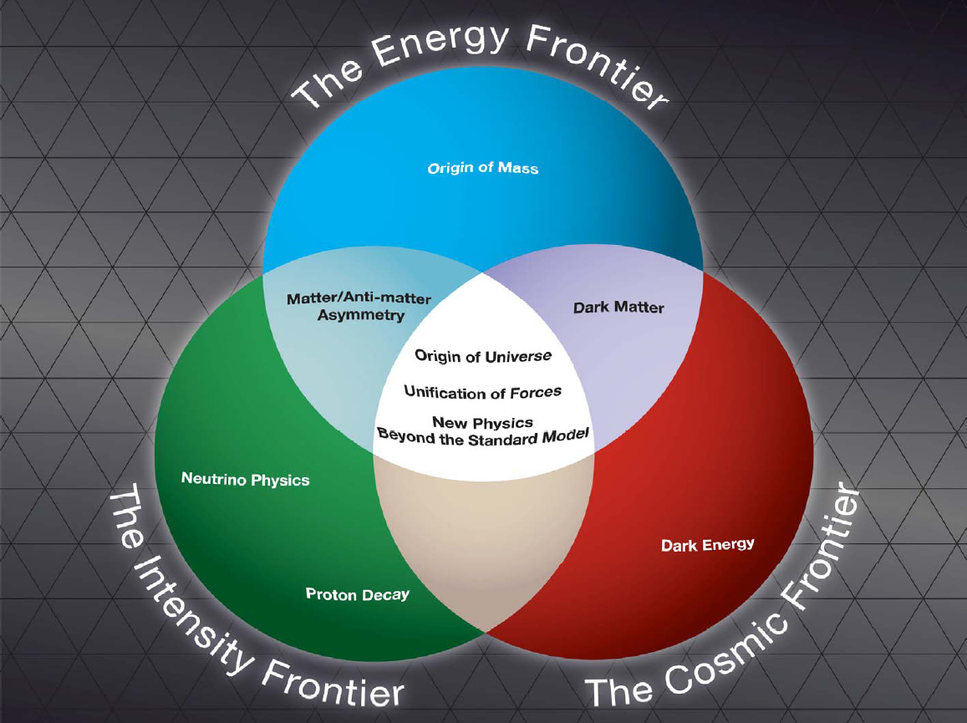
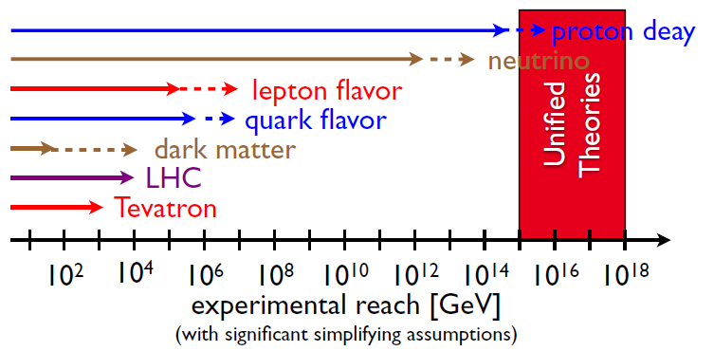
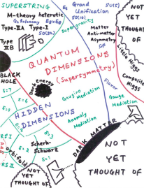
Synergies Between the Three Frontiers: “Fishing for BSM Physics”
Go to high energies directly with colliders
⟹ energy frontier
Look for rare processes and small effects
probing high energies indirectly
⟹ intensity frontier
Look up the sky and see what falls on you
⟹ cosmic frontier
All evidences for physics BSM have
come from non-accelerator experiments
→ new particles either too heavy or
very weakly coupled
We don’t know the next important
energy scale in nature
Colliders probe only a very limited range of energy scale
They are very expensive, too!
H. Murayama

Slide 4
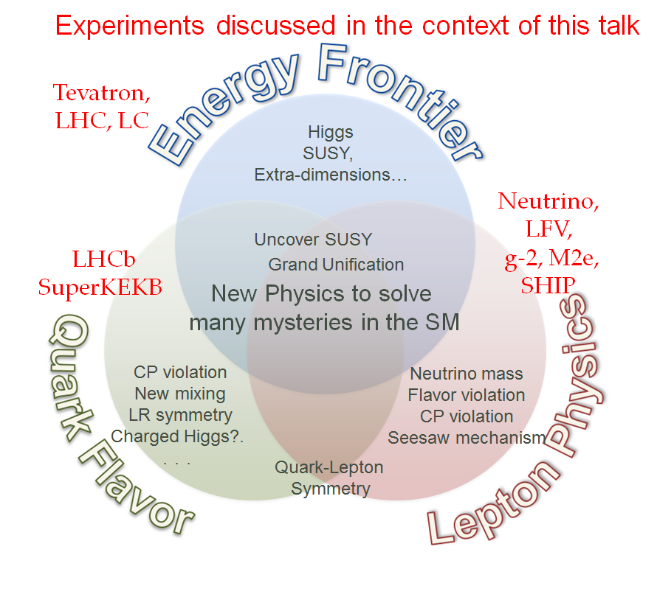
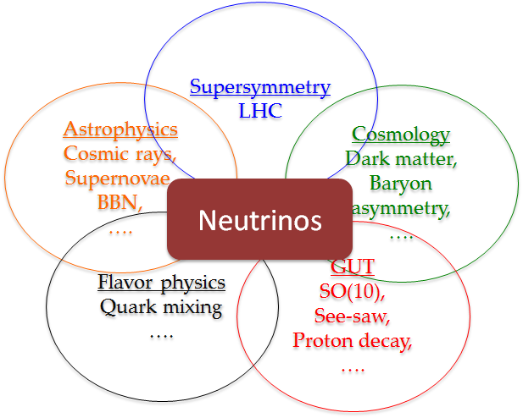
Beyond Standard Model Physics: Puzzle is Sharpened
Tremendous success of the SM over the last
100 years → the last piece of the SM -
HIGGS BOSON has been discovered
However, there are (at least) several missing items in the SM:
non-baryonic dark matter
neutrino mass
baryon asymmetry (absence of anti-matter)
accelerated expansion of the Universe
Neutrinos are related to everything:
Puzzle is sharpened: Baryon asymmetry
Need new sources of CPV are needed
Need to see how anti-matter can turn
into matter
Quark sector: LHCb, SuperKEKB
Lepton sector: CPV in ν, 0νββ, LFV, SHIP
Both sectors: proton decay
BUT !!! … Higgs and Θ₁₃ might help us to define future directions

Slide 5
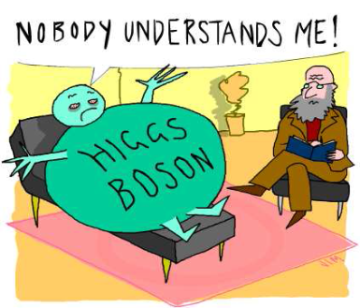
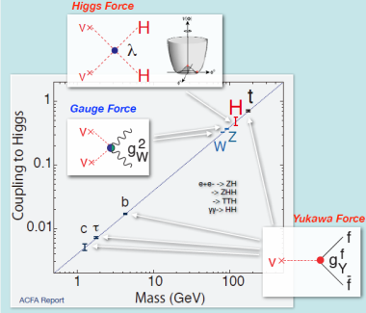
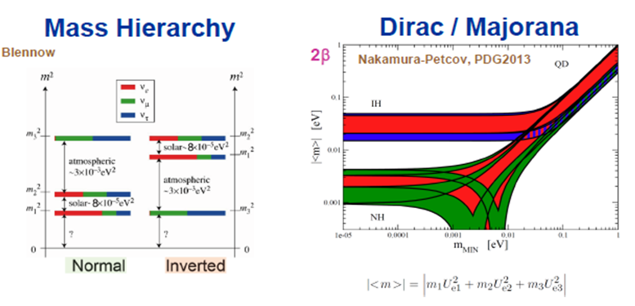

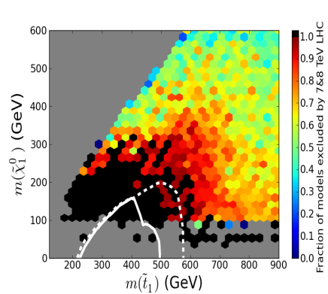
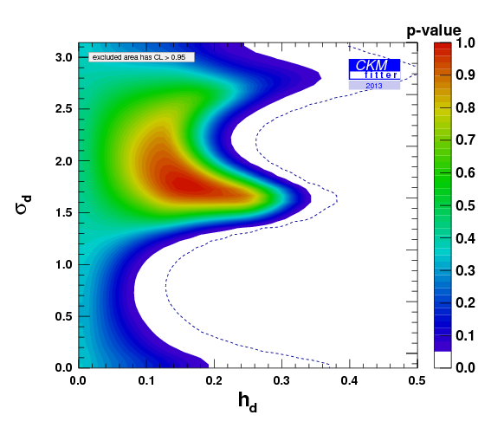
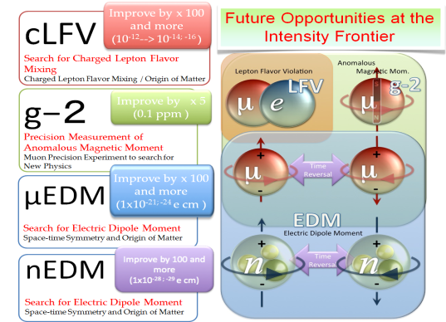
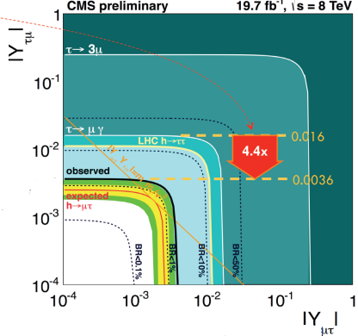
Energy Frontier - Precision Higgs
Physics: Next Energy Scale
(couplings, invisible decays, self-coupling)
Intensity Frontier - Neutrino physics
(mass scale and hierarchy, sterile ν_{R},
CP violation,Dirac / Mjorana, Leptogenesis)
DIVERSITY
BSM Physics -new particles / interations (SUSY, Exotica,
Indirect constraints form Flavour Physics)
Charged Lepton Flavour
Violation (colliders,
new muon experiments):

Slide 6
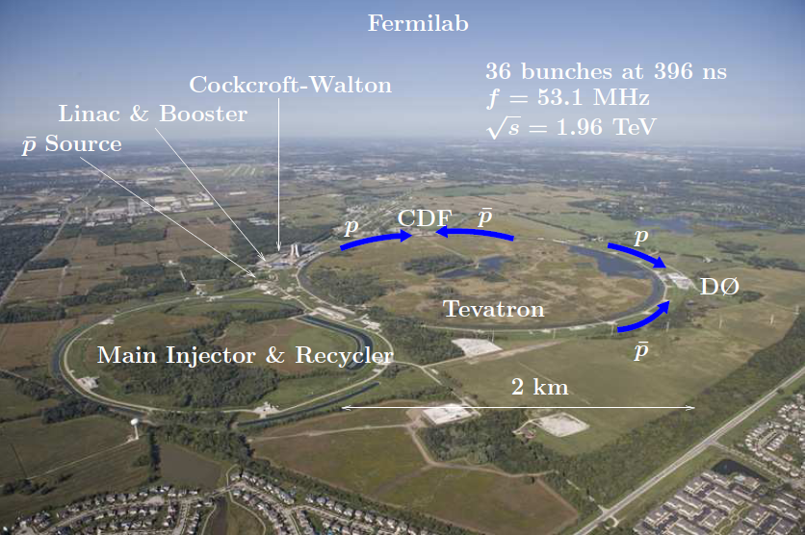
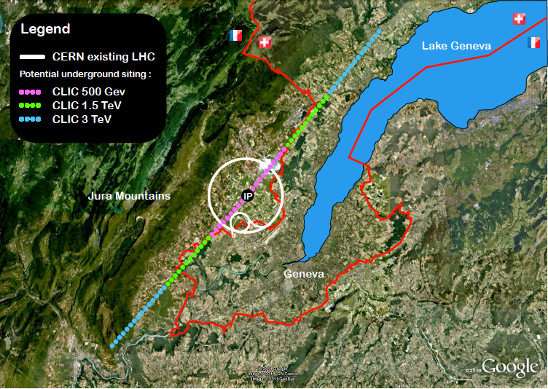
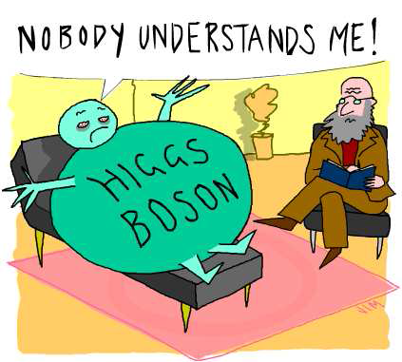
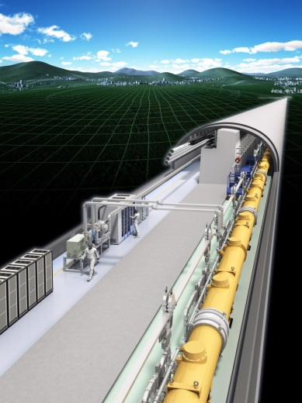
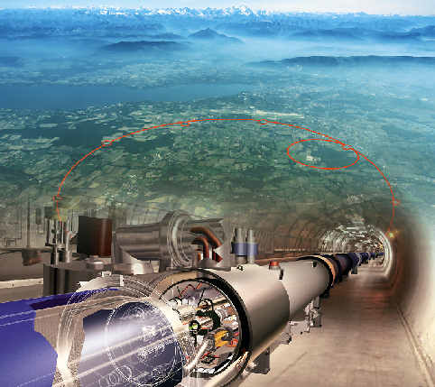
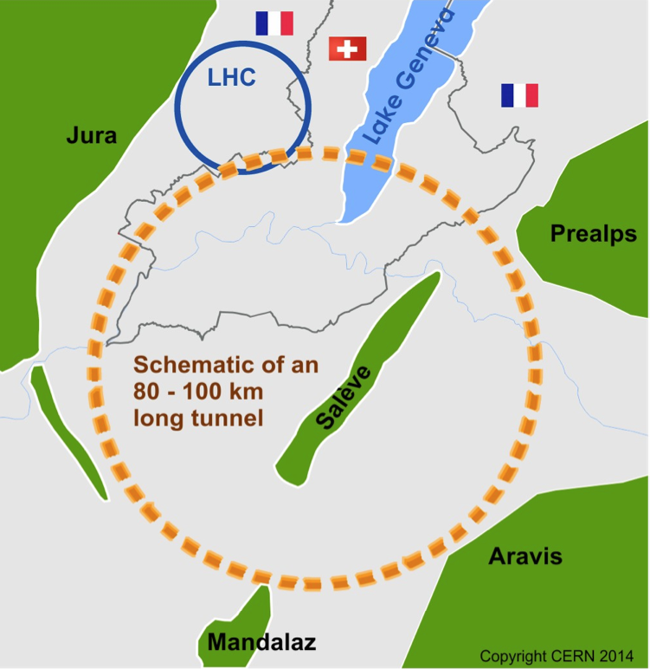
The Energy Frontier Landscape: Past, Present, Future
Tevatron
CLIC
ILC
LHC / HL-LHC
FCC (100 km)
Tevatron – completed run in 2011
Shorter timescale: HL-LHC and ILC
Longer timescale: CLIC
Very recent proposals:
→ CERN: FCC (pp, ep, ee)
→ China: CepC, SppC
 | Type | √s | ∫Ldt
Tevatron | ppbar | 1.96 TeV | 10fb⁻¹
HL-LHC | pp | 14TeV | 3000fb⁻¹
ILC | e⁺e⁻ | 90GeV-1TeV | 250fb⁻¹ – 1000fb⁻¹
CLIC | e⁺e⁻ | 3TeV | 500fb⁻¹ - 2000fb⁻¹
FCC | pp | 100TeV | 3000fb⁻¹
TLEP | e⁺e⁻ | 90GeV-350GeV | 1000fb⁻¹ – 2500fb⁻¹

Slide 7
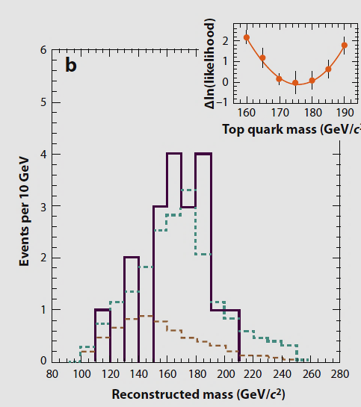
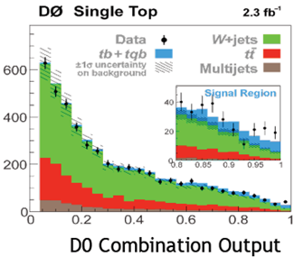
ttbar discovery
ttbar
Single top
Top Discovery & Precision Measurements
1995
2011
TEVATRON PHYSICS LEGACY:
Worked extremely well over 25 years
Delivered > 12fb⁻¹ per experiment (CDF and D0)
Discovery of top quark and single top
Precision Measurements (Mw, Mt, …)
Evidence for H→bb at 3σ level, including LEE
Top Discovery:
Single Top Production:
Higgs
S
U
S
Y
S
U
S
Y
t’
No evidence of a New Physics

Slide 8
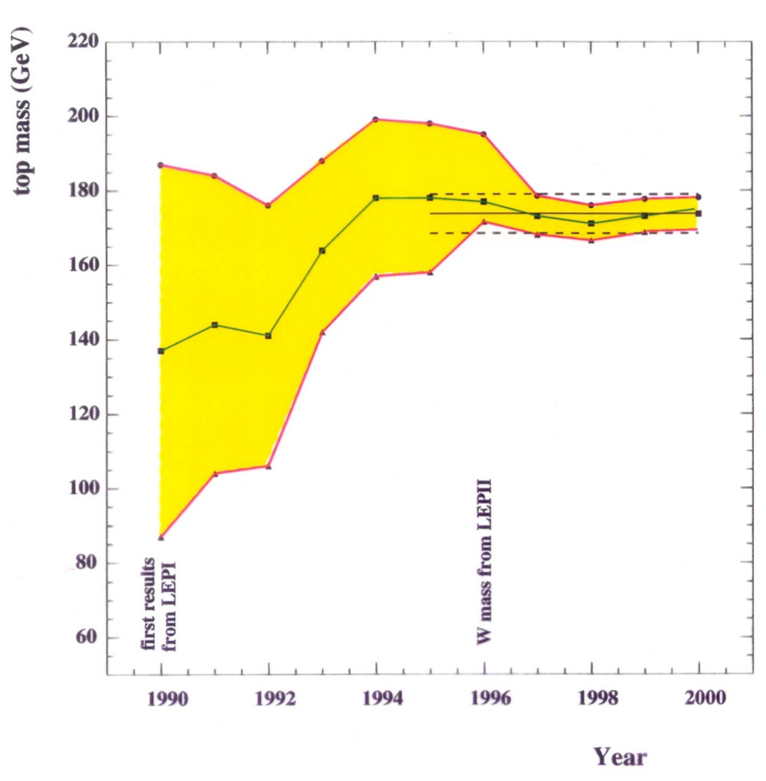
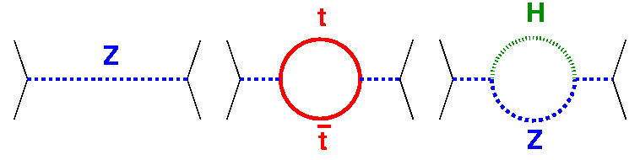
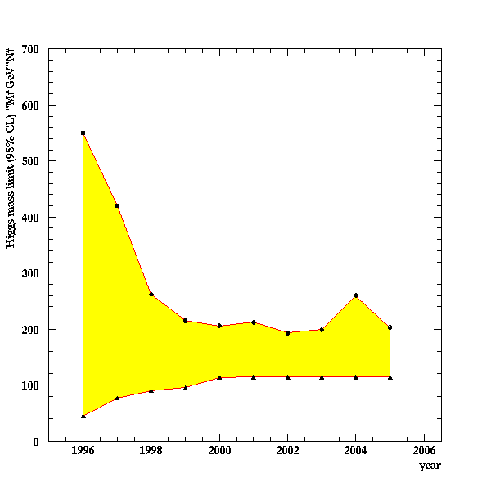
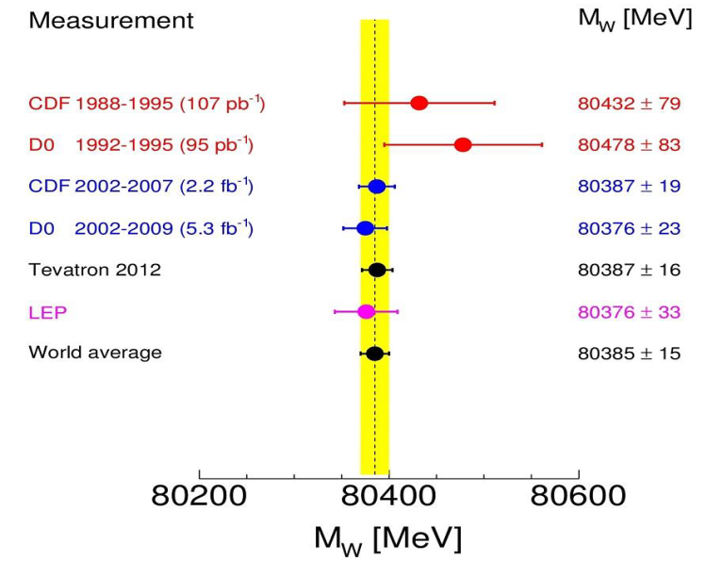
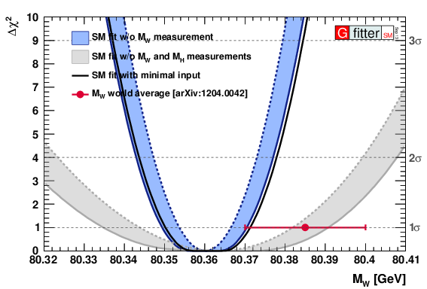
“Why Continue Precision Physics ?”- SM Test at the Level of Quantum Fluctuations
LEP: indirect determination
of the top mass
Radiative corrections gave us:
Top mass before discovery
Bounds for the Higgs mass before its discovery
With known W, Top and Higgs masses, one can constrain whatever lies beyond the SM!
Prediction of the range
for the Higgs mass
TODAY: W-mass world
average: M_{W} = 80,385 ± 15 MeV
(best precision from Tevatron)
FUTURE: Target 10 MeV with full Tevatron Run II statistics:
(largest single uncertainties are statistics and PDF-systematics)
→ Tevatron precision will be hard to top at LHC
Mw could allow
discrimination
between SM and
MSSM scenarios
→ further confront
indirect precision
(11 MeV)

Slide 9
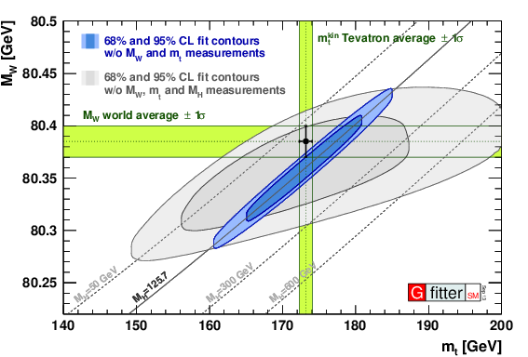
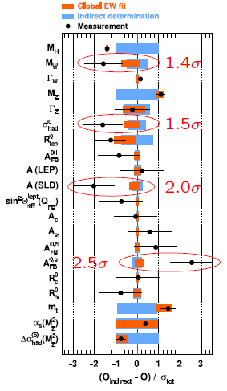
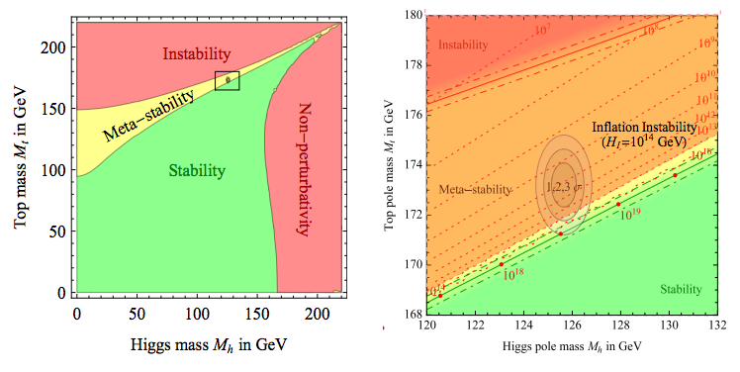
State of the Electroweak Theory: Precision Frontier
Consistency of
the SM EWK fit:
Very good
agreement
between indirect
and direct
determinations
(global p-value ≈ 20%)
Precision top mass
→ SM / BSM physics (top couplings, asymmetry, cosmological implications)
Peculiar values m_{top} and m_{H} : stability/meta-stability boundary
If BICEP2 confirmed → current m_{top}
corresponds to the instable vacuum:
  BICEP2 – different explanation?
  BSM physics at lower scale fixes stability
[1]
[2]
[3]
[1] arXiv: 1205.6497; [2] arXiv: 1403.3985; [3] arXiv: 1405.4781

Slide 10
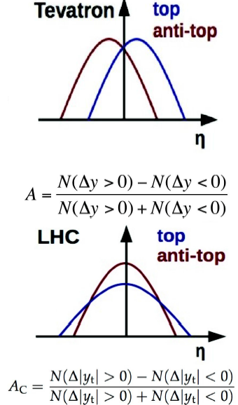
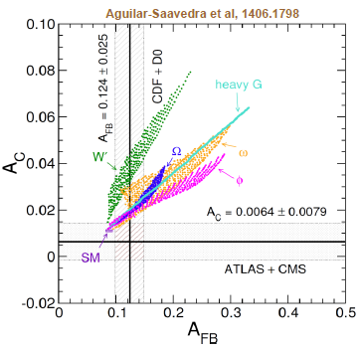
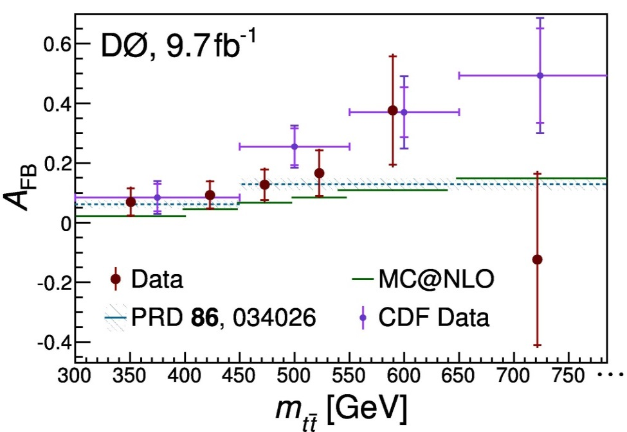
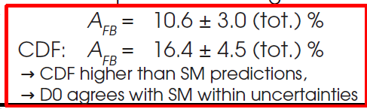
Top Quark: Production Asymmetries
Interference appears at NLO QCD
(only occurs in qq initial state; gg is
forward-backward symmetric)
SM predictions at NLO (QCD+EWK):
Tevatron: A_{FB} ~ 8-9 % (fwd-bwd
asymmetry)
LHC: A_{FB} ~ 1% (no valence antiquarks → tops more central)
→ waiting for full NNLO pQCD
predictions)
Experimentally: asymmetries based on decay leptons (easier) or fully reconstructed top quarks (harder)
Tevatron fwd-bwd asymmetry has been a hot topic
Kinematic dependence with m_{ttbar:} when considering
CDF and D0 → reduced discrepancy with prediction
D0
D0
Tevatron results use full data sets, combinations to come
LHC measurements at increased √s expected to observe asymmetries (today – similar exp. and theory errors)
Theory: Need QCD predictions at NNLO

Slide 11
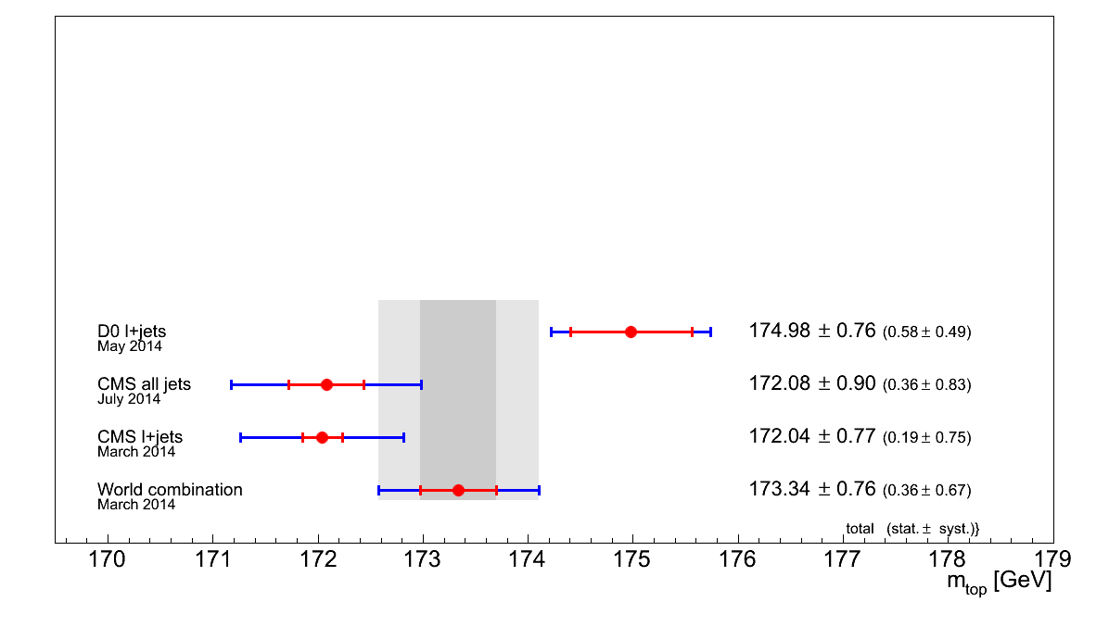
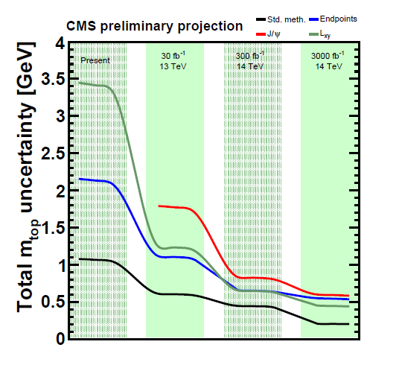

Top Quark Mass Measurement and Projections
Combination (LHC+Tevatron) Top Mass:
Top Mass threshold measurement at the ILC:
ICHEP 2014: Monte Carlo Top Mass
→ Tension between recent D0 and CMS results
Stat. and syst errors on m _{top} (ILC / CLIC):
CMS Top Mass
Projection @ LHC
LHC / HL-LHC:
dominated (already) by systematic error
hard to go below 0.5-1 - what kind of mass?
ILC:
O(100MeV) conversion threshold mass to MSbar
precision of O(120MeV) achievable
CMS-FTR-13-017
Syst. Uncertainty (3000 fb⁻¹): down to ~ 200 MeV
Theory uncertainty:

Slide 12

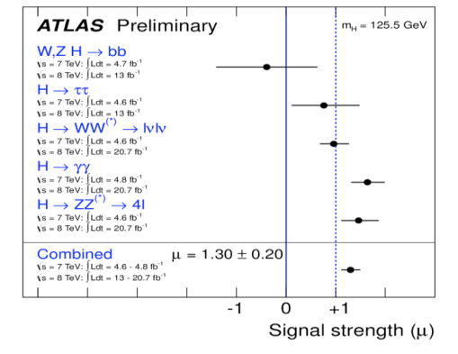

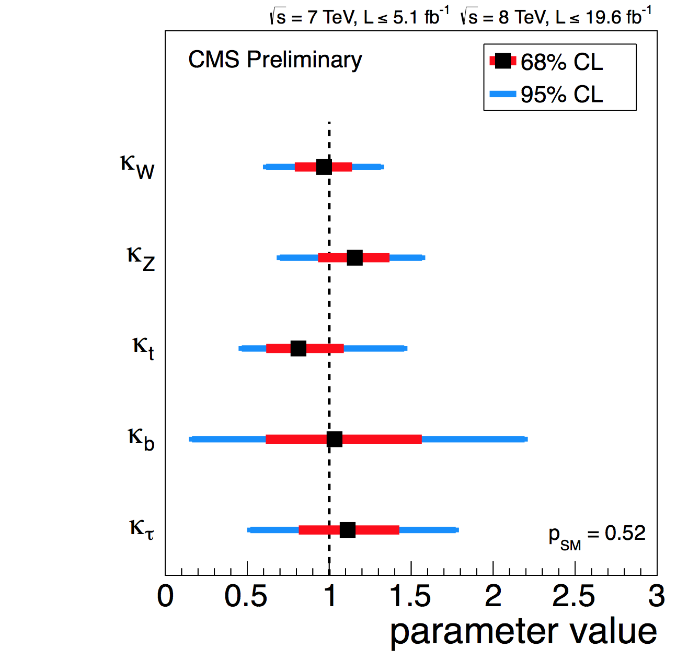
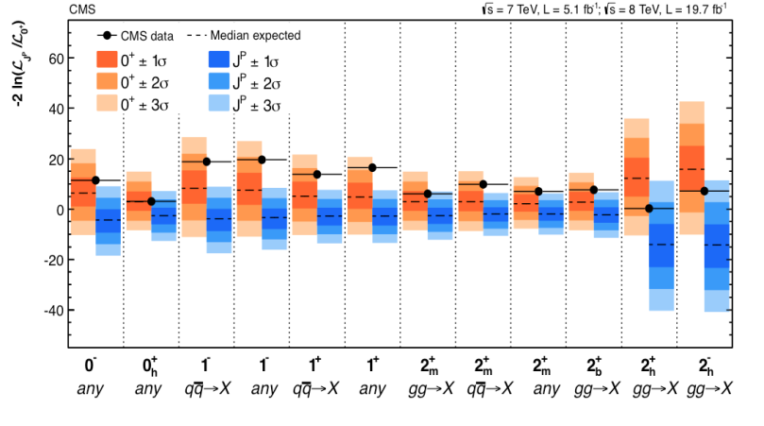
Three Years of Remarkable LHC Operations: First Steps in an Incredible Journey
Clarify the EWK Breaking Sector:
Signal
strength
Couplings
J^{P} = 0⁺ of Higgs –
no surprises !
With the discovery of a Higgs boson,
the SM could be completed → and …
it looks very much like “the SM Higgs Boson »
Higgs is a journey,
not a destination

Slide 13
Energy Frontier - Precision Higgs
Physics: Next Energy Scale
(couplings, invisible decays, self-coupling)
Intensity Frontier - Neutrino physics
(mass scale and hierarchy, sterile ν_{R},
CP violation,Dirac / Mjorana, Leptogenesis)
DIVERSITY
BSM Physics -new particles / interations (SUSY, Exotica,
Indirect constraints form Flavour Physics)
Charged Lepton Flavour
Violation (colliders,
new muon experiments):

Slide 14
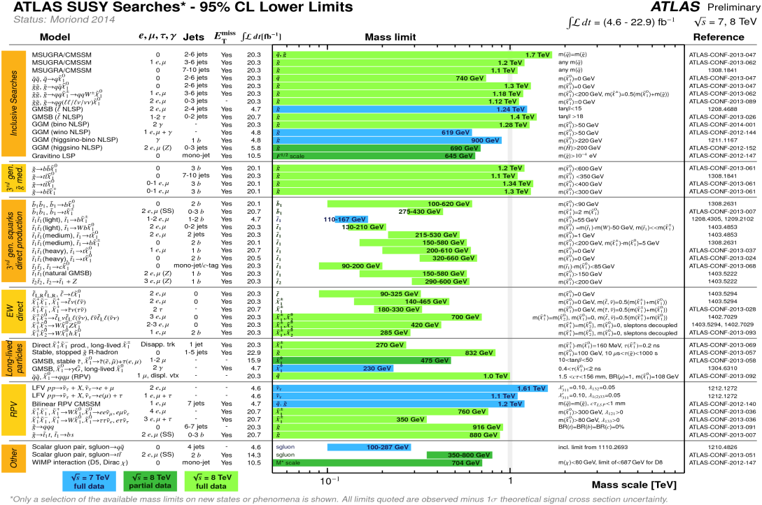
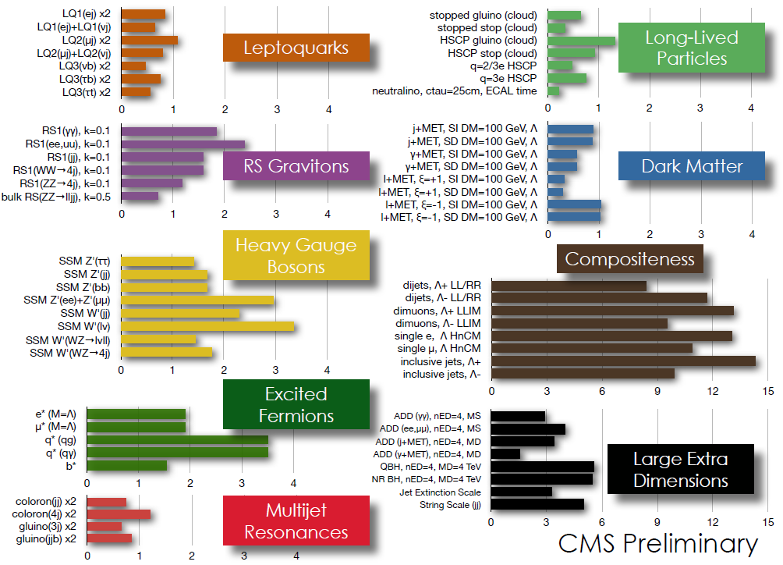
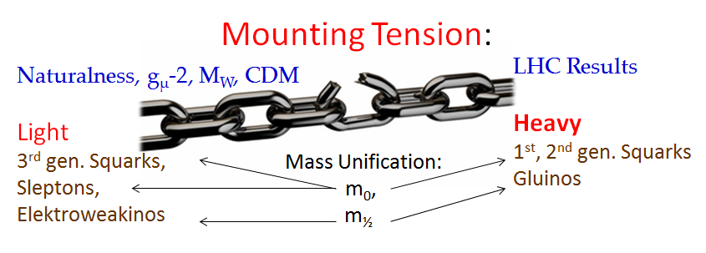
Desperately Seeking for SUSY / Exotica: TONS of EXCLUSION LIMITS from LHC
The Higgs is found, but so far, no evidence of BSM Physics
Strong limits on SUSY Partners and Exotica Particles
→ e.g. squarks/gluinos are > O(1 TeV), stop/sbottom> O(300-600 GeV)
Exotica
Limits:
Overall SUSY
Grand Summary:
There is no rigorous definition of
Natural SUSY models, but ATLAS &
CMS experiments are pursuing the
direct signatures of “naturalness”
SUSY as framework for searches
→ “Which SUSY ??? “

Slide 15
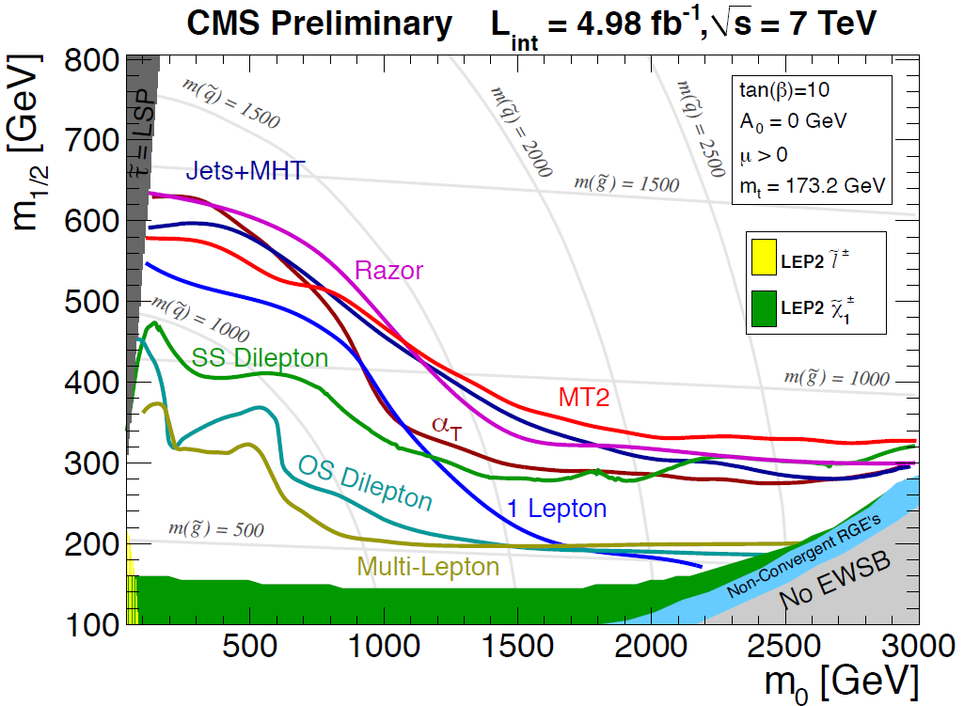
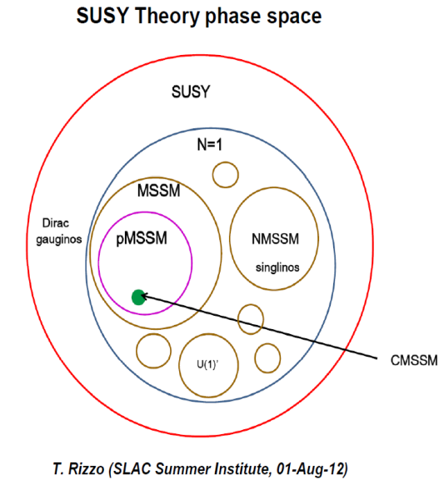
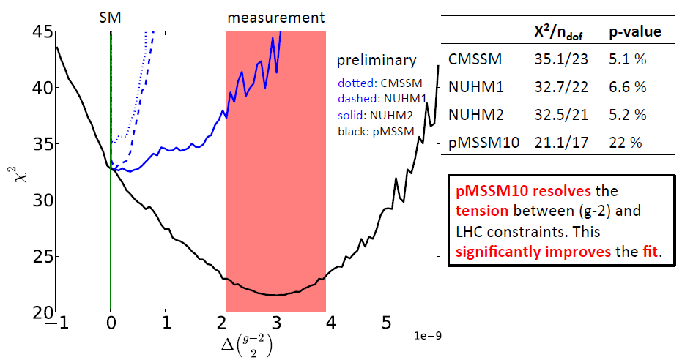
Widening the Horizon: “Which SUSY” ?
« Which SUSY ? » → m₀/m_{½} plot is a highly model-
dependent interpretation of the data !
Looks bad in CMSSM
(not a full SUSY) → 120
MSSM parameters
reduced to 4 + 1 sign
More freedom in the
Phenomenological MSSM
→ 120 par. reduced to
19-20 (many “models”
consistent with data)
CMSSM / mSUGRA vs PMSSM:
Makes clear that the g-2 anomaly is still nearly decoupled from LHC SUSY constraints
But LHC and g-2 could reconnect when the new
g-2 experiment gets results
K. Vries, 2014 ICHEP

Slide 16
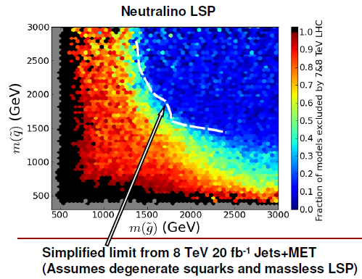
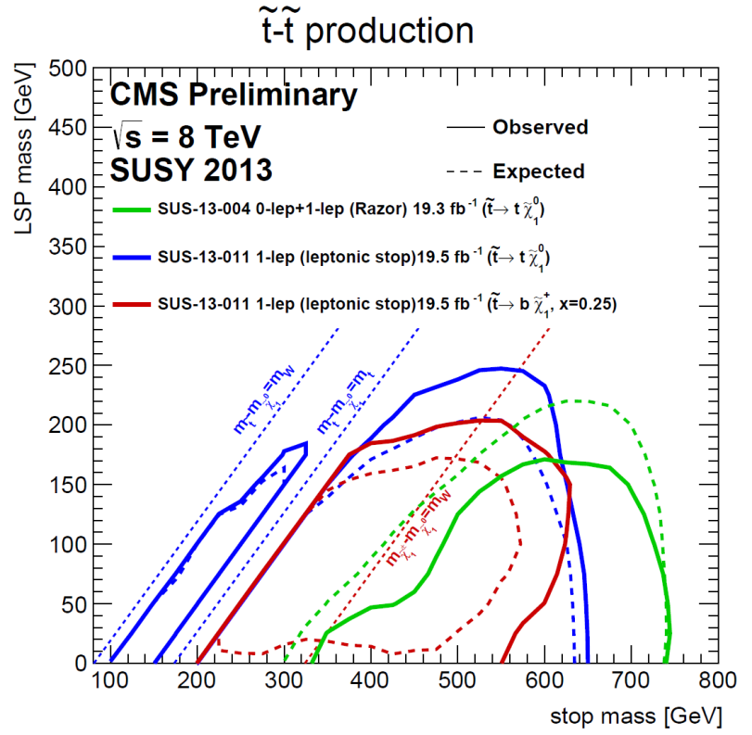
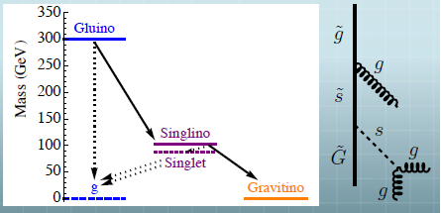
Could New Physics be Missed at the LHC ?
PMSSM vs. Simplified models
One has to make qualified statements
about what is ruled in or out for SUSY:
Colored Sparticle Exclusions Neutralino LSP:
Weakest limits on models with compressed spectra
Invisible NLSPs are sneutrinos and detector-stable neutralinos
If SUSY is natural, we should likely will find it
by observing 3rd generation SUSY particles first !
Stop gaps: Supersymmetry Partner Hiding Here ?
→ stop looks like top: near m_{DM} ~ 0 precision top
measurements and top @ NNLO theory calculation needed
Stealth SUSY stop scenarios:
good challenge for
experimentalists (invisible
particle very light)
Stealth
SUSY:

Slide 17
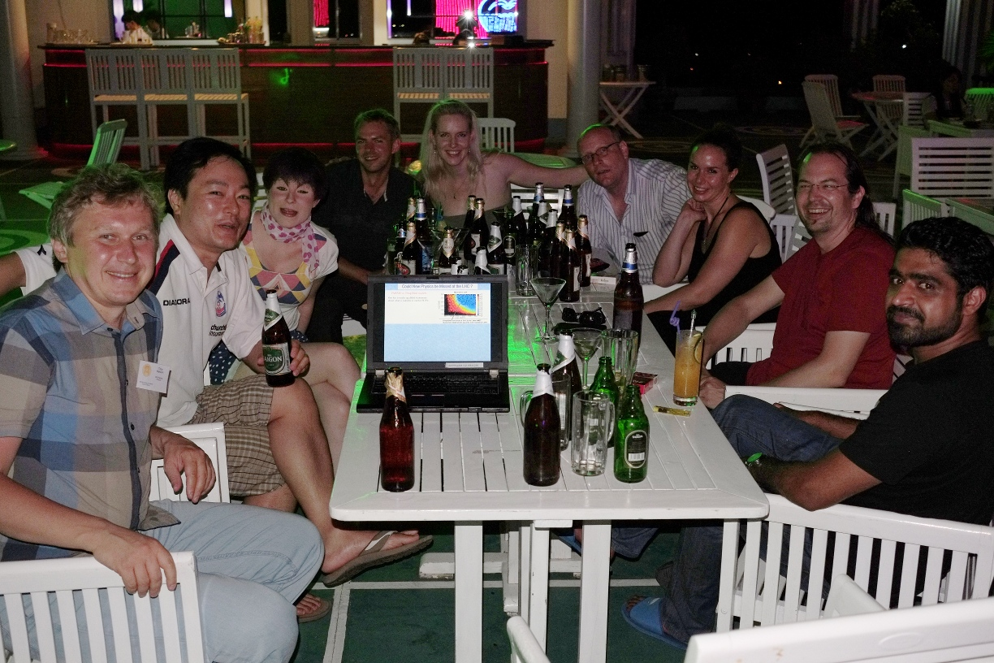
Could New Physics be Missed at the LHC ?
NO WAY …
SUCH A LOVELY CONFERENCE ENVIRONMENT
→ THANKS A LOT TO THE ORGANIZERS
Many SUSY Models
“studied” yesterday
at the table

Slide 18

… Waiting for the LHC Restart …
« Dreaming for the Future … »

Slide 19

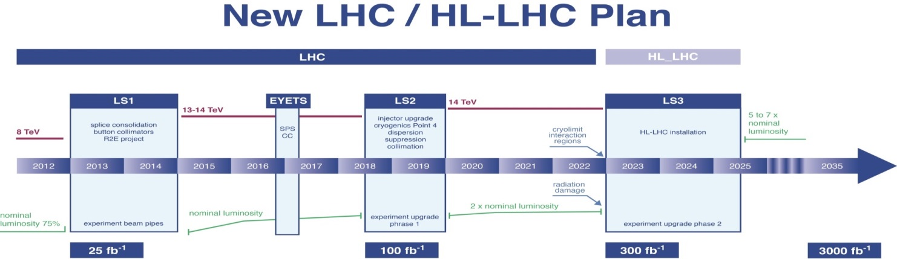
What’s Future: “A Higgs Factory” – It Is All About the “Next Energy Scale” ?
Full exploitation of the HL-LHC is mandatory
Rethink LHC
upgrades in
this perspective
HL-LHC
Study the Higgs
in details
LHC is the DISCOVERY MACHINE !!!

Slide 20

LHC Prospects: Higgs Measurements, SUSY and BSM Searches
Higgs
pp → H, H → WW, ZZ, γγ
mainly gg: Gain factor ~ 2
SUSY – 3rd Generation:
Mass scale ~ 500 GeV
qq and gg: Gain factor ~ 8
SUSY – Squarks/Gluino:
Mass scale ~ 2.0 TeV
qq,gg,qg: Gain factor ~300
Z’:
Mass scale ~ 5 TeV
qq: Gain factor ~1000
Use parton luminosities to illustrate gain factors: 8 → 14 TeV
J. Virdee
Energy is everything: bright prospects
for the near future
e.g. only with a few fb⁻¹ @ 14 TeV
new territory will be probed in
searches for strongly produced SUSY
Limits not much increased by luminosity
At the end of Run II (14 TeV, 100/fb):
M_{X}=1 TeV → statistics x 15
M_{X}=2 TeV → statistics x 50
M_{X}=3 TeV → statistics x 100
“Natural” limit of LHC ~ few TeV
sensitivity (depending on the object)

Slide 21



Future Prospects in a Nutshell: Higgs Boson Couplings at the HL-LHC
ATLAS
arXiv: 1307.7292
arXiv: 1307.7135
300 fb⁻¹
CMS
3000 fb⁻¹
Dashed:
theoretical
uncertainty
300 fb⁻¹
CMS
3000 fb⁻¹
3000 fb⁻¹: typical precision 2-10%
per experiment (except rare modes)
→ 1.5-2x better than with 300 fb⁻¹
Crucial to also reduce theory uncertainties
CMS Scenario 1 (pessimistic): systematic uncertainties as today
CMS Scenario 2 (optimistic): experimental unc. as 1/√L, theory halved

Slide 22




What’s Future: “A Higgs Factory” – It Is All About the “Next Energy Scale” ?
Full exploitation of the HL-LHC is mandatory
Rethink LHC
upgrades in
this perspective
HL-LHC
Linear
Colliders
20 Years of R&D: ILC (0.25 -1 TeV) and CLIC (0.35 -3 TeV)
Study the Higgs
in details
ILC:
CLIC:
« HIGGS AT A TOOL » FOR DISCOVERY !!!
Today ILC @ Japan: is the only mature technology for the Future Accelerator at the Energy Frontier
e⁺e‑ Storage Rings
HE pp Colliders
Design Studies
Ambitious R&D
and scope
Long-term
Global Projects
FCC (pp,ee):
CepC:
“Science fiction”
projects at the
technology frontier

Slide 23
The Way Forward: Storage Ring or LC for the Future e+e- Accelerator
Energy tends to be the cost driver:
hadrons - high-field magnets; e+e- - high-gradient RF
ℒ ×E_{CM} drives the MWatts (at least for leptons):
→ it’s all about COST per GeV | inv fb
e+e- Storage Rings:
(250 GeV favours storage rings)
Technology: CepC (240 GeV) & FCC-ee (350 GeV) studies still in it’s infancy
Design in flux (subject to change)
Key challenges being addressed (2018?)
Physics: evaluate the consequence of the
limited Higgs/Top physics potential:
CepC: no ννH prod mech.; no m_{top} meas.
TLEP: no direct ttH, HHH couplings
LHC:
< 100 MW
Linear Colliders
(350 -500 and up LC looks better):
Technology: ILC/CLIC > 20 years R&D
ILC: ready to go (10 y. construction), if political decisions are taken
Physics: Both US (P5) and EU (ES) have
supported the very strong physics case
→ The ultimate future of e+e-
colliders is linear … or not at all
(very simplified)
N. Walker
SuperKEKB addresses many similar e+e- storage ring challenges
Need to wait for robust and defendable (MWatts
and COST) estimates from storage ring studies

Slide 24




The LC is a “Higgs Factory” and the Energy Frontier Machine
Higgs Boson Production at LC:
Baseline ILC Program (250 + 500 + 1000 GeV):
Model-independent global fit for couplings:
ILC’s precisions on
will ultimately
reach sub-% level
(luminosity
upgrade)!
Staged Running Program:
Start with a Higgs Factory 250 GeV
Upgrade to ~ 500 GeV (TDR baseline)
Technical extendibility of energy
staging to ~ 1 TeV has to be secured
Control of systematics:

Slide 25



The Flagship of LC @ 250 GeV: Recoil Mass Measurement
“Window” to absolute measurements of all σ(ZH) x BR and model-independent determination of Higgs boson couplings, total width (e.g. invisible Higgs, H → cc, modes undetectable at LHC)
Higgs recoil analysis →
identify 2 opposite charged leptons with invariant mass consistent with M_{z}
Statistical uncertainty on σ(ZH) at √s = 250 GeV eventually limits the precision on all BR measurements:
K. Fujii

Slide 26


Complementarity of LHC and LC Higgs Coupling Measurements
Hadron experiments cannot directly measure a narrow Higgs width (< 5 MeV) → cannot simultaneously constrain the couplings and new contributions to the total width
LC(250): great precision on ΔZ, total
widths is an issue (stat. limited: σxBr (HZ))
D. Zerwas
LC(500):
Theory uncertainties on BR are very important → Need to match superb experimental precision and sensitivity to new physics
FCC-ee / TLEP (350 GeV) - ttH is not measured directly:
→Non-measurement of Δt means determination via Δc;
H→cc theory error leads to deterioration of precision
cascades into Δg
impacts the total width
D. Zerwas

Slide 27




Higgs Couplings Measurements: “Ultimate Precision”
LHC vs ILC:
Model-independent
coupling determination
is unique to the ILC
ILC Model Independent Global Fit for Couplings:
Baseline ILC Program:
Luminosity Upgrade:
K. Fujii

Slide 28




Effect of New Physics on Higgs Couplings
Deviations in Higgs couplings is a signature of many BSM theories
→ The pattern of deviations can be specific
for each model.
Sensitivity to BSM physics manifesting itself only
through deviations to Higgs couplings
(no new particles observable at LHC):
Precision Higgs coupling measurements at the ILC at the 1% level enable us to fingerprint the different models
ILC: Lumi 1920 fb⁻¹, sqrt(s) = 250 GeV, Lumi 2670 fb⁻¹, sqrt(s) = 500 GeV
T. Tanabe
We must examine this Higgs to the fullest extent !
→ It may be the only clue to leave the SM oasis and cross the desert !!!

Slide 29


BSM Higgs: Heavy Higgs Mass Reach
LHC: Heavy Higgs direct search
ILC: Indirect search via effect on Higgs couplings BR(h→WW)/BR(h→bb)
LHC vs ILC:
ILC:
Lumi 1920 fb⁻¹, sqrt(s) = 250 GeV
Lumi 2670 fb⁻¹, sqrt(s) = 500 GeV
T. Tanabe
Combined effect of γγ, ττ, bb channels
Cahill-Rowley, Hewett, Rizzo
HL-LHC 3000 fb⁻¹
ILC (1150 fb⁻¹, 250 GeV & 1600 fb⁻¹, 500 GeV)
LHC vs ILC:
*the fraction of models having given parameters that are excluded by the combined HL-LHC or ILC searches

Slide 30


Higgs / WIMP Portals to Dark Matter
Higgs Portal: Invisible Higgs Decays (e.g. into Dark Matter particles):
BR results reinterpreted in the context of Higgs portal of DM interactions
Caveat: significant theoretical uncertainties in translating the EFT limits into
DM-nucleon cross section
LHC
arXiv: 1404.1344
Complementary to direct searches
(improves reach at low DM mass)
WIMP Portal : Searches for Mono-γ/mono-jet
Loopholes of HL-LHC → Hunting Ground of ILC
LHC vs ILC:
LHC sensitivity: Mediator mass up to Λ~1.5 TeV
ILC sensitivity: Mediator mass up to Λ~3 TeV
for DM mass up to ~√s/2
3000 fb ⁻¹
A. Chaus, J. List

Slide 31








The ILC - A Global Project in Japan
A. Yamamoto
Solid SRF technological base for the ILC is now in place → GLOBAL EFFORT
(>20 years R&D worldwide; cost driver: SRF tech. 17,000 1.3 GHz Nb cavities; 1,800 cryomodules
TTF/FLASH (DESY) ~ 1 GeV
ILC-like beam; ILC-RF unit
STF / STF2 (KEK)
ILC-like Cryomodule Test： S1-Global
SRF beam acceleration: STF2
CesrTA (Cornell)
electron cloud
low emittance
DESY
◉
◉
INFN Frascati
KEK, Japan
FNAL
◉
◉
Cornell
◉
NML /ASTA (FNAL)
ILC RF unit test
Full Cryomodule Test
SRF beam acceleration
(soon)
ATF / ATF2 (KEK)
ultra-low beam emittance
final focus optics; nano-beam
KEKB electron-cloud
DA^{f}NE (INFN Frascati)
kicker development
electron cloud

Slide 32

A Window of Opportunity: Worldwide Infrastructure for the ILC
Preliminary;
results are not published
US and EU (industrial) production
and test capacity are in-place
ILC can be built now within “carefully estimated envelope” based on the real EU-XFEL project costs
N. Walker

Slide 33
Compact Linear Collider (CLIC)
>20 years of R&D; CDR published in 2012
2012-2018 programme:
Rebaselining (cost, MW, Ecm staging)
Further high-gradient R&D
Systems testing (CTF3,ATF2,FACET)
Tech. systems development (CLIC module)
Physics studies…
CTF3
Synergy with ILC (LCC collaboration):
ATF2 (KEK) - nanobeams, stabilisation
FACET(SLAC)- emittance preservation/tuning
Currently the only option to
multi-TeV e⁺e⁻
if physics case requires
18

Slide 34

HISTORY OF COLLIDERS (Thinking of the Future):
HADRON
COLLIDER
LEPTON
COLLIDER
Precision measurements of neutral current (i.e. polarized e+d) predicted m_{W}, m_{Z}
→ UA1/UA2 discovered W/Z particles
→ LEP nailed the gauge sector
Precision measurements of W,Z(LEP+Tevatron) predicted m_{H}
→ LHC discovered a Higgs particle
→ LC nails the Higgs sector?
Precision measurements of Higgs (HL-LHC + LC) will nail the “New Energy Scale” ?
Push Energy Frontier
beyond LHC:
Problem: no argument for a particular energy scale yet ☹
We must exploit all opportunities→long-term goal – 100 TeV FCC-pp

Slide 35



Future Circular Collider (FCC) @ CERN
FCC STUDY:
Forming an international collaboration to study Future Circular Colliders in 80-100 km ring
100 TeV pp: ultimate goal (FCC-hh)
90 - 350 GeV e+e-: possible intermediate step (FCC-ee)
√s= 3.5-6 TeV ep: option (FCC-eh)
Goal: CDR and cost review for the next European Strategy Update in ~2018.
Courtesy: J. Wenninger/ Johannes Gutleber
LHC
FCC
15 T magnets ⇒ 100 TeV in 100 km
20 T magnets ⇒ 100 TeV in 80 km

Slide 36





Physics Case for a 100 TeV Collider
Focus on understanding why 100 TeV region:
What are origins of mass scales 14 <Λ< 100 TeV ?
“Sort of” no-lose BSM scenarios at 100 TeV ?
Rare processes important to explore at 100 TeV ?
Interplay with other probes available 30 years
from now (e.g. cosmos, e+e- collider) ?
Rare processes: ttH/ttZ - probe of top Yukawa coupling down to sub-% precision
Scale:
PDF:
M. Mangano
F. Gianotti
Projecting the discovery reach
http://cern.ch/collider-reach (Salam, & Weiler)
arXiv: 1309.1688
arXiv: 1311.6480
Z’
Squarks/gluinos
Expected Sensitivity (Λ ):
Compositeness: 120 TeV
Z’: 50 TeV
Squarks/gluinos: 15 TeV
Rule of thumb: at fixed Luminosity, discovery reach scales like 2/3 Ebeam
=> x 5 from 14 to 100 TeV

Slide 37

Flavor Physics vs Energy Frontier Experiments
Direct searches at the Energy Frontier
probe the scale of NP Λ
Limited by available CM energy
Flavor physics
probes NP indirectly through loop effects
Limited by the size of flavor violation δ
and the available statistics/precision
DIRECT
INDIRECT

Slide 38

Flavor Physics Probe 10² – 10⁵ TeV Scale of NP
NP Flavor Problem:
Most TeV-scales new physics contain new sources of
CP and flavor violation
The observed baryon asymmetry of the Universe requires
CPV beyond the SM (not necessarily in flavor changing
processes, nor necessarily in quark sector)
Constraints from HF are demanding
→ adding effective operators to SM generally leads to very large Λ:
The Standard CKM Fit:
Much larger allowed region if SM not assumed to hold, more parameters
Crucial for improving sensitivity to BSM → compare tree vs. loop measurements → e.g. γ and |V_{ub}| (statistics limited with any currently imagined dataset/experiment)
NP Phase
NP/SM amplitude ratio
Need experimental precision and theoretical cleanliness to increase NP sensitivity
O(10-20%) NP contributions to
most loop processes (FCNC) are
compatible with all current data
Future:
Comparable increase in reach to higher mass scales as going from LHC 7-8 → LHC 13-14

Slide 39






Rare B_{s} (B_{d})→ μμ Decays
The FCNC SM decay is helicity suppressed; expectations are well known theoretically with small uncertainty
Very sensitive to loop contributions from new particles, with possibly large enhancements
CMS: Scan of the ratio of the joint likelihood
BR(Bs → μμ)/
BR(Bd → μμ)
clean
test of
MVF
Bs (dominant higgsino-stop loop):
B → μμ Limits:
History
Shrinking room for NP comparable with SM
arXiv: 1205.6094
The quest for Bs decays is finally over
Br(B_{s}⁰ → μ⁺μ⁻) > 5σ measurement
(CMS + LHCb Combination):
→ experimental uncertainty will decrease a lot;
interpretation not theory limited

Slide 40








Tensions on Some Flavor Observables
Excess of B → D*τν decays (B-factories) (sensitive to extended Higgs sector at tree level such as 2HDM)
B → K*μμ anomaly (LHCb)
(decay rate and angular distributions are sensitive to
NP in photon, vector and axial-vector couplings - can
one calculate form factor ratios reliably at small Q²?)
NP, theory,
fluctuation ?
Flavor Physics is very important to reveal “Next Energy Scale” (many talks at the conference)
→ More in “Experimental Summary” by Tatsuya Nakada
Anomalous like-sign dimuon charge
asymmetry (D0)
Tauonic B Decays
Tree-level decays in the SM via W-boson
→ sensitive to charged Higgs boson
in a 2HDM with flavour-violation in the
up sector: searches for A⁰, H⁰ → tc; t → h⁰c)
Nearly a 4σ significance
Would be a NP clear sign:
SM: ~ 4 x 10⁻⁴ in B_{d}
2x 10⁻⁵ in B_{s}
Phys. Rev. D89, 012002

Slide 41
Energy Frontier - Precision Higgs
Physics: Next Energy Scale
(couplings, invisible decays, self-coupling)
Intensity Frontier - Neutrino physics
(mass scale and hierarchy, sterile ν_{R},
CP violation,Dirac / Mjorana, Leptogenesis)
DIVERSITY
BSM Physics -new particles / interations (SUSY, Exotica,
Indirect constraints form Flavour Physics)
Charged Lepton Flavour
Violation (colliders,
new muon experiments):

Slide 42



Neutrinos are Messengers of New Physics
Mixing angles & Δm² are well known - O(10%)
Neutrino masses: what is the absolute scale
and the hierarchy (normal or inverse) ?
How large is CPV phase δ_{CP} ?
Is Nν =3 or there are more (sterile) neutrinos ?
Is neutrino Dirac of Majorana fermion ?
Do neutrino oscillations violate CP ( δ_{CP})?
→ Necessary condition for successful
baryogenesis (matter-antimatter
asymmetry of the universe)
CP violation requires genuine 3ν oscillations,
distinct from 2ν limits...
3 mixing angles should be nonvanishing ✔
2 mass gaps should be nonvanishing ✔
1 phase should be nonvanishing
Nature has already provided us with 5
favorable conditions at terrestrial scales ...
Let us hope that the 6th is also realized !

Slide 43




Neutrino Flavors: Masses and Mixings
Prize: precise determination of Θ₁₃ (reactor expts)
(previously just known to be small relative to Θ_{12,} Θ_{23):}
Daya Bay: sin²(2𝜃₁₃ ) = 0.090 ± ^{0.009} _{0.008}
Double Chooz: sin²(2𝜃₁₃ ) = 0.097 ± 0.035
Reno: sin²(2𝜃₁₃ ) = 0.100 ± 0.018
Flavour mixing is very different for quark and leptons
The large value of Θ₁₃ opens the window to the measurement of the neutrino mass hierarchy and leptonic CP violation.
“Solar” parameters (𝜃₁₂ and Δm²₂₁):
« Atmospheric” parameters (𝜃₂₃ and|Δm²₃₂|):
SNO, Super-K (solar), KamLAND (reactor), …
Super-K (atmospheric), T2K, MINOS (accelerator)
Precision flavor physics: 2-5% precision achieved

Slide 44




Prospects: CP Violation and Mass Hierarchy
TODAY:
T2K joint νe +νμ analysis:
FUTURE
Neutrino Factory a Precision
→ CP violation physics reach @ facilities
To probe CP
violation in
ν-sector same level as in the CKM matrix
→ muon
storage rings
First T2K hints:
NH & δ_{CP} = -π/2
arXiv: 1209.5973
Mass Hierarchy Sensitivity in Future Experiments (consistent assessment from oscillations):
Rejecting normal hierarchy is more difficult and really requires LBNE
Width of the bands correspond to different values of the CP phase (δ_{CP})
Unlikely to have solid (> 3σ)
result for another 8-10 years…
arXiv: 1311.1822

Slide 45


Superconducting RF Technology for Energy and Intensity Frontiers
Energy Frontier (SRF for ILC):
Energy-efficient/ultra-high Q₀ (10¹⁰ )
- small surface resistance
Long beam pulses (~1 ms)
- intra-pulse feedback
Larger aperture / smaller beam loss
Intensity Frontier (LBNE/USA):
Same technology modified for high
current/intensity facilities → P5 endorsed
the PIP-II SRF linear accelerator project
→ most powerful neutrino beams
SRF
Technology

Slide 46





Prospects: Double Beta Decay Experiments
Observation of 0νββ decay would establish:
Neutrinos are Majorana particles
Lepton number violation
Neutrino mass scale
Majorana neutrinos are required in seesaw
mass models and leptogenesis
Next generation of 0νββ experiments will use different technologies and approaches:
→ Probe the inverted hierarchy region
→ If inverted hierarchy is found and 0νββ decay experiments see no signal, neutrinos are not Majorana particles
A. Sousa
arXiv: 1203.5250
arXiv: 1203.5250

Slide 47






Searches for Majorana Neutrino / Heavy Neutral Particles @ Colliders
Lack of new, heavy particle → interest in “hidden sector” theories (e.g. long-lived portal particles)
Search for Majorana Neutrino in B → π⁺μ⁻μ⁻ (LHCb)
Forbidden in SM, proceed via production of on-shell Majorana
PRL 112 (2014) 131802
LHCb demonstrated capability to probe:
ν-masses 250-500 MeV and ν-lifetimes 0-1000 ps
Hunt for Heavy Neutrinos at Z/H Factory (TLEP):
Depends on HNL decay length and efficiency:
→ Mixing with active neutrinos leads to measurable
effects at High Energy
If N is heavy it will decay in the detector (not invisible)
➔ Deficit in Z «invisible» width
➔ H / Z visible exotic decays H→ ν_{i}‾Ν_{i} and Z→ ν_{i}
N_{Z} = 10¹³ 100$m$ <L<5m
Final LEP result:
TLEP
(Fcc-ee):
A. Blondel, 2014 ICHEP

Slide 48


Search for HIdden Particles (SHIP): Beam-Dump Experiment @ CERN
SM is unable to explain:
Neutrino masses
Excess of matter over antimatter in the Universe
The nature of non-baryonic Dark Matter
→ All three issues can be solved by adding three new fundamental fermions, right-handed Majorana Heavy Neutral Leptons (HNL)
νMSM: T.Asaka, M.Shaposhnikov PL B620 (2005) 17
Role of N₁ with mass in keV region:
Dark Matter (N₁ → 3ν or N₁ → ν γ )
Role of N_{2,3} with mass in the GeV region: neutrino
masses and baryogenesis N_{2,3} → μ/e π or N_{2,3} → μνe
(N_{2,3} have long lifetimes ~ 10 μs)
Role of the Higgs: give mass to fermions and bosons,
and inflate the Universe
→ N_{2,3} could be produced in decays of D mesons:
SPS beam dump + long spectrometer
http://ship.web.cern.ch/ship

Slide 49
Energy Frontier - Precision Higgs
Physics: Next Energy Scale
(couplings, invisible decays, self-coupling)
Intensity Frontier - Neutrino physics
(mass scale and hierarchy, sterile ν_{R},
CP violation,Dirac / Mjorana, Leptogenesis)
DIVERSITY
BSM Physics -new particles / interations (SUSY, Exotica,
Indirect constraints form Flavour Physics)
Charged Lepton Flavour
Violation (colliders,
new muon experiments):

Slide 50




Charged Lepton Flavor Violation (LFV)
SM predicted lepton flavor conservation (m_{ν} = 0)
→ Today known to be violated, but suppressed
by terms of order (Δm_{ν}²/M_{W}²)² ~ 10⁻⁵⁰
Many BSM models predict enhanced rates of LFV (close to the current experimental limits)
→ Unambiguous Sign of New Physics
g-2 and μ → eγ: best constraints on generic NP
If new TeV particles (e.g. sleptons) exist → have their
own mixing matrices → LFV
ν-mass
term (SM)
BSM
physics
E.g.: τ ◊ 3μ rates in the SM / BSM scenarios
μ → e conversion: excellent experimental
prospects (sensitive to Higgs mediated flavour-violation)
τ◊ μμμ, τ → eμμ, τ → eee, μ → eee: sensitive to
flavour-changing neutral effects
Next 10–20 years: 10²–10⁵ sensitivity improvement
→ any signal would trigger broad program

Slide 51






Searches for Lepton Flavor Violation @ Collider Experiments
Search for Lepton Flavor Violation in τ → μ⁺μ⁻μ⁻ (LHCb)
LHCb
Observed (expected) τ → μ⁺μ⁻μ⁻: 8.0x10⁻⁸ (8.3x 10⁻⁸)
ν-mass
term (SM)
Sensitivity:
1 fb⁻¹ (LHCb)
1 ab⁻¹ (e+e-,
charm/tau
factory)
PLB724 (2013) 36
Projections:
BSM
physics
LHCb Run 2 may overtake the Belle limit …
but should eventually be overtaken by Belle 2
Belle
Flavor-violating Higgs decays:
H → τμ (CMS)
→ Translate BR limits to limits on Yukawa couplings
Mild access in data
Previous best limits on
B(H→μτ) <~ 10%:
→ From reinterpretation of
LHC ATLAS H→ττ searches
and from τ→μγ (arXiv:1209.1397)
Can do better with first
dedicated search:
Best limits on
τ anomalous
Yukawa
couplings.
CMS-PAS-HIG-14-005

Slide 52



New Generation of Muon Experiments (M2e, Meg, g-2)
New heavy particles could affect
charged leptons via loops
(new l-l coupling : ):
Lepton flavor conserving,
CP conserving part of this
contributes to muon g-2
Lepton flavor conserving,
CP violating part creates an EDM
Lepton flavor violating part
induces μ → e conversion
arXiv: 1307.5787

Slide 53






New Generation of Muon Experiments: M2e (FNAL, JPARC) and Meγ (PSI)
Physics sensitivity: μ→ eγ vs μ→e conversion
Future M2e conversion experiments:
sensitive to both loop (dipole) and tree-level (contact) interaction contributions
Neutrino-less muon-nuclear capture
Photonic (dipole)
Contact
Future M2e Conversion Experiments:
→10⁴ improvement over best limit
JPARC
FNAL

Slide 54



New Generation of Muon Experiments: Sensitivity to High Mass Scales
M2e Conversion:
New Physics Scenarios:
Sensitive to mass
scales up to
O (10000 TeV)
EPJ.C57: 13-182,2008
M2e Conversion:
Meγ Experiment:
M2e, Meγ @ LHC:
Scan of “LHC
accessible” SUSY
parameter space
PRD74(2006) 116002

Slide 55





Muon g-2 Experiments @ FNAL and JPARC
g-2 Experiment at FNAL: remake of the E821 BNL Exp. with 4x sensitivity → data-taking expected in 2017
Improved field uniformity
Better calorimeters
20x statistics
Hint
for NP ???
g-2 / EDM Experiment in JPARC:
Complementary approach
( similar sensitivity 0.1 ppm)
→ data-taking expected in 2016:
Measure spin precession precisely:
Parallel to magnetic field → g-2
Orthogonal to magnetic field → EDM

Slide 56

We Have to Exploit All Opportunities !!!
The direct understanding of the EWSB nature remains a crucial question:
→ Higgs is absolutely central: study its properties with an ultimate precision O(1%)
→ HL-LHC has the highest priority
→ LC has an evolutionary program to address ultimate precision
→ deviations could give us upper limit on the new physics scale
LHC is the discovery machine →
the adventure in the TeV energy
regime has just begun
New Physics can also show up at low energy in the form:
High-scale phenomena revealed by low-scale
processes (flavor physics, g-2, Mu2e, …)
Low-mass BSM particles (axions, neutral leptons/neutrinos, low-mass WIMPs, sterile ν’s)

