Slide 1

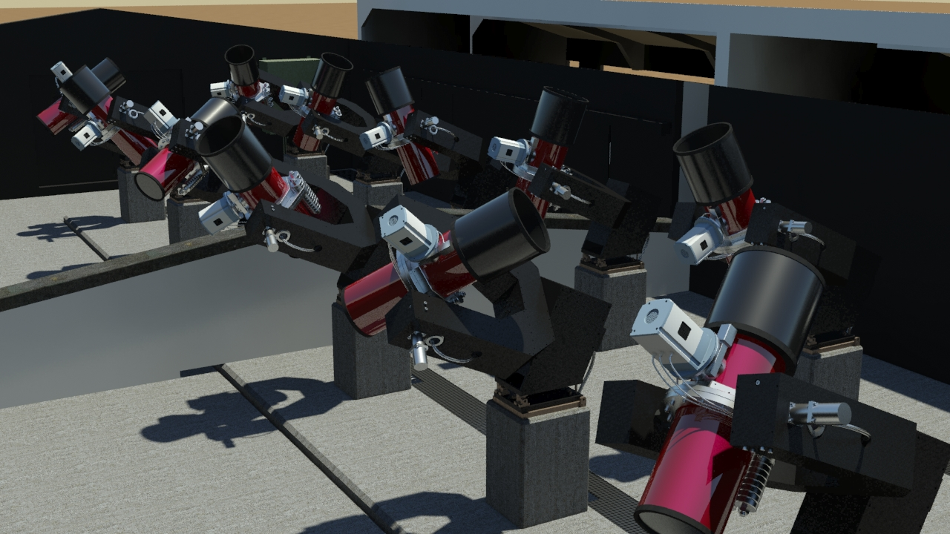
Marion Neveu-VanMalle
on behalf of the NGTS consortium:
Belfast, Cambridge, DLR Berlin, Geneva, Leicester, Warwick
Image: Richard West

Slide 2
Transiting planets : - density
- atmospheric composition
Figure credit: Winn (2011)

Slide 3
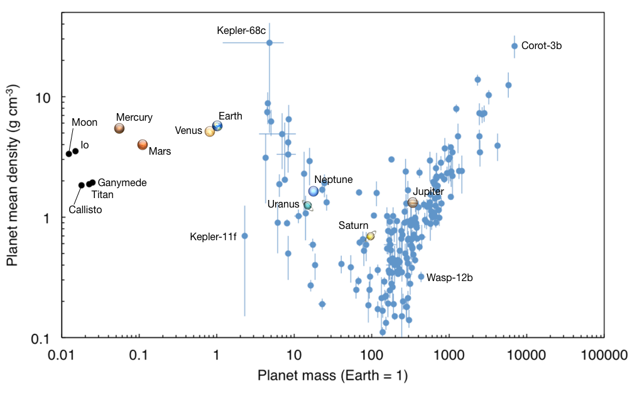
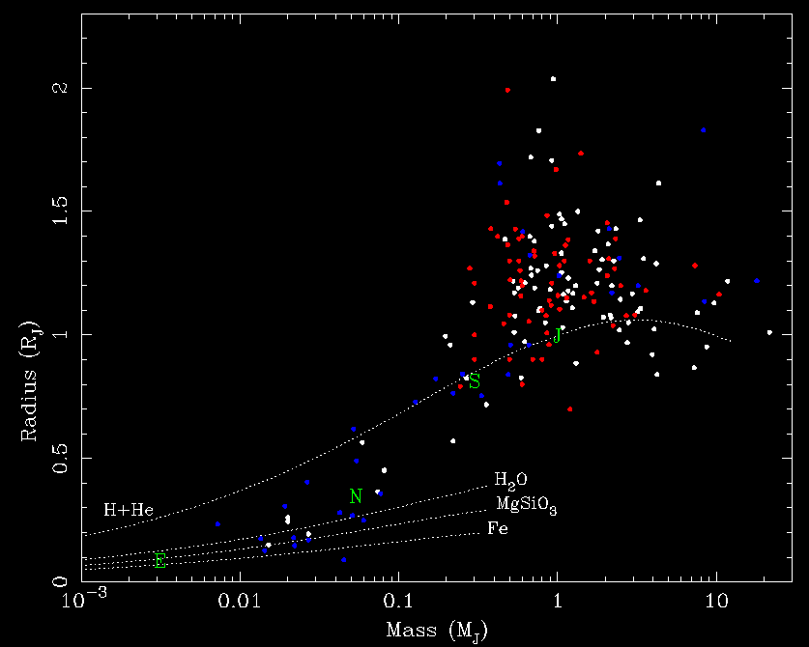
WASP (>30%)
Kepler
Solar System

Slide 4
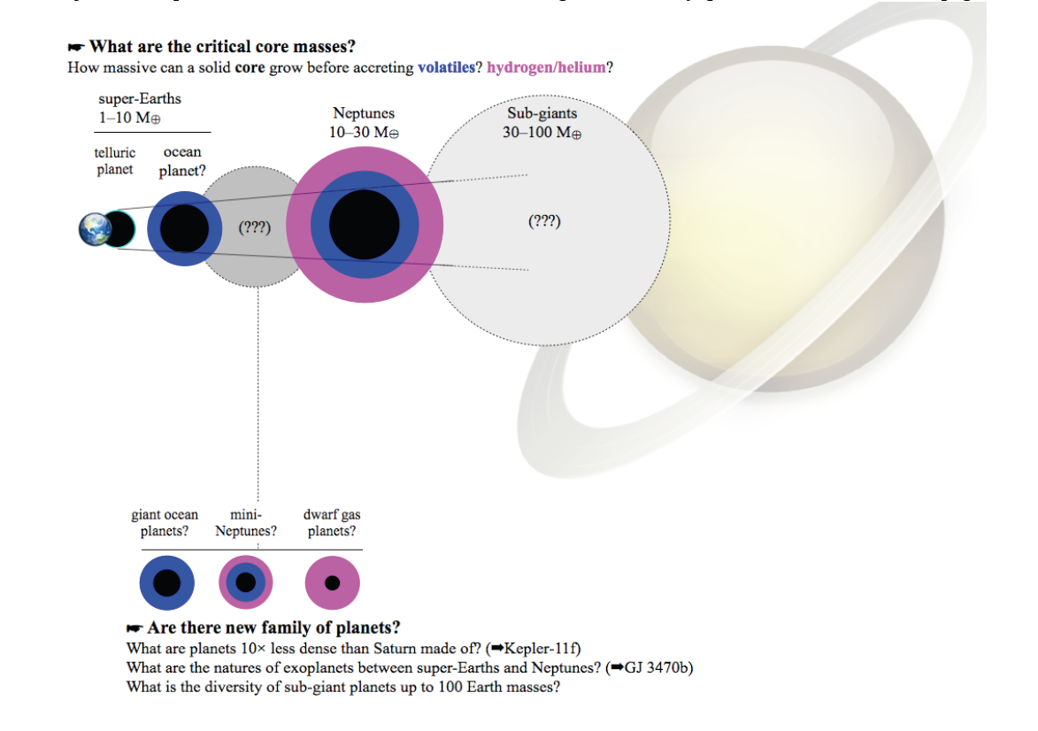

Slide 5
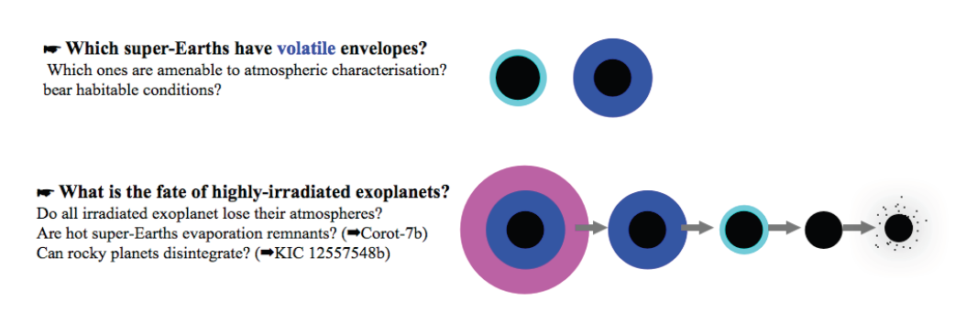
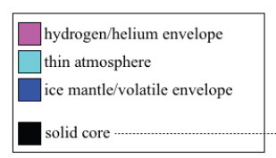

Slide 6
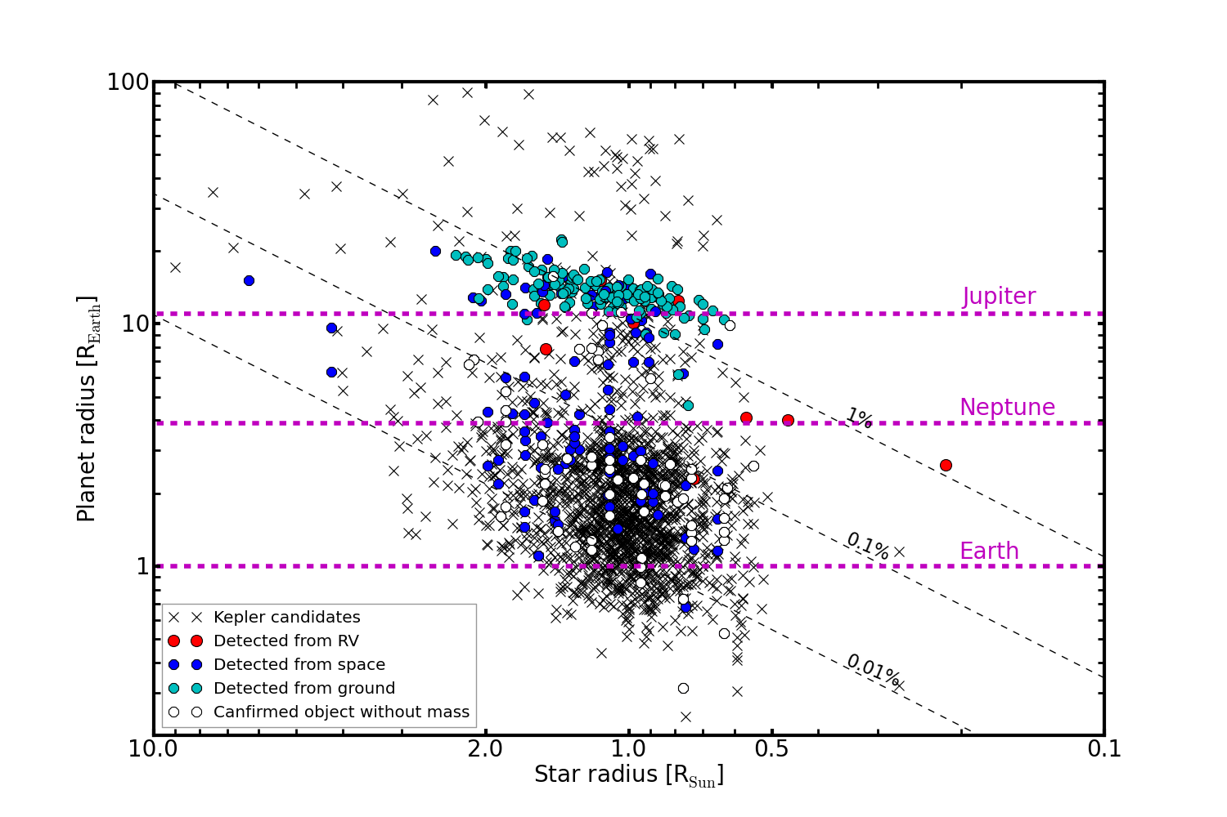

Slide 7
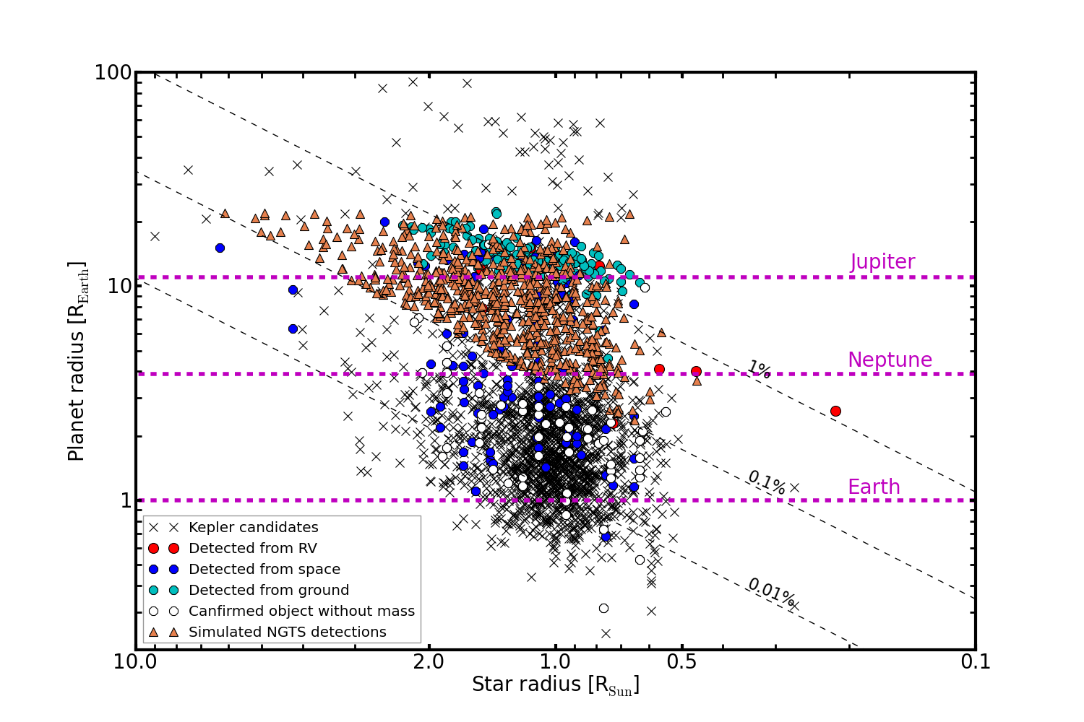

Slide 8
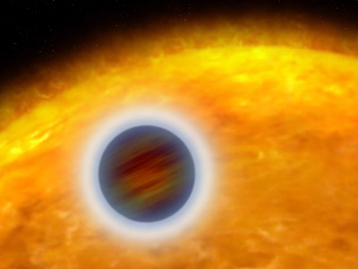
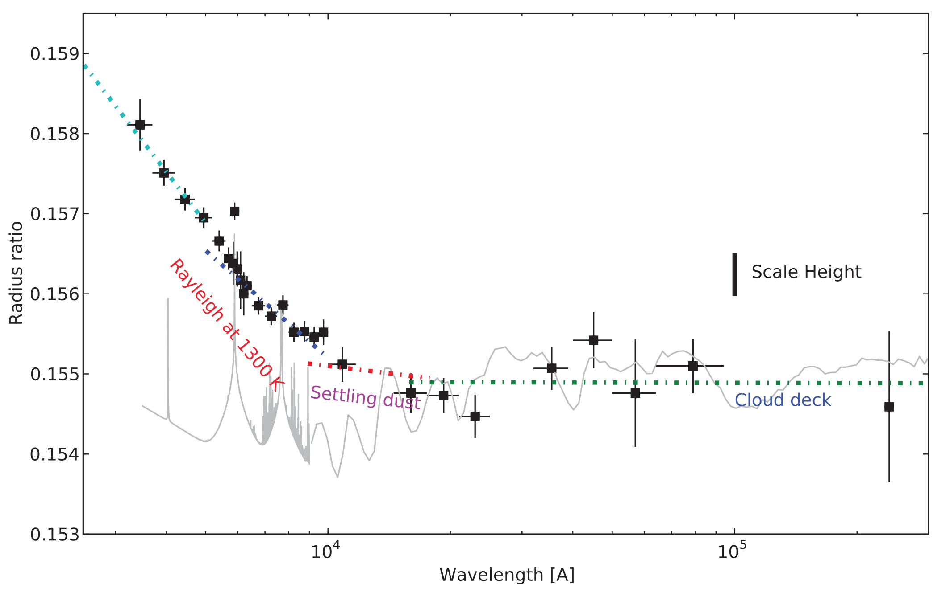
Planetary atmospheres:
transmission spectroscopy
Dust and clouds in HD189633b
Pont et al 2013

Slide 9
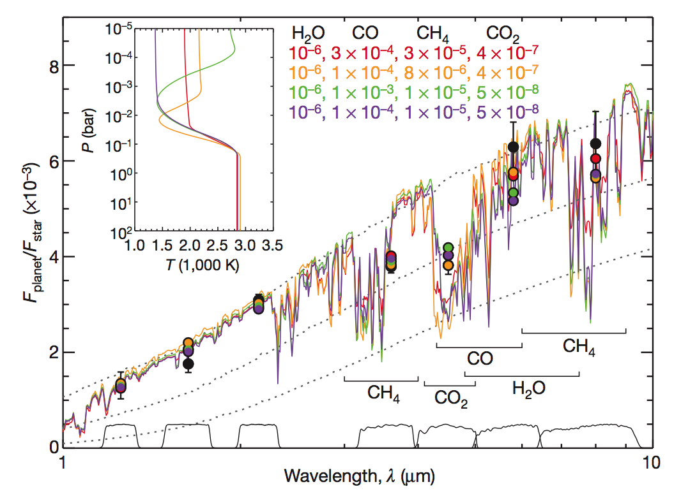
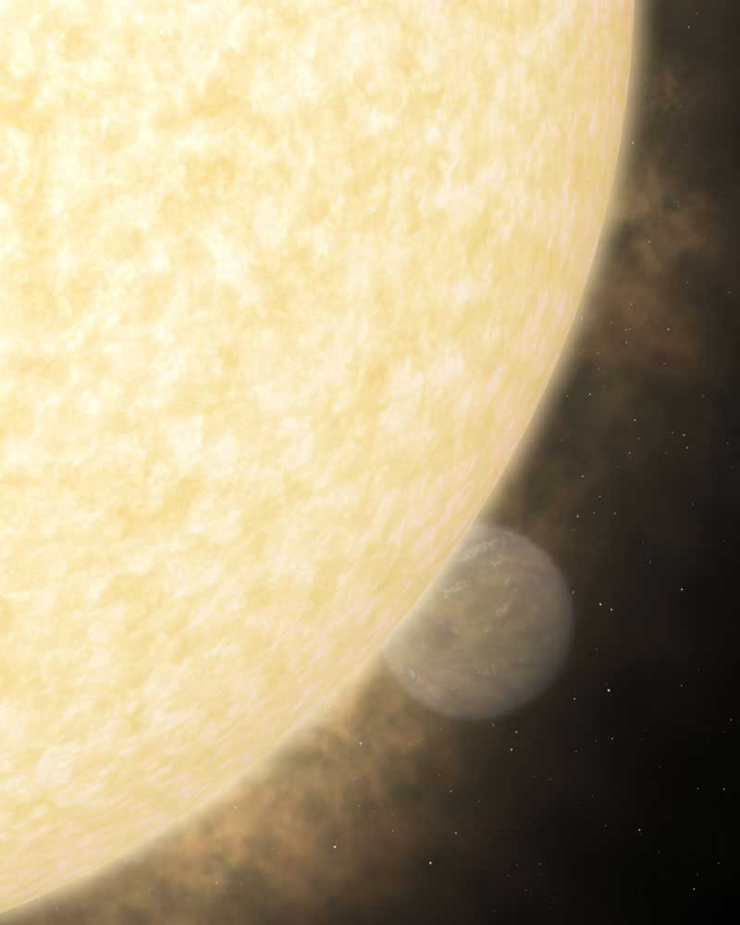
Planetary atmospheres: secondary eclipses
Carbon rich atmosphere in WASP-12b?
Madhusudhan et al. 2010, Nature
Notes:
We want more bright targets

Slide 10
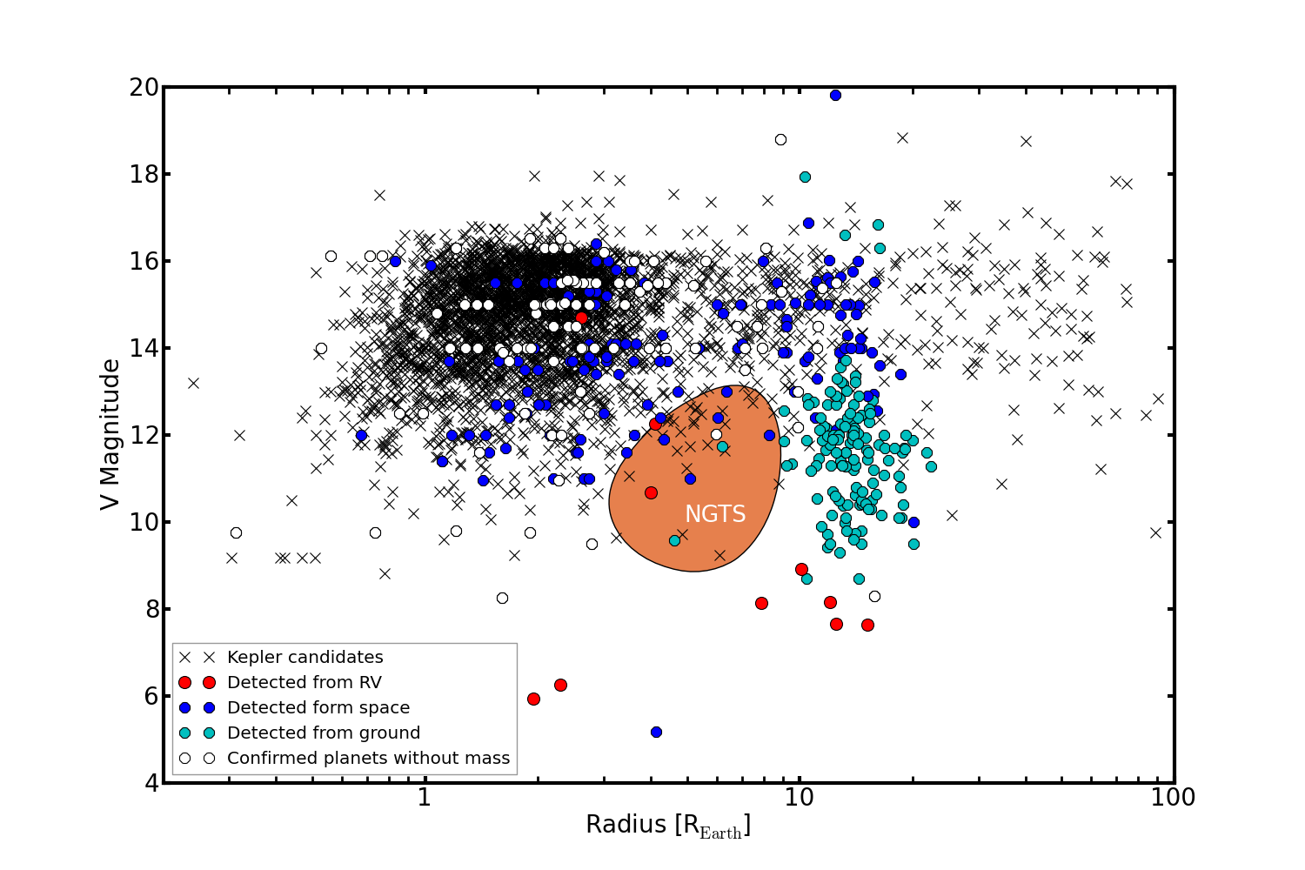
RV surveys and Kepler proved that those objects are common
NGTS will find them around stars bright enough for follow-up with HARPS and ESPRESSO
and characterization with VLT, HST, CHEOPS, JWST,
E-ELT…
RV limit

Slide 11
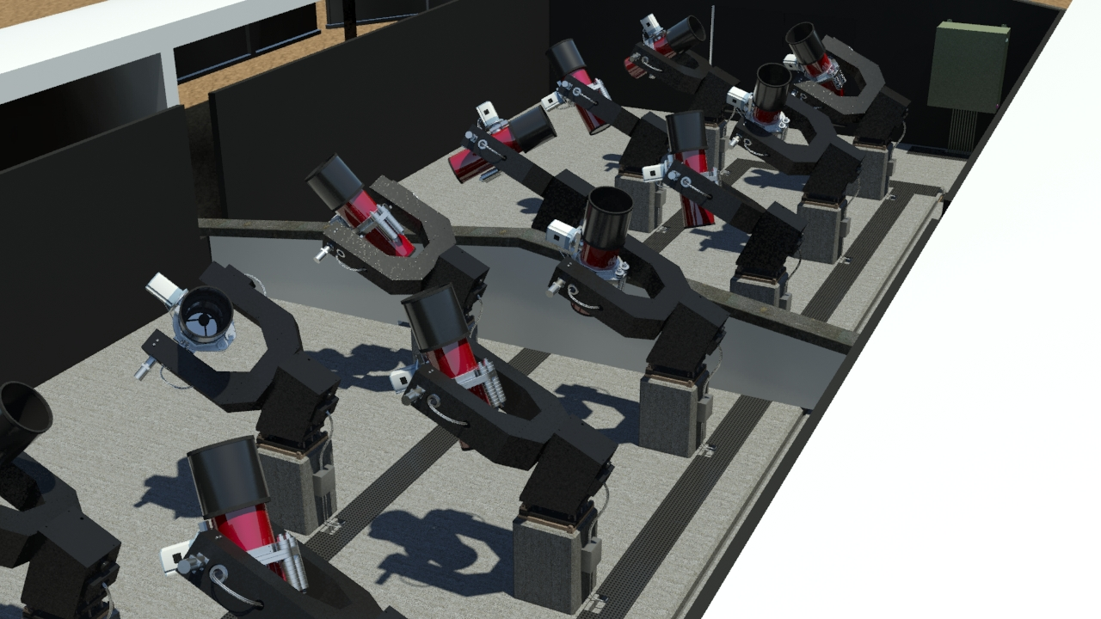
www.ngtransits.org

Slide 12
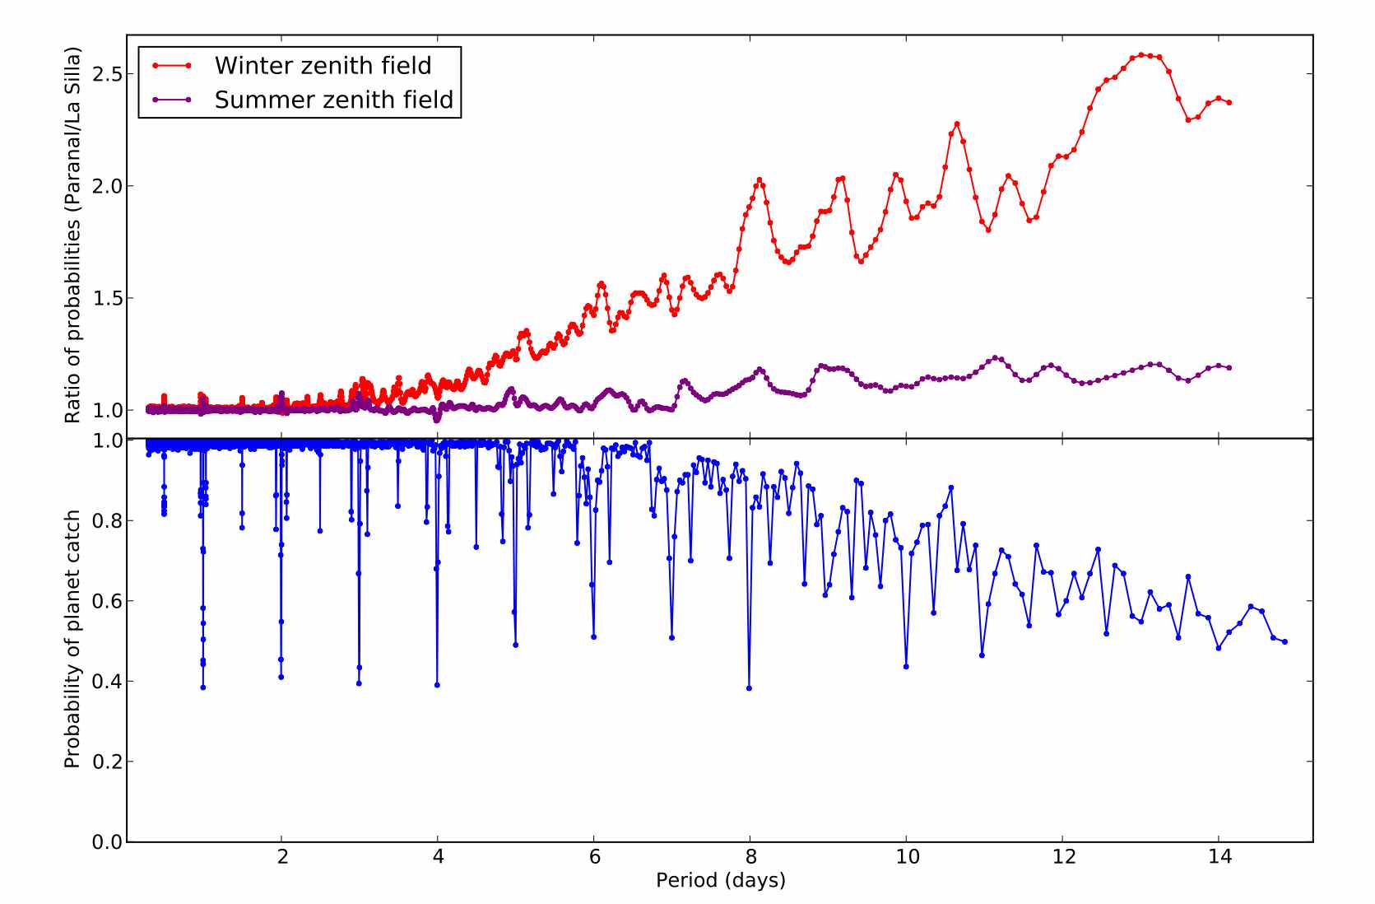
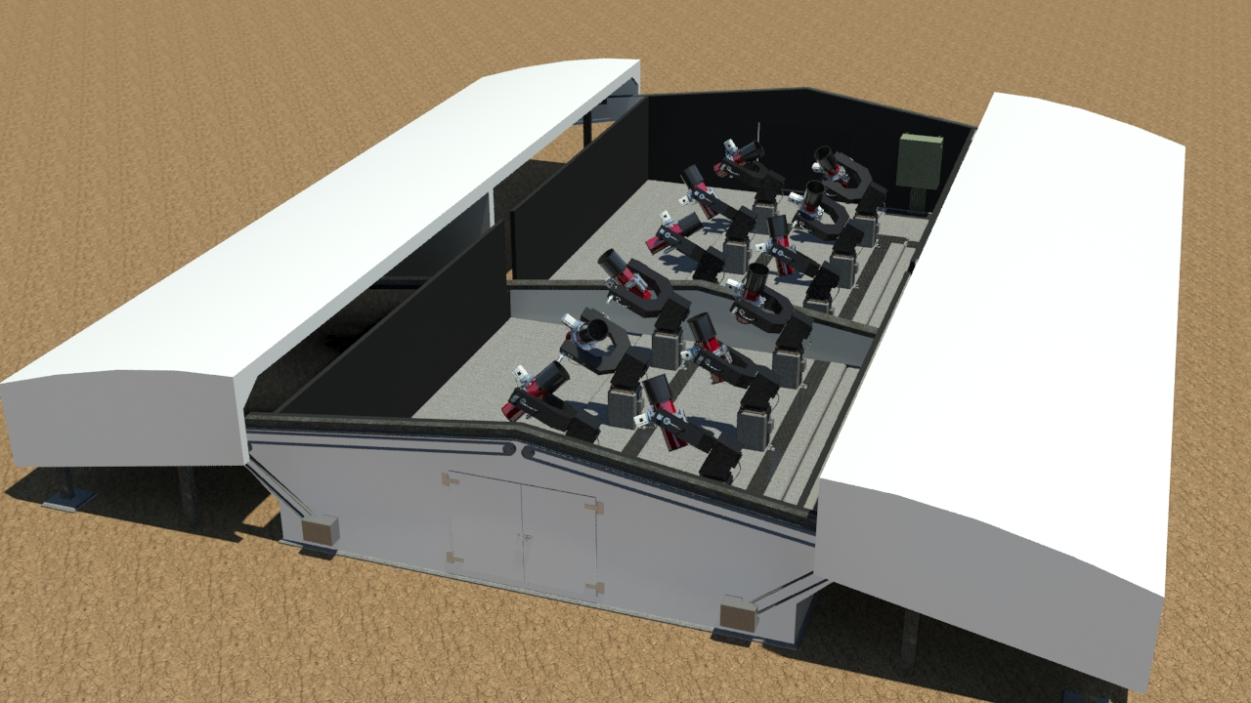
NGTS location: Paranal (ESO)

Slide 13
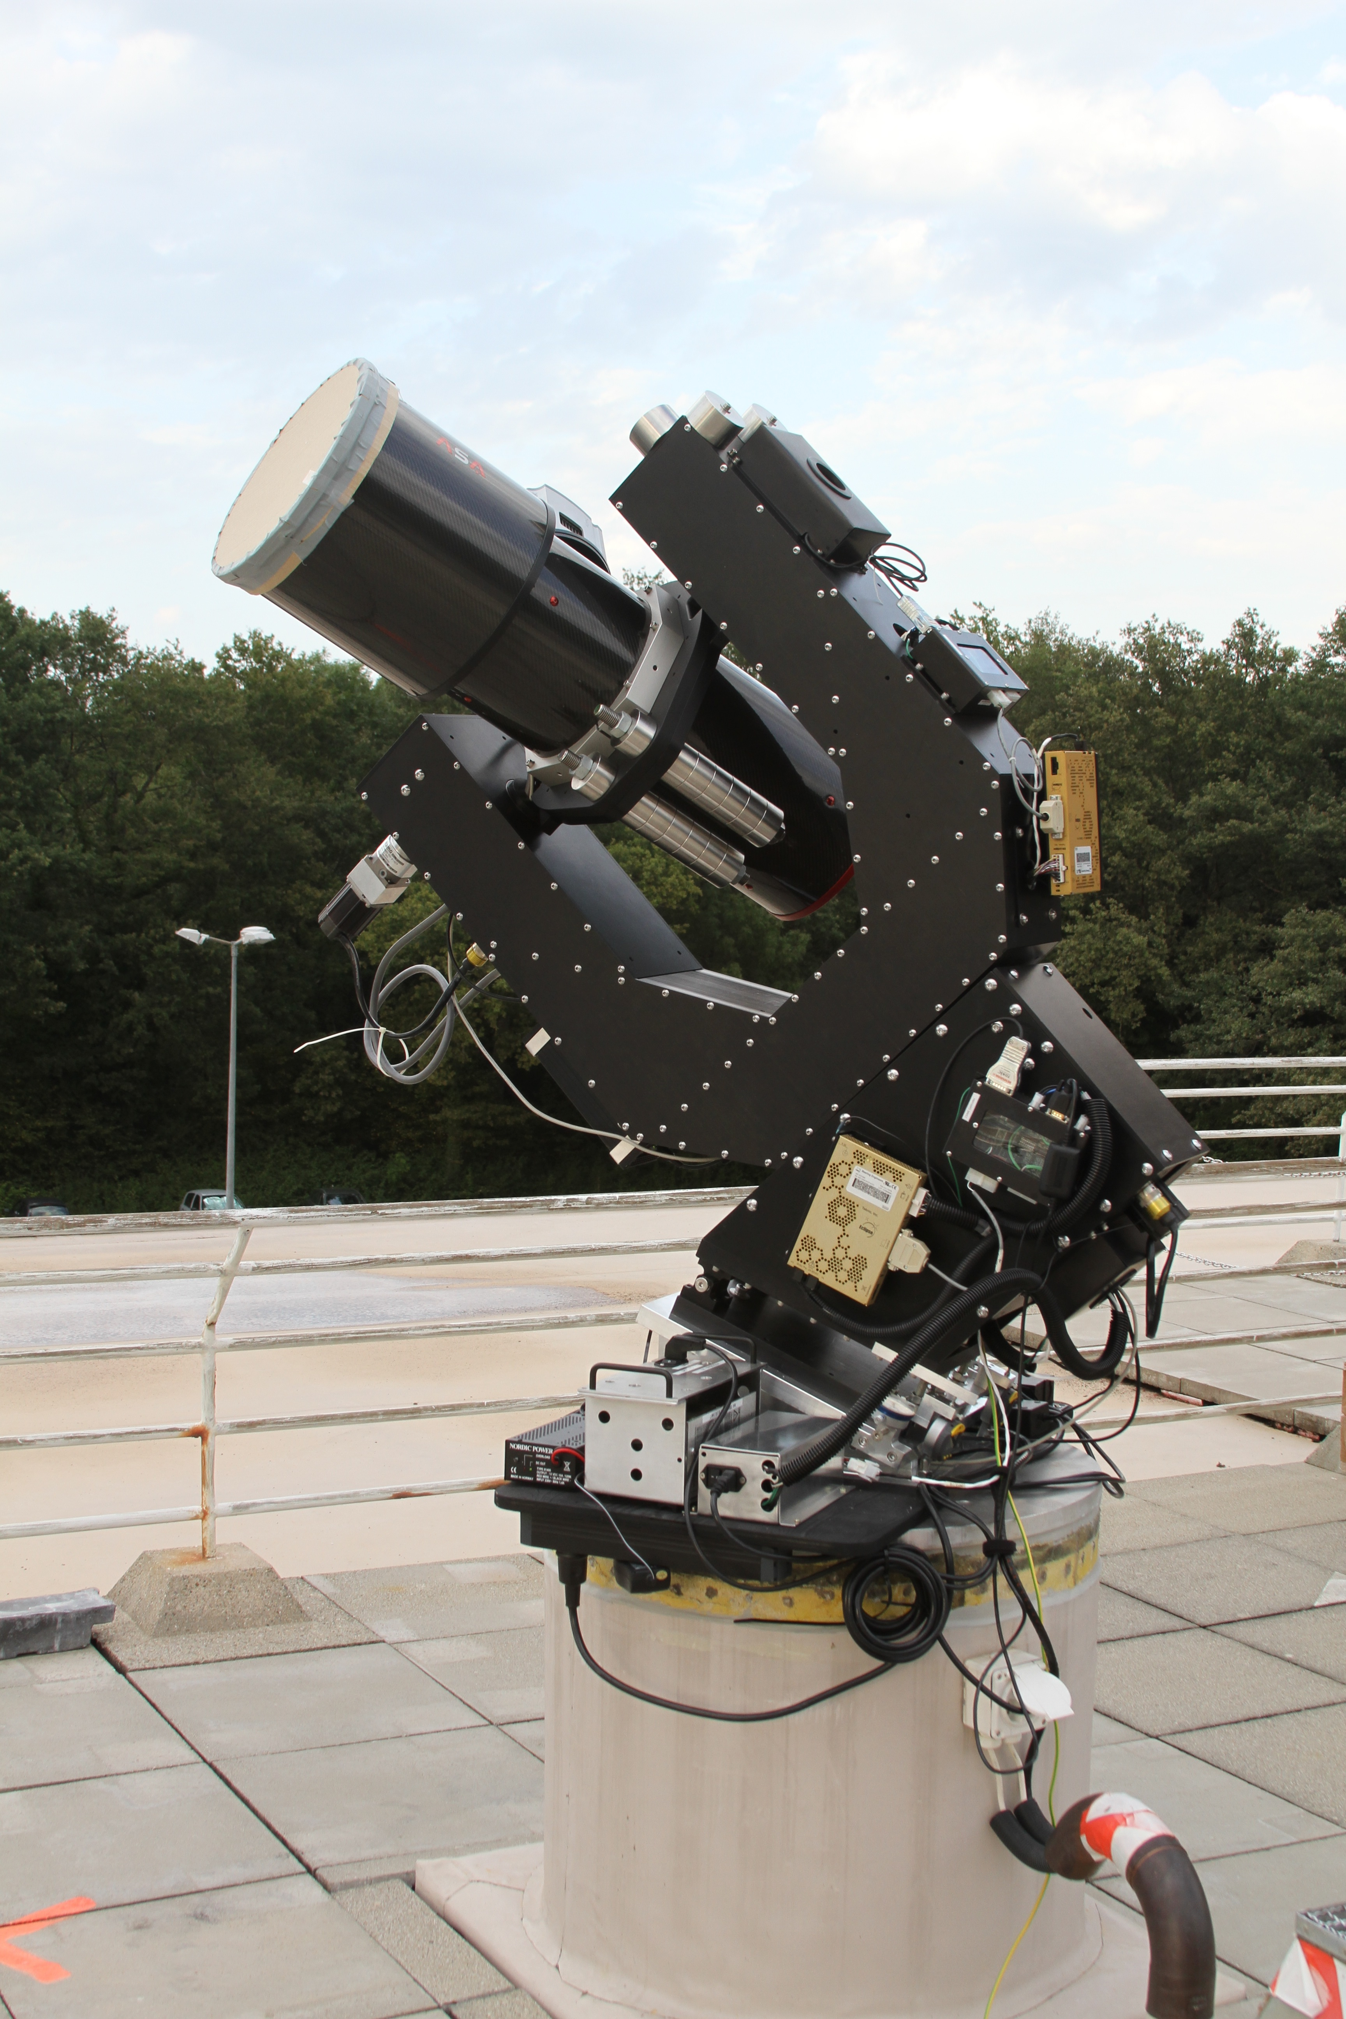
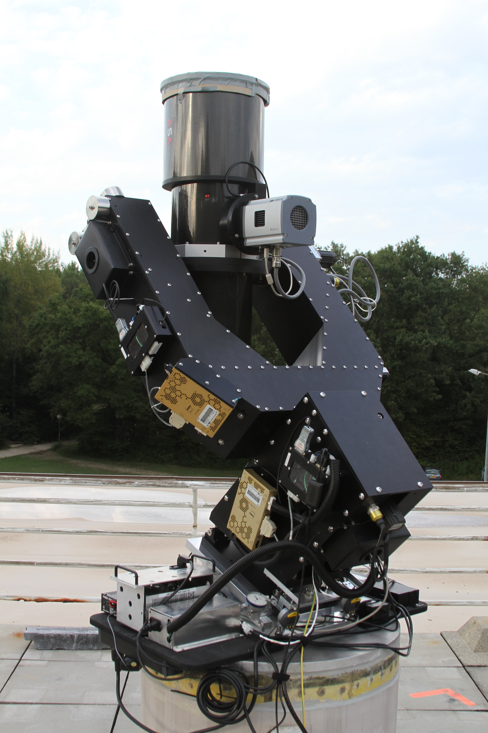
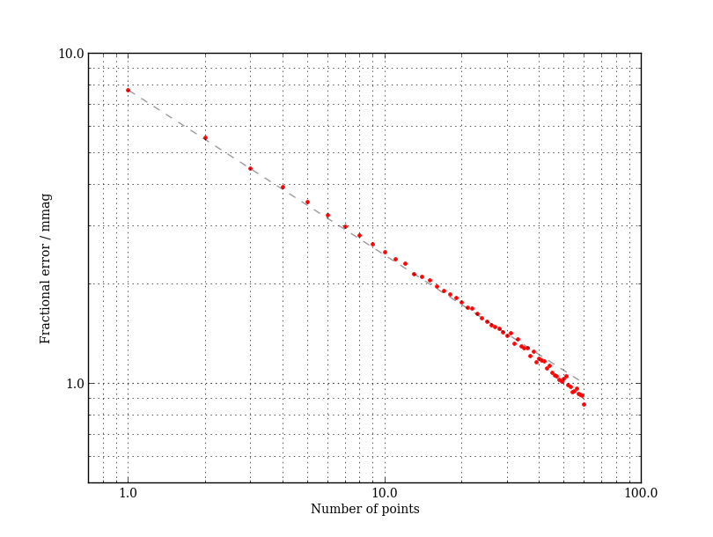
System testing in Geneva
2012/13

Slide 15
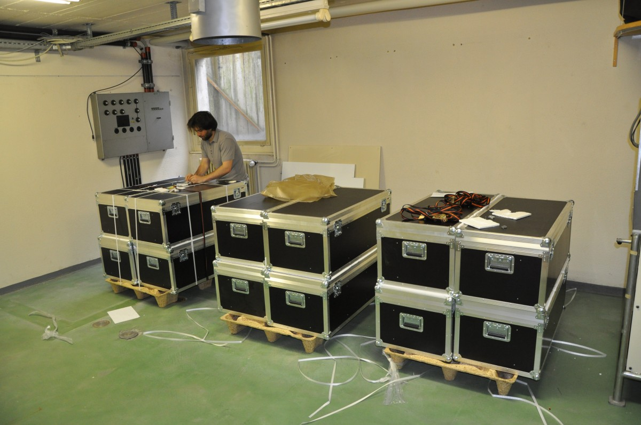
12 telescopes in Geneva

Slide 16
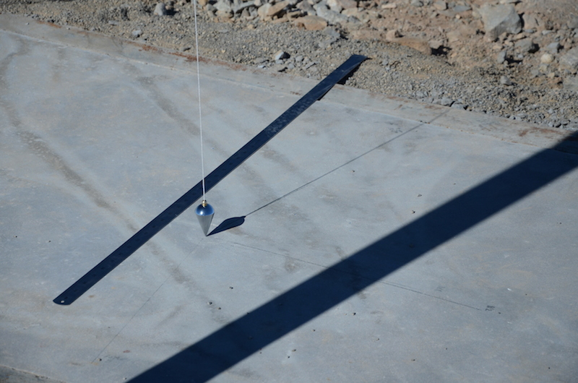
Search of the North

Slide 17
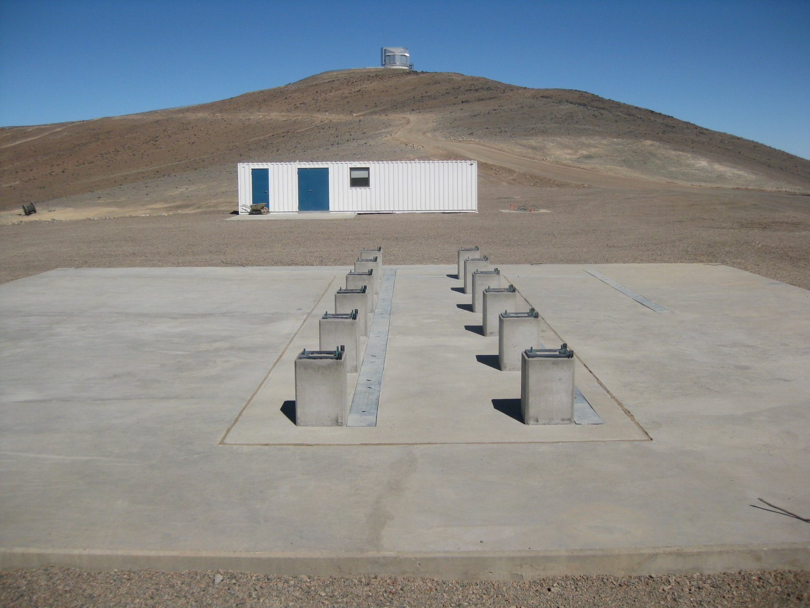
Concrete poured

Slide 18
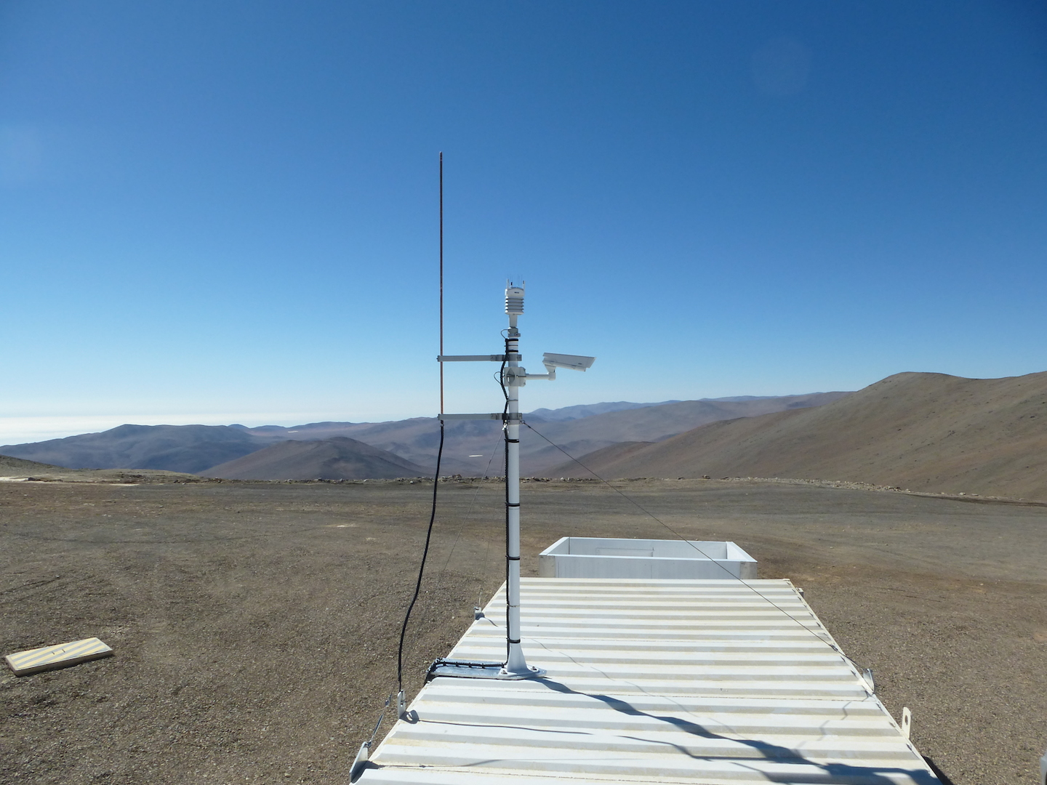
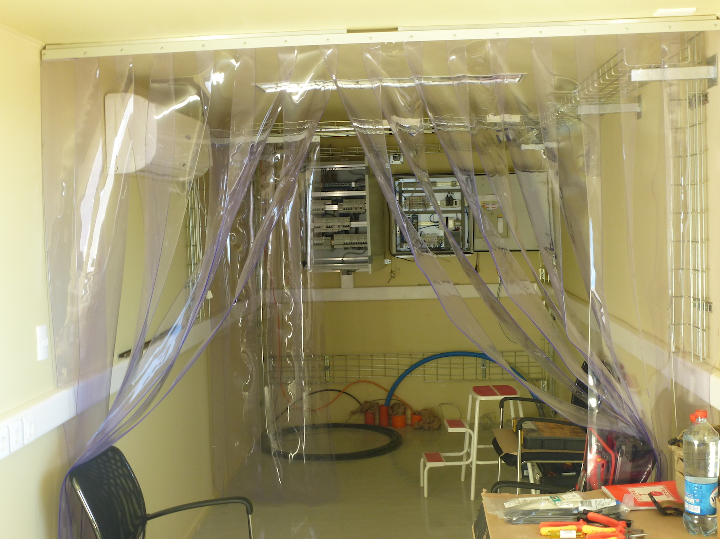
Control room ready

Slide 19
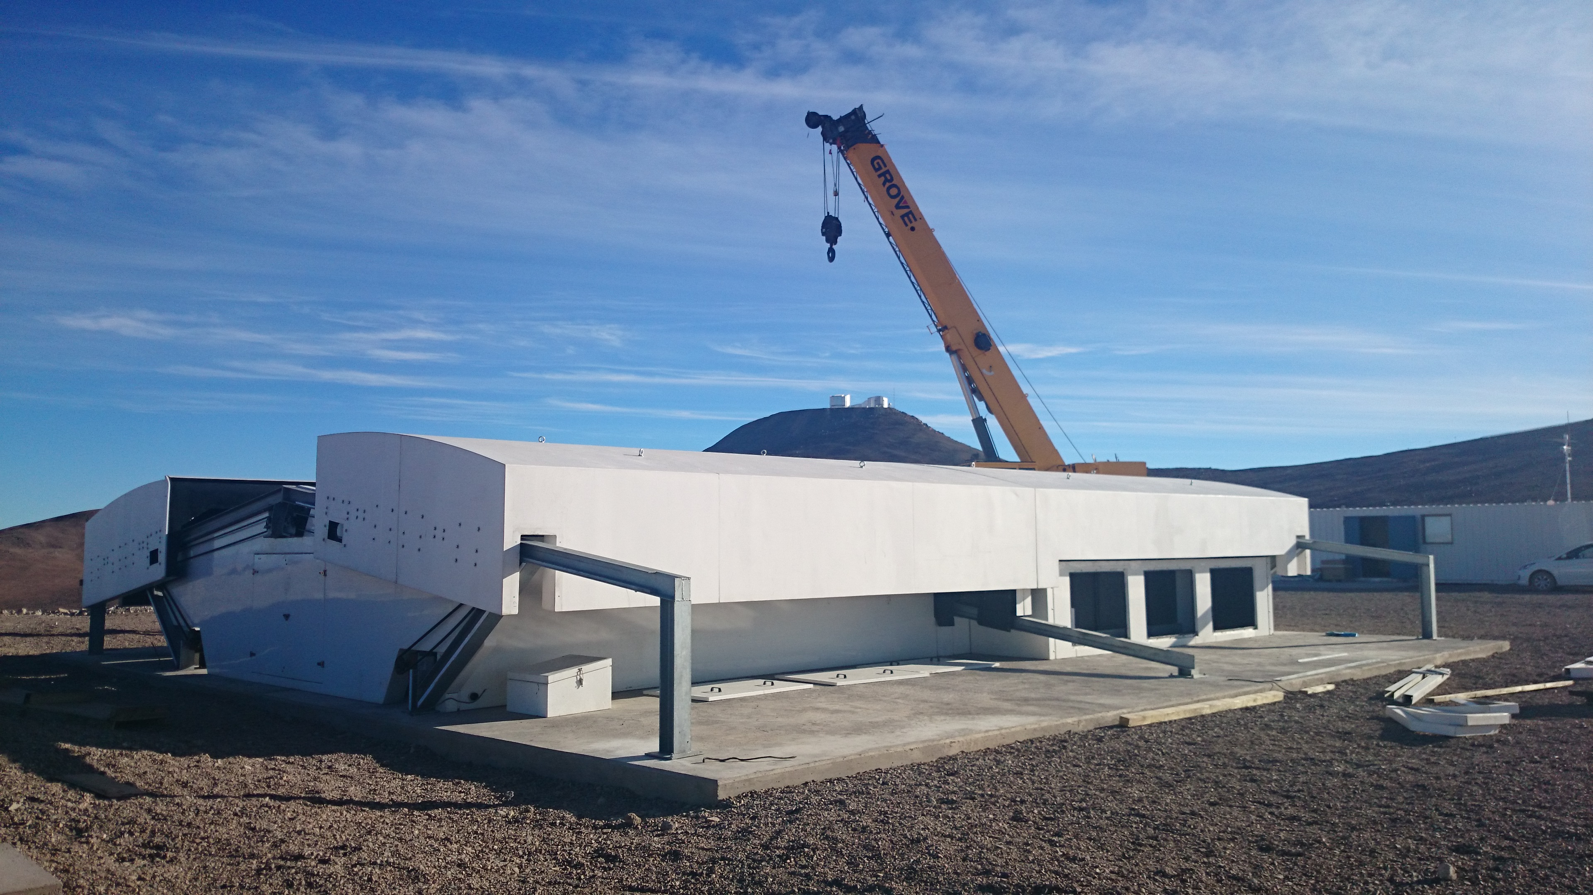
Building installed

Slide 20
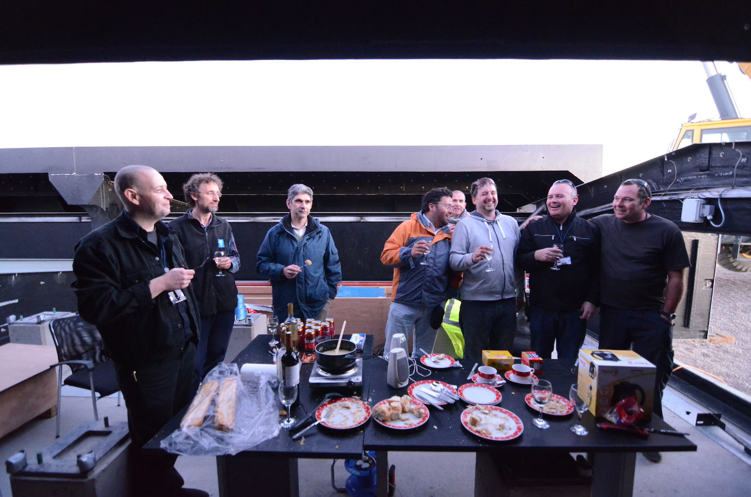
First fondue!!!!

