Slide 1




2dF Quasar Dark Energy Survey (2QDES)
Utane Sawangwit
National Astronomical Research Institute of Thailand
Collaborators:
T. Shanks (Durham), M. Irwin (Cambridge)
M.J. Drinkwater, D. Parkinson (Queensland)
S.M. Croom (Sydney) ,N.P. Ross (LBNL)

Slide 2
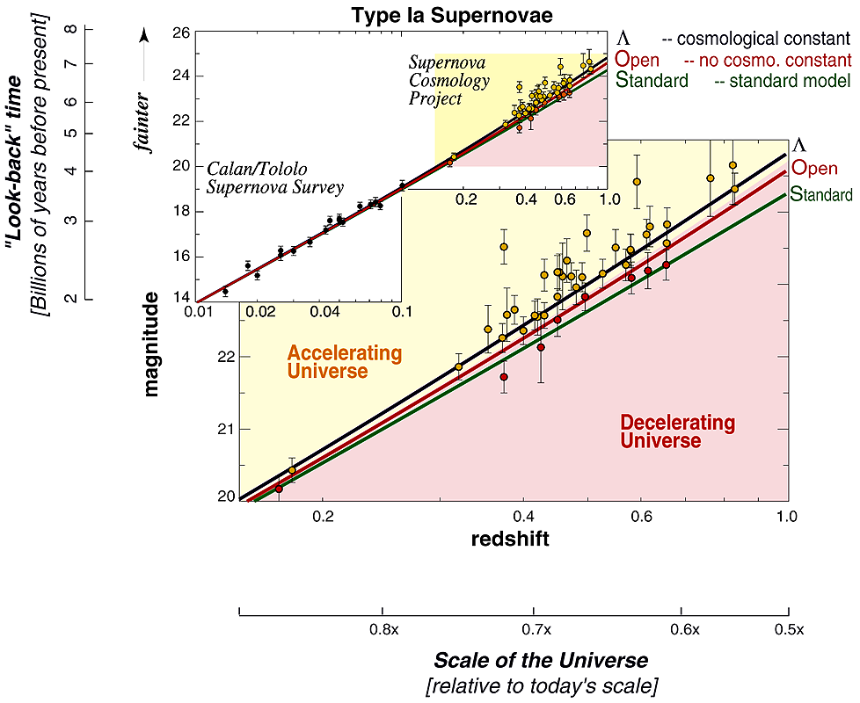
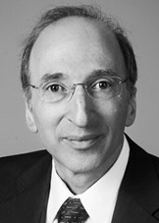
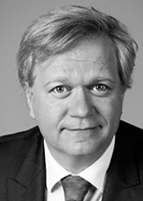
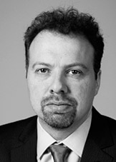

A Startling Discovery
In 1998, the first Hubble diagram using Type Ia supernovae was constructed
It showed that expansion of the universe is accelerating!
Result by Perlmutter et al quickly confirmed by Riess et al
Nobel Prize in Physics 2011

Slide 3
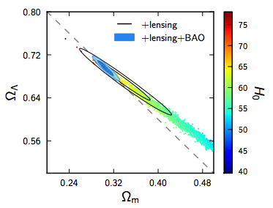
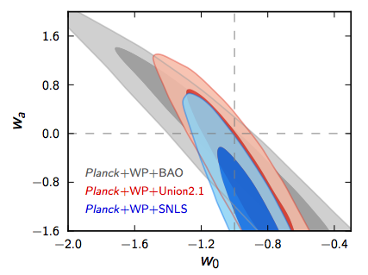
Dark Energy
What is it ? Cosmological Constant w=-1,w_a=0?
Fine-tuning, naturalness?
So far, LCDM still provide the best description of the Universe we live in

Slide 4
Baryon Acoustic Oscillations (BAO)
@ Recombination, the baryon-photon fluid start to decouple and baryon wave stalls…
While the photon continues with the speed of light and leave a shell of overdense gas at ~150 Mpc (determined by the wave speed, baryon to photon ratio, and travel time, matter-radiation ratio)
Perturbation grows via gravitational instability and finally galaxies form at the initial overdense location and also at this scale

Slide 5
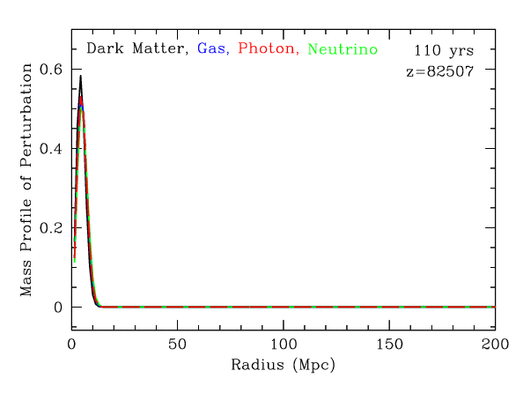
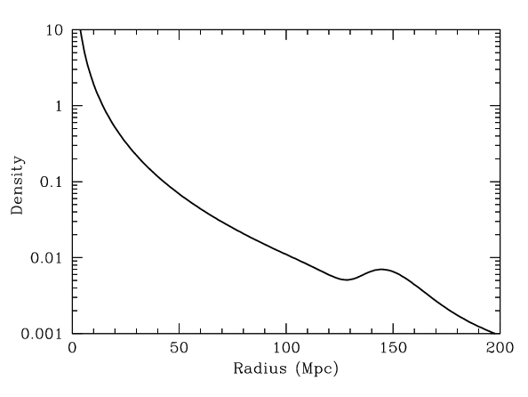
Animation by D. Eisenstein

Slide 6
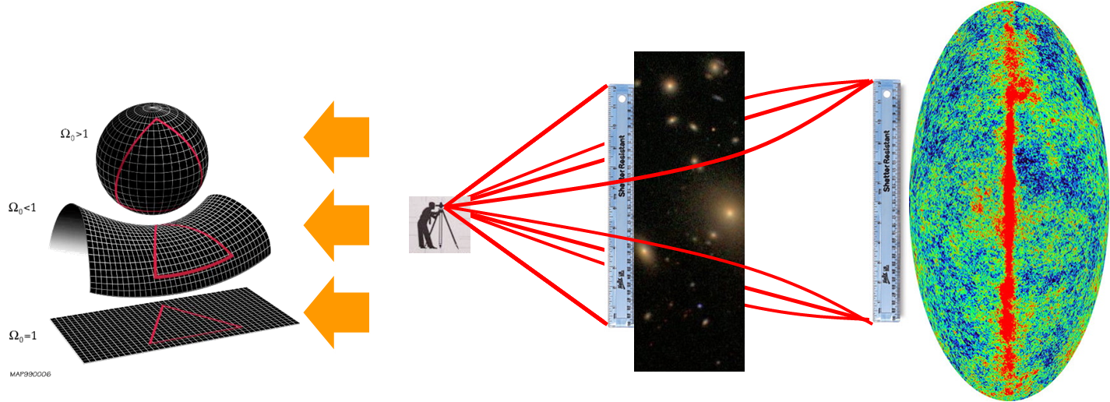
BAOs as a standard ruler
Detections of BAOs in the galaxy power spectrum at low redshift (e.g. Cole et al.,2005, Tegmark et al.,2006) and 2PCF (Eisenstein et al., 2005) at 2-3σ
Many large projects and studies used BAOs in survey volume of ~ Gpc³ as a standard ruler (WiggleZ, BOSSIII) in studying the nature of Dark Energy.

Slide 8
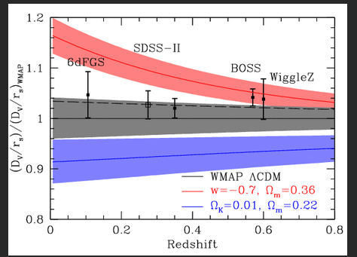
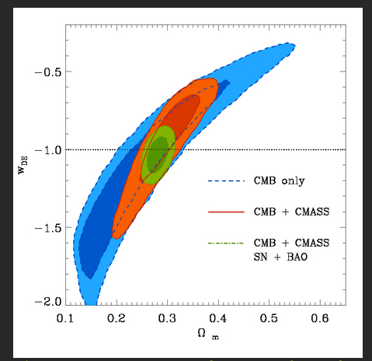
BOSS III results

Slide 9
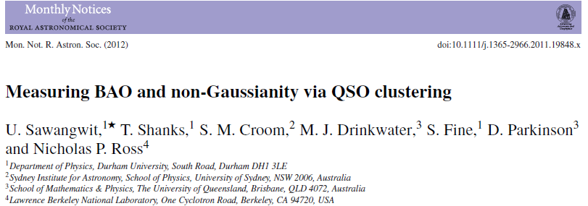
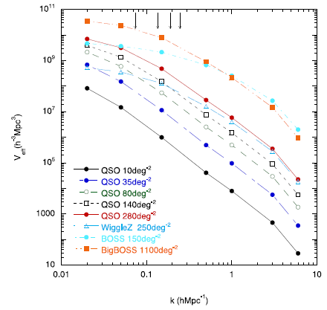
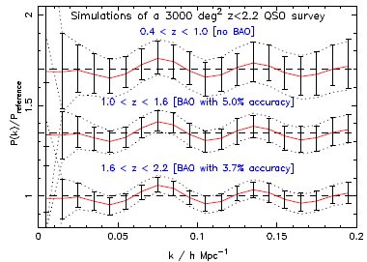
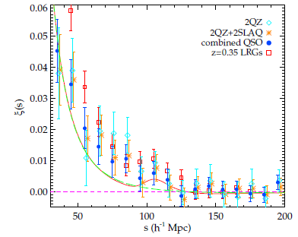
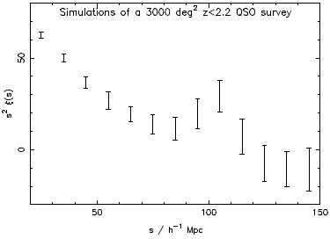
Notes:
Use empirical data and simulation/forecast to determine the size of a competitive survey ,

Slide 10
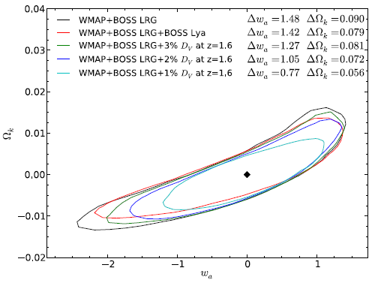
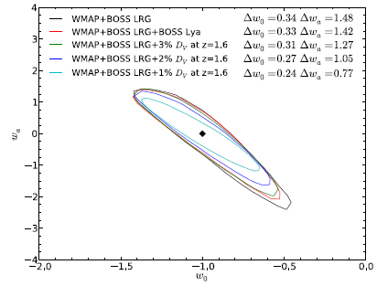
Dark Energy evolution via BAO
Nominal survey size for 3σ detection of BAO peak, 3% error in D_{V}; 85deg⁻² (i.e. 2SLAQ g < 21.85mag) over 3000 deg²
50% higher QSO density (i.e. g<22.5mag) and 50% bigger area 6σ BAO detection, ΔD_{V} =1.5% and 60% of BOSS error on dark energy evolution parameter, w_{a}
w(a)=w₀+w_{a}(1-a)

Slide 11
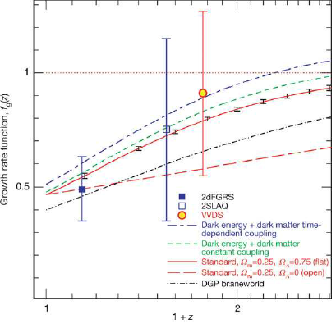
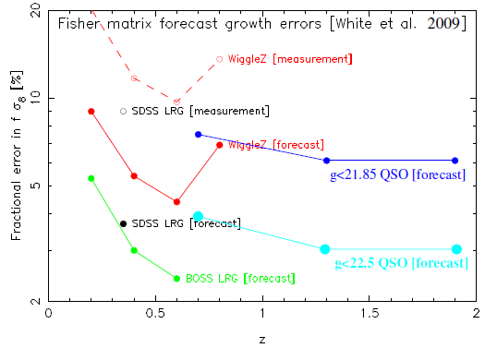
Redshift-Space Distortion
Testing gravity model via growth rate, f(z)≈Ω_{m}^{γ}(z) where γ is model dependent, e.g. γ ≈0.55 for standard GR with LCDM
Although Ω_{m}(z=1.5) 1.0, the measured fσ₈ still provide a vital “anchor” for low-redshift measurements
Guzzo et al. (2008)

Slide 12
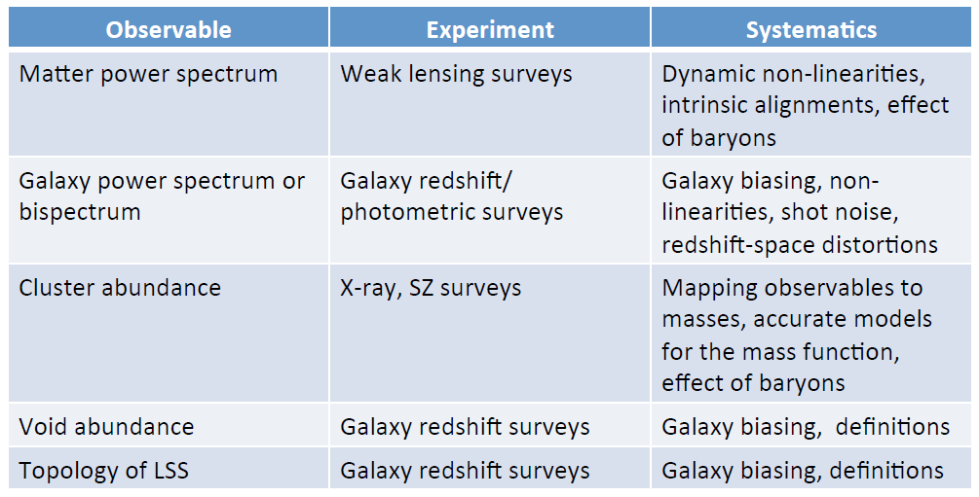
LSS probes of the PNG
Credit: Cristiano Porciani

Slide 13
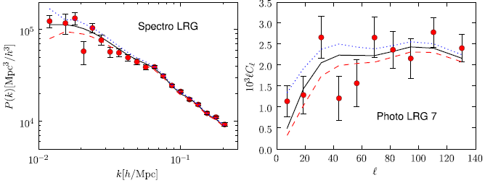
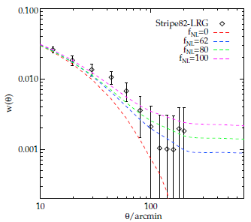
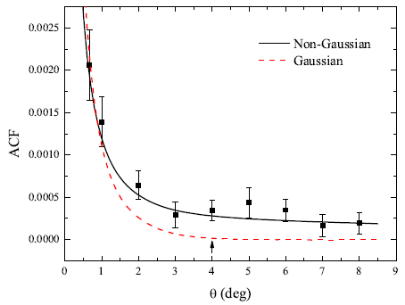
2-pt function of biased tracers
3D powerspectrum
2D Angl. powerspectrum
f_{NL}= 0
f_{NL}= 100
Fourier space
f_{NL}= -100
-120 < f_{NL} < 200 (2σ)
-270 < f_{NL} < 160 (2σ)
30 < f_{NL} < 140 (2σ)
Configuration
space
25 < f_{NL} < 117 (2σ)
NVSS (Xia et al. 2010)
Nikoloudakis, Shanks & Sawangwit (MNRAS submitted)

Slide 14
∆f_{NL} forecast
k_{min}= 0.003 hMpc⁻¹ , limited by the lowest k mode available
k_{max}= 0.1 hMpc⁻¹ , to stay well within the linear regime, avoiding non-linear structure growth
  Nominal survey, 3000deg², 90deg⁻² QSO → ∆f_{NL} = ± 15
  Competitive survey, 4500deg², 105deg⁻² QSO → ∆f_{NL} = ± 8
  The SDSS’III Baryon Oscillation Spectroscopic Survey (BOSS)
  z=0.6 LRGs → ∆f_{NL} = ± 20
  Planck → f_{NL} (local) = 2.7 ± 5.8

Slide 15
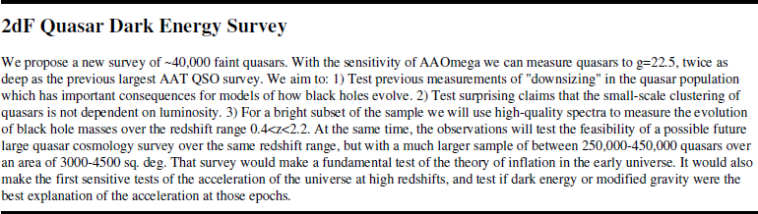
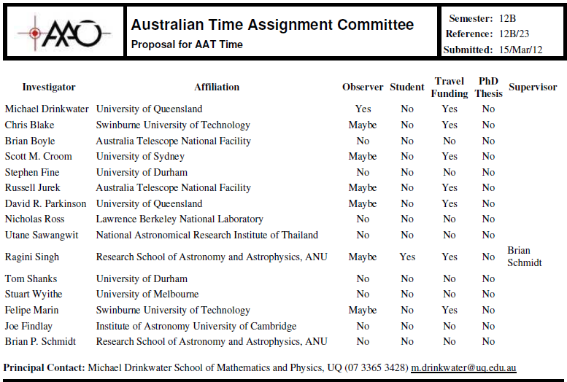

Slide 16
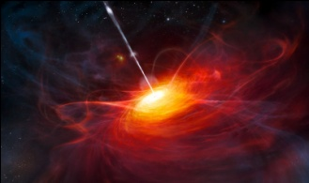
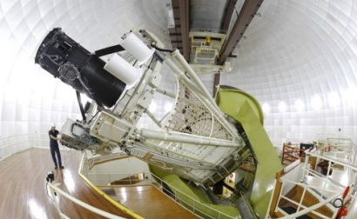
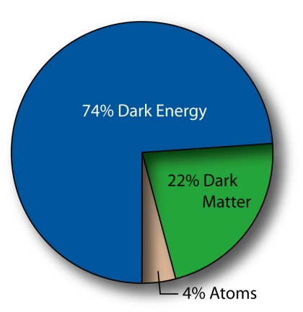
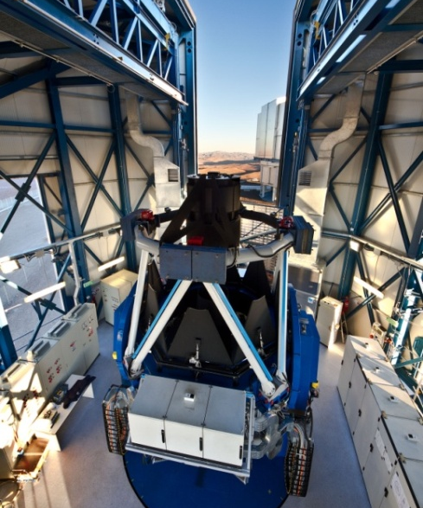
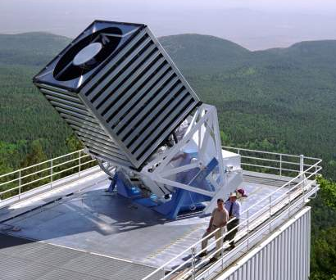
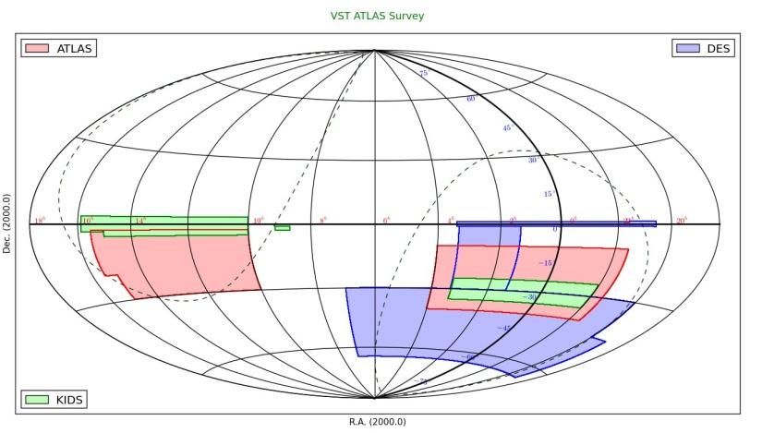
2dF Quasar Dark Energy Survey: 2QDES
BAO+RSD @ z=1.5
+PNG
3.9m AAT+2dF & AAOmega
ESO VST ATLAS survey
PI: T. Shanks (Durham)
SDSS multi-epoch data
“Stripe 82”

Slide 17
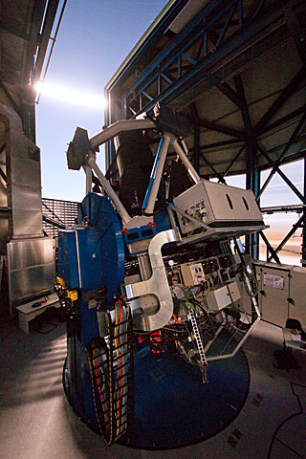
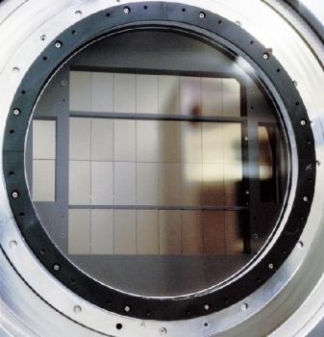
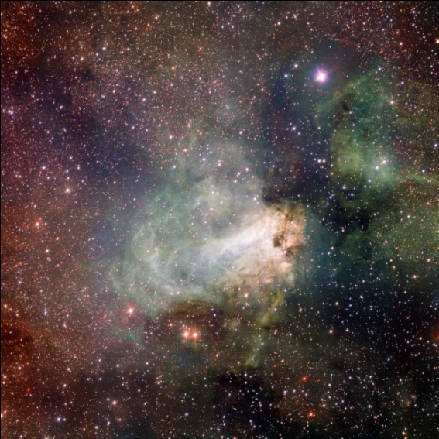
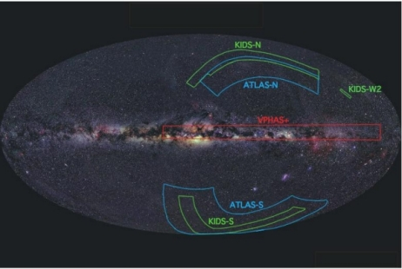
OmegaCAM @ ESO VLT Survey Telescope (VST)

Slide 18
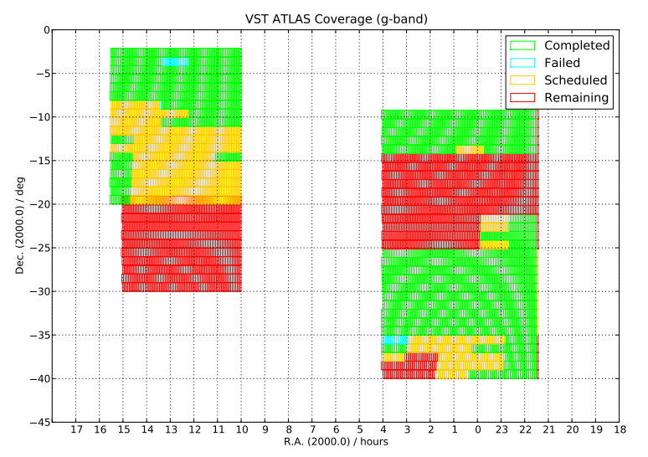
VST ATLAS survey current status
As of Aug 1, 2013

Slide 19
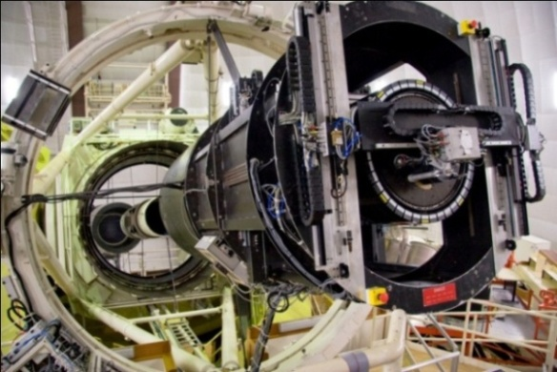
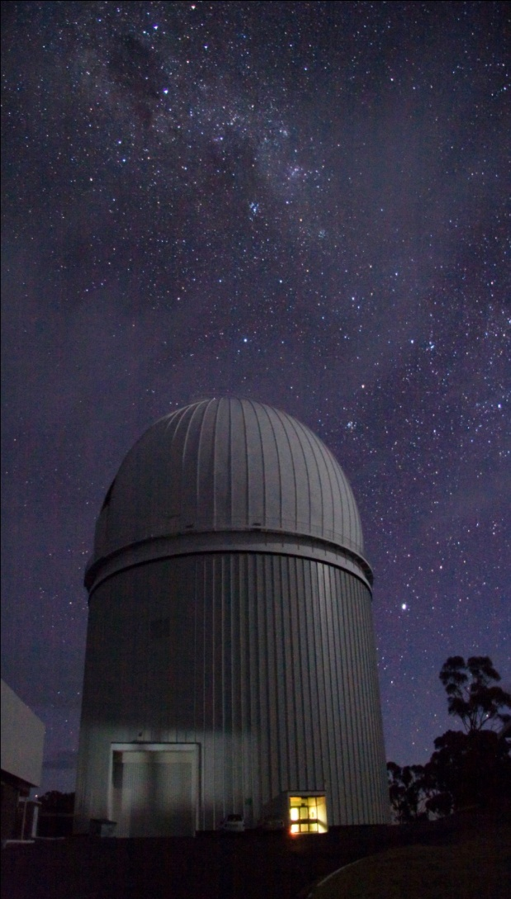
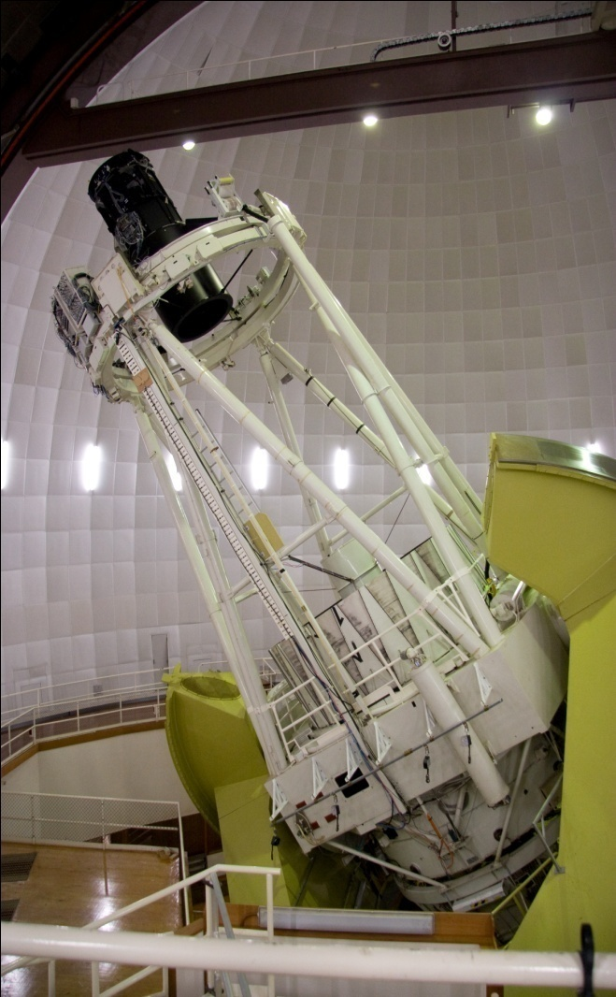
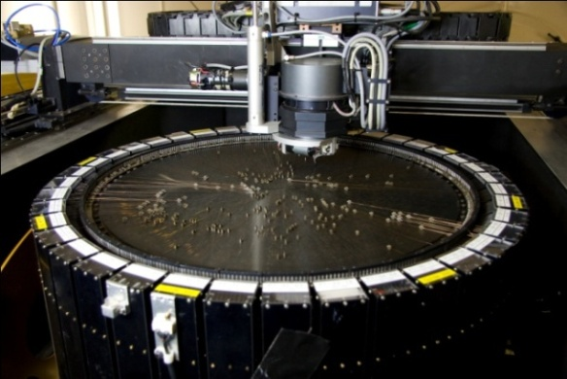
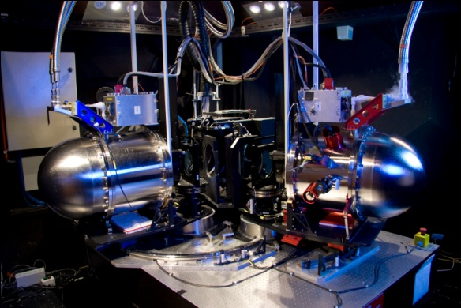
The main workhorse of the 2QDES
3.9-m AAT + 2dF & AAOmega spectrograph

Slide 20
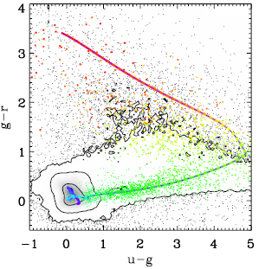
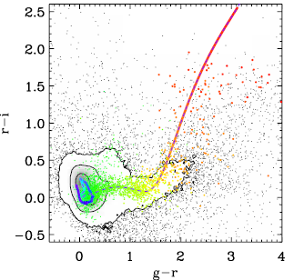

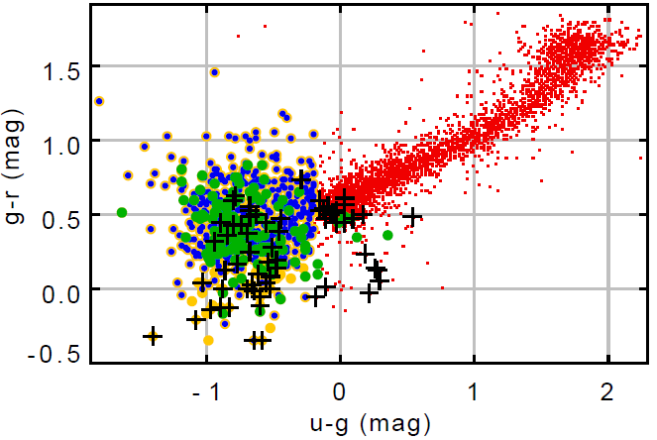
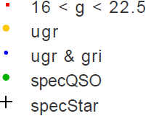
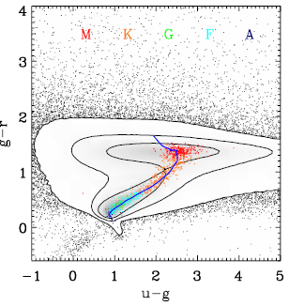
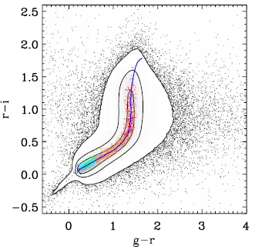
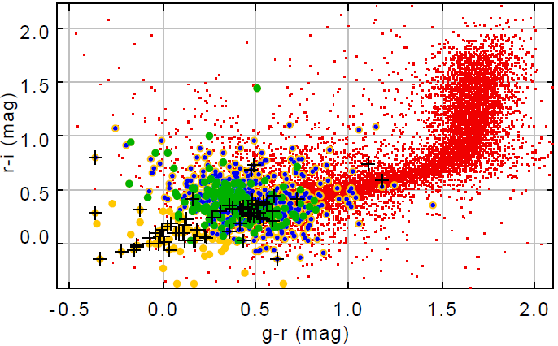
z<2.2 quasar Candidate selection
Using traditional ugr and gri colour-colour
Also Bovy et al. (2011), XDQSO using flux-flux rather than colour-colour to assign prob. for the redshift of interest
SDSS
VST ATLAS+2QZ
Quasar
Bovy et al. (2011)
Star

Slide 21
2QDES pilot study
- Director night: Dec 2011
Allocated nights: 28-30 April 2012, Moon at beginning of
the nights, seeing 1.5-3.0arcsec, data are reduced and being analysed
- 7 more allocated nights coming up in Nov. 2012 and Jan. 2013
Applying for 10 nights over the next 12 months, more feasibility
study and will have enough data to study evolution of QSO LF to
fainter magnitude than the 2SLAQ survey
- Affected by the Jan. bush fire, lost time in Jan & Feb 2013
gri
ESO VST
AAT 2dF+AAOmega
© U. Sawangwit

Slide 22
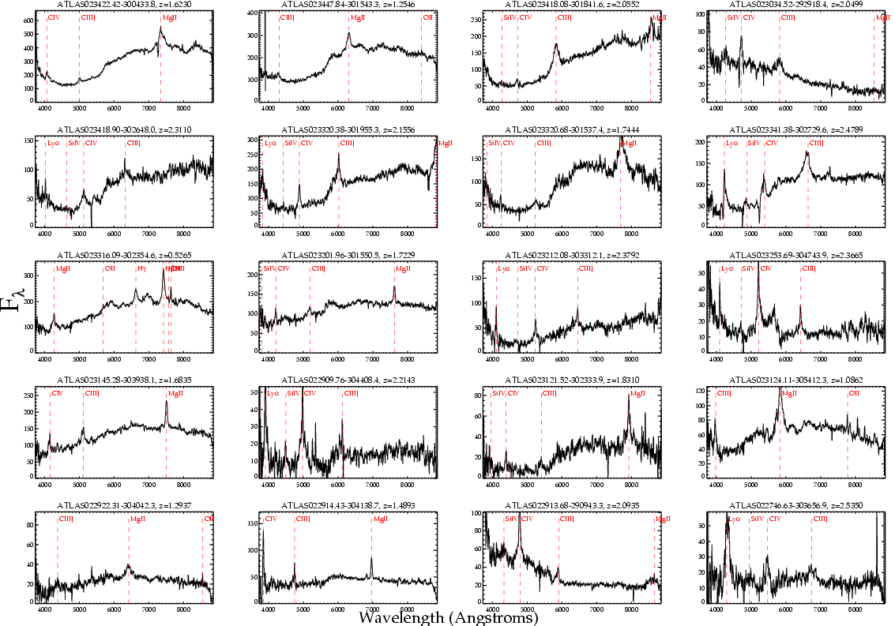

Slide 23

Current Status

Slide 24
Summary
QSO/galaxy clustering at high-z can provide a complementary route to f_{NL} compared to CMB observations
Many galaxy spec-z and photo-z surveys designed to study DE and growth of structure will also make huge contributions towards our understanding of the early Universe
Pilot observations underway + 2dF fibre upgrade

Slide 25

Thanks for your attention

Slide 26


Slide 27


Dark Energy evolution via BAO
Nominal survey size for 3σ detection of BAO peak, 3% error in D_{V}; 85deg⁻² (i.e. 2SLAQ g < 21.85mag) over 3000 deg²
Notes:
Use empirical data and simulation/forecast to determine the size of a competitive survey ,

Slide 28
Dark Energy evolution via BAO
50% higher QSO density (i.e. g<22.5mag) and 50% bigger area 6σ BAO detection, ΔD_{V} =1.5% and 60% of BOSS error on dark energy evolution parameter, w_{a}
w(a)=w₀+w_{a}(1-a)

Slide 29
Redshift-Space Distortion
Testing gravity model via growth rate, f(z)≈Ω_{m}^{γ}(z) where γ is model dependent, e.g. γ ≈0.55 for standard GR with LCDM
Although Ω_{m}(z=1.5) 1.0, the measured fσ₈ still provide a vital “anchor” for low-redshift measurements
Guzzo et al. (2008)

Slide 30


