Slide 1
Dark Matter Search with CsI(Tl) crystal scintillators : KIMS
HongJoo Kim (KyungPook National Univ.)
for KIMS collaboration
Windows on the Universe, Quy Nhon, Vietnam
Aug. 11-17, 2013

Slide 2
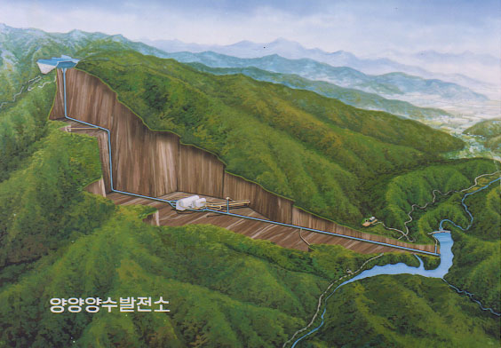
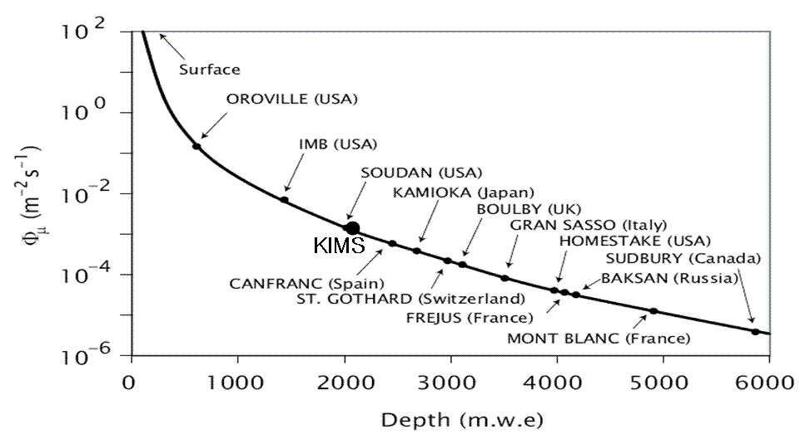
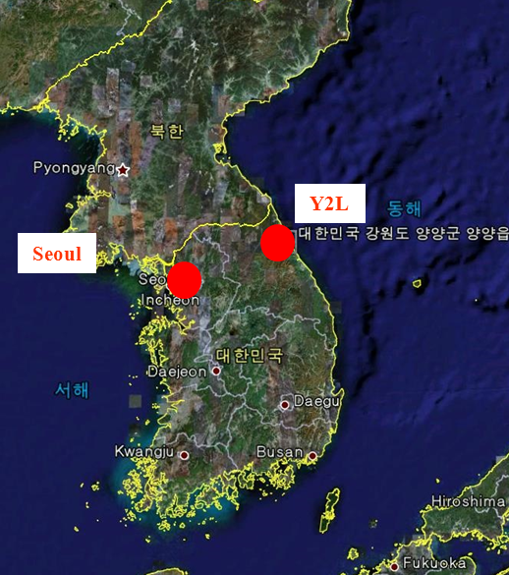
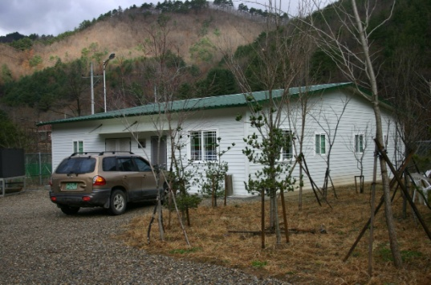
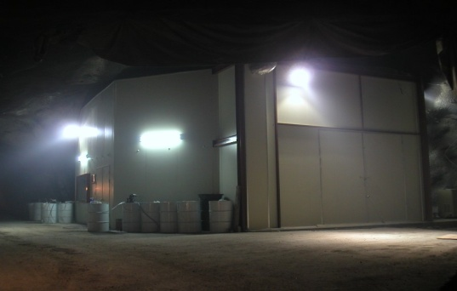
Yangyang Underground Laboratory
Korea Middleland Power Co.
Yangyang Pumped Storage Power Plant
(Upper Dam)
Construction of Lab. buildings done in 2003
Gneiss (2 Gyr )
(Power Plant)
Depth | Minimum 700 m
Temperature | 20 ~ 25 ºC
Humidity | 35 ~ 60 %
Rock contents | ²³⁸U less than 0.5 ppm ²³²Th 5.6 ± 2.6 ppm ⁴⁰K 270 ± 5 ppm
Muon flux | 2.7 x 10⁻⁷ /cm²/s
Neutron flux | 8 x 10⁻⁷ /cm²/s
²²²Rn in air | 1~2 pCi/liter
(Lower Dam)
Minimum depth : 700 m / Access to the lab by car (~2km)

Slide 3
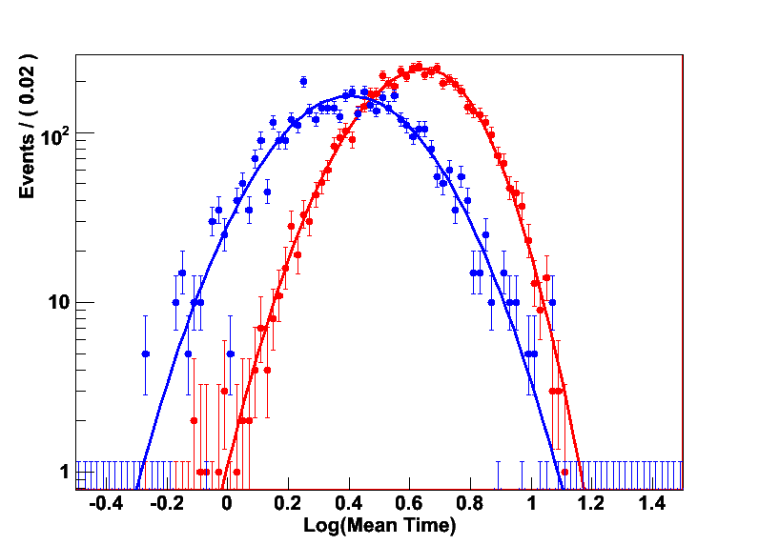
WIMP search with CsI(Tl) Crystals
Large mass with an affordable cost
➔ Good for AM study
High light yield ~60,000/MeV
Pulse shape discrimination
➔ Moderate background rejection
Easy fabrication and handling
Cs & I (SI cross section ~ A²)
Cs &,I are sensitive to SD interaction
CsI(Tl) Crystal 8x8x30 cm³ (8.7 kg)
3” PMT (9269QA) : Quartz window, RbCs P.C.
~5 Photo-electrons/keV
electron recoil
Isotope | J | Abun | <Sp> | <Sn>
¹³³Cs | 7/2 | 100% | -0.370 | 0.003
¹²⁷I | 5/2 | 100% | 0.309 | 0.075
⁷³Ge | 9/2 | 7.8% | 0.03 | 0.38
¹²⁹Xe | 1/2 | 26% | 0.028 | 0.359
¹³¹Xe | 3/2 | 21% | -0.009 | -0.227
nuclear recoil

Slide 4
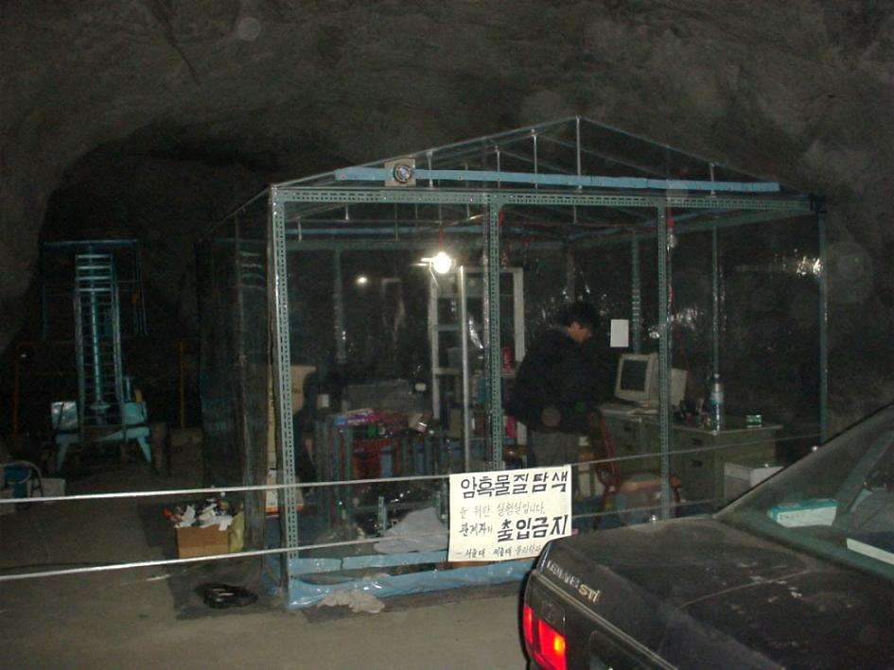
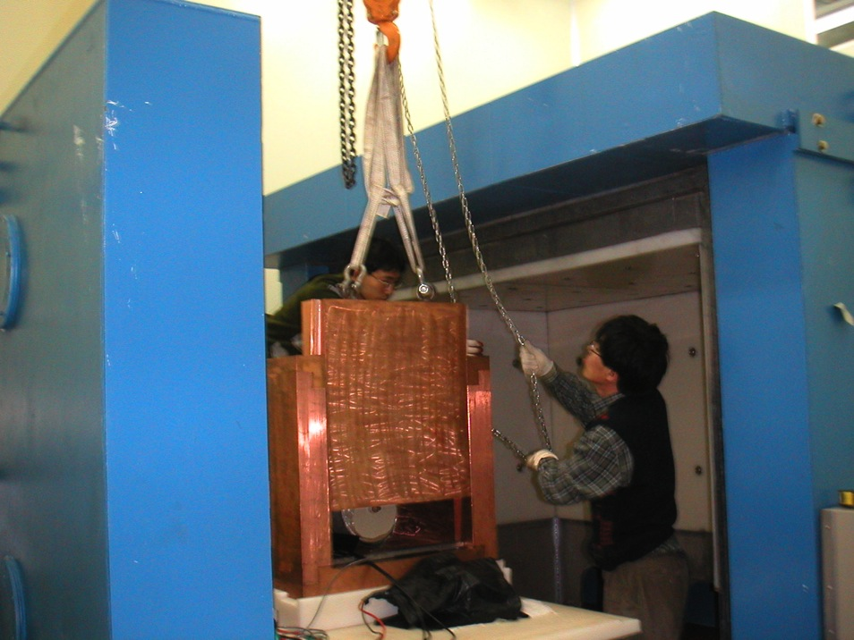
KIMS (Korea Invisible Mass Search)
2000 @ CPL, began in the vinyl room
KIMS collaboration members
Seoul National University: H.C.Bhang, J.H.Choi, S.H. Choi, K.W.Kim, S.C.Kim, S.K.Kim, J.H.Lee,J.I.Lee , J.K.Lee, M.J.Lee, S.J.Lee, J.Li, X.Li, S.S.Myung,S.L.Olsen, I.S.Seong
Sejong University: U.G.Kang, Y.D.Kim
Kyungpook National University:
H.J.Kim, J.H.So, J.Y.Lee
Yonsei University: Y.J.Kwon
Ewha Womans University: I.S.Hahn
Seoul City University : Douglas Leonard
Korea Research Institute of Standard Sciences : Y.H.Kim, K.B.Lee, M.K. Lee
Tsinghua University : Y.Li, Q.Yue, J. Li
2003.2.27

Slide 5
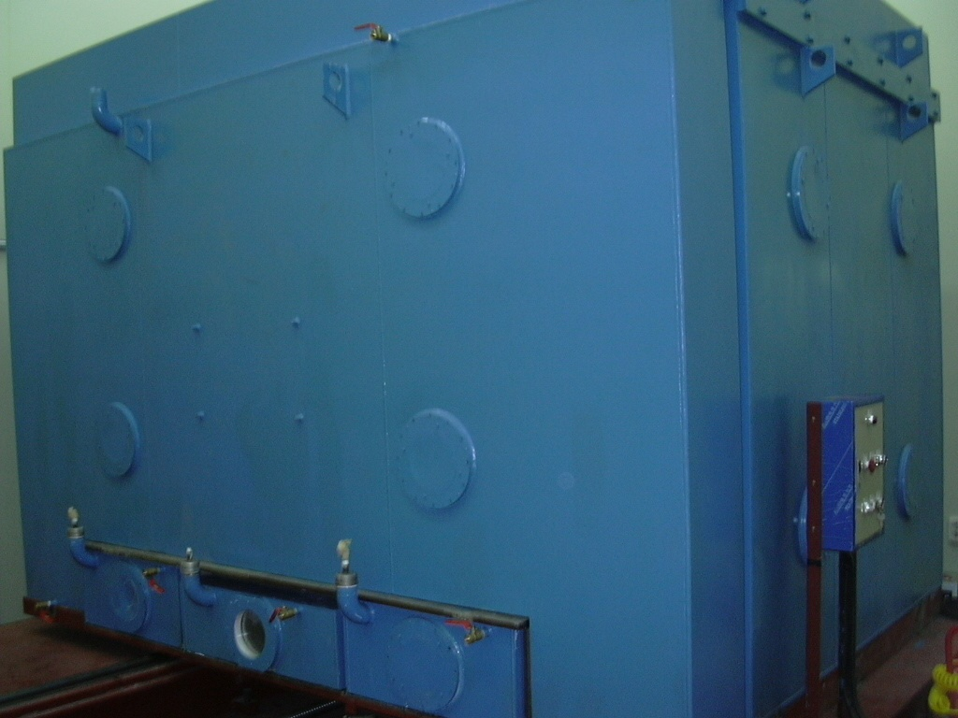
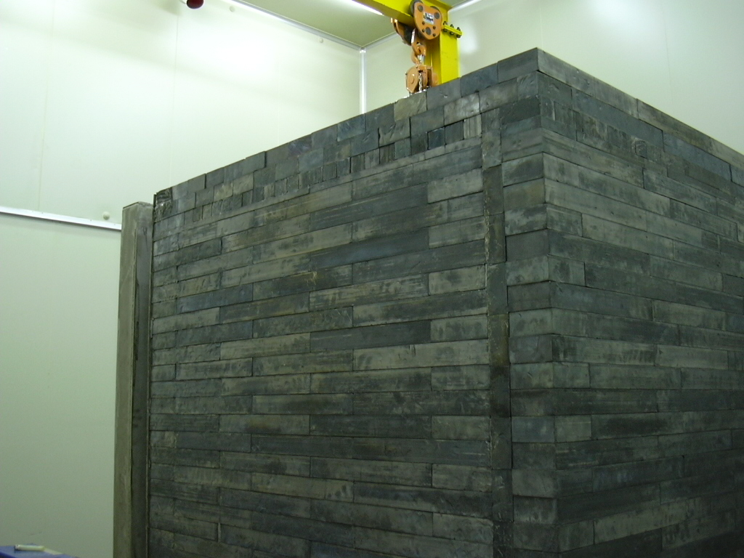
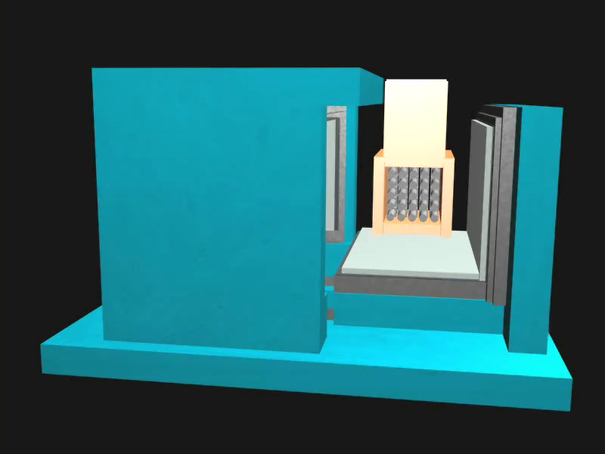
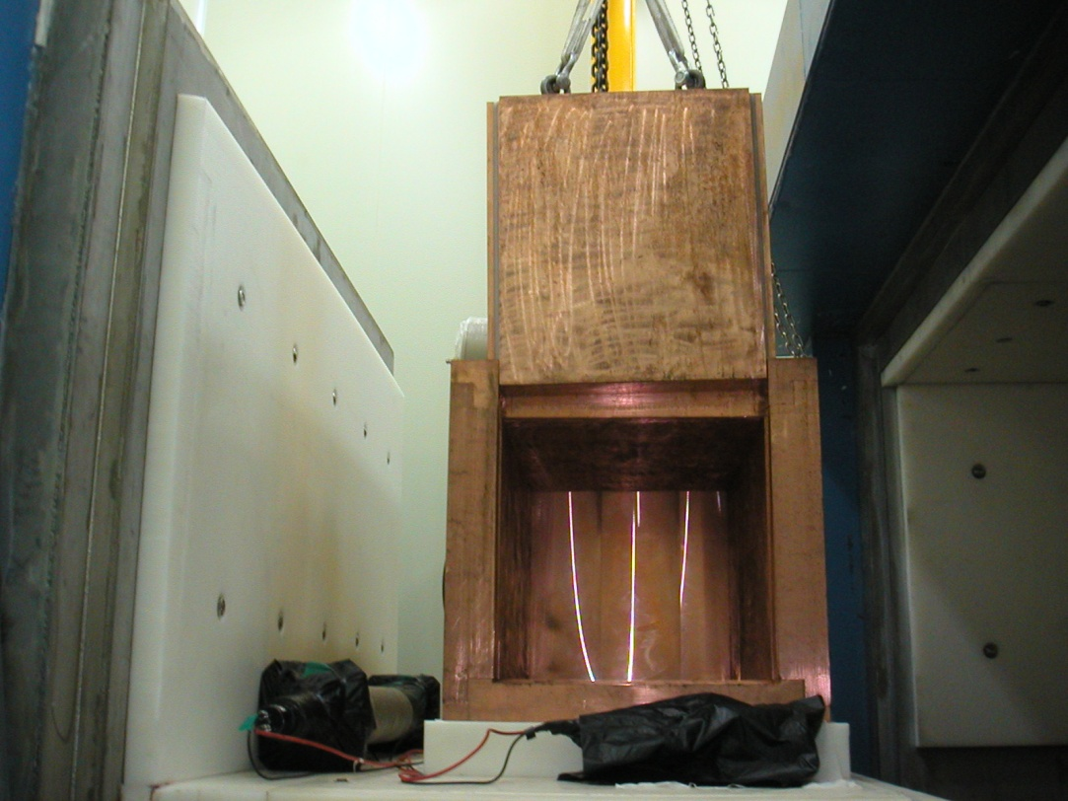
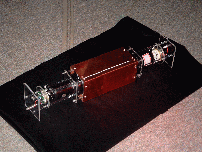
Mineral oil 30cm
12 x CsI(Tl) crystal
Copper shield
Boliden Lead 15cm : 30t
Polyethylene
Lead shield
CsI crystal detector
OFHC Cu 10cm : 3t
Moderator(Muon Det.)

Slide 6
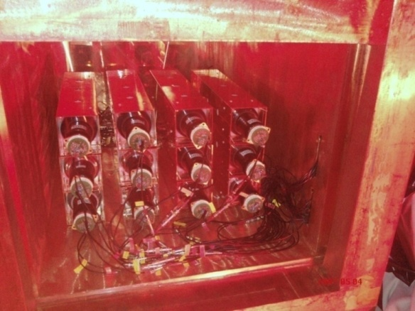
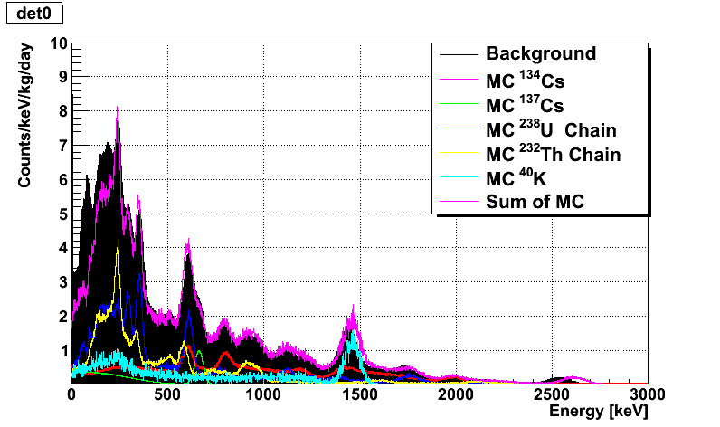
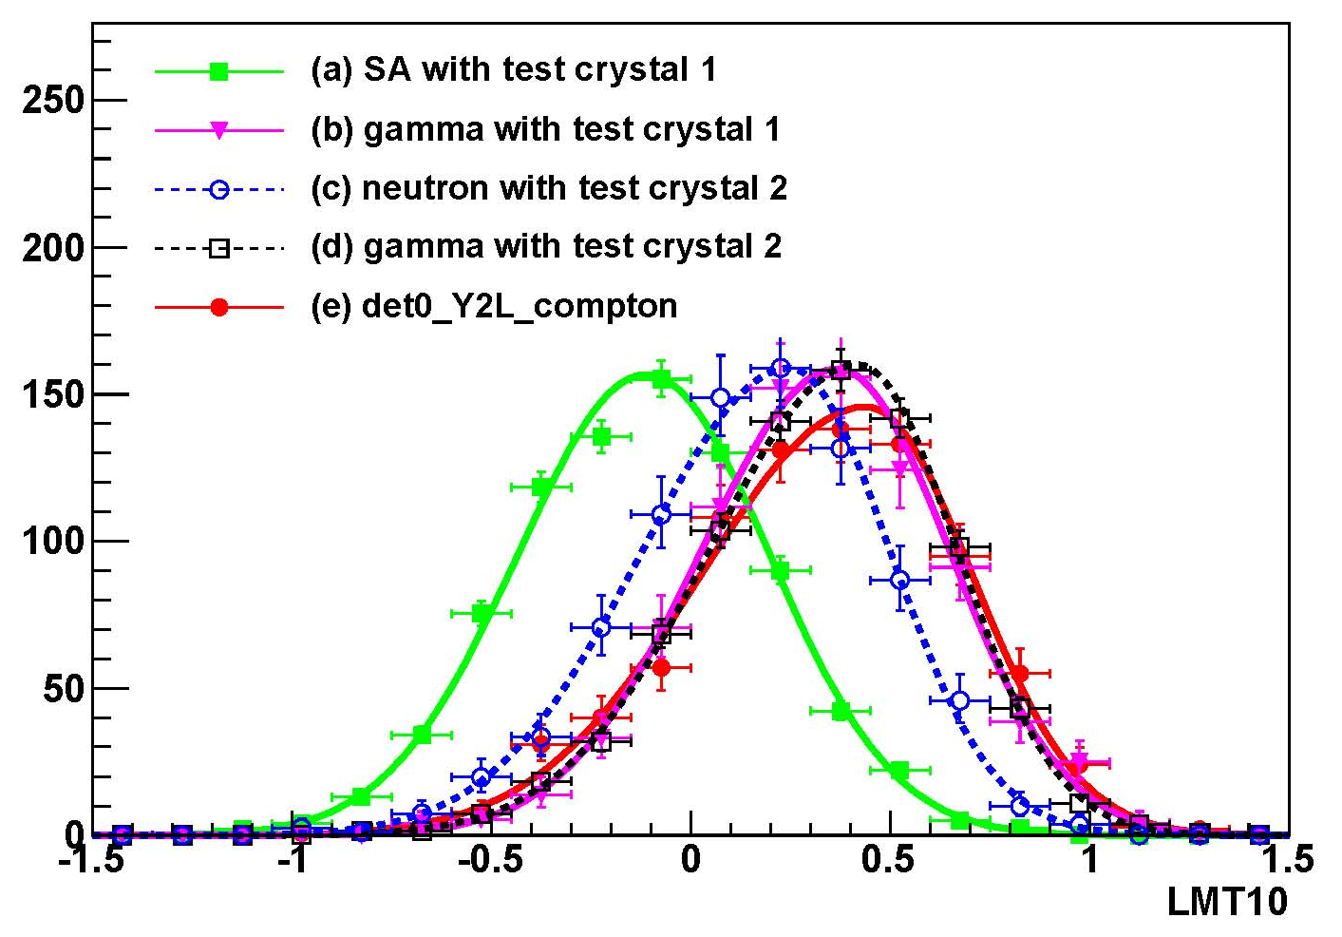
KIMS with 104.4 kg CsI(Tl)
12 crystals(104.4kg) in operation
2.5 year data (Sep. 2009 – Feb. 2012)
Background Level : 2~3 cpd/kg/keV
Source calibration with ⁵⁵Fe & ²⁴¹Am
Backgrounds are well understood.
Total backgrounds
Pulse shape discrimination
Data
MC

Slide 7
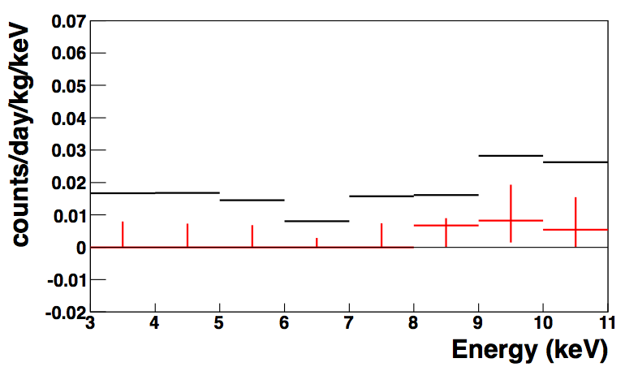
Nuclear recoil event rates (PSD analysis)
Pdf = f0 x F_{NR} + f1 x F_{SA} + (1-f0-f1) x F_{gamma}
The posterior pdf for f0 & f1 is obtained from Bayesian analysis method.
1 year data excluding det0, 8, 11
Example : 6 keV bin, DET09

Slide 8
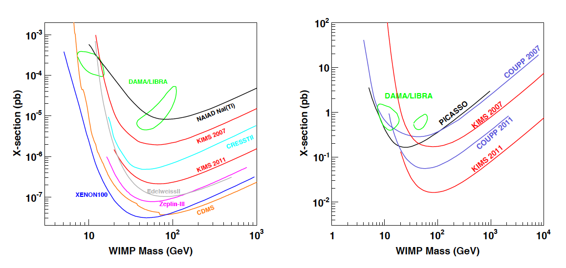
PSD result on WIMP search @KIMS
Total exposure: 24524.3 kg days
S.C. Kim et al., PRL 108 181301 (2012)
=> 3 years data analysis will be done.
SI WIMP-nucleon
SD WIMP-proton

Slide 9
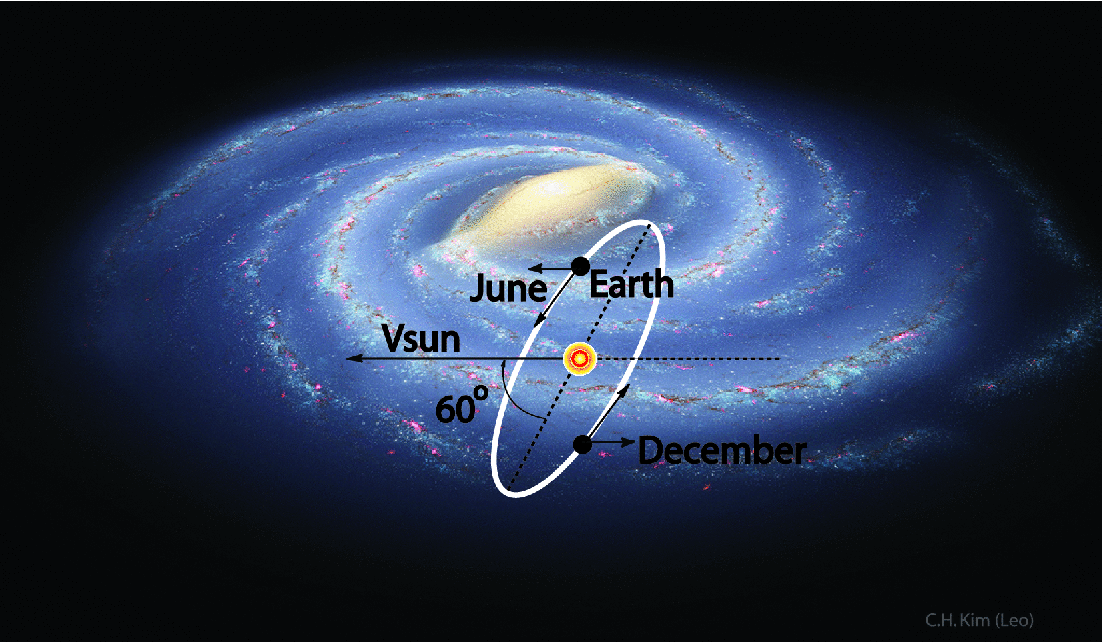
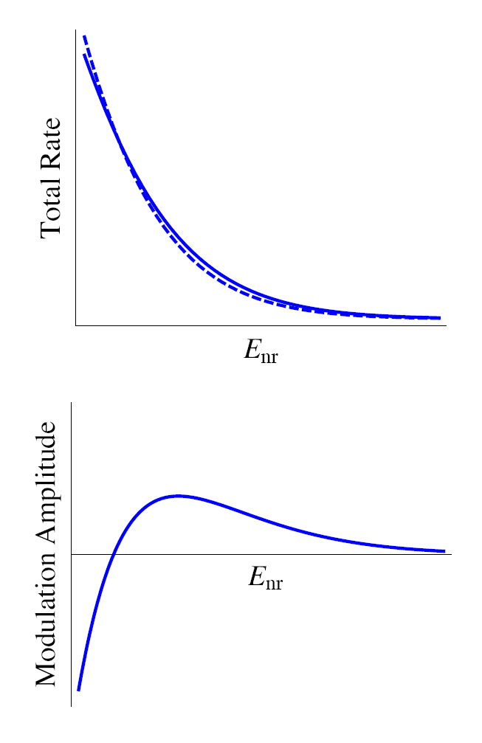
Annual Modulation Derived From The Earth’s Orbit
3% of Total Rate
220km/s
Jun.
Dec.
30km/s
$$v_{E}(t)≈220+15\cos\left. (2π\frac{t−152.5}{365.25})\right.km/s$$

Slide 10
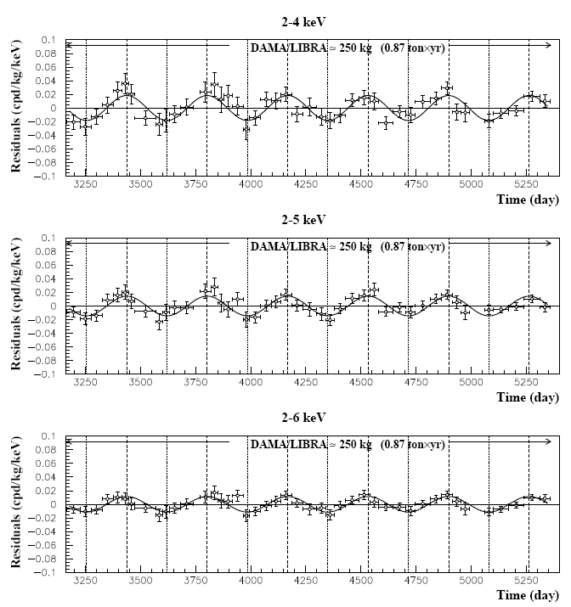
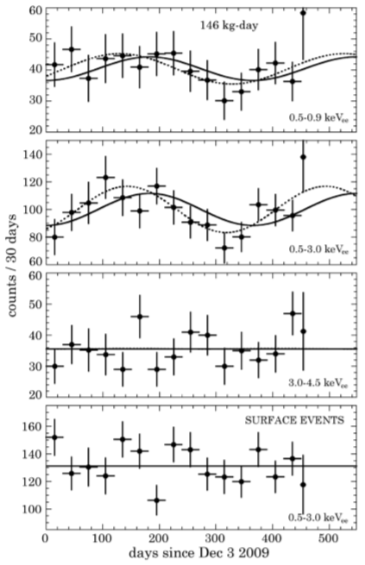
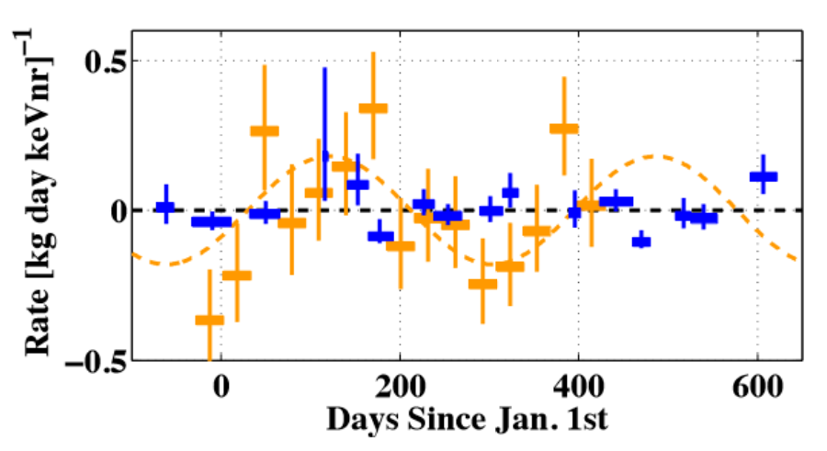
Annual Modulation Signals
DAMA/LIBRA
CoGeNT
CDMS-II
Eur. Phys. J. C 67 (2010) 39
PRL 107 (2011) 141301
arXiv:1203.1309v2
CDMS-II
CoGeNT
2~4 keV 0.0183 ± 0.0082, 8.3σ
CDMS didn’t see
annual modulation

Slide 11
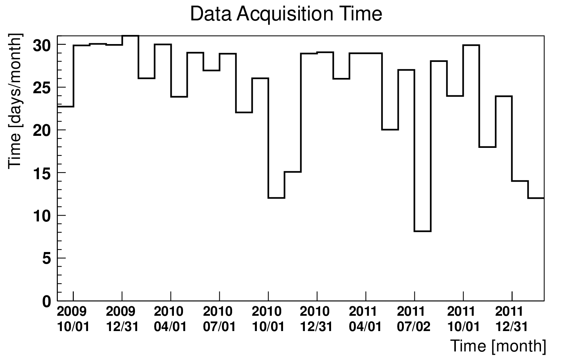
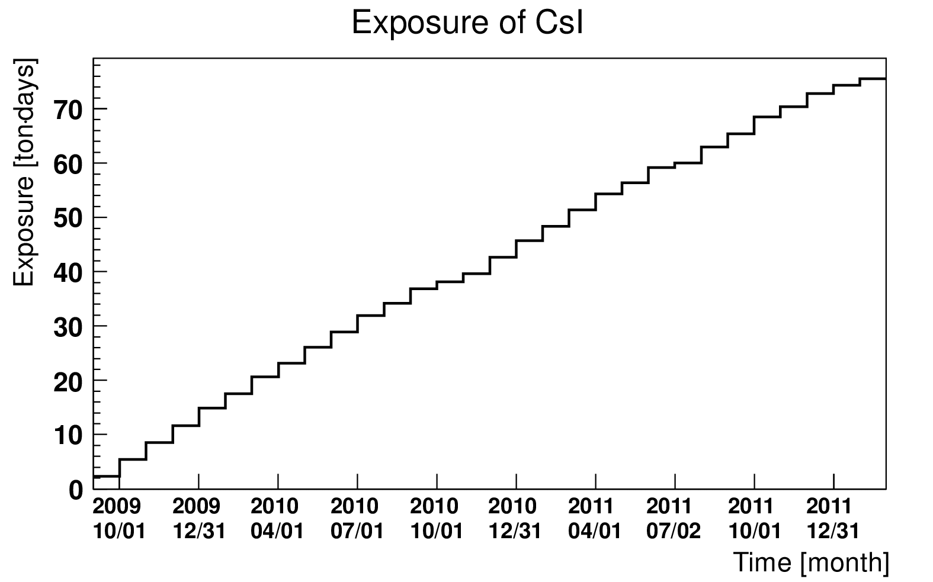
Data Taking
75.53 ton∙days
75.53 ton∙days during 2.5 years
Sep. 2009 ~ Feb. 2012
Sep. 2009 ~ Feb. 2012
Data taking :75.53 ton∙days during 2.5 years

Slide 12
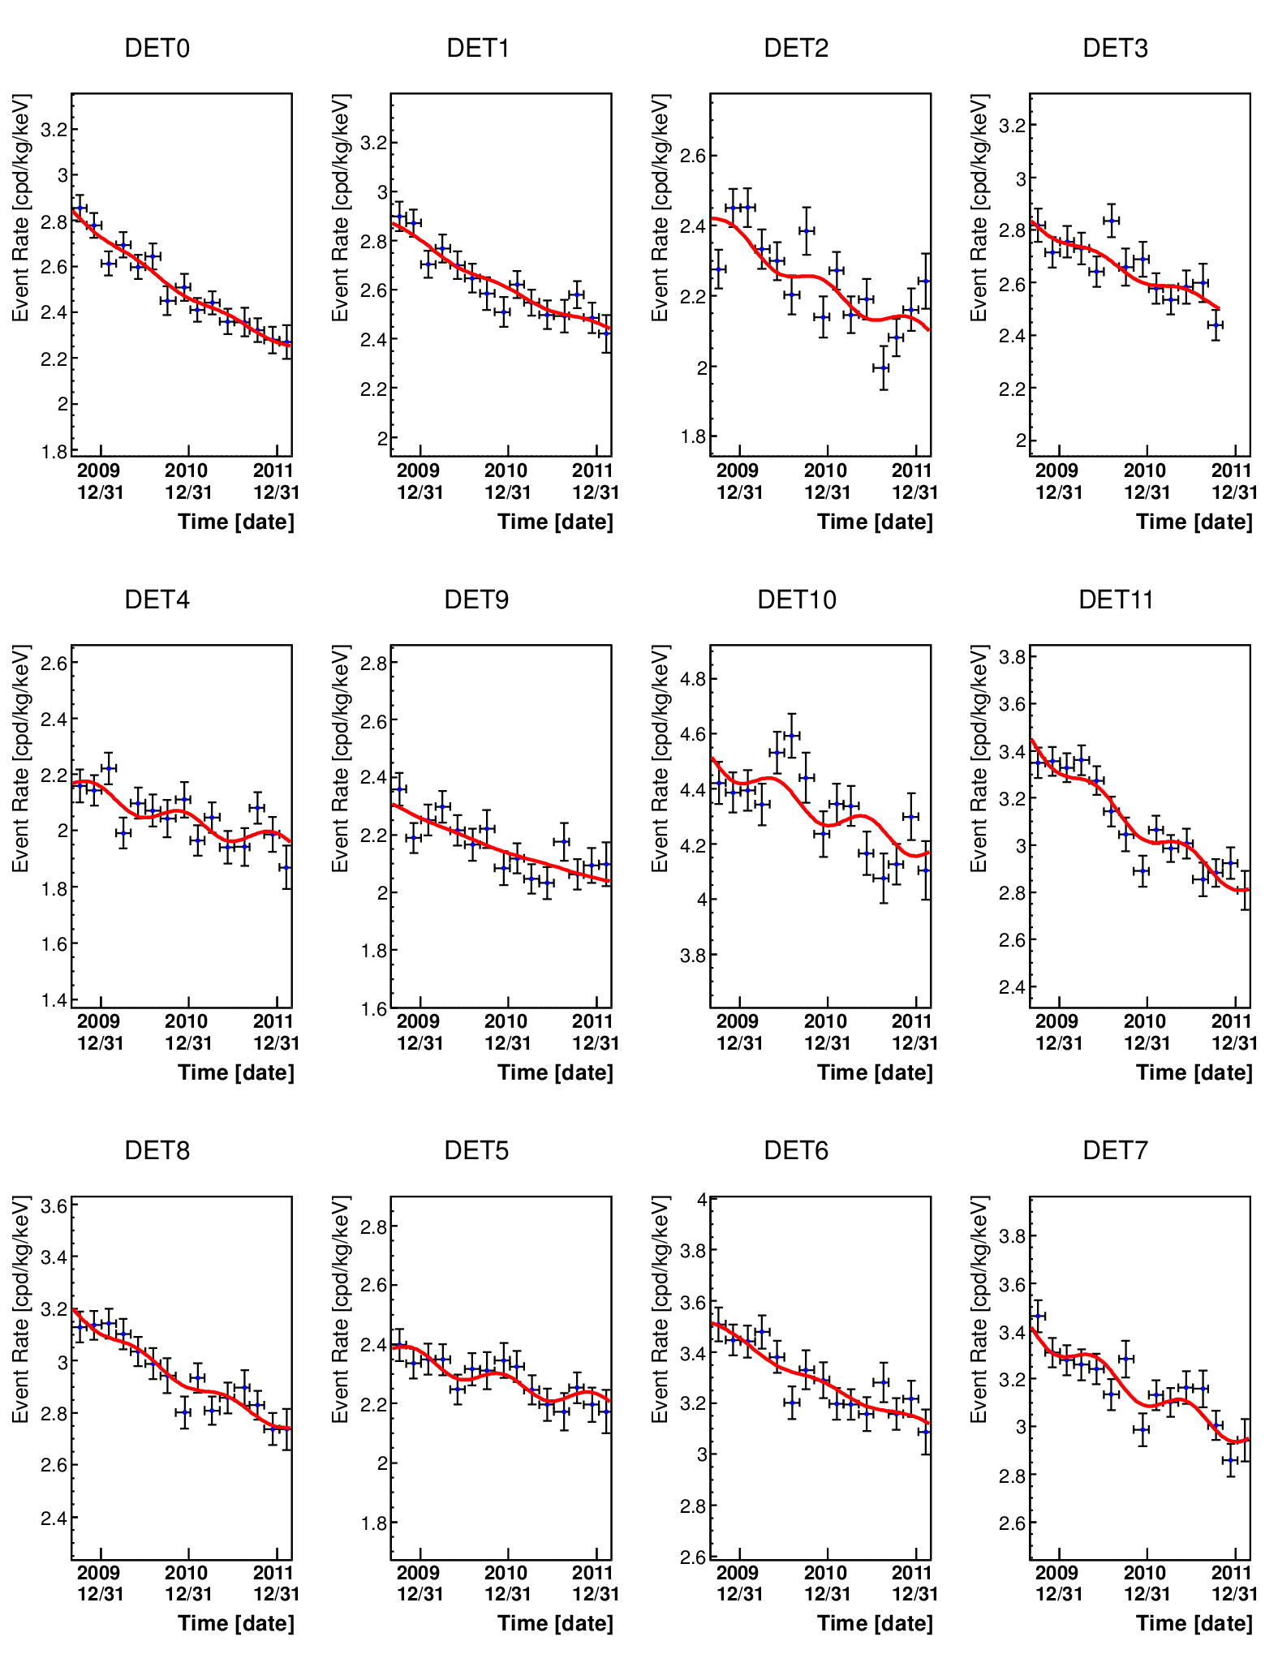
Annual Modulation Fitting
2 Jun.
$$f\left.(t)\right.=A_{decay} e^{−\frac{(t−t_{0})}{τ}} + Bkg + A cos\frac{2π}{ω}(t−t_{1})$$
Decay
Constant
Modulation
A_{decay} : Initial level (¹³⁴Cs)
t₀ : Initial time – fixed to 1 Sep. 2009
τ : Decay constant (¹³⁴Cs) – fixed to T_{1/2}=2.065 y
Bkg : Constant background level
A : Annual Modulation Amplitude
ω : Period – fixed to 1 year=365.25 d
t₁ : Annual Modulation Peak – fix to 2 June

Slide 13
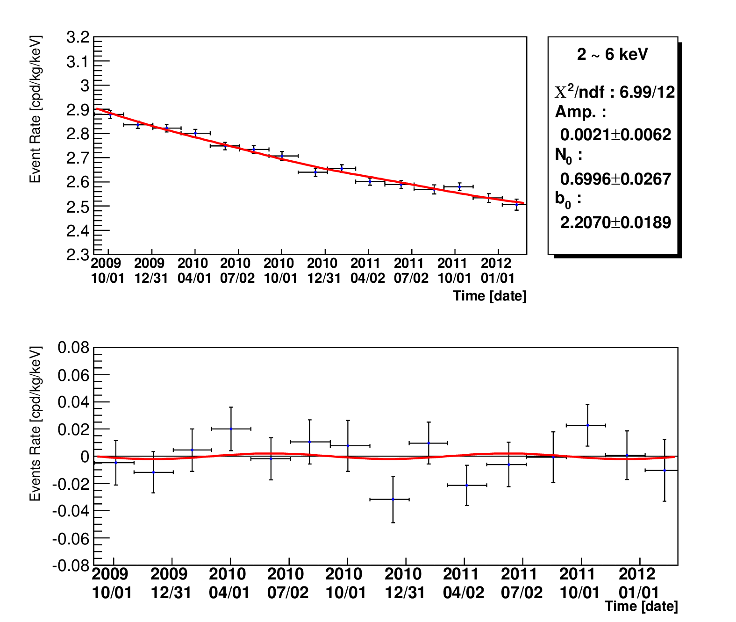
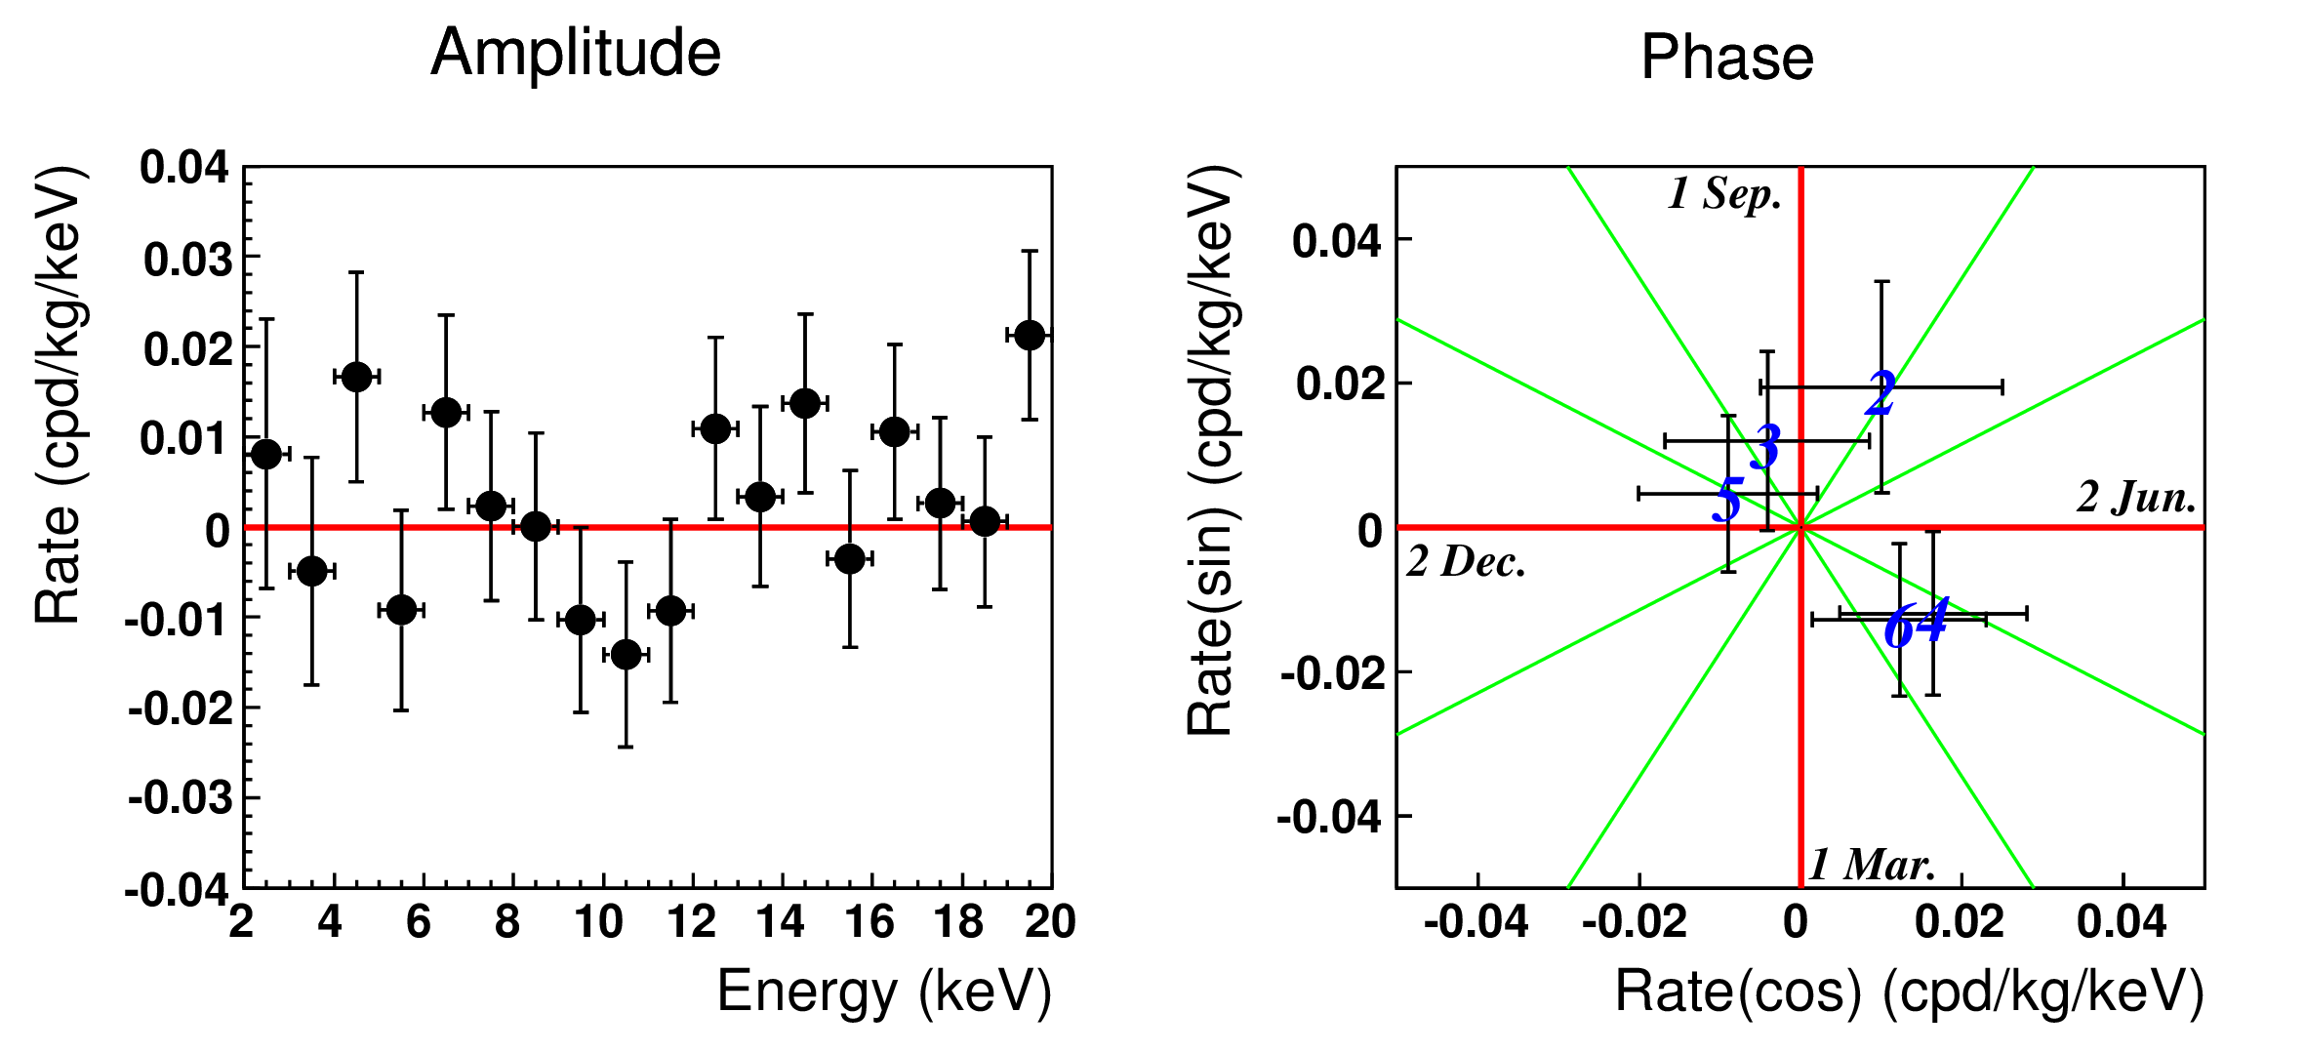
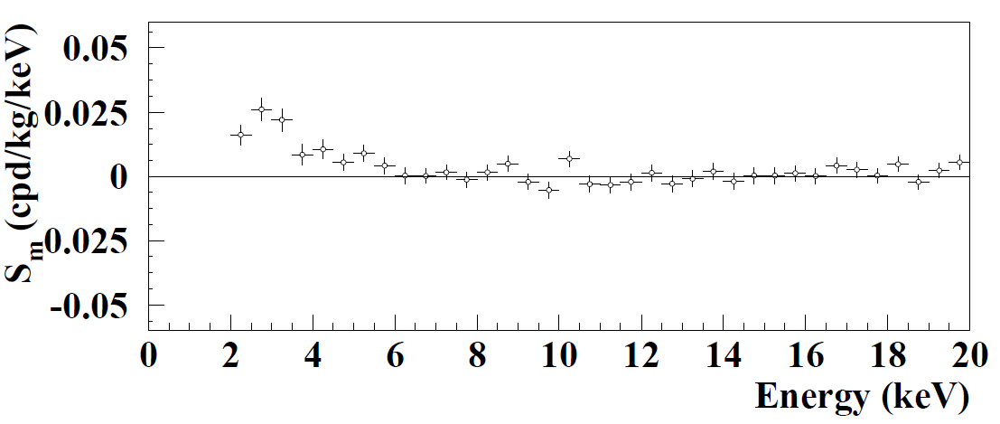
preliminary
2~6 keV : 0.0021±0.0062
3~6 keV : 0.0008±0.0068
A_{decay}
Bkg
2~6 keV : 0.0021±0.0062 (0.0122 90% CL Positive Limit), 3~6 keV : 0.0008±0.0068 (0.0119 90% CL Positive Limit)
DAMA Result
2~4 keV : 0.0183±0.0082, 8.3σ
2~6 keV : 0.0021±0.0062 (0.0122 90% CL Positive Limit),
3~6 keV : 0.0008±0.0068 (0.0119 90% CL Positive Limit)

Slide 14
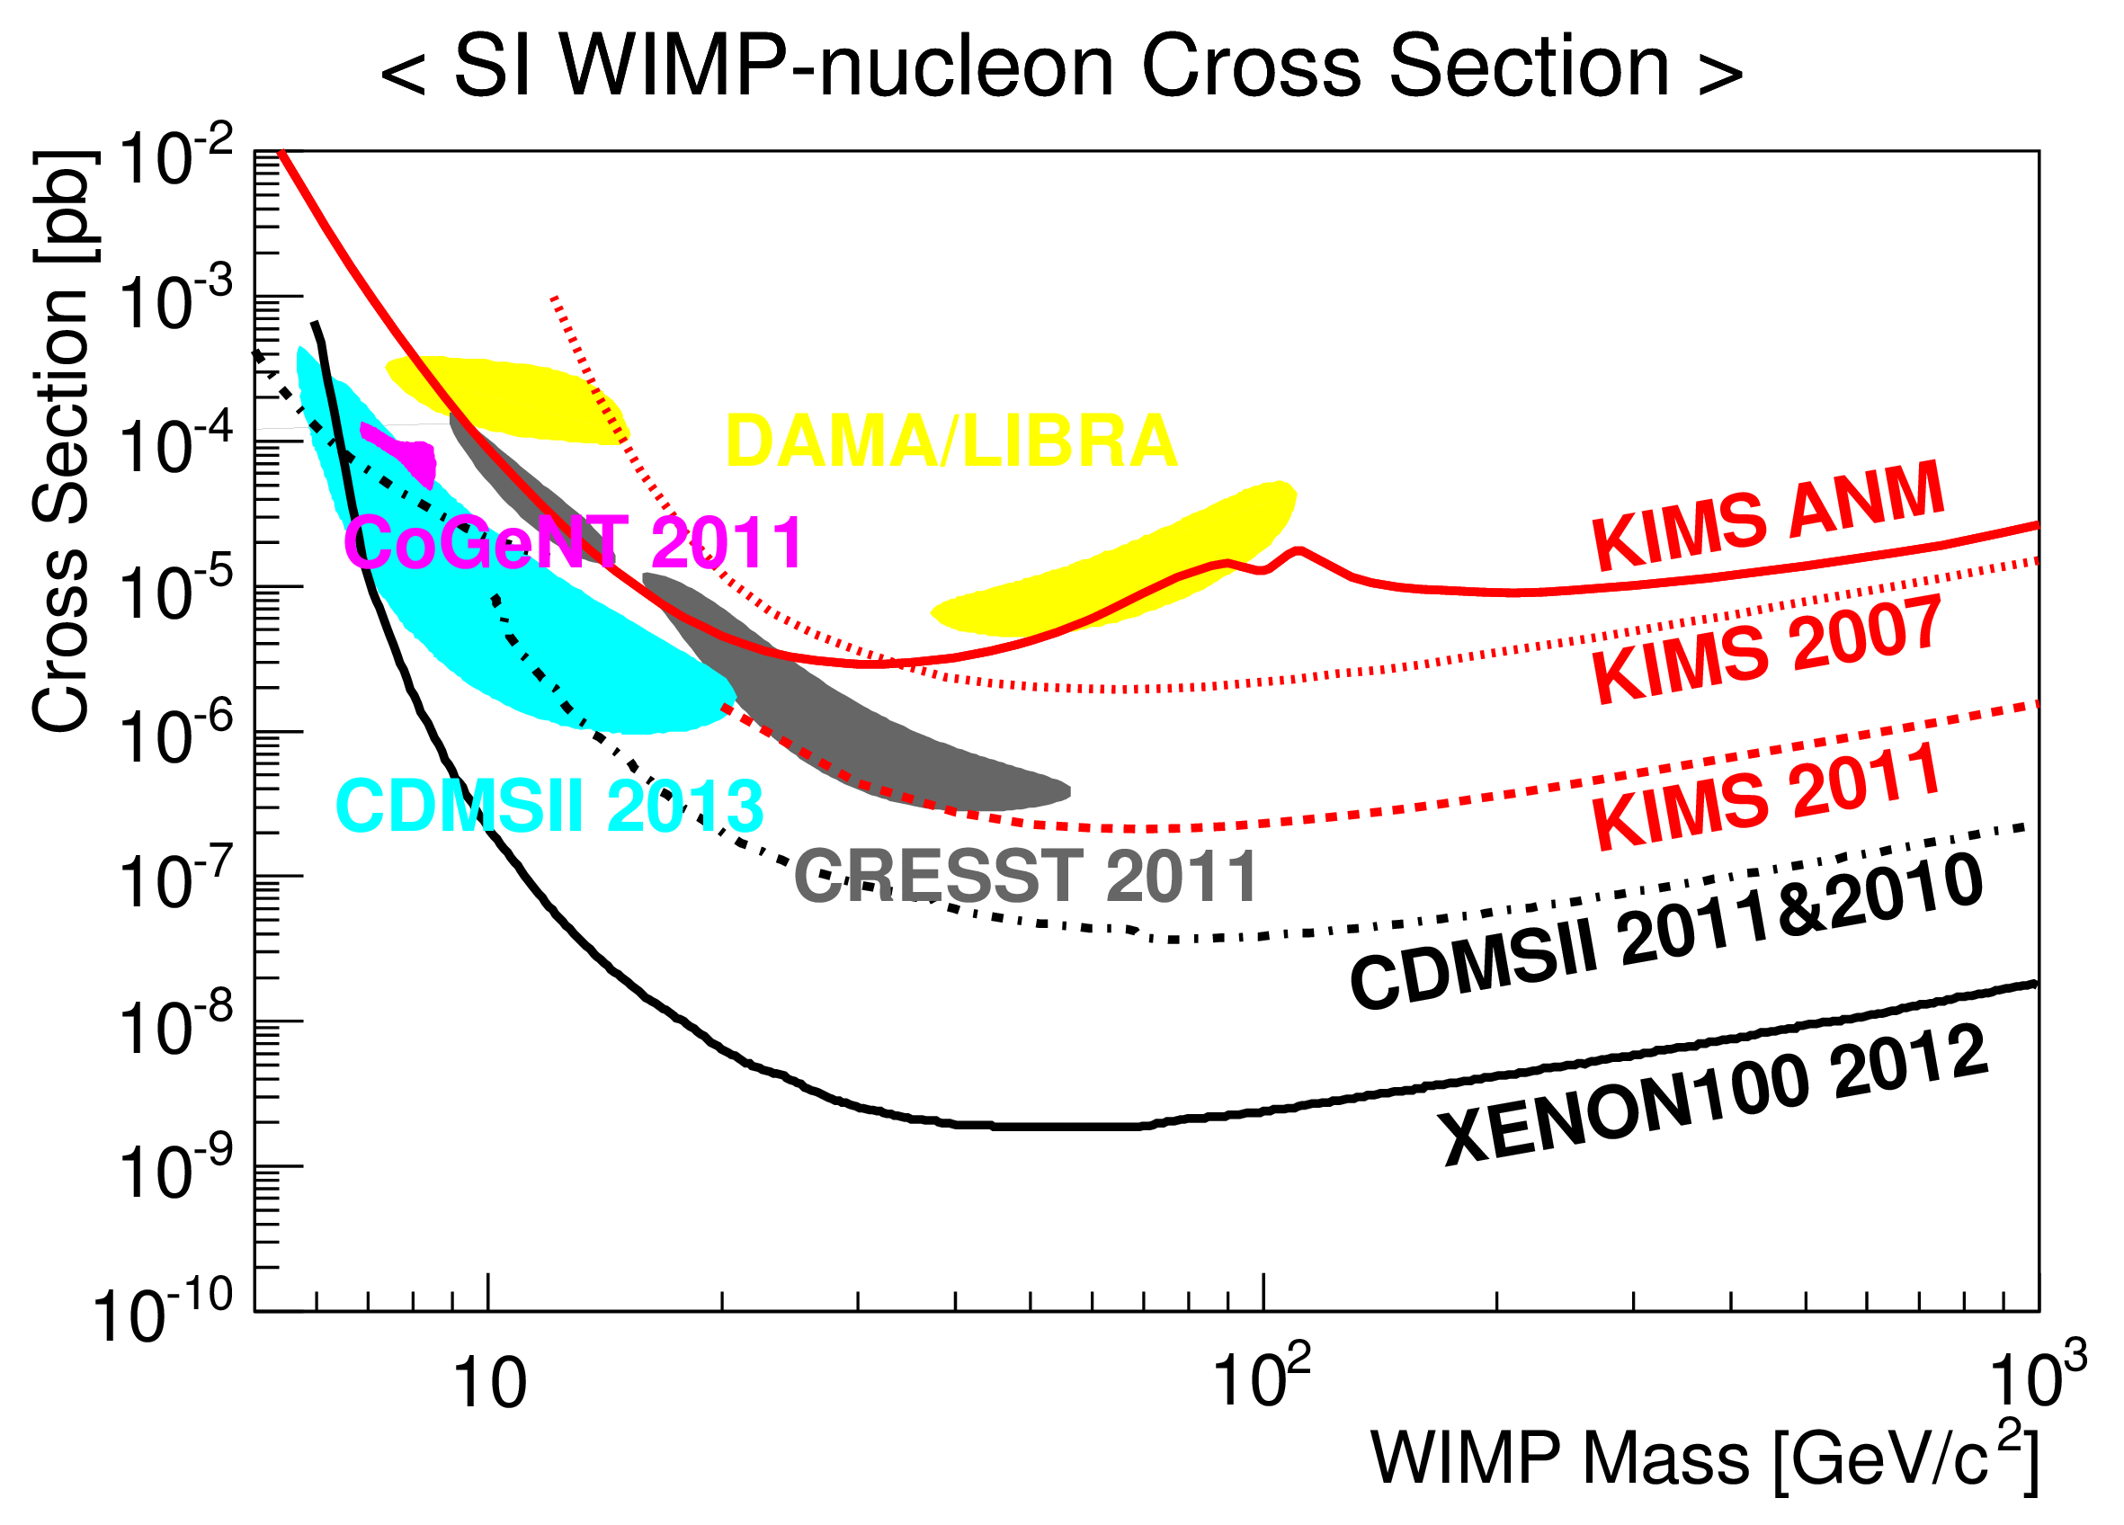
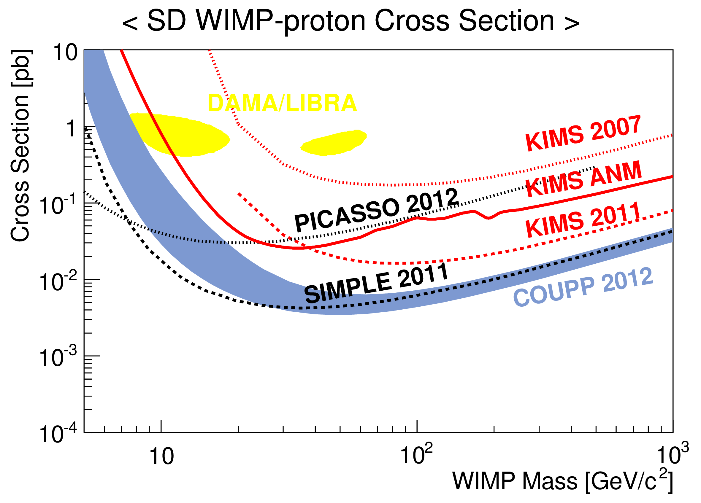
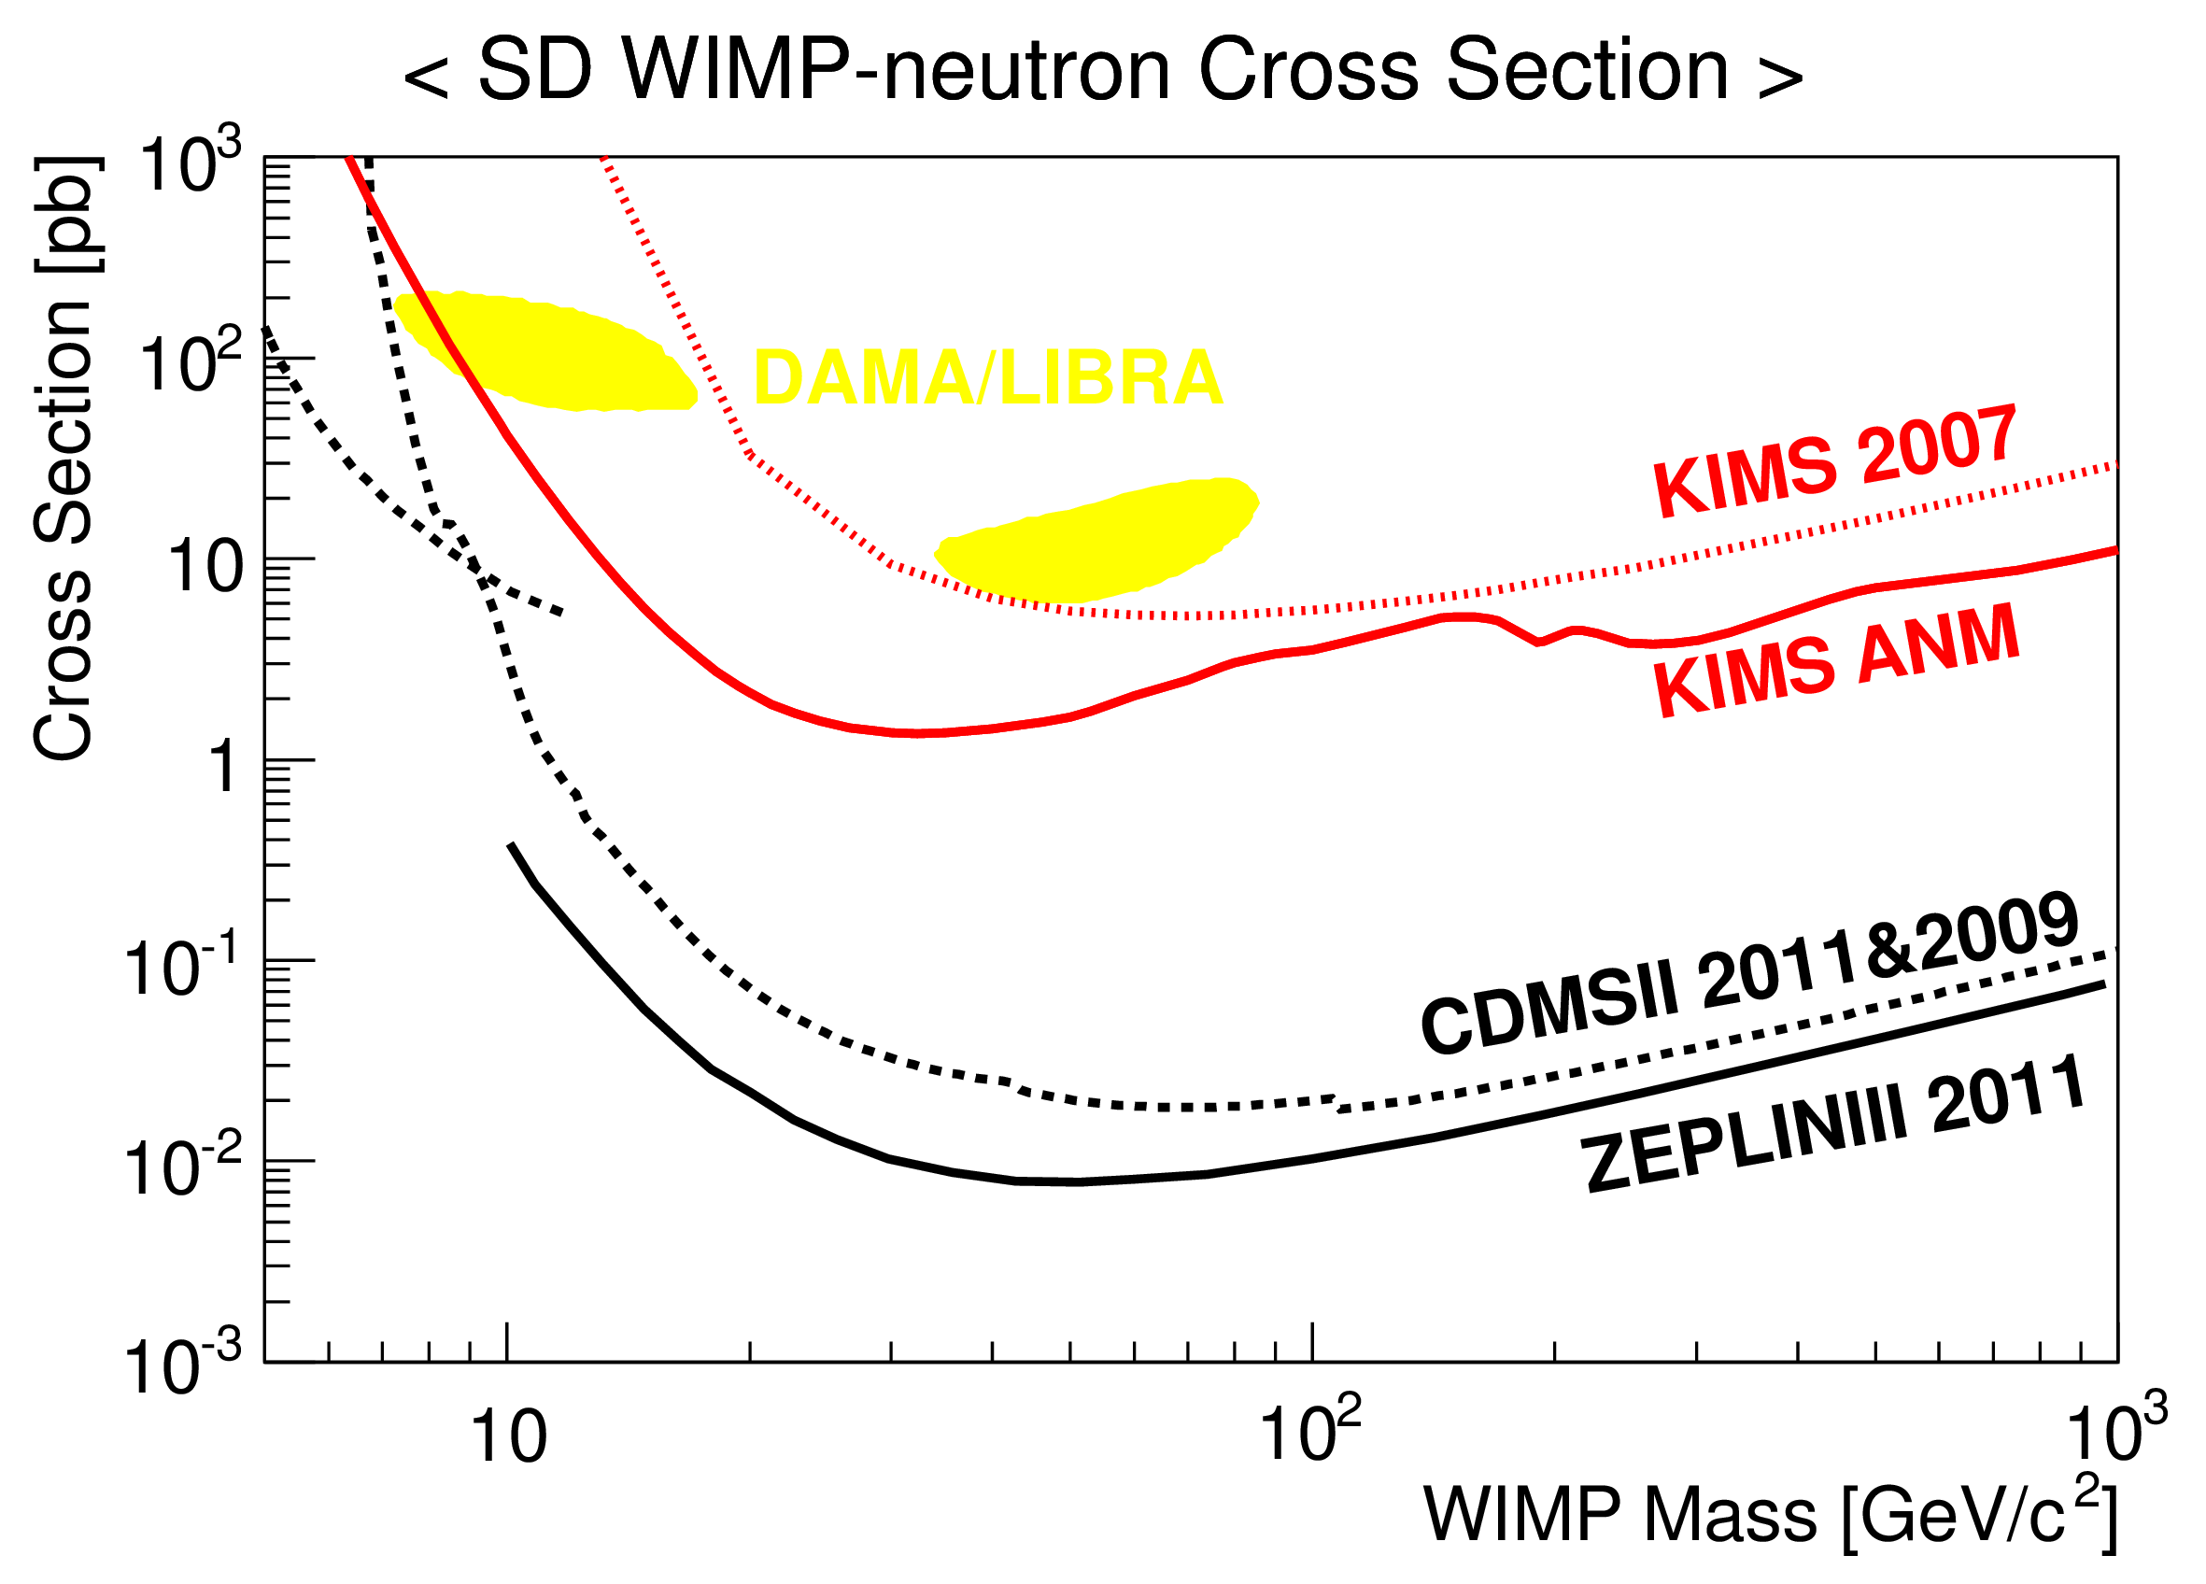
Spin-dependent
(WIMP-proton)
Spin-independent
(WIMP-nucleon)
Spin-dependent
(WIMP-neutron)
preliminary
Spin-independent : $σ_{W−n}^{SI}=σ_{0}\frac{μ_{n}^{2}}{μ_{A}^{2}}\frac{1}{A^{2}}$ , Spin-dependent : $σ_{W−n,p}^{SD}=σ_{0}\frac{μ_{n,p}^{2}}{μ_{A}^{2}}\frac{3}{4}\frac{J}{(J+1)}\frac{1}{{<S_{n,p}>}^{2}}$

Slide 15
KIMS Perspectives
Upgrade of CsI(Tl) crystal detector
Change PMTs to more sensitive and lower noise ones.
Lower threshold ~ 1.5 keV, < 1 counts/(keV kg day).
KIMS-NaI
Duplicate DAMA experiment.
Develop ultra-low background NaI(Tl) crystals through international collaboration (ANAIS, DM-ICE group @ south pole)
KIMS is ready to house NaI(Tl) crystals and 1st crystal will be installed at Y2L this summer.
KIMS-CMO200 (AMoRE-DARK)
^{nat}Ca^{nat}MoO₄ crystals with cryogenic technique : ~ 200 kg mass.
High sensitivity in low mass WIMP.
Good nuclear recoil separation is expected. Need to be developed.

Slide 16
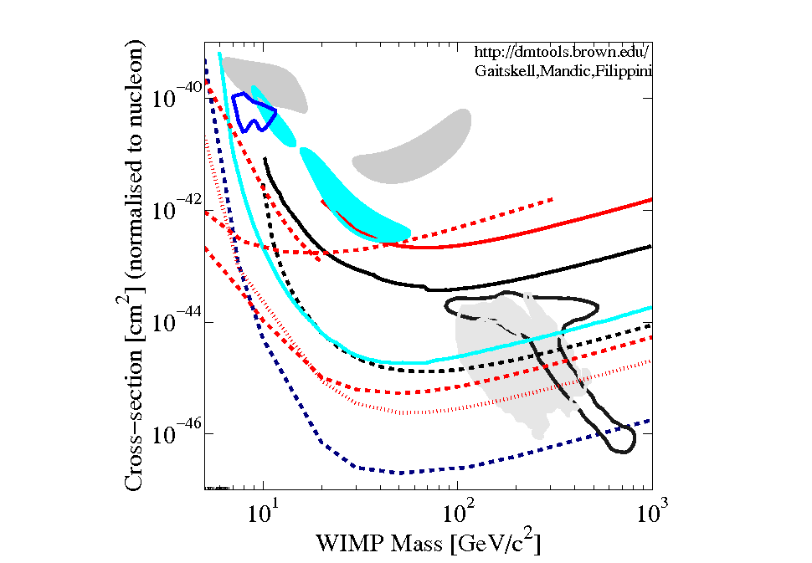
WIMP search perspectives & KIMS
CoGent
CRESST
KIMS upgrade
DAMA
KIMS-PPC
KIMS2012
CDMS
Trotta et al.
SuperCDMS
Buchmueller et al.
XENON
KIMS-CMO 200kg
XENON1T

Slide 17
Summary and Prospect
1 year data with 100 kg CsI(Tl) data analyzed with PSD method. DAMA Iodine region is inconsistent with KIMS nuclear recoil rate limit. 3 years data will improve the sensitivity.
2.5 year data are analyzed without PSD for annual modulation. The amplitudes of annual modulation are 0.0021±0.0062 cpd/kg/keV (2~6 keV) and 0.0008±0.0068 cpd/kg/keV (3~6 keV) which are consistent with zero amplitudes within errors
Upgrade plans show further reduction of backgrounds and NaI(Tl) R&D is underway. AMoRE-DARK will explore not only 0-νββ search but also dark matter search with cryogenic technique.
Center for Underground Nuclear, Particle, Astrophysics (CUNPA) got funded : KIMS upgrade and AMoRE project included.

Slide 18
Thank you for attention

Slide 19
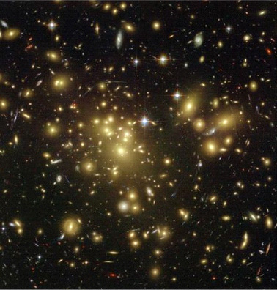
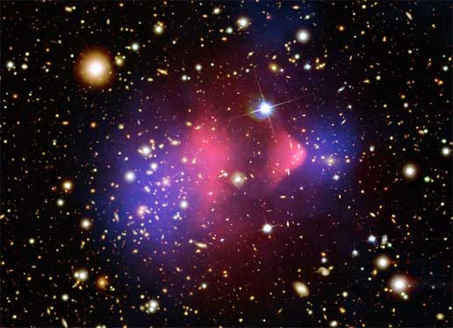
Evidences for Dark Matter (~25% of Universe)
Rotation curve for Galaxy
Gravitational Lensing
Bullet cluster
Not visible, but gravitationally evident!
Parameters of ΛCDM by WMAP

Slide 20
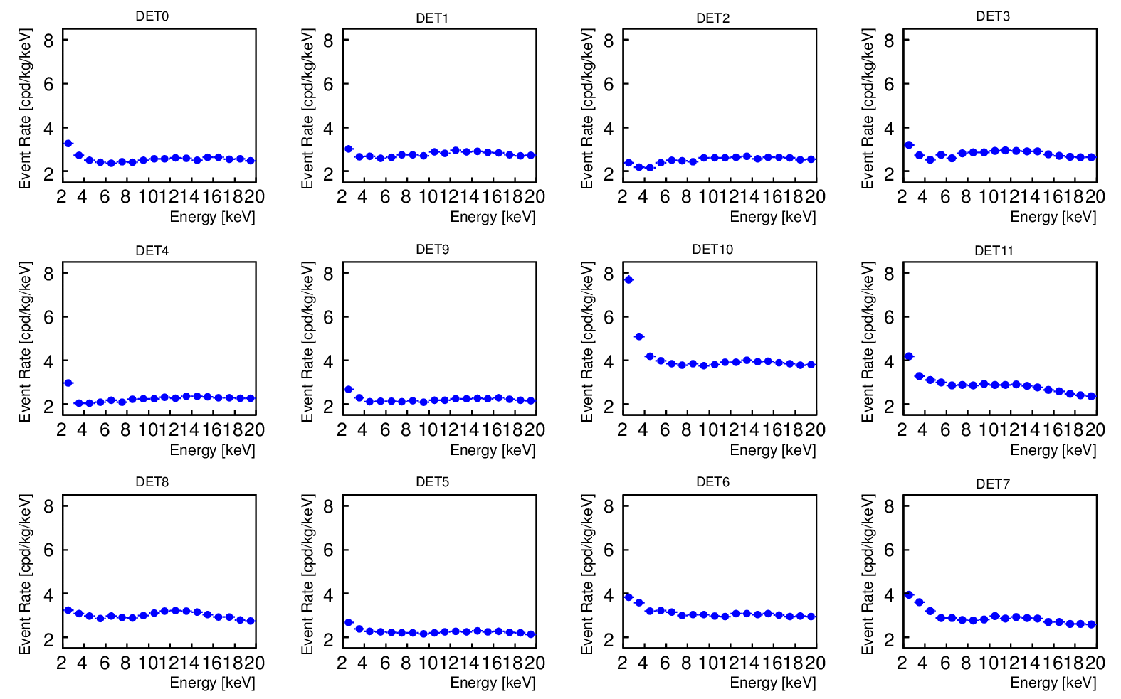
Energy Spectrum
2~4 cpd/kg/keV

Slide 21
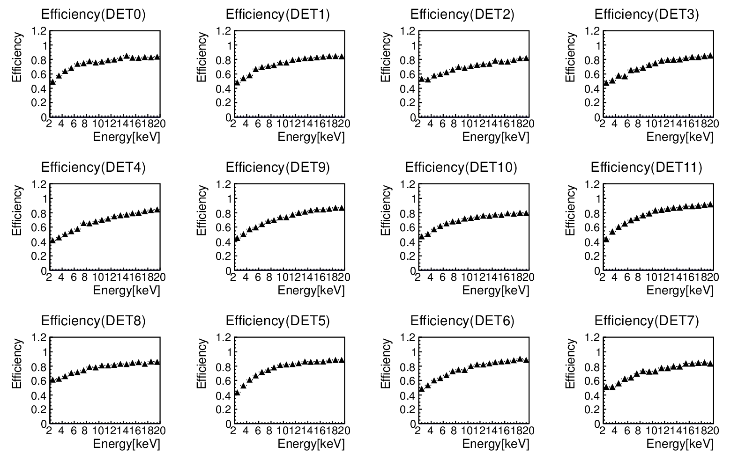
Events Selection
Cut | Target
Electronics Noise | electronics noise, …
Partial Charge | PMT afterpulse, pile-up signal, …
Spark Cut | PMT thermionic electron, spark, …
Charge Asymmetry | PMT scintillation or Cherenkov, …
Signal Start Time | PMT dark current, …
Time Asymmetry | PMT dark current, …
Fit Quality | Cosmic signal’s tail, …
7 selection conditions are applied

Slide 22
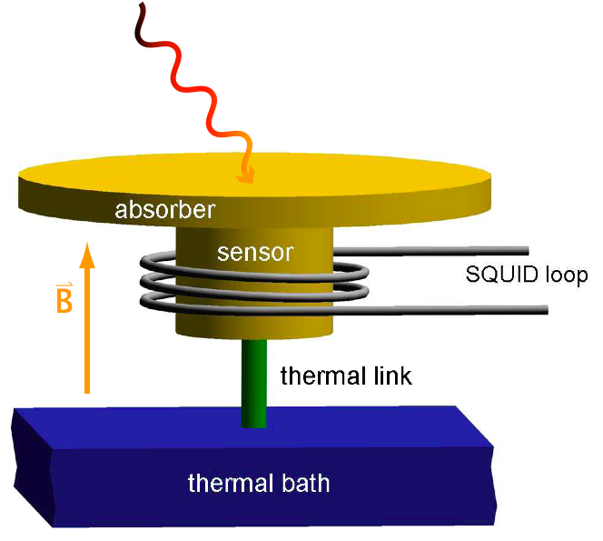
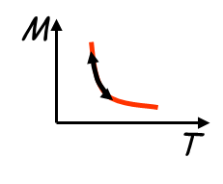
MMC (Metallic Magnetic Calorimeter) for LTD
Principle of operation
Energy absorption in CMO crystal.
Phonon & Photon generation.
Temperature increase (gold film).
Magnetization of MMC decrease.
SQUID pickup the change.
Advantage of MMC
Fast rising signal. (critical for lower 2νββ random coincidence.)
Fairly easy to attach to absorber.
Excellent Energy resolution
paramagnetic sensor:
Au:Er
paramagnetic sensor: Au:Er
Large CMO crystal (216 g) was tested
Notes:
1.2.3.4.5 수정
Mass 수정 216g

Slide 23
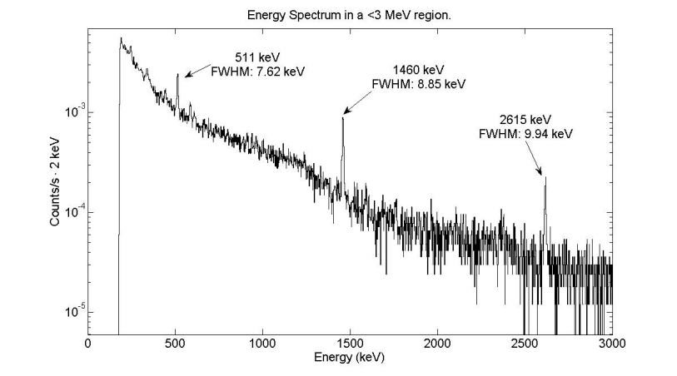
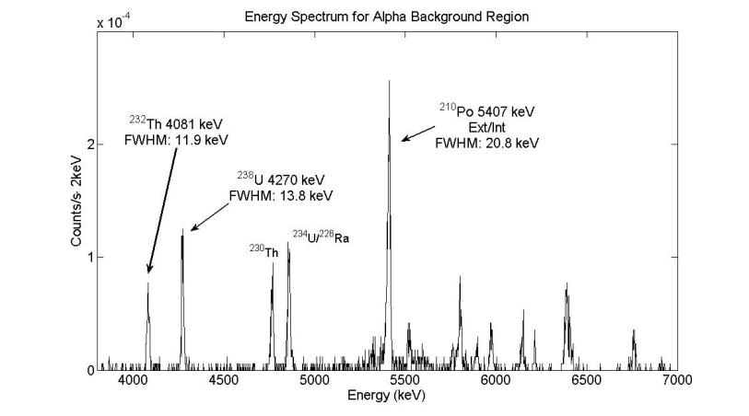
Energy Resolution
194 hour measurement at the overground laboratory (KRISS).
 | 1461 keV | 2615 keV
FWHM (keV) | 8.85 ± 0.62 | 9.94 ± 1.28
Recent R&D result of Lucifer group. arXiv:1303.4080v1

Slide 24
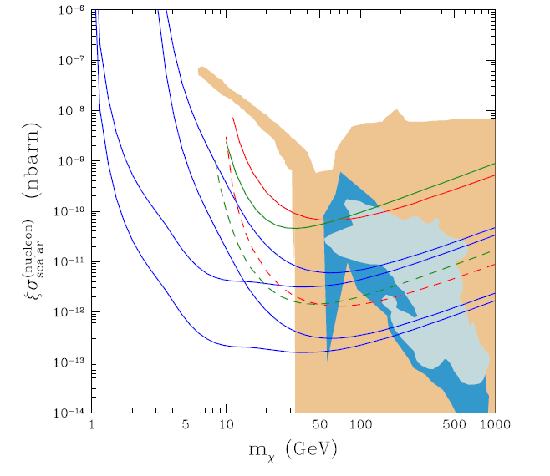
Dark matter sensitivity of CaMoO₄ cryogenic experiment
E_{th}=10 keV
(5 and 100 kg year)
CaMoO₄
CDMS 2008
SuperCDMS 25kg
XENON10 2007
Bottino et al
XENON100 6000 kgd
E_{th}=1 keV
(5 and 100 kg year)
CMSSM, Ellis et al
Trotta et al
Ellis et al
CMSSM, Markov chain Trotta et al
Effective MSSM, Bottino et al
by S. Scopel

