Slide 1
Highlights of Gamma-ray Astronomy
Jamie Holder
Bartol Research Institute/Department of Physics and Astronomy
University of Delaware
Rencontres du Vietnam: Windows on the Universe
Inaugural Conference of the ICISE
Quy Nhon, August 2013

Slide 2
Overview
What is Gamma-ray astronomy?
What are we looking for?
How do we do it?
What have we seen (broad brush) ?
Plans for the future.
Notes:
Dustbin mirror
Subsequently 30” mirror, Pic du Midi

Slide 3
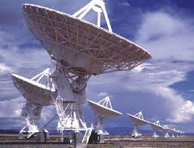
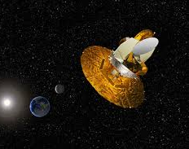
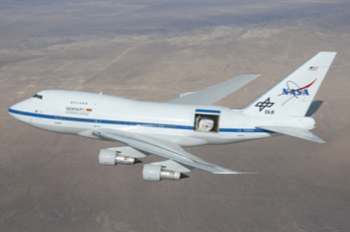
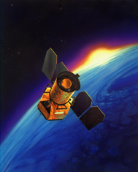
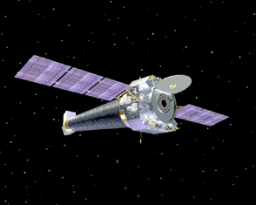
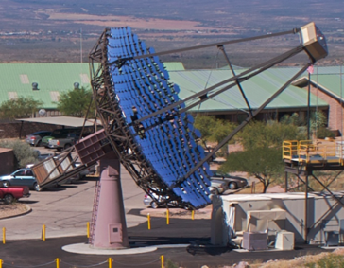
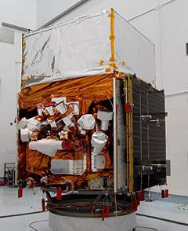
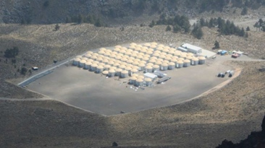
10³
10¹
10⁻¹
10⁻³
10⁻⁵
10⁻⁷
10⁻⁹
10⁻¹¹
radio
microwave
infra-red
UV
X-RAY
optical
10⁻¹²
10⁻¹⁴
10⁻¹⁶
10⁻¹⁸
10⁻²⁰
GBM
LAT
VERITAS
0.5 MeV
HAWC
100 TeV

Slide 4
Gamma-ray emission implies a population of very energetic particles.
Produced by non-thermal processes. Particularly:
Inverse Compton Scattering (electrons)
Neutral pion decay (hadrons)
Energy
Flux (νF_{ν})
Stars
π⁰ decay
Dust
Synchrotron Emission
Synchrotron Emission
Inverse Compton
Scattering
Radio Infra-red X-rays γ-rays
Energy

Slide 5
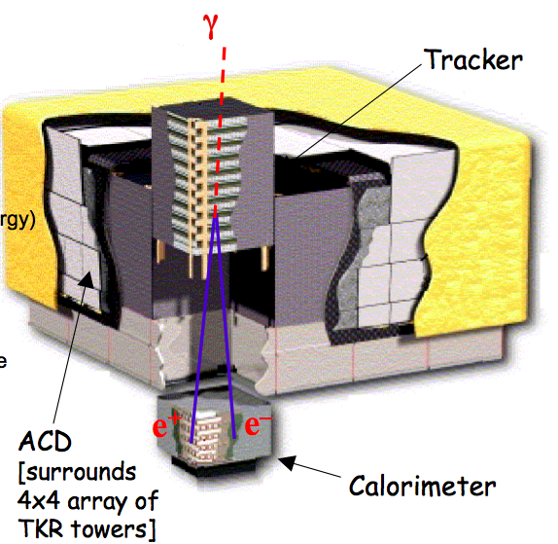
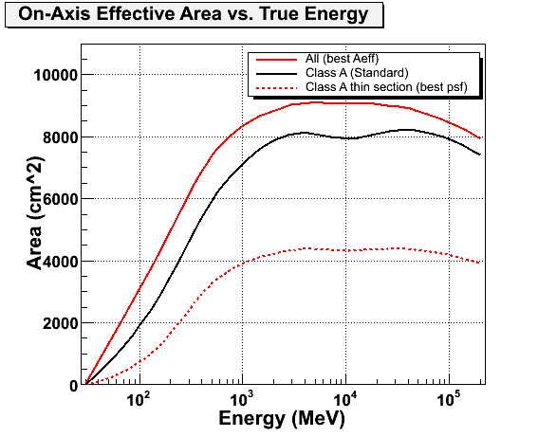
How to detect them?
The atmosphere is opaque to gamma-rays
But they can be detected directly via e+ e- pair production using satellite-borne particle trackers (e.g. Fermi-LAT, AGILE)
This works very well below 100 GeV but what about higher energies?
Satellite effective area < 1m²
e.g. Crab Nebula, Flux >1TeV = 6 photons/m²/year
So we need to increase the effective area…

Slide 6
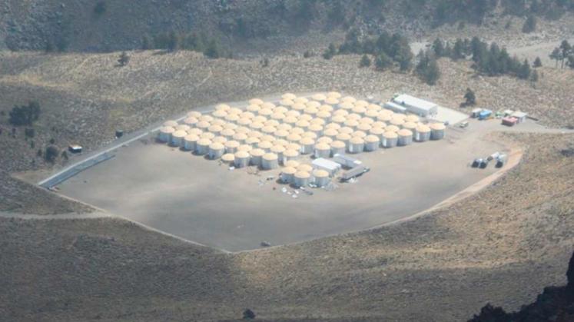
Use the atmosphere as part of the detector
Pair production and bremsstrahlung lead to an electromagnetic cascade or 'air shower'
.γ
E
.e⁺ e⁻
E/2
X₀
E/4
E/8
E/16
Air shower arrays (e.g. Tibet III/ ARGO), or water Cherenkov detectors (e.g. HAWC), allow direct detection of the shower tail at high altitude
E~80 MeV
1 atmosphere ~ 28 X₀

Slide 7
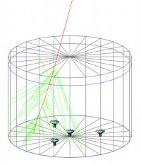
Use the atmosphere as part of the detector
Pair production and bremsstrahlung lead to an electromagnetic cascade or 'air shower'
.γ
E
.e⁺ e⁻
E/2
X₀
E/4
E/8
E/16
Air shower arrays (e.g. Tibet III/ ARGO), or water Cherenkov detectors (e.g. HAWC), allow direct detection of the shower tail at high altitude
E~80 MeV
1 atmosphere ~ 28 X₀

Slide 8
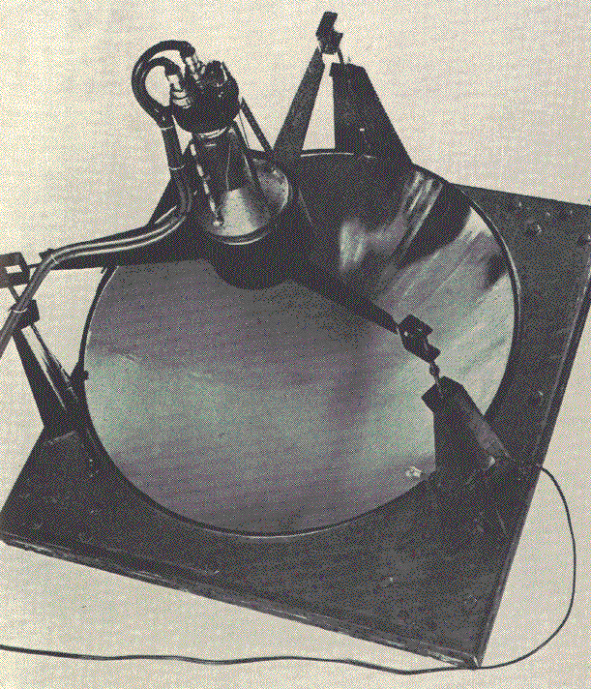
Use the atmosphere as part of the detector
The Jelley & Galbraith light bucket (1952)
Alternatively, we can detect Cherenkov light produced in the atmosphere by the relativistic charged particles
Very simple device:
Mirror
Photon detector (PMT)
Oscilloscope
An imaging camera allows us to take a picture of the Cherenkov flashes
Use the shape and orientation of these images to select gamma-ray showers from the background of cosmic ray showers

Slide 9
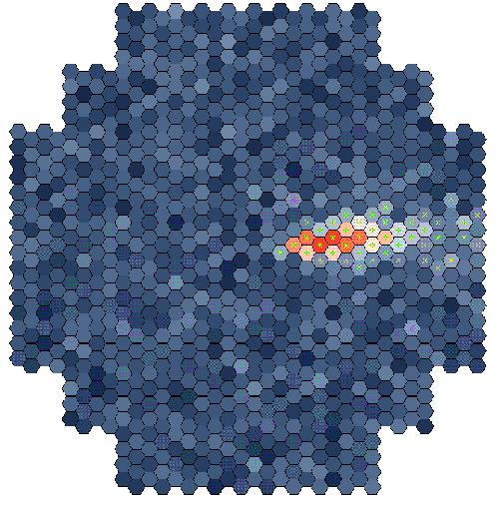
Stereoscopy: Telescope Arrays

Slide 10
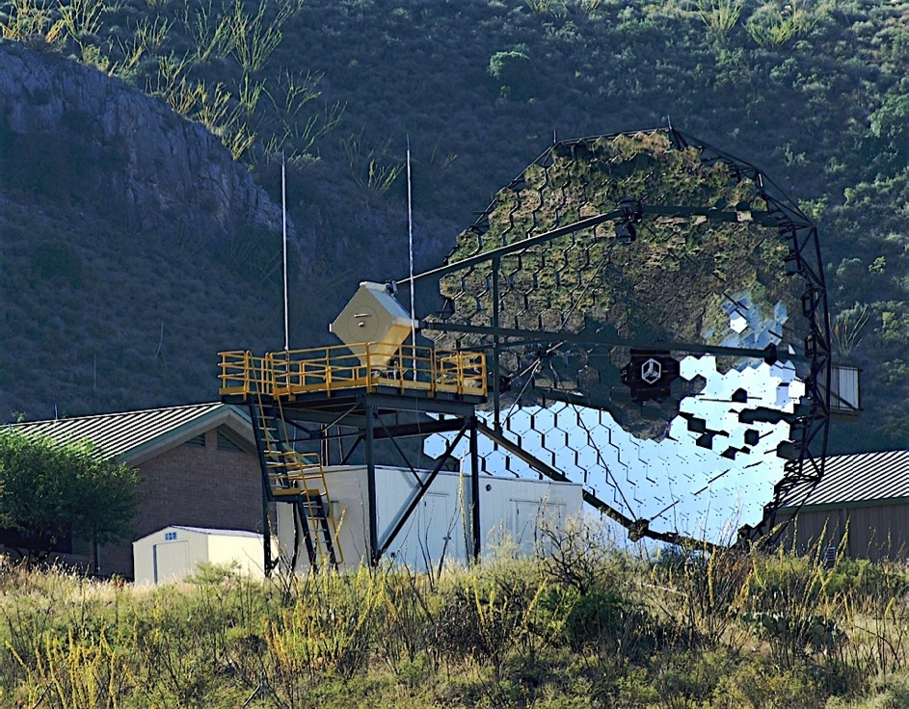
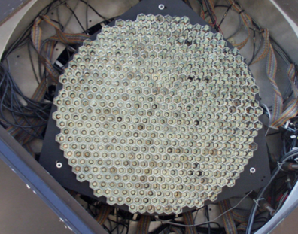
VERITAS
Situated at 1250m altitude at the Whipple Observatory in Arizona
12m tessellated mirrors
499 PMTs
12m
3.5°

Slide 11
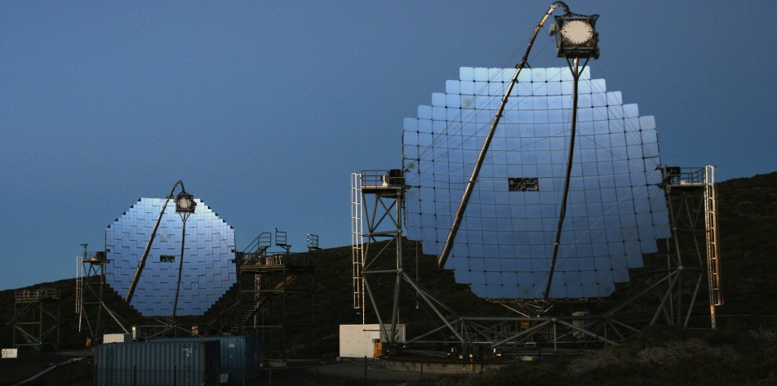
The Big Three
MAGIC
VERITAS
MAGIC II
H.E.S.S.
Plus smaller projects (HAGAR, GRAPES, SHALON, FACT…)

Slide 12
What have we seen?
Notes:
143 sources
Many different types, Galactic, extragalactic, hadronic, leptonic, different power sources…

Slide 13
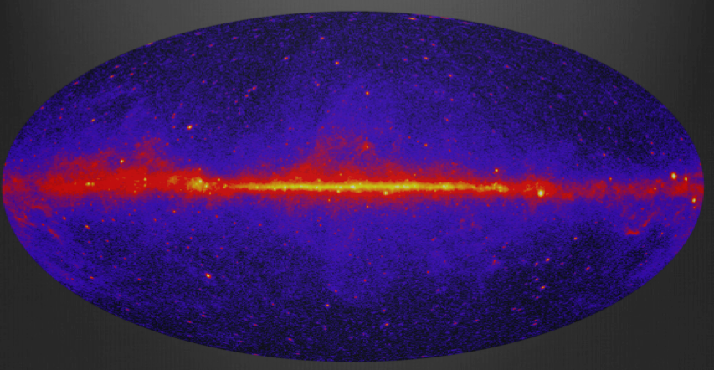
100 MeV to 100 GeV
The Fermi-LAT Sky
Notes:
143 sources
Many different types, Galactic, extragalactic, hadronic, leptonic, different power sources…

Slide 14
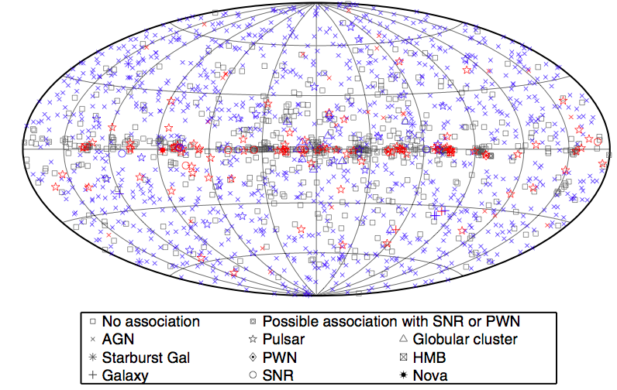
100 MeV to 100 GeV
Source catalog after background subtraction
1873 sources, 127 identified, 577 ‘unassociated’
Notes:
143 sources
Many different types, Galactic, extragalactic, hadronic, leptonic, different power sources…

Slide 15
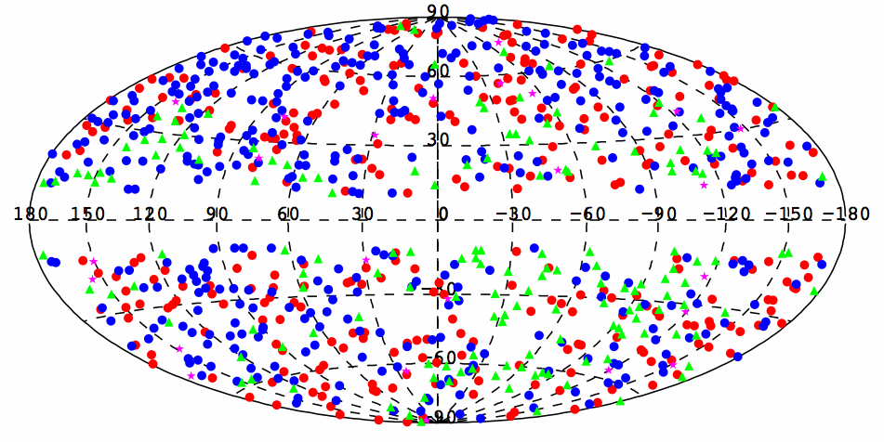
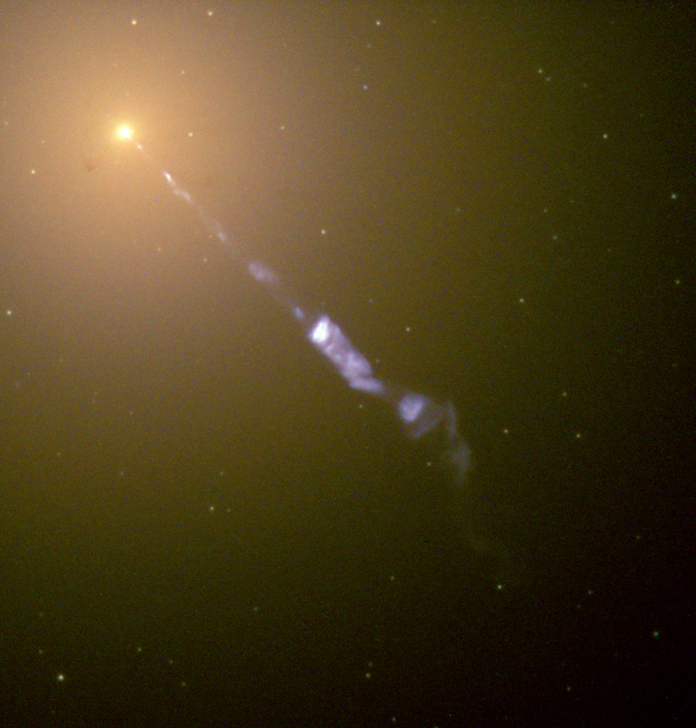
100 MeV to 100 GeV
The extragalactic GeV sky is dominated by blazars (mainly BL Lacs and FSRQs)
Robert
Notes:
Red: FSRQs, blue: BL Lacs, magenta: non-blazar AGNs, green: AGNs of unknown type

Slide 16
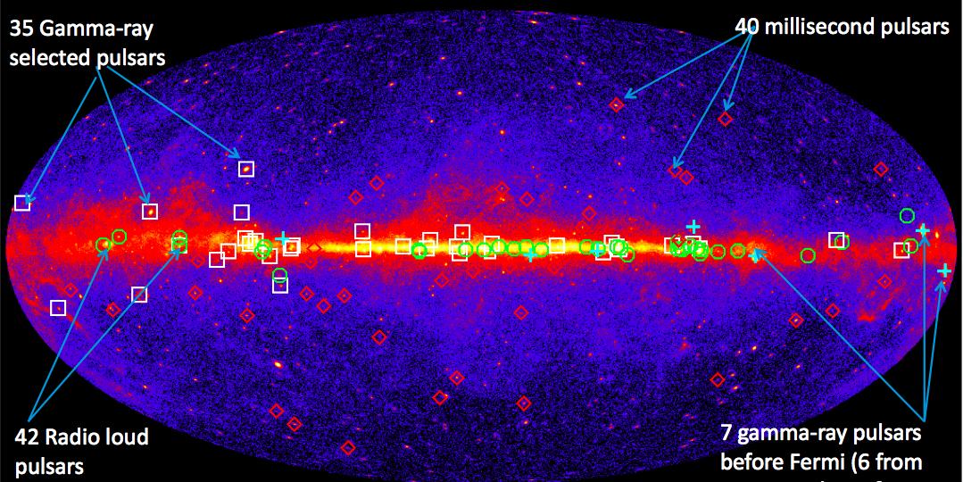
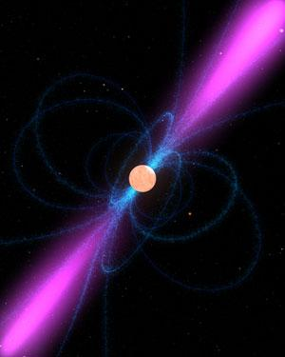
100 MeV to 100 GeV
The Galactic GeV sky is dominated by pulsars (117 in the 2nd Fermi-LAT pulsar catalog)
Notes:
Red: FSRQs, blue: BL Lacs, magenta: non-blazar AGNs, green: AGNs of unknown type

Slide 17
100 MeV to
100 GeV
Credit J. McEnery
Notes:
143 sources
Many different types, Galactic, extragalactic, hadronic, leptonic, different power sources…

Slide 18
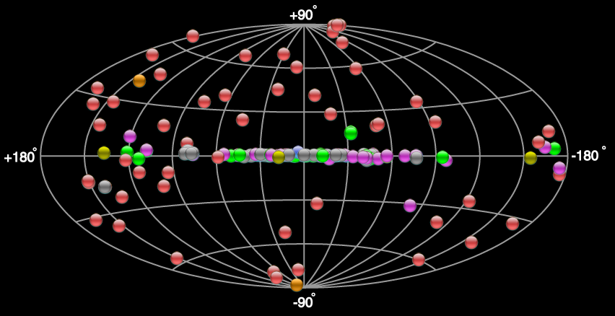
100 GeV to 50 TeV
Credit TeVCat
Notes:
143 sources
Many different types, Galactic, extragalactic, hadronic, leptonic, different power sources…

Slide 19
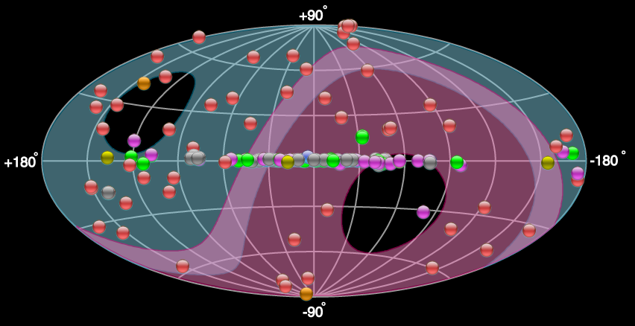
100 GeV to 50 TeV
Credit TeVCat
HESS
VERITAS/MAGIC
The extragalactic TeV sky is dominated by blazars (mainly BL Lacs)

Slide 20
100 GeV to 50 TeV
Credit TeVCat
HESS
VERITAS/MAGIC
Christopher
Yves

Slide 21
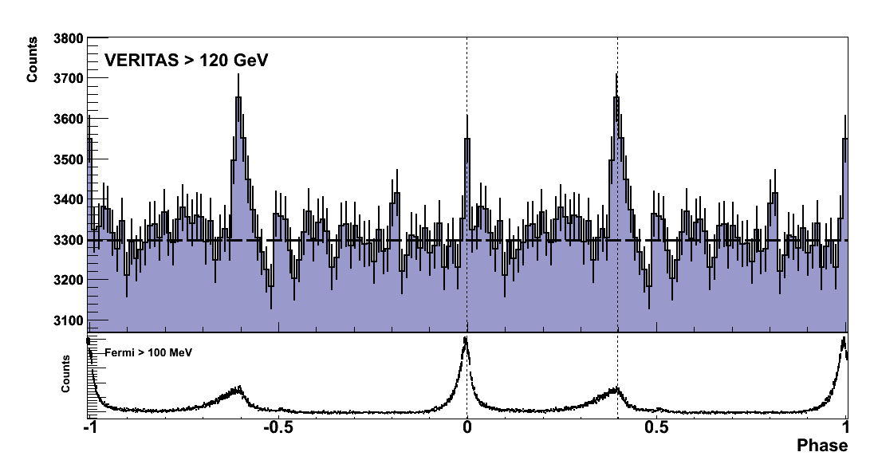
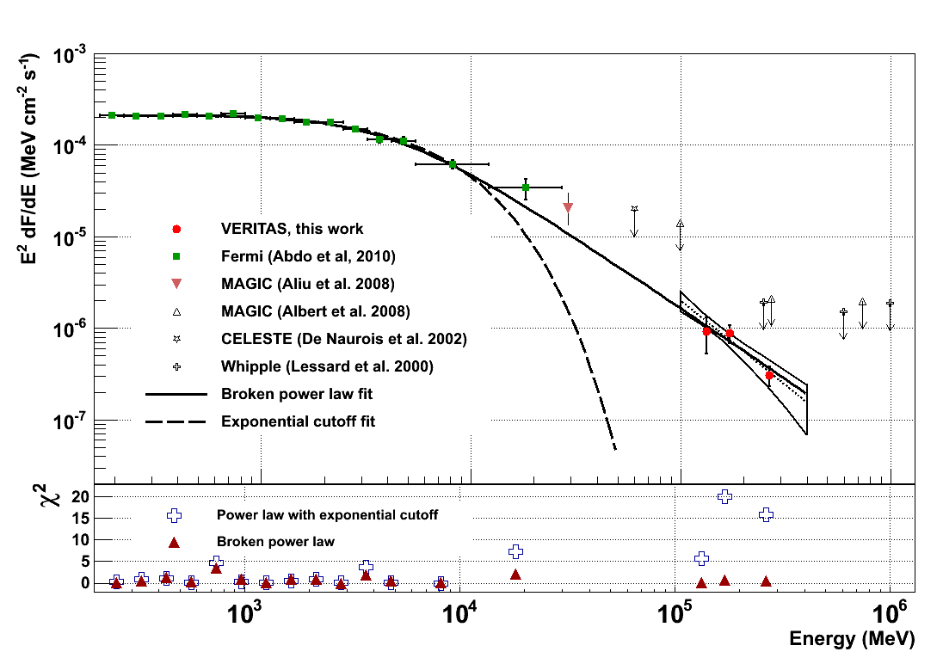
Only one > 100 GeV Pulsar: The Crab
One of the most powerful gamma-ray pulsars. (Spin-down E= 4.6 x 10³⁸ erg s⁻¹.)
Fermi-LAT measures spectral break at E_{c} = 6 GeV
VERITAS and MAGIC measure emission above 100 GeV
Overall spectrum favours a broken power-law fit
Implies emission region > 10 stellar radii.
Absence of exponential cutoff makes curvature radiation unlikely as the dominant mechanism at these energies

Slide 22
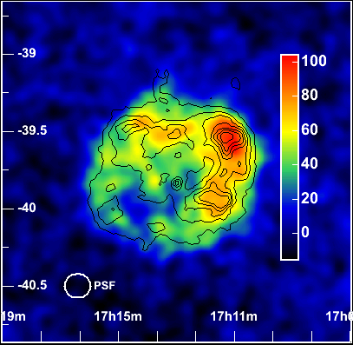
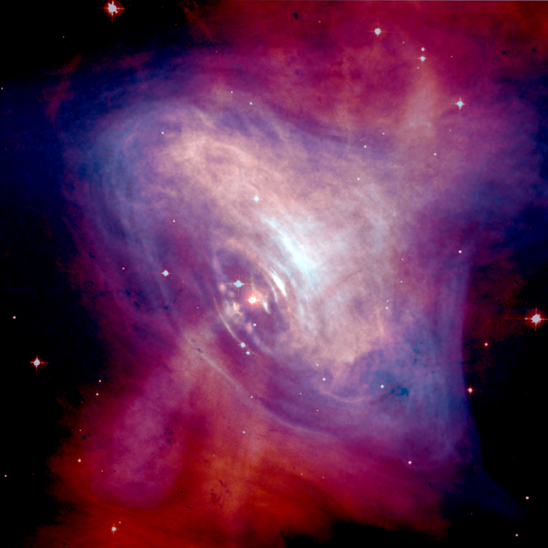
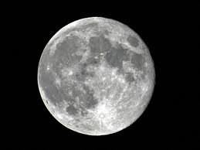
…but many Pulsar Wind Nebulae and SNR
Pulsars and their Nebulae:
Energetic pulsars drive an electron/positron wind through spin-down energy
Electrons accelerated in the shock where the wind collides with the surrounding nebula
Gamma-rays produced through subsequent inverse Compton.
Supernova Remnants:
Particles are accelerated in the expanding shock wave
Gamma-rays from inverse Compton (electrons) and/or pion decay (protons)

Slide 23
Not only gamma-ray astrophysics
Gamma-ray telescopes also allow us to study/ search for
Cosmic rays (including electrons and positrons)
Extragalactic infra-red photon fields
Intergalactic magnetic fields
Primordial black-hole evaporation
Axion-like particles
Lorentz Invariance violation
Multi-messenger correlations (UHECRs, GWs, Neutrinos)
Optical work (Intensity Interferometry, Photometry, Optical SETI…)
Indirect Dark matter studies…

Slide 24
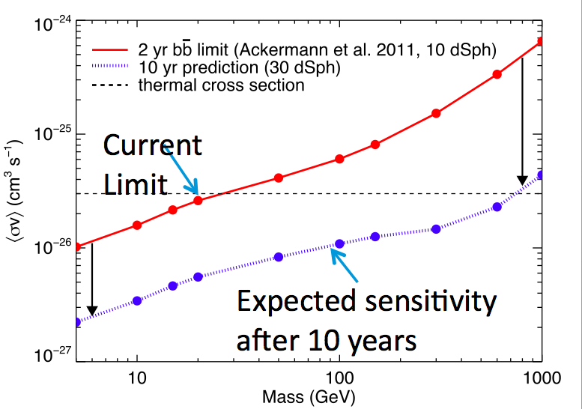
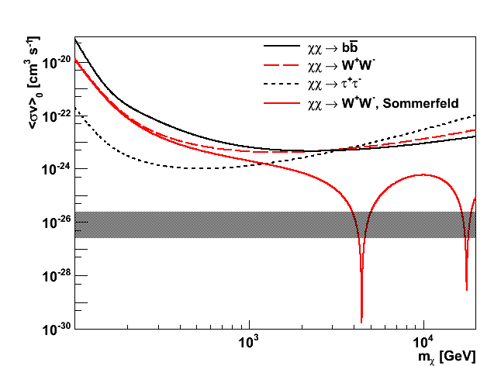
Indirect Dark Matter Candidates
Dwarf spheroidal galaxies are gravitationally-bound, DM-dominated objects (by > 1000), with low astrophysical backgrounds
Fermi: stacked analysis (10 objects)
VERITAS: Segue I
Typical range

Slide 25
The Future
Notes:
143 sources
Many different types, Galactic, extragalactic, hadronic, leptonic, different power sources…

Slide 26
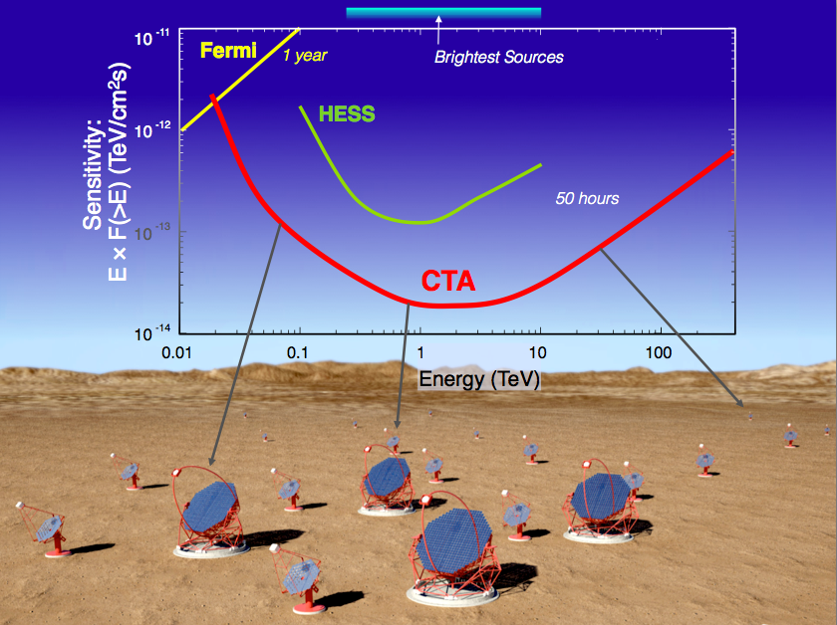
/VERITAS
Credit J. Hinton
Notes:
A huge improvement in all aspects of performance } A factor ~10 in sensitivity, much wider energy coverage,
much better resolution, field-of-view, full sky, ...
● A user facility / proposal-driven observatory } With two sites with a total of >100 telescopes
● A 27 nation ~€200M project

Slide 27
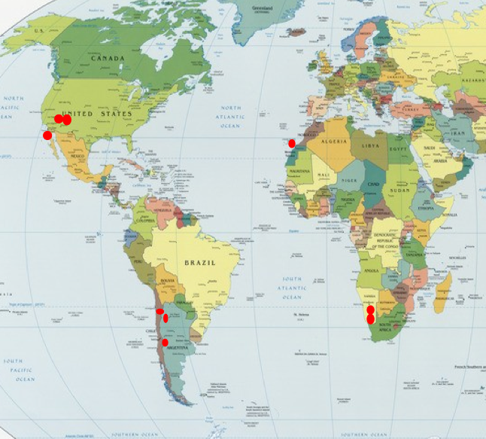
Northern and Southern Arrays planned. 9 sites under consideration
Notes:
Dustbin mirror
Subsequently 30” mirror, Pic du Midi

Slide 28
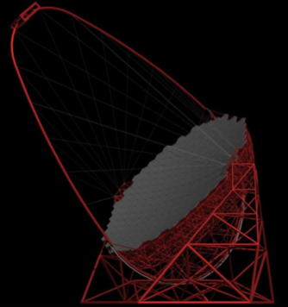
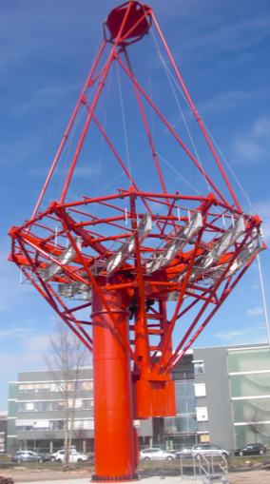
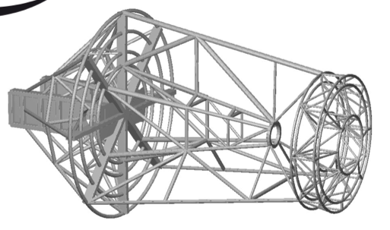
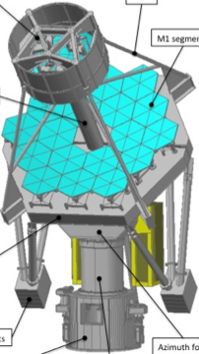
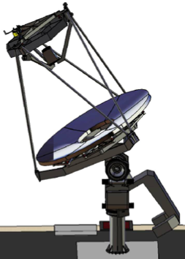
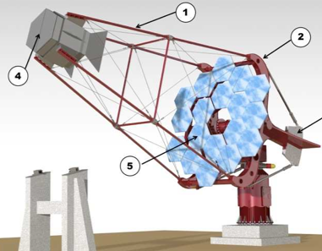
CTA: Telescopes
~23m
~12m
Large
Medium-single
Medium-dual
~4m
Small-dual (ASTRI)
Small-dual (GATE)
Small-single
Notes:
Dustbin mirror
Subsequently 30” mirror, Pic du Midi

Slide 29
A complementary approach…
IACTs are not the only way to go. HAWC will soon be complete (2014)
LHASSO proposes a survey instrument consisting of
90,000m² Water Cherenkov Detector
24 Wide FoV Air Cherenkov telescopes
A 1km² Array of scintillator detectors and muon detectors
425 burst detectors for high energy secondary particles
Engineering Array in operation at ARGO/ Tibet site
Notes:
Dustbin mirror
Subsequently 30” mirror, Pic du Midi

Slide 30
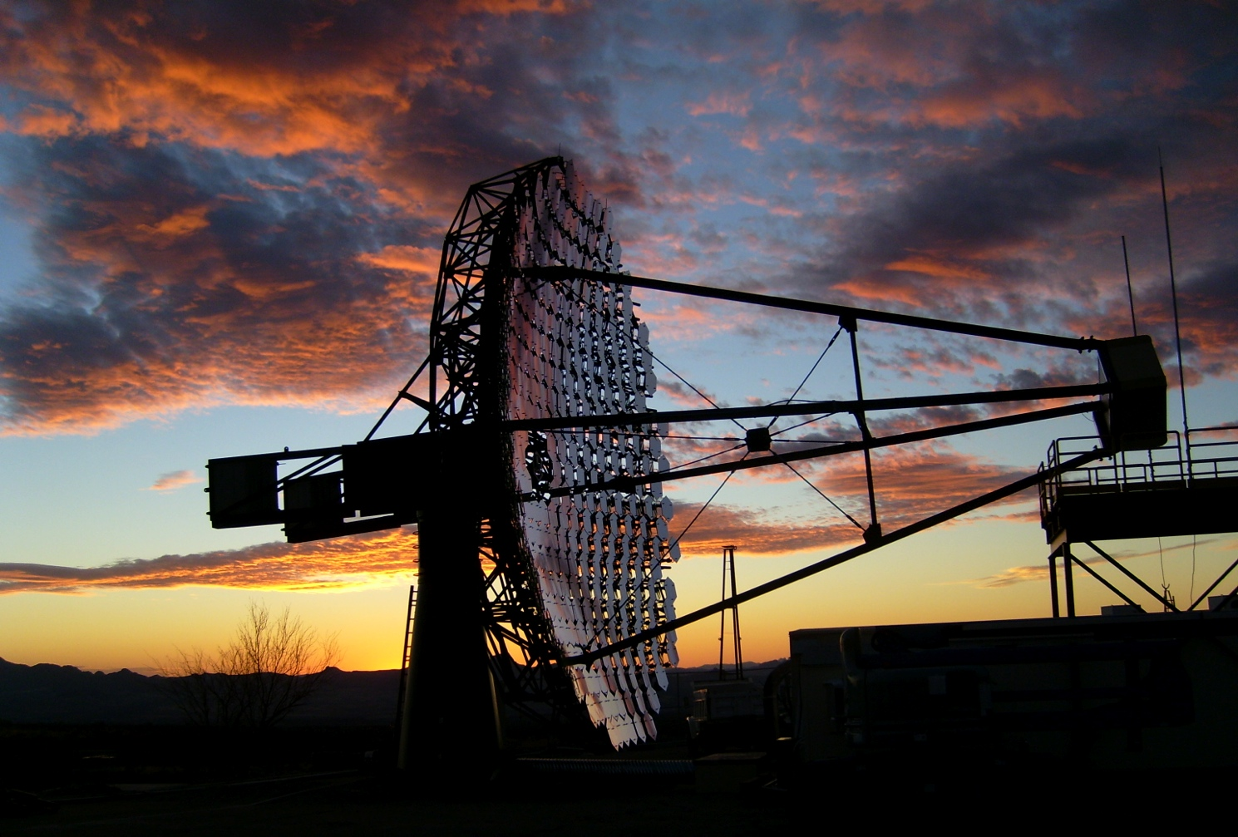
Summary
Gamma-ray astronomy is an important astronomical discipline, with enormous potential for growth
The scientific applications are wide-ranging; many aspects are only beginning to be explored.
The immediate, and longer-term future is very bright!
Notes:
Dustbin mirror
Subsequently 30” mirror, Pic du Midi

Slide 31
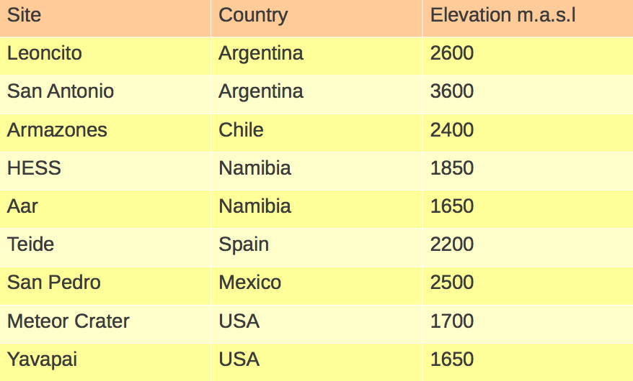
Backup
Notes:
Dustbin mirror
Subsequently 30” mirror, Pic du Midi

Slide 32
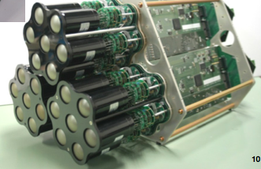
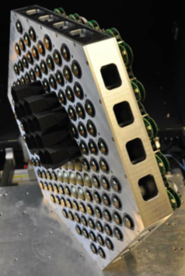
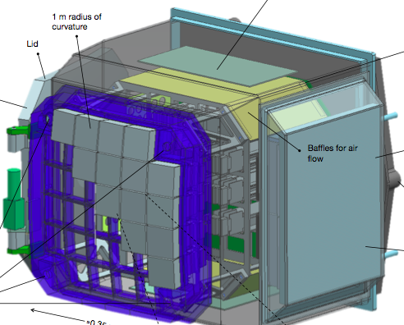
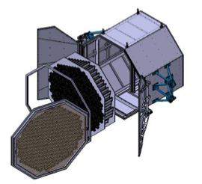
CTA: Camera and Data Acquistion
Both PMTs and silicon devices under consideration
Dragon
readout
CHEC
NectarCAM
FlashCAM
Notes:
Dustbin mirror
Subsequently 30” mirror, Pic du Midi

Slide 33
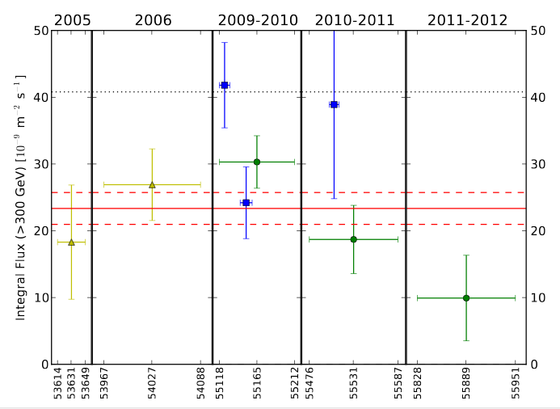
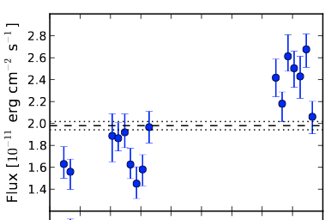
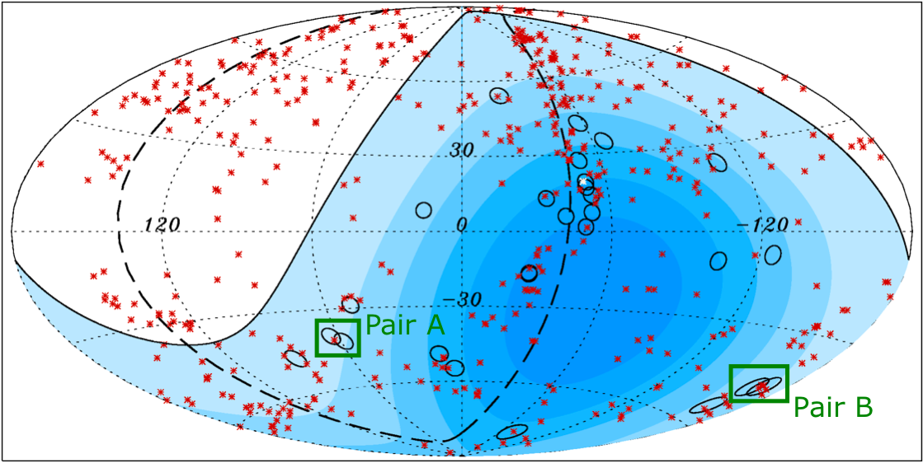
Search for the Intergalactic Magnetic Field
Preliminary
Preliminary
Swift X-Ray
H.E.S.S./ VERITAS TeV
The IGMF cannot be measured directly, but it may leave a signature on the TeV emission from extragalactic sources
Can be temporal, spatial, or spectral
Hard-spectrum, distant sources are best
Numerous authors have attempted to place bounds – an important assumption is long-term flux-stability
VERITAS is monitoring “IGMF” sources to test this - e.g. 1ES0229+200 shows definite X-ray variability, and a hint of TeV variability (P_{STEADY}=1.6%)
Notes:
The detection of
the IGMF could provide important insights for solv-
ing outstanding problems of its origin and role in both
the cosmology and astrophysics of structure formation
Brie y, TeV-scale gamma rays
from the blazar interact with the UV to far-IR extra-
galactic background light (EBL), producing electron-
positron pairs, which then undergo inverse Compton
(IC) scattering on the CMB photons, producing sec-
ondary gamma rays of a lower energy than the pri-
mary.

Slide 34
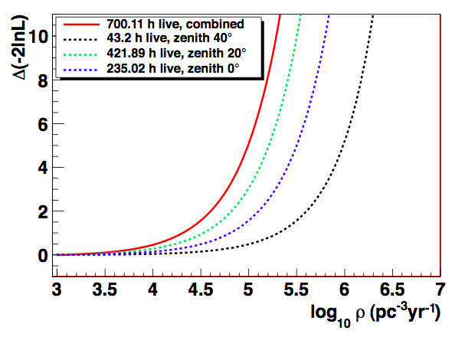
Primordial Black Hole Searches
Tesic, G. et al., JPhys: Conf Series, 375, 052024, 2012.
99% CL
700 hours of observations
Limit on the rate of evaporations is ρ_{PBH}<1.29×10⁵pc⁻³yr⁻¹ with a search window of 1s
~5 times as much data in the archive, plus upgraded sensitivity and refined analysis should improve this substantially.
Notes:
Reverse Alphabetical

Slide 35
Lorentz Invariance Violation
Markarian 421
Crab Pulsar
?????
Search for an energy dependence of the speed of light
Can use AGN flares:
Bright, distant (~ few 100 Mpc), fast, and high energy (>1TeV)
Unpredictable & LIV signal may be masked by physics of flare production
Alternatively, use pulsars:
Very fast, predictable and repeatable. Fairly well understood
Soft spectrum (<400 GeV), nearby (2kpc)
Notes:
Reverse Alphabetical

