Slide 1
A subkeV energy threshold spherical gazeous detector for light Dark Matter identification
G Gerbier IRFU Saclay
+ I Giomataris, J Derre, P Magnier, A Dastgheibi, D. Jourde, M Gros, E Bougamont, XF Navick, T Papaevangelou, J Galan, G Tsiledakis IRFU
P Loaiza, T Zampieri LSM
Principles of detector
Results of calibrations at low energy
Preliminary results at low energy/RA
Prospects : physics / development
August 14th 2013
Quy Nhon, “Window on the Universe”

Slide 2
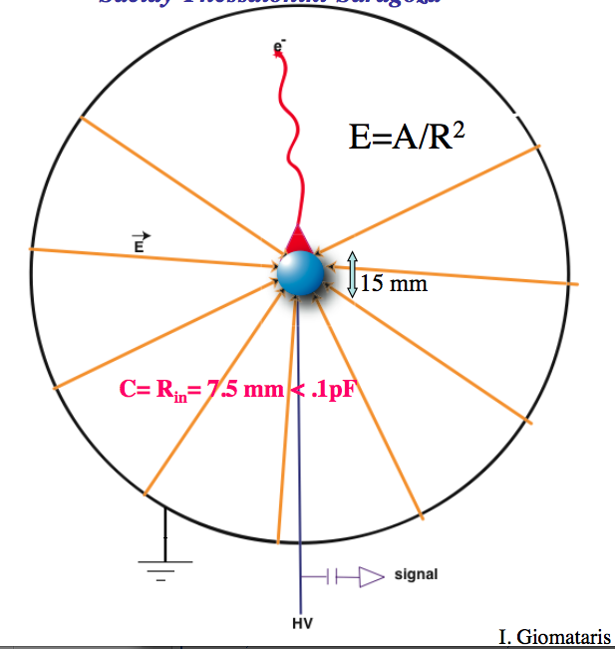
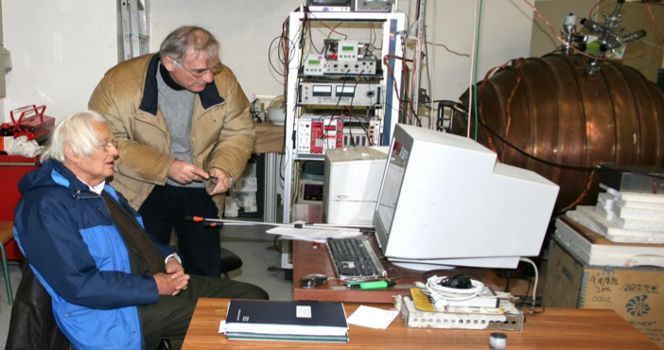
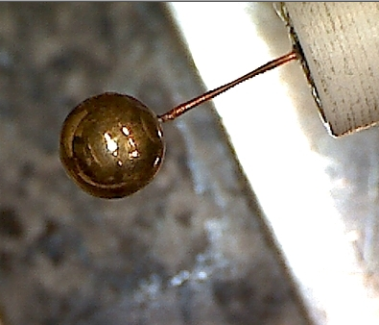
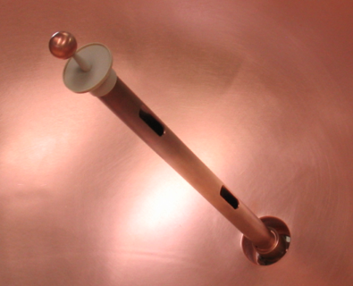
Spherical Proportional Counters
Sphere cavity + spherical sensor + HT
=> Low threshold (low C), does not depend on size
Fiducial volume selection by pulse risetime
Flexible (P, gaz)
Works in sealed mode
Large volume => 10’s kg possible
2 LEP cavity 130 cm Ø tested
Digitisation at 2 MHz + soft trigger
Drift region
Ampl region
r_{s}
r_{c}
E≈V/r²*r_{s}
for r_{c}>> r_{s}

Slide 3
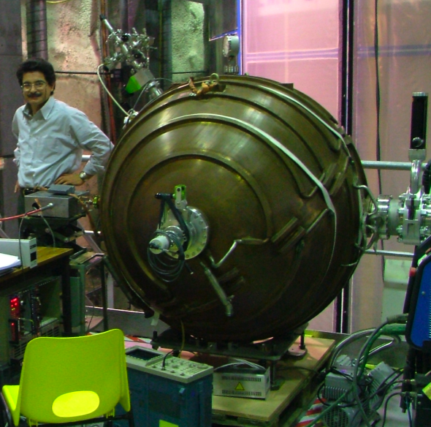
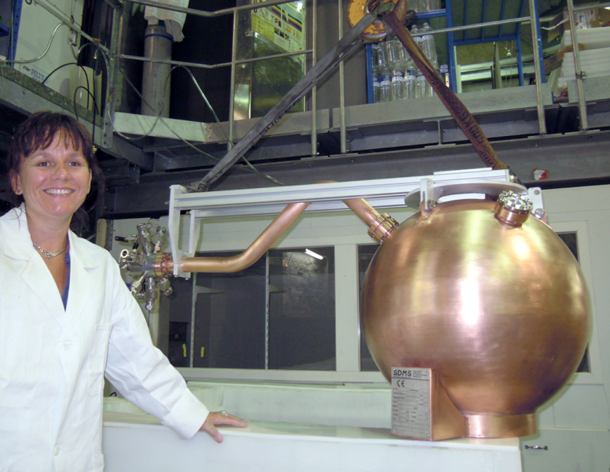
Spherical Proportional Counters
Sphere cavity + spherical sensor + HT
=> Low threshold (low C), does not depend on size
Fiducial volume selection by pulse risetime
Flexible (P, gaz)
Works in sealed mode
Large volume => 10’s kg possible
2 LEP cavity 130 cm Ø tested
Digitisation at 2 MHz + soft trigger
1 low activity 60 cm Ø in operation @ LSM
Track
Drift region
Point like
deposition
Ampl region

Slide 4
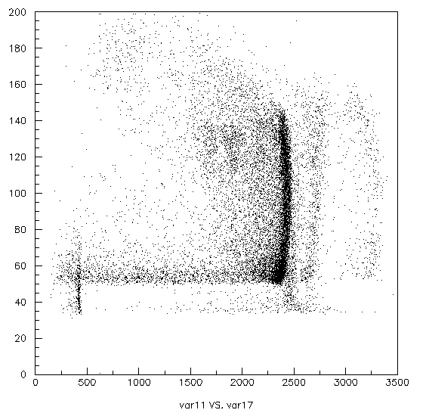
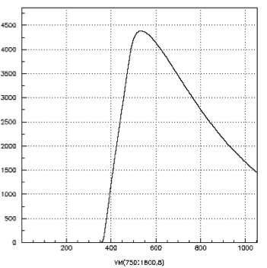
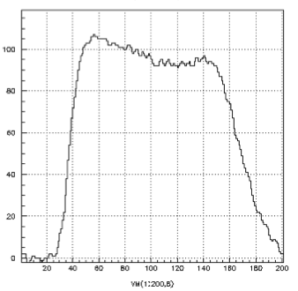
Run with Ar/CH₄ + 3g ³He @ 200 mb SPC 130cm Ø @ LSM
NB: no start
=> risetime records place and/or history of energy deposition
α ²¹⁰Po
5.3 MeV
If point like energy deposition, rise time depends only on radius of interaction (diffusion)
alpha
Rise time (μs)
n capt on ³He
764 keV
Uncovoluted
If track, rise time depends on orientation of track, ie on difference of drift times
de/dx
²²²Rn ²¹⁸Po ²¹⁴Po
Amplitude

Slide 5
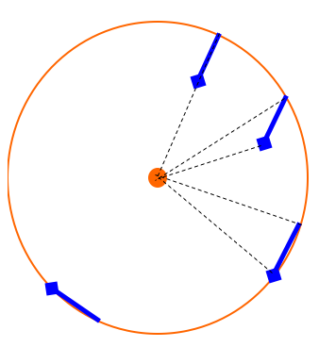
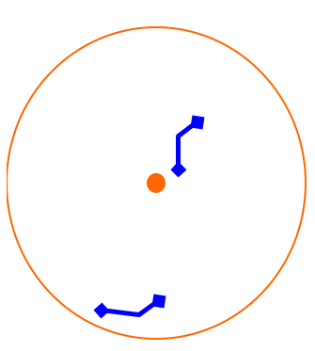
Run with Ar/CH₄ + 3g ³He @ 200 mb SPC 130cm Ø @ LSM
α ²¹⁰Po
5.3 MeV
α ²¹⁰Po
5.3 MeV
from ²¹⁰Pb
@ Cu surface
Range = 15 cm
Rise time (μs)
n capt on ³He
764 keV
Rate 400 capt/d
n capt on ³He
=> p + T
3
1
2
Unwanted Radon daughter deposit on surface
²²²Rn ²¹⁸Po ²¹⁴Po
Amplitude
« Volume » alpha
fast neutron expected here

Slide 6
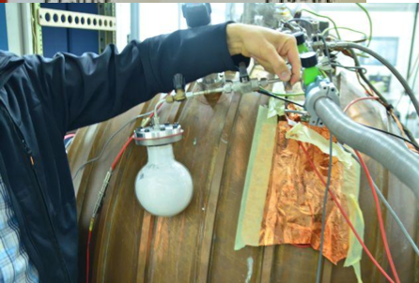
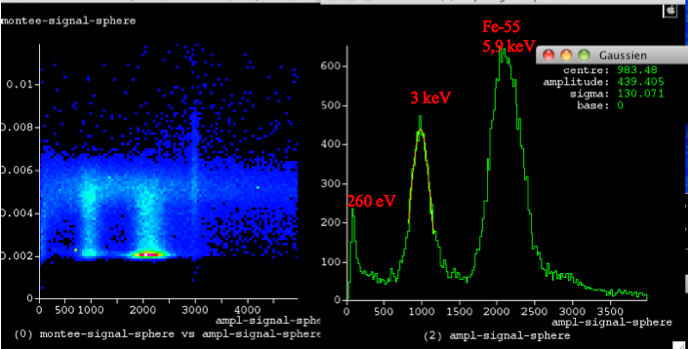
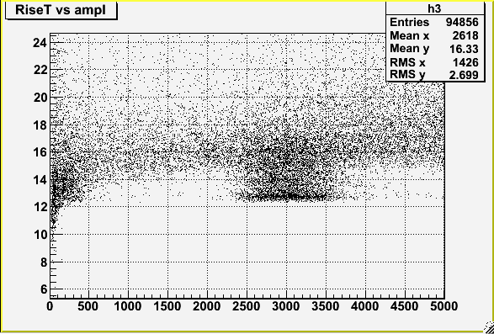
Going to low energy : calibration with ³⁷Ar source for volume response
³⁷Ar, EC, 35 days lifetime, Kα 2.6 keV and Lβ 260 ev
Source made by n,α from Calcium powder irradiated with fast neutrons
=> Calibration show homogenous volume response
2.6 keV
260 eV

Slide 7
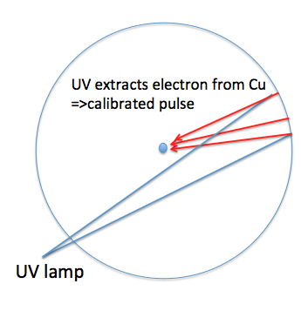
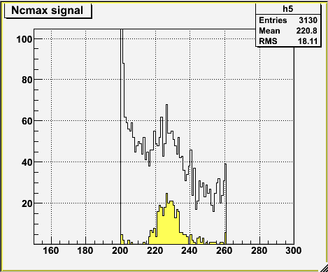
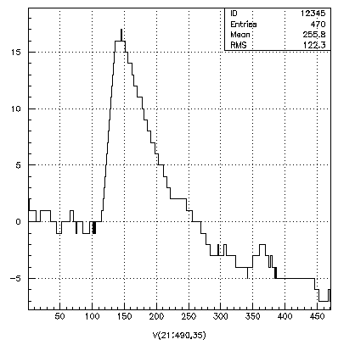
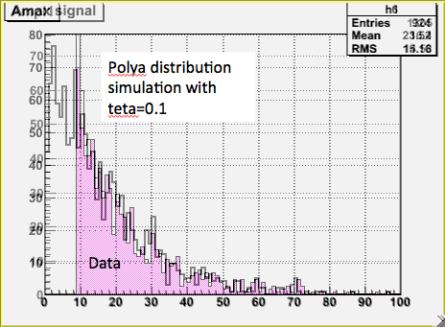
Calibration with UV flash pulsed lamp for single electron response
250 mb, Ar+2%CH4
HV = 3100 V
14 mm sensor
μs
Delta time (UV-sphere pulse)
Look for pulse in 200-260 μs window
About 1 in 10 => single electron response
Pulse shape
1 electron
16 ADU 30 eV
Trigger efficiency for single electron = 54 %
NB : single electron in Ar gaz w ≈ 30 eV
=> Threshold = 20 eV
Single electron
distribution
Trigger @ 10 ADU

Slide 8
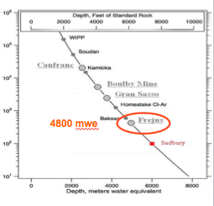
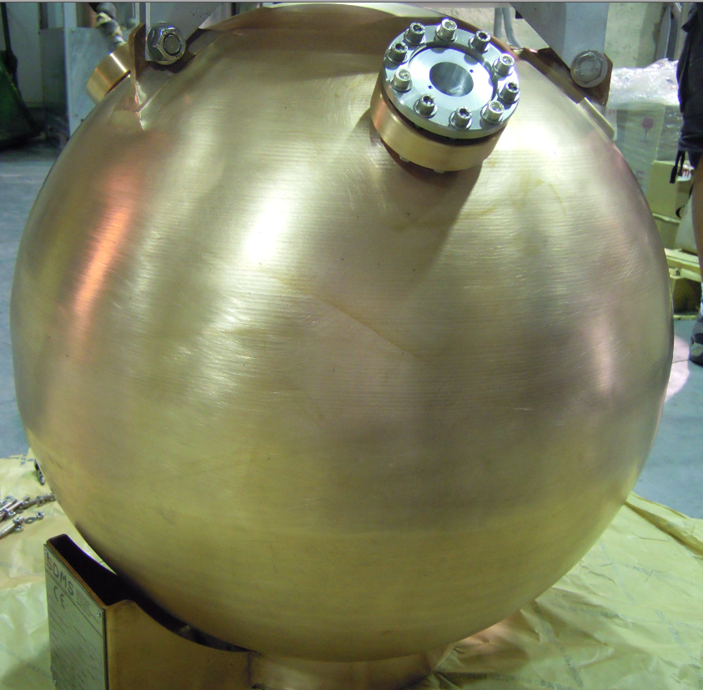
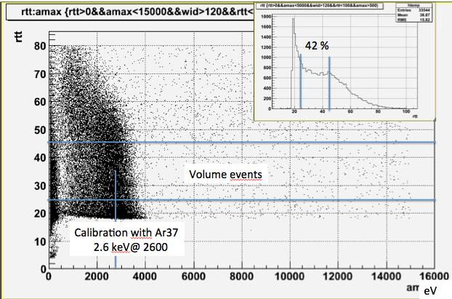
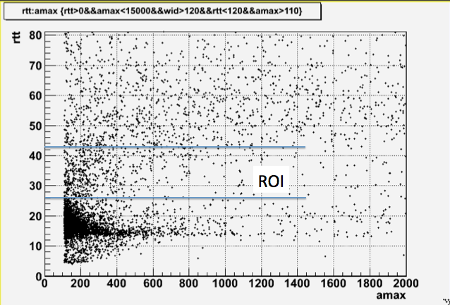
Light dark matter search : low activity 60 cm Ø prototype @ LSM in PE/Pb shield
In test since september 2012
Test of sensors from 14 mm to 6 mm
Reduction of RA contaminants
Commisionning runs with Argon (but ³⁹Ar intrinsic radioactivity)
=> Run with Neon+2%CH₄ @ 2 bars
=> 200 g sensitive mass, 48 h run
Data
Preliminary
eV
eV

Slide 9
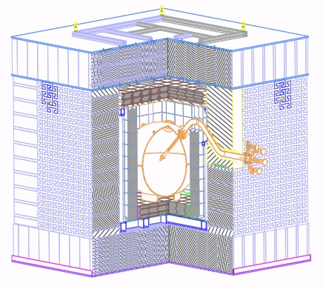
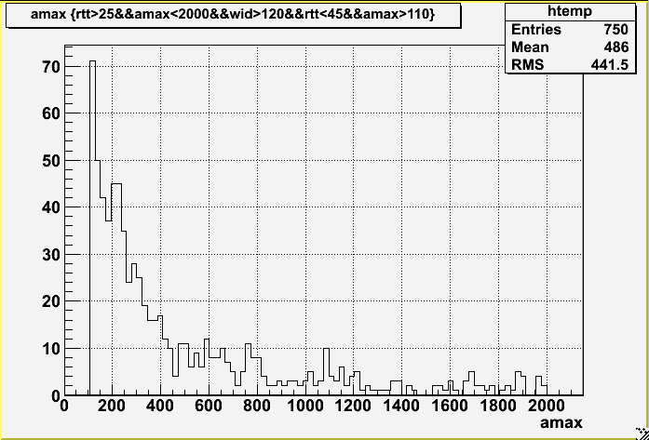
Light dark matter search : low activity 60 cm Ø prototype @ LSM
In operation since september 2012
Test of sensors from 14 mm to 6 mm
Reduction of RA contaminants
Commisionning runs with Argon (but ³⁹Ar intrinsic radioactivity)
=> Run with Neon+2%CH₄ @ 2 bars
=> 200 g sensitive mass, 48 h run
Preliminary
eV
eV

Slide 10
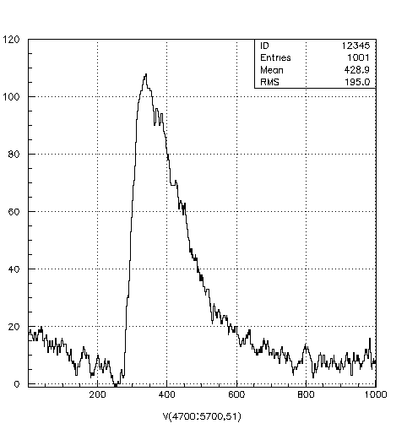
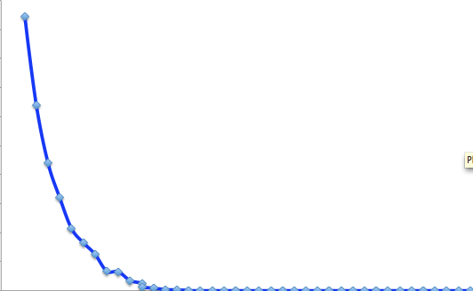
Light dark matter search : low activity 60 cm Ø prototype @ LSM
In operation since september 2012
Test of sensors from 14 mm to 6 mm
Reduction of RA contaminants
Commisionning runs with Argon (but ³⁹Ar intrinsic radioactivity)
=> Run with Neon+2%CH₄ @ 2 bars
=> 200 g sensitive mass, 48 h run
100 eV
Signal from 2.2 GeV WIMP, with σ = 1.1 10⁻³⁷ cm²
assuming QF =0.3
Preliminary
eV
eV

Slide 11
Light dark matter search : low activity 60 cm Ø prototype @ LSM
In operation since september 2012
Test of sensors from 14 mm to 6 mm
Reduction of RA contaminants
Commisionning runs with Argon (but ³⁹Ar intrinsic radioactivity)
=> Run with Neon+2%CH₄ @ 2 bars
=> 200 g sensitive mass, 48 h run
More probable : background !
Many knobs :
Pressure
Gaz change (He)
HV
300
/kg.kev.d
eV
Background flat rate
eV

Slide 12
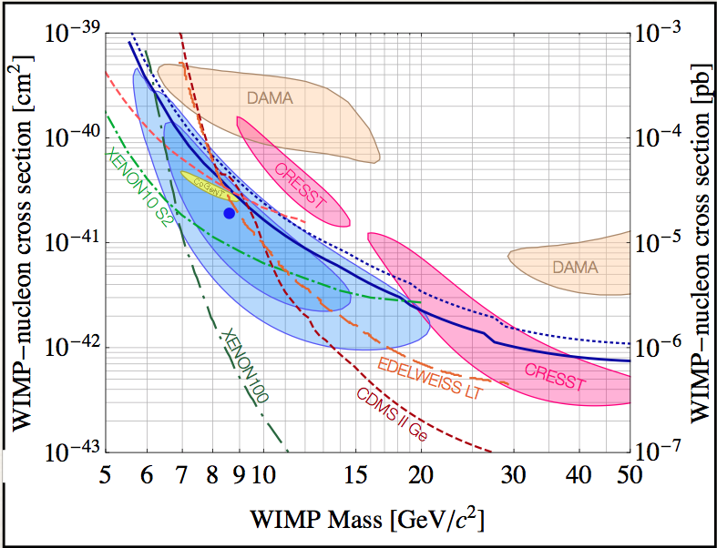
Sensitivity curves for light WIMP’s

Slide 13
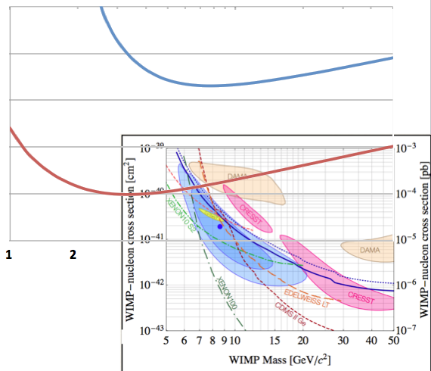
Sensitivity curves for light WIMP’s
Preliminary
Actual sensitivity⬄ 100 evts/kg.keV.d @ 0.8 keV NR
10⁻³⁷
Ne
10⁻³⁸
Projected sensitivity for 1 evt/kg.keV.d @ 0.3 keV NR
10⁻³⁹
Ne
10⁻⁴⁰
5
GeV/c²
NB : still very high surface contamination by Po210/Pb210 by factor 50

Slide 14
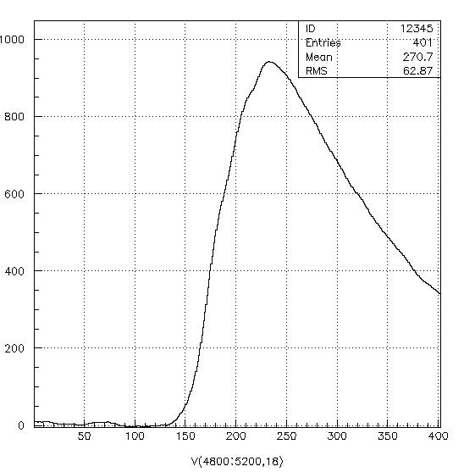
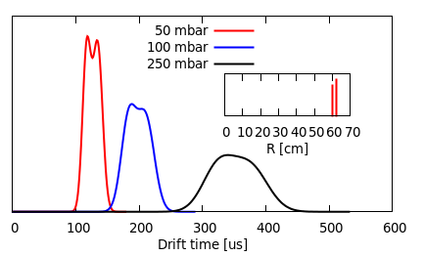
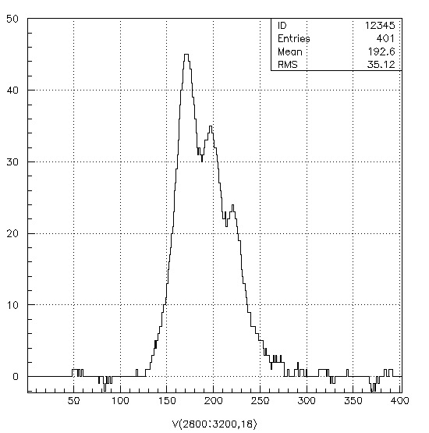
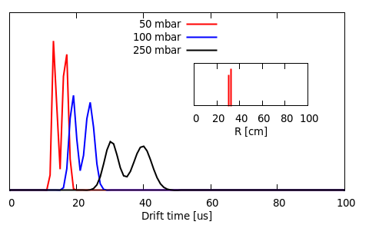
Additional discrimination identification through single/multiple energy deposition
Simulation by J Galan
Recorded pulse
RC
Uncovoluted from RC shaping

Slide 15
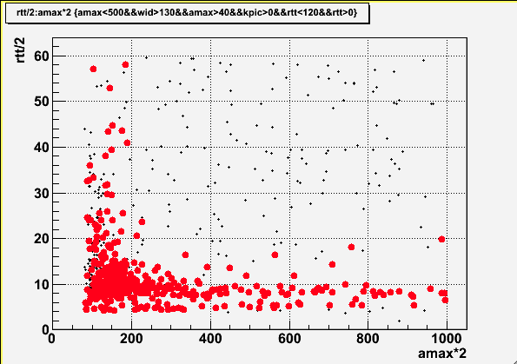
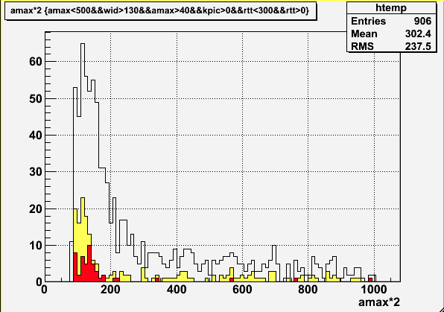
Test run with Ne (2bars)+He (2bars) 8h He gives longer drift times => better identification of multiples
rt
μs
Volume selection events ≈ 40 % eff
Red : after single energy deposition selection
Energy eV
=> Need simulation of pulse shapes of electrons and neutrons
Need calibration with Ar37 and fast neutron for accurate efficicencies
Need study of rejection power vs gaz mix
…
Energy eV

Slide 16
Other applications
Axion Like Particle detection : (decays in 2 photons inside sphere volume) motivation : solar corona temperature problem L. Di Lella, K. Zioutas, Astropart. Phys. 19 (2003) 145(J Galan)
Thermal and fast neutron detection : interest : containment of products of capture eg He3, other gaz studied
Network of 4m Ø spheres for SuperNovae neutrino detection through coherent scattering (about 10 evts for 10 kpc SN @10 atm Ar)
Measurement of neutrino coherent scattering at reactor …

Slide 17
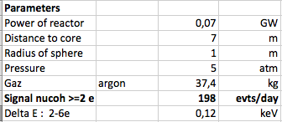
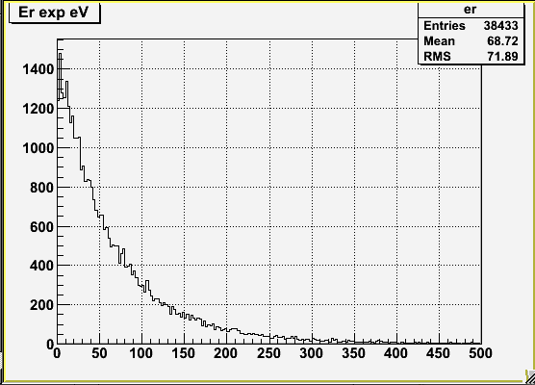
Measuring coherent neutrino scattering at nuclear reactor within reach
Simulation of expected spectrum from nuclear reactor, on Ar, with quenching factor and instrumental response to single electron
Normalisation to experimental reactor 70 MW
Sphere of 2 m diam, 5 bars
Evis >30 eV
Assumptions :
120 days exposures OFF and ON
Rate back = 500 evts/kg.d.keV
ROI = 30-250 eV
=>Nback= 500*37*120*0.22= 500 000 evts
=>Nsig = 24 000 evts
=> S/N = 1/20 , Nσ = 24
80 ev/keV.kg.d
20 ev/keV.kg.d
30 eV
eV

Slide 18
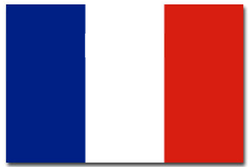
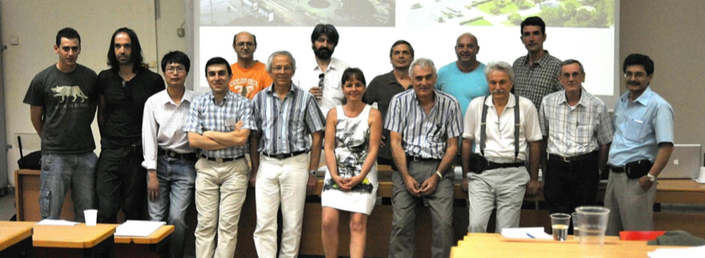
A proto collaboration
New Experiments With Spheres
Neutrino Experiments With Spheres
New Experiments for Wimps with Spheres
CEA-IRFU/Saclay (GG,IG),LSM (F Piquemal),
Aristotle University of Tessaloniki (I Savvidis), University of Ioannina (I Vergados), NCSR DemoKritos (G Fanourakis), Hellenic Open University (S Tzamaria)
University of Tsinghua Beijing (C Tao), Shanghai Jiao Tong University (K Ni),
IHEP-Beijing (Z Wang, C Yang)
University of Saragoza (I Irastorza), Livermore (JR Armendariz)
Projects under study
4 m Ø underwater 2000 m @ Pylos @ few 100s bars for SN
2 m Ø underground low activity for DM and ALP search shielded in water tank
Perform ν coherent scaterring expt
Develop neutron spectrometer
Develop sensors + scint light detection
+ Great tool for training to particle detection !
Tessaloniki 2012

Slide 19
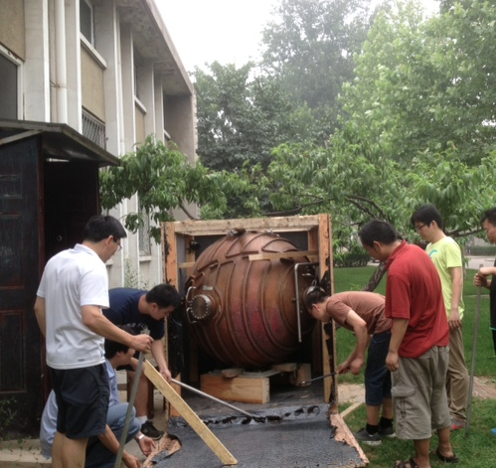
A proto collaboration
New Experiments With Spheres
Neutrino Experiments With Spheres
New Experiments for Wimps with Spheres
CEA-IRFU/Saclay (GG,IG),LSM (F Piquemal),
Aristotle University of Tessaloniki (I Savvidis), University of Ioannina (I Vergados), NCSR DemoKritos (G Fanourakis), Hellenic Open University (S Tzamaria)
University of Tsinghua Beijing (C Tao), Shanghai Jiao Tong University (K Ni),
IHEP-Beijing (Z Wang, C Yang)
University of Saragoza (I Irastorza), Livermore (JR Armendariz)
Projects under study
4 m Ø underwater 2000 m @ Pylos @ few 100s bars for SN
2 m Ø underground low activity for DM and ALP search shielded in water tank
Perform ν coherent scaterring expt
Develop neutron spectrometer
Develop sensors + scint light detection
Great tool for learning training !
Tessaloniki 2012

Slide 20
Conclusions/outlook
First studies show that spherical gaz detector :
can indeed reach single ionisation electron sensitivity @ P>1 atm
has background rejection capabilities and redondancies to identify signal
is well adapted for low mass WIMP search 0.1 to 5 GeV
has potential for neutrino coherent scattering detection & other LE rare processes
Developments to improve performances of current prototype
Decrease high radioactive contamination : surface
Improve pulse shape analysis : calibration, templates…
Perform calibration with neutron/Ar37
Perform quenching factor measurements in keV region (D Santos installation at Grenoble)
Going to larger volume/pressure requires
Decoupling of amplification from drift : new ideas about sensors currently tested
+ R&D on scintillation measurement, …
… lot to develop and discover

Slide 21
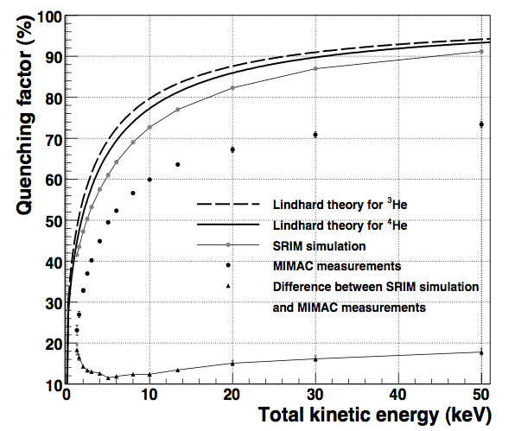
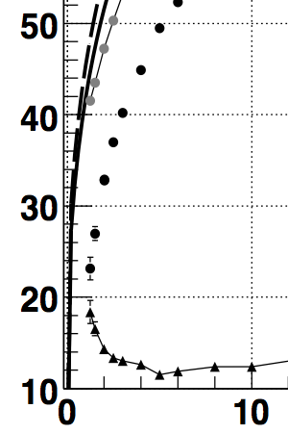
Quenching factor (He) measurements by D Santos down to 1.5 keV
Big difference below 5 keV between calc and exp
Measurement : 23 % vs prediction : 45 % ??
Difference attributed to UV light scintillation production

Slide 22
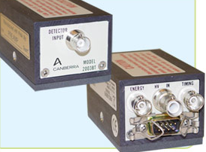
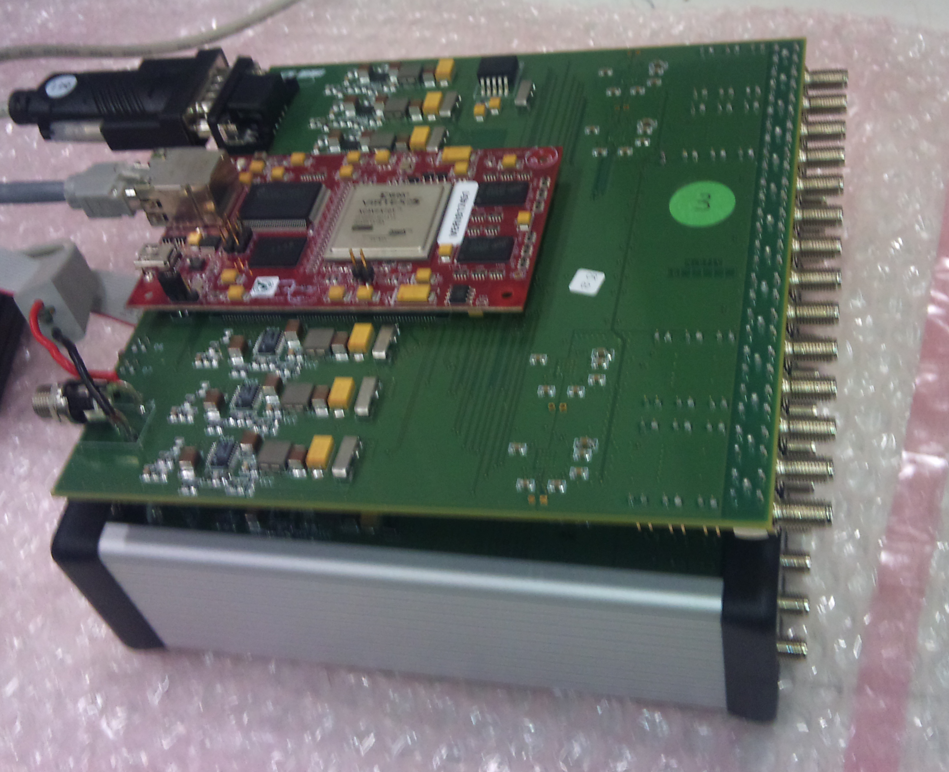
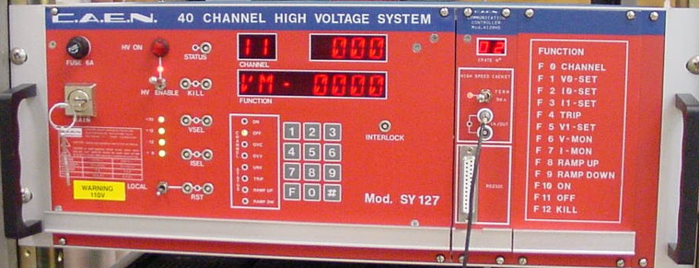
Système d’Acquisition
Un seul câble pour la H.T et la détection du signal
Capacité de liaison
Amp
Rj45
Filtre
ADC
Mac
© CANBERRA
Ampli de charge
Sensibilité = 180 mV/pC
Bruit ≤ 500 ē
Carte ADC «CALI» développée à l’IRFU
F_{Échantillonnage} =1-5 MHz
Gain : 1, 2 et 4
Bruit ≤ 250 ē
HV CAEN SY127; 8KV;2µA

Slide 23
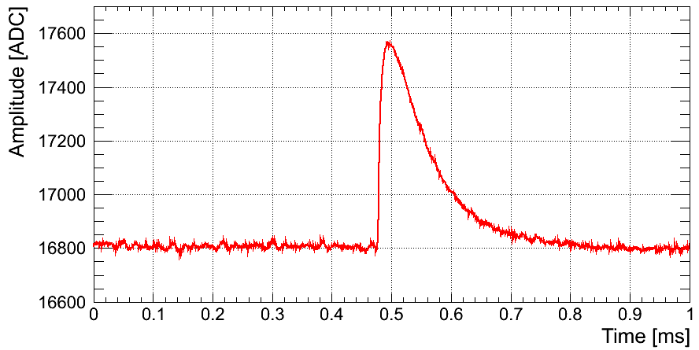
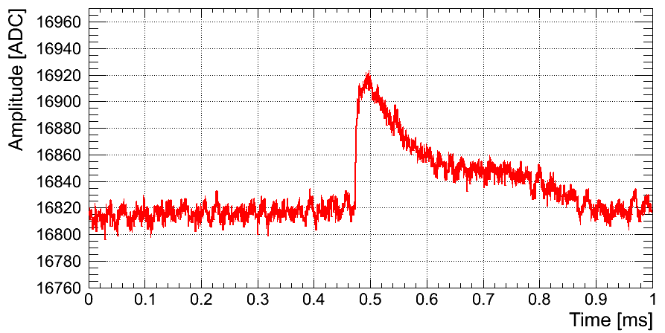
Système d’Acquisition
Filtre
Capacité de liason
AOP
ADC
Rj45
CAEN SY127; 8KV;2µA
Ampli de charge
Sensibilité = 180 mV/pC
Bruit ≤ 500 ē
Carte ADC «CALI» développée à l’IRFU
F_{Échantillonnage} =1-5 MHz
Gain : 1, 2 et 4
Bruit ≤ 250 ē
Programme d’acquisition :
« SAMBA » => trigger, record
(Développé par M.GROS,
IRFU/SEDI pour Edelweiss)
260 eV
40 eV
Signaux typiques

Slide 24
