Slide 1
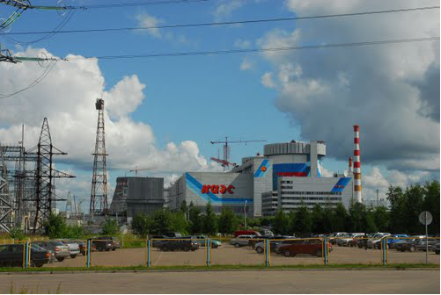
Inaugural Conference of ICISE
“Windows on the Universe”
Quy Nhon 13/08/2013
Sensitivity of the DANSS detector
to short range neutrino oscillations
M.Danilov
Representing the DANSS Collaboration
(ITEP (Moscow) & JINR(Dubna))
Detector of the reactor AntiNeutrino based on Solid-state plastic Scintillator (DANSS)

Slide 2
There are several ~3σ indications of 4th neutrino
LSND, MiniBoone: νe appearance
SAGE and GALEX ν_{e} deficit
Reactor ν_{e} deficit
Indication of a sterile neutrino
Δm² ~ 1 eV²
Sin²2θ₁₄ ~ 0.17
=> Short range neutrino oscillations

Slide 3
DANSS Goals
Reactor monitoring using neutrinos:
1. to measure the thermal reactor power with accuracy of 1.5% per day;
2. to define the fuel composition and amount of the produced 239Pu with accuracy
of 6% in 10 days of measurements;
Search for short range neutrino oscillations
DANSS Parameters:
IBD detection efficiency ~70%
ν counting rate
up to 10000/day
Background rate ~1%
Distance to reactor core
(center to center)
9.7-12.2m (change in 5min)
Energy resolution
~20% at 1MeV
Cosmic muon veto (PS plates)
Sensitive volume ~ 1m³
(2500 PS strips)
Cu frames (inner part
of passive γ-shielding)
Pb (external part of passive γ-shielding)
CH₂ + B (n-shielding)
Total weight – 13t + lifting gear

Slide 4
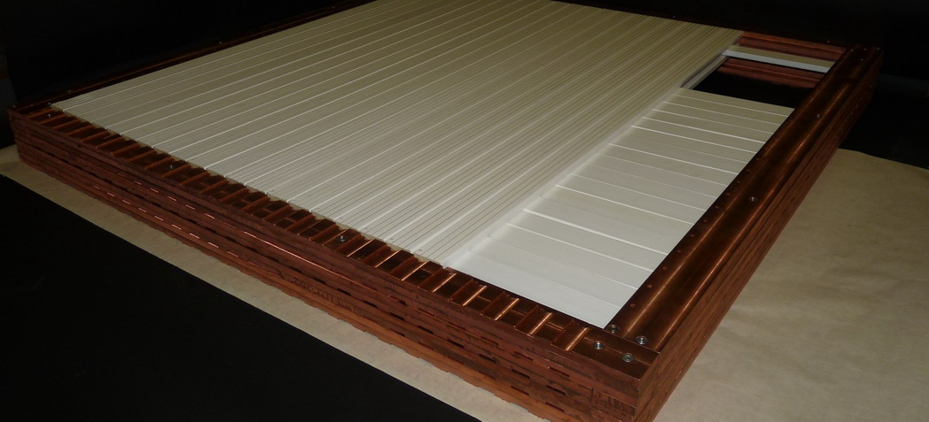
DANSS Design
glue
WLS-
-fiber
○1.2 mm
Each scintillator strip is read out individually by a Silicon Photo Multiplier (SiPM) via a WLS fiber.
Sensitivity is ~15 p.e./MeV
Light attenuation ~20%/m
50 strips are combined into a Module which is also read out by a small PMT
(via 2 additional WLS fibers per strip).
Sensitivity is ~10 p.e./MeV
The frame of a Module is made of radio-pure electrolytic copper and thus shields the sensitive part against insufficiently pure components of front-end electronics placed outside the frame.
Gd-containing
light-reflecting
coating~6mg/cm2
PS
SiPMs (CPTA, Moscow)
X-plane
Copper
frames
Y-plane
View of a Module (under construction).

Slide 5
DANSS advantages
Handling is much safer (non-flammable, non-caustic)
no restrictions to move the detector very close to the reactor core
higher neutrino flux => better sensitivity.
High segmentation (2500 strips) => space information
better IBD signature => stronger BG suppression.
possibility of continuose calibration with cosmics for every strip
PS is not doped with Gd, but interleaved with it
better stability of the scintillator.
Dual readout with SiPM and usual PMT => better control of systematic
Detector on movable platform under reactor => better control of systematic
low cosmic background
DANSS disadvantages
Worse energy resolution in comparison with liquid scintillator
Relatively large number of readout channels

Slide 6
DANSS position under WWER-1000 reactor at Kalinin NPP
Typical reactor building
with WWER-1000
3 GW thermal power
²³⁸U + (3.5-5)% ²³⁵U
5*10¹³ ν/s/cm2 @10m
Reservoirs with
Technological liquids
~ 60 mwe
Core:
h =3.5m
∅ = 3.12m
DANSS on a movable
platform with a lifting gear
Detector distance from
reactor core 9.7-12.2 m
(center to center)

Slide 7
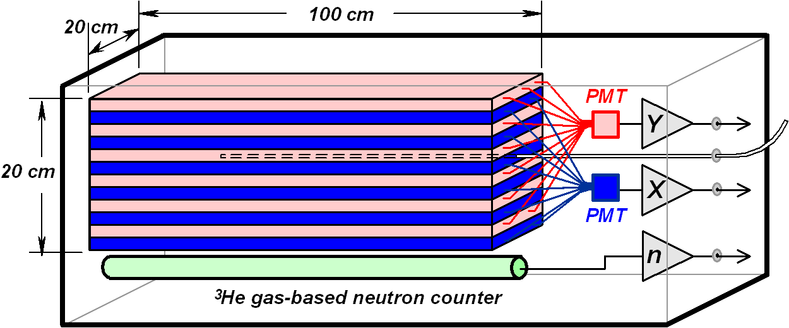
A small prototype - “DANSSino”
Purpose:
Study of background conditions
Tests of shielding efficiency
Measurements of trigger rates
Properties:
ν p e⁺ n (Inverse Beta Decay)
Efficiency e⁺ (Prompt) - 47% (E>1MeV)
Efficiency n (Delayed) – 28% (E>1 MeV)
Calibration
r/a source:
⁶⁰Co
²²Na
¹³⁷Cs
²⁴⁸Cm ~3 n
50+50=100 strips
20 cm × 20 cm × 100 cm
1/25 of the DANSS
40 kg (movable)
2 PMT (X → odd, Y → even)
No SiPM readout

Slide 8
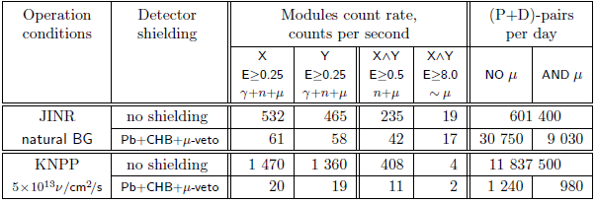

Background under reactor is order of magnitude lower than on surface
Heavy material shielding increases muon induced IBD background
(and IBD detection efficiency)

Slide 9
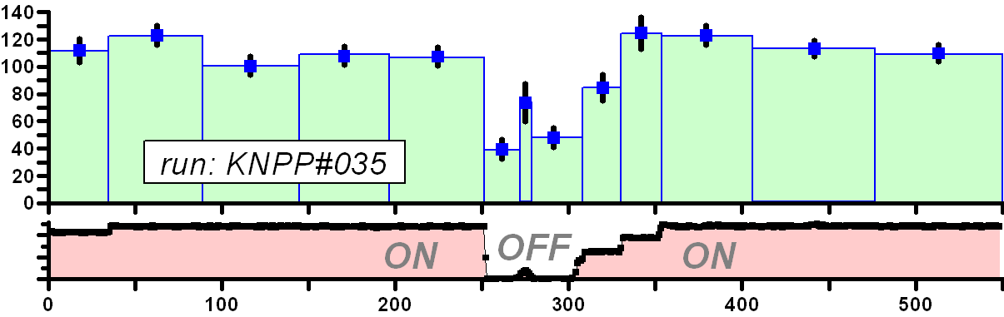
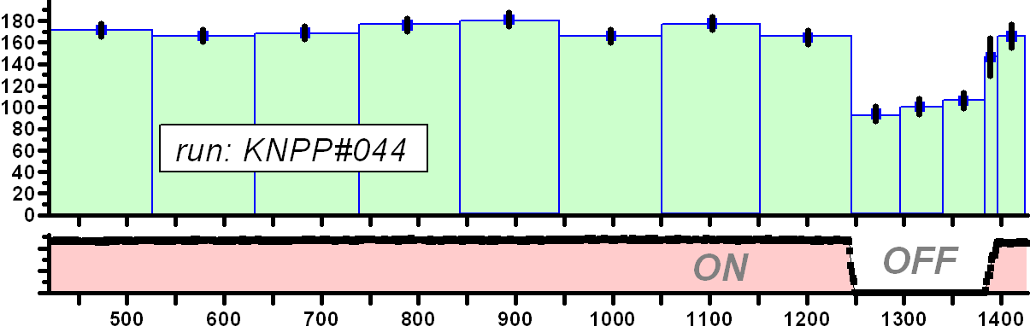
Clear correlation between reactor power and DANSSino counting rate
Rate of neutrino-like events detected per day
Reactor power
Rate of neutrino-like events detected per day
Reactor power

Slide 10
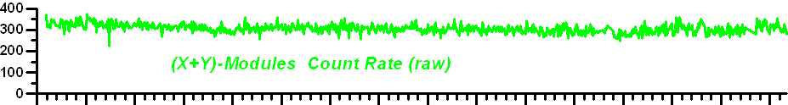
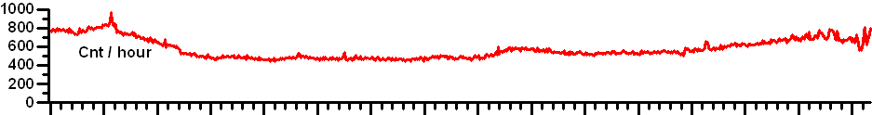
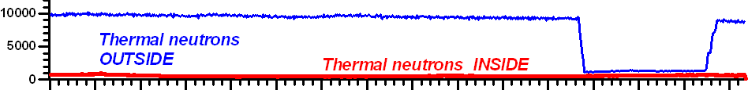
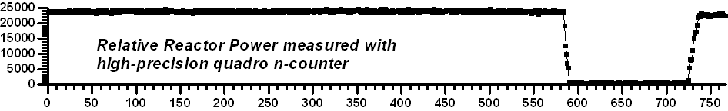
Raw counting rates during reactor ON and OFF periods
No change inside shielding!
(Hz)
Thermal neutrons inside shielding

Slide 11
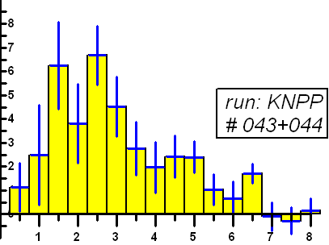
Background subtracted rate of neutrino-like events / 0.5 MeV / day
Neutrino rate
~ MC expectations
Spectrum simulated for ²³⁵U fission
Energy
MeV

Slide 12
Delayed signal time distribution for different types of events
²⁴⁸Cm
Random γ-n
μ-induced
True IBD
T μsec

Slide 13
Comparison of counting rates for reactor On and OFF periods
for different selection criteria
Evidence for neutrino detection (~70/day) with S/B~ 1
DANSSino confirmed DANSS design parameters
Reliable estimates of DANSS sensitivity

Slide 14
The role of the source dimensions
Δm² = 2 eV²
Sin²2θ₁₄ = 0.17
Large size of reactor core smears oscillations
but not too much!

Slide 15
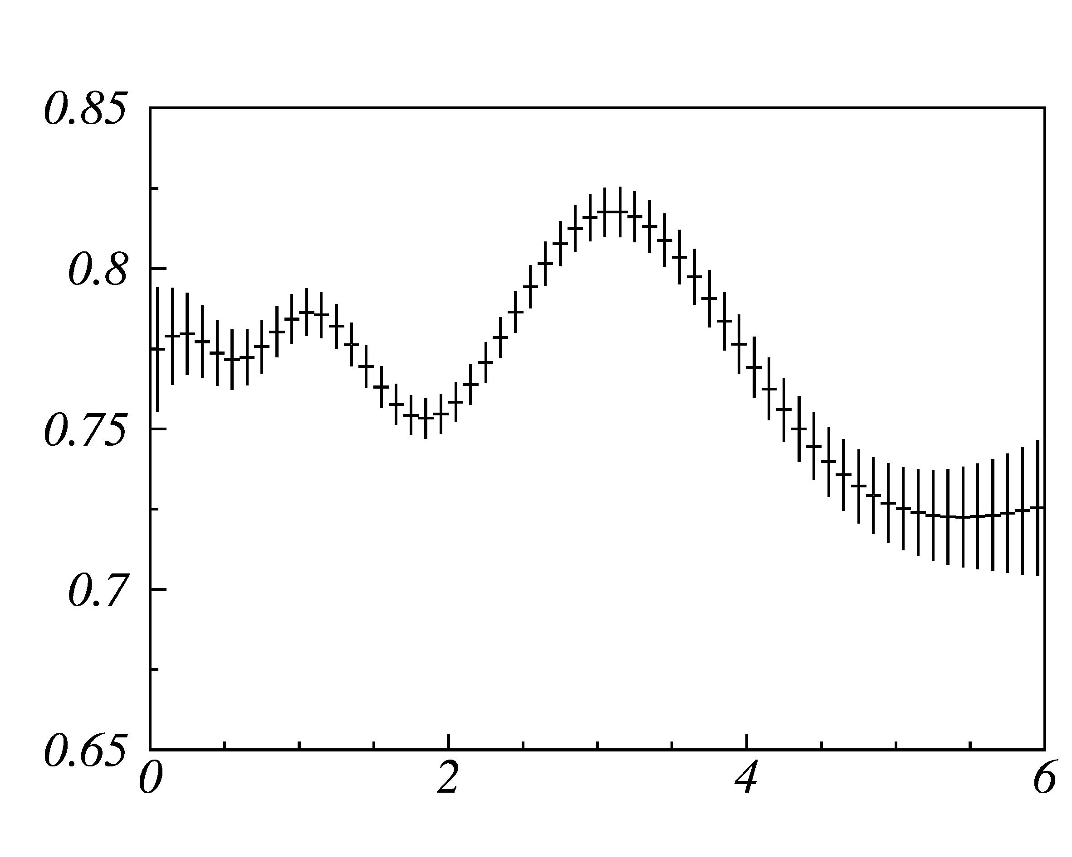
Ratio of positron spectra at 11m and 9.7m for Δm² =2eV², Sin²2θ₁₄=0.2
(errors correspond to 8 months of running)
R
E [MeV]
Distortions are perfectly seen

Slide 16
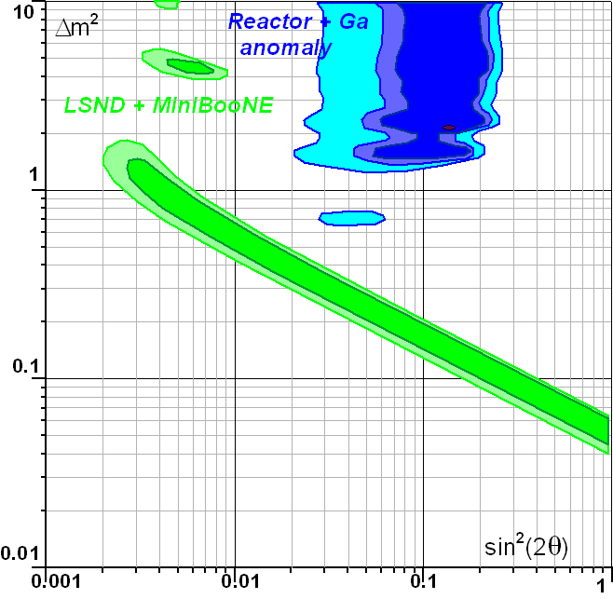
Sensitivity estimates (shape only) for 1 year (without systematics)
Most interesting parameter space is well covered
ВВЭР-1000
СМ-3 Small core
100MW Reactor

Slide 17
Summary
High granularity, good stability, very low background,
high neutrino flux and changeable distance to reactor core
should allow DANSS to study the most interesting parameter region of
possible oscillations to the 4th neutrino.
DANSS design parameters have been confirmed by the DANSSino results
In spite of a small size (4% of DANSS),
non perfect shielding and μ veto
DANSSino detected about 70 events/day with S/B ~ 1.
DANSS data taking will start in 2014
Details can be found in arXiv:1305.3350 [physics.ins-det]

Slide 18
Backup slides

Slide 20
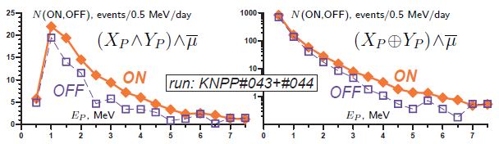

Slide 21
MC example:
sin²(2θ) = 0.17
Δm² = 2 eV²

Slide 22
Zoom of oscillation curves in the measured range

Slide 23
